Slide 1


Benchmarking Computational Models of Visual Saliency
Ali Borji
ICIP 2015 Tutorial on
Visual Saliency: Fundamentals, Applications, and Recent Progress

Slide 2

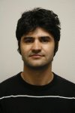

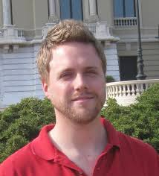

http://mmcheng.net/saltutorial/

Slide 3
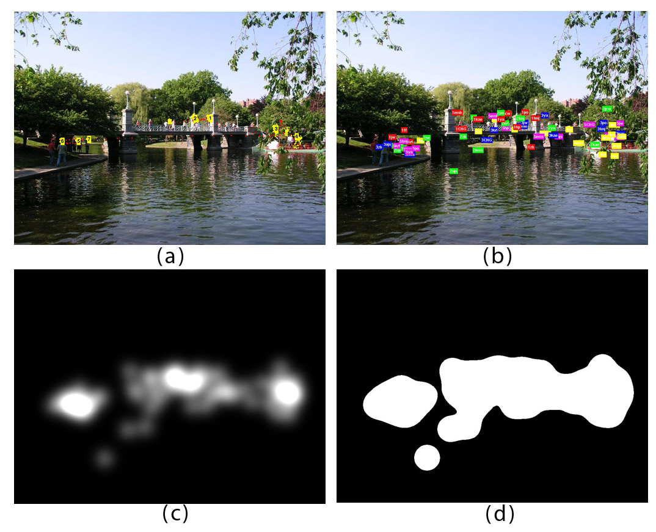
Where do people look?
Judd et al., ICCV 2009

Slide 4
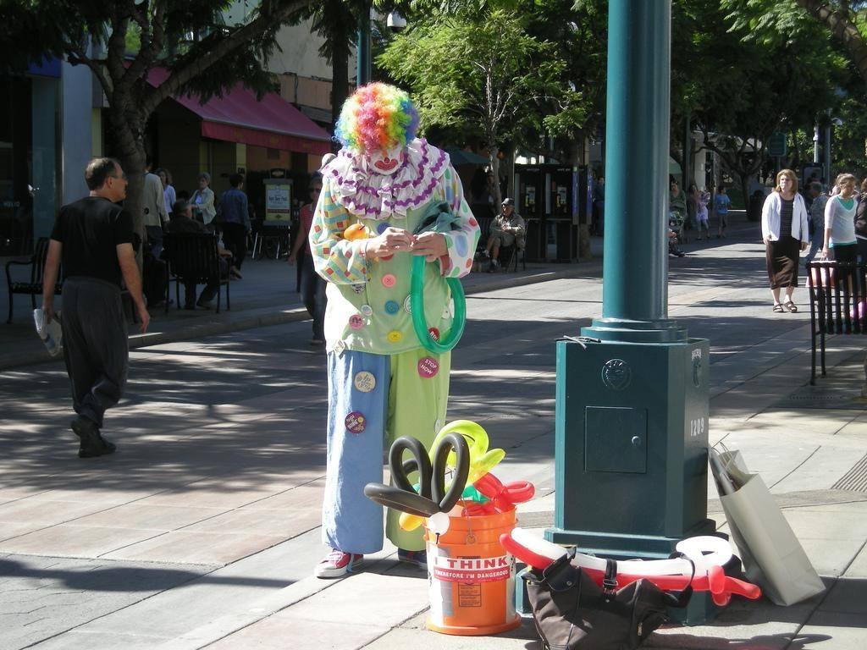




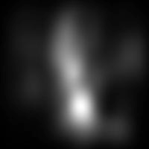


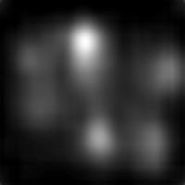
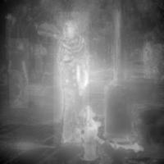
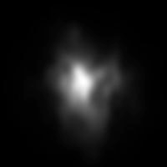
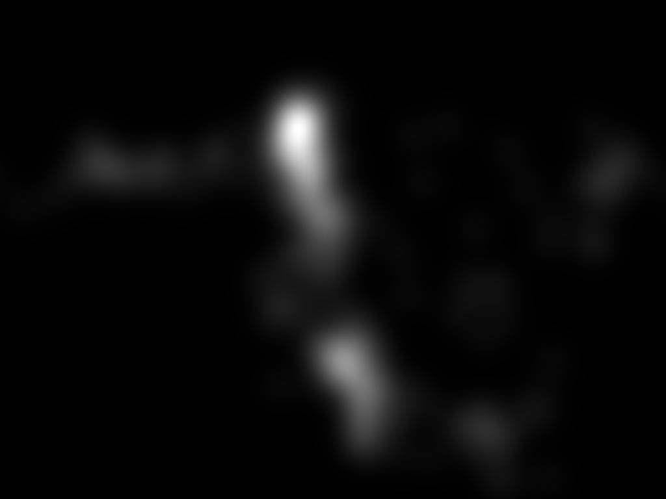
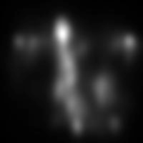
Which one is a better model?
[for predicting human fixations on this image]
Control/baseline models
Saliency models
…

Slide 5
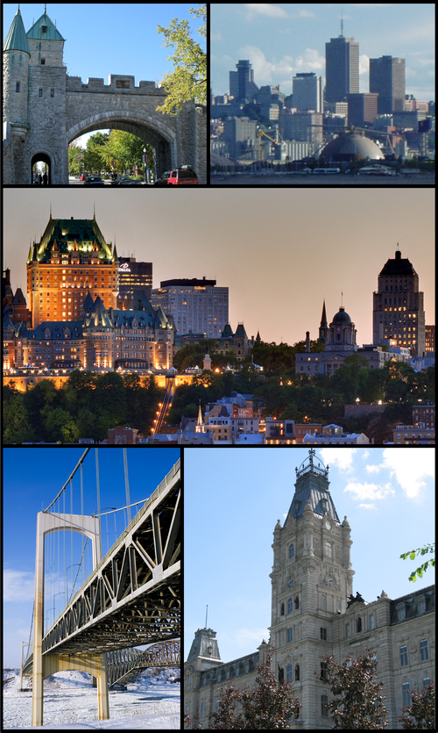


Outline
Model Benchmarks
Challenges
  Datasets
  Center-bias and Smoothing
  Scores
Summary & Future
Vancouver
￼
Notes:
I will start off with a brief introduction to the visual attention. The talk has two main parts on bottom-up and top-down visual attention. I will then mention some applications of these models and finish with a summary.
REPEAT THE QUESTION

Slide 6
USC Benchmark (Borji et al., 2012)
Notes:
MUST BE HERE AROUND MIN 44 45
New directions: Complex cluttered scene processing and understanding
and BIG DATA
let me accelerate a little bit
[[Express your interest in mental disorder]]

Slide 7
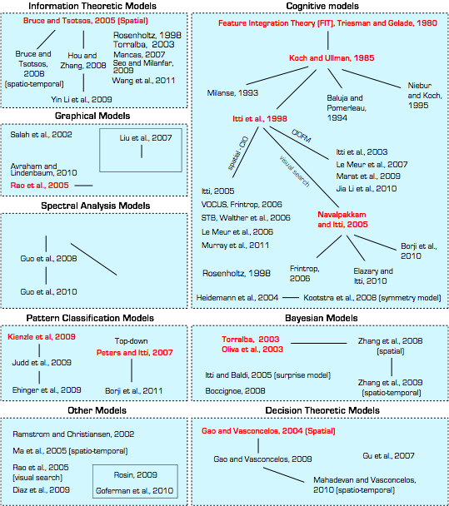
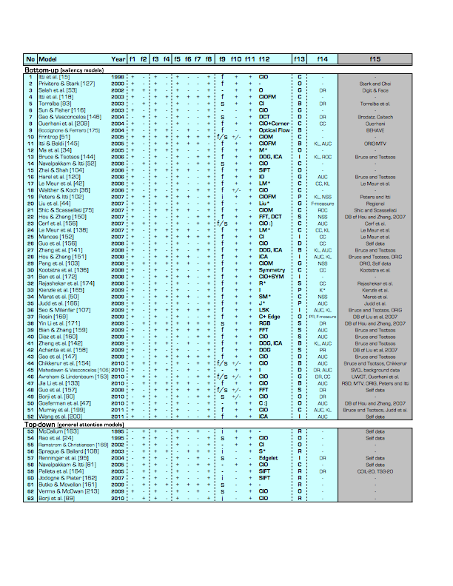
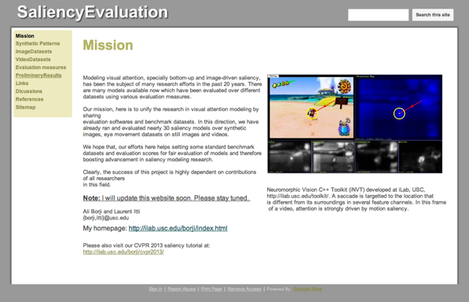
Attention Models
A hierarchical illustration of saliency models.
As of Nov. 2012
Bottom-up models
Top-down models
- Cognitive models
- Information-theoretic models
- Graphical models
- Spectral-analysis models
- Decision-theoretic models
- Pattern classification models
Yet, few top-down models!?
Borji and Itti, IEEE PAMI 2013
Borji et al., IEEE TIP 2012
Notes:
the first thing that i did as a postdoc was to see what is out there ….
many models were the same
scoring and dataset bias were problems, we conducted a fair model comparison
most importantly there was a large gap bet models and humans

Slide 8
Borji et al., IEEE TIP 2012

Slide 9
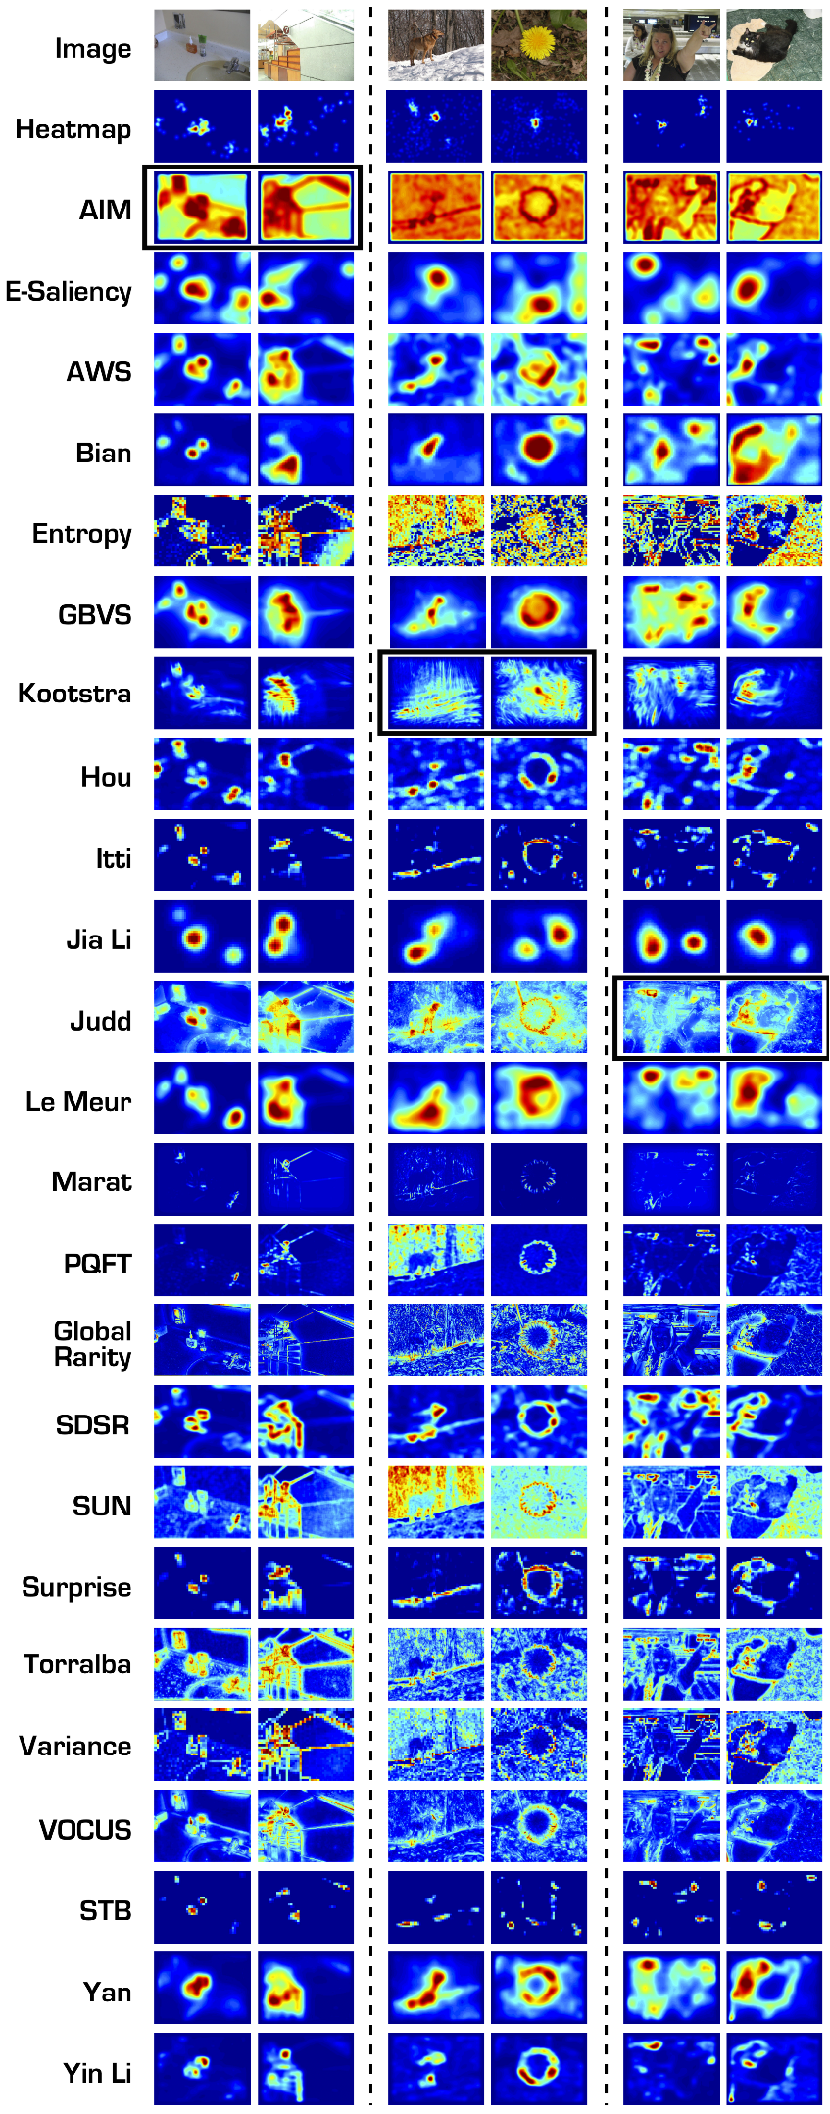
Model Benchmark
Borji et al., IEEE TIP 2012
35 saliency models (including baseline models; e.g., Gaussian, IO, Entropy, ...)
  54 synthetic patterns and 5 datasets of natural scenes (3 still image, 2 video)
3 evaluation scores (CC, NSS, shuffled AUC)
Discussion and analysis of challenges (e.g., center-bias, evaluation scores, dataset bias, ...)
Run-time analysis
Analysis of worst and best stimuli for models
All models lag behind the human inter-observer model
The top performing model over static and dynamic natural scenes is AWS (Garcia-Diaz et al. 2009); it also performed second best with synthetic images
Some models are very fast, yet yield competitive eye movement prediction accuracy
Different models often have common easy/difficult stimuli
Analysis of datasets reveals that existing datasets are highly center-biased, which influences some of the evaluation scores
  We recommend using the Shuffled AUC score for tackling center-bias

Slide 10
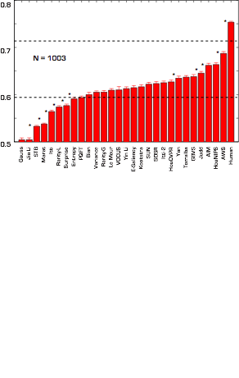

Model Benchmarking over Judd et al. 2009 dataset
using shuffled AUC score
Borji et al., IEEE TIP 2012
Still a large gap between
humans and models
Shuffled AUC

Slide 11
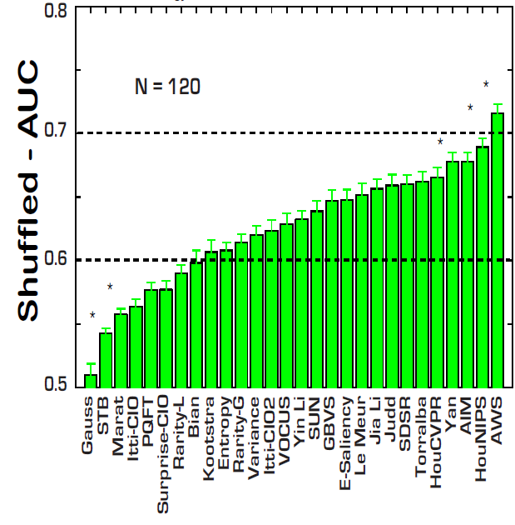
Bruce and Tsotsos dataset
Judd dataset
BRUCE: Hou PAMI: 0.7131
Schauerte ECCV : 0.7201
As of Sept. 2012

Slide 12
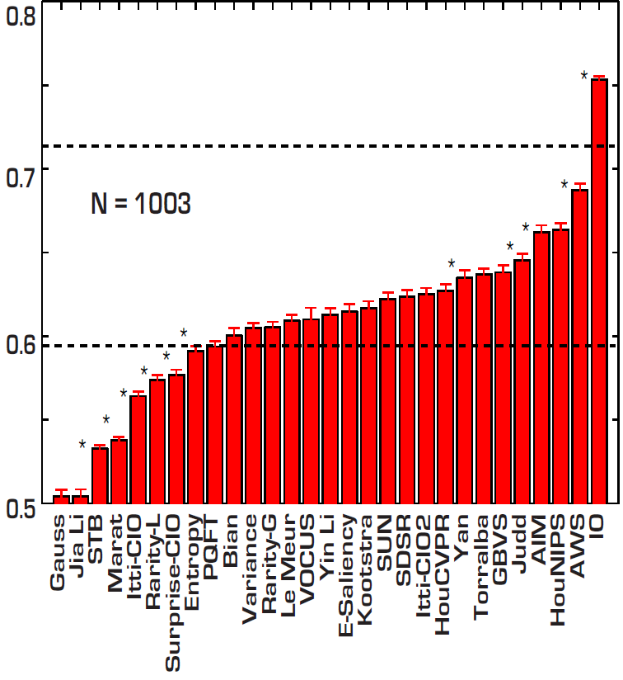


Still a large gap between
humans and models
Judd dataset
BRUCE: Hou PAMI: 0.6604
Schauerte ECCV : 0.6751
As of Sept. 2012

Slide 13
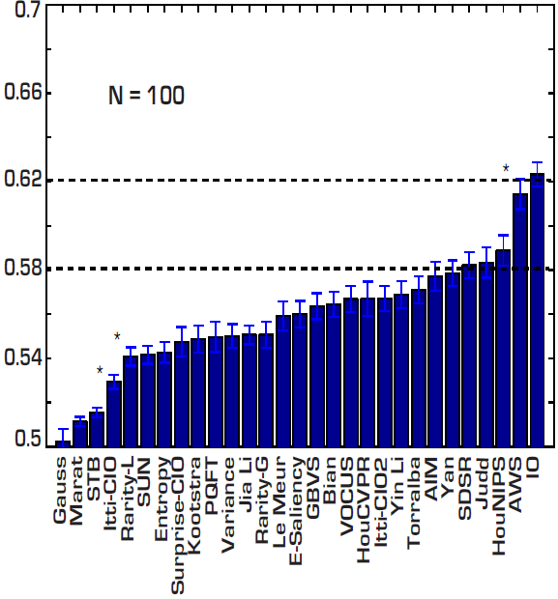
Kootstra dataset
Judd dataset
BRUCE: Hou PAMI: 0.6089
Schauerte ECCV : 0.6125
As of Sept. 2012

Slide 14
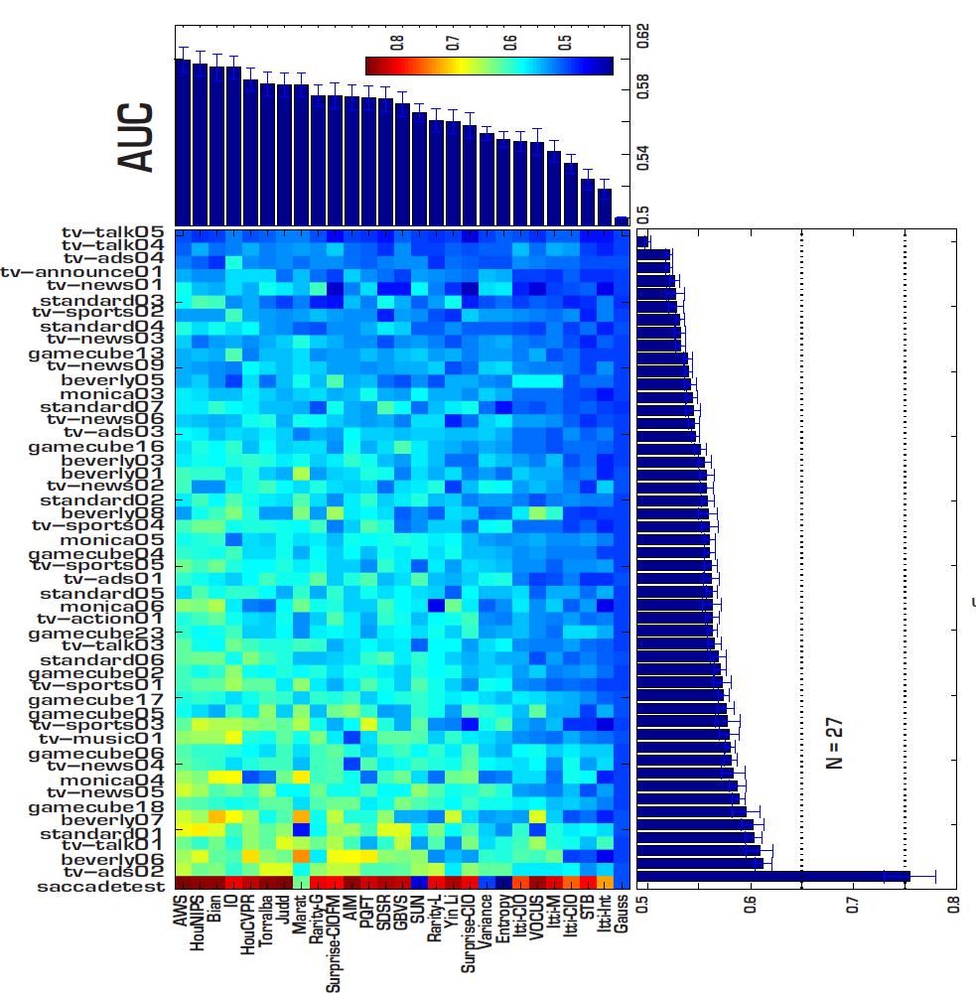
Shuffled
CRCNS-ORIG
dataset

Slide 15
MIT Benchmark (Bylinskii et al., 2015, ongoing)
Notes:
MUST BE HERE AROUND MIN 44 45
New directions: Complex cluttered scene processing and understanding
and BIG DATA
let me accelerate a little bit
[[Express your interest in mental disorder]]

Slide 16
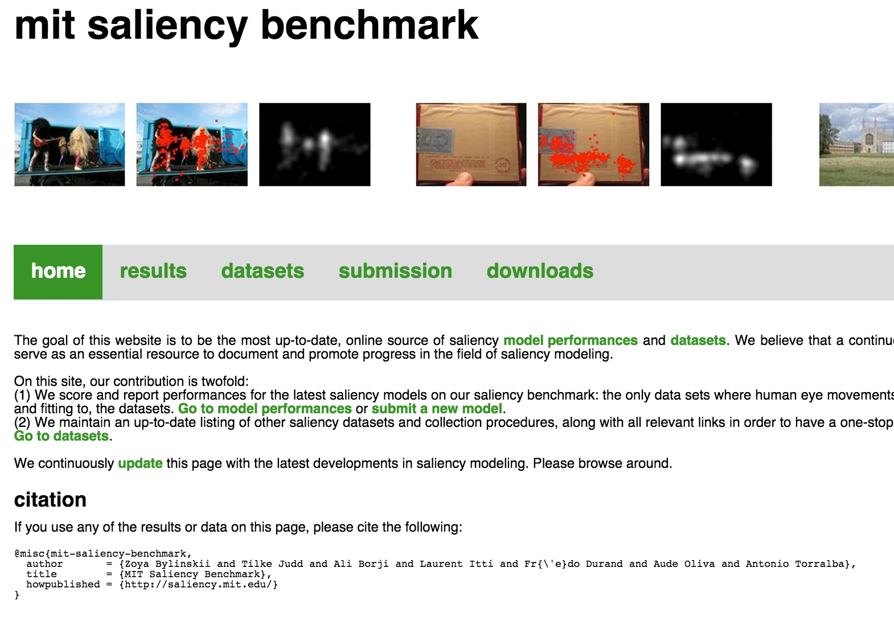

Slide 17
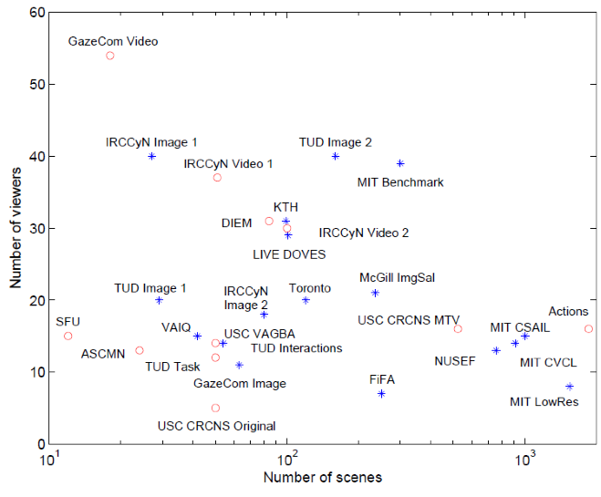


Slide 18
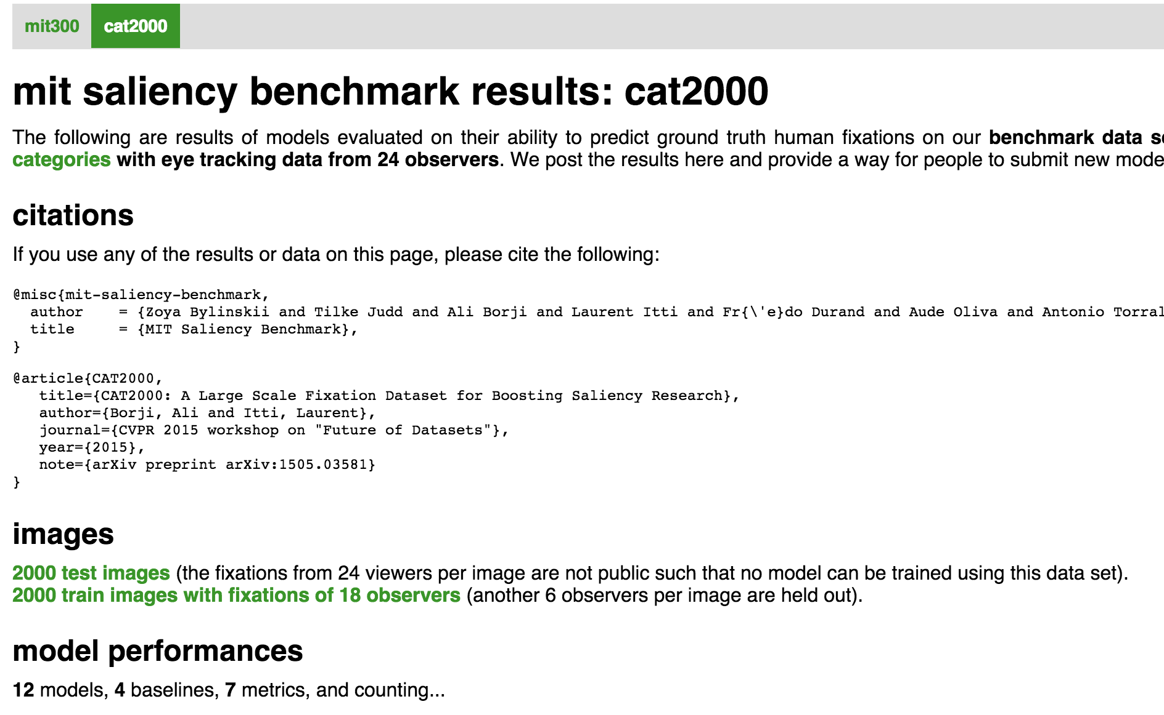
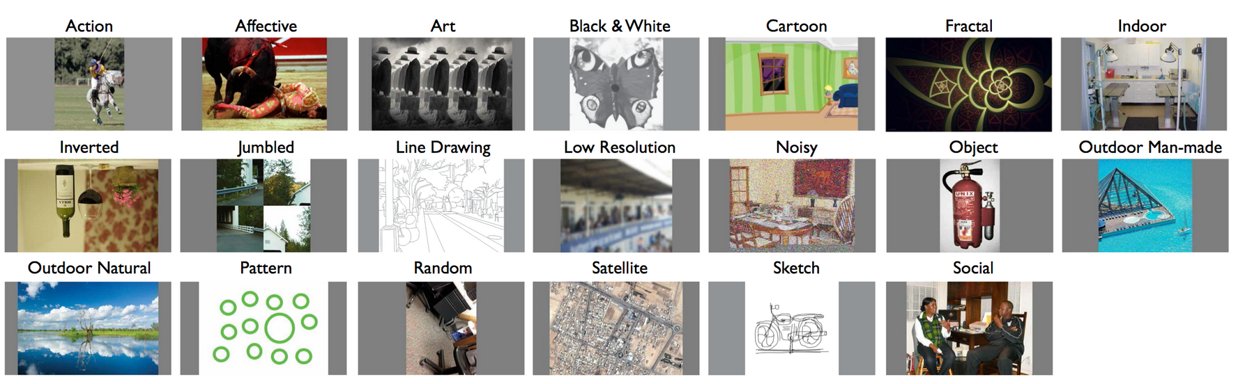

24 people , 4000 images,
20 categories, 32 Billion saccades

Slide 19
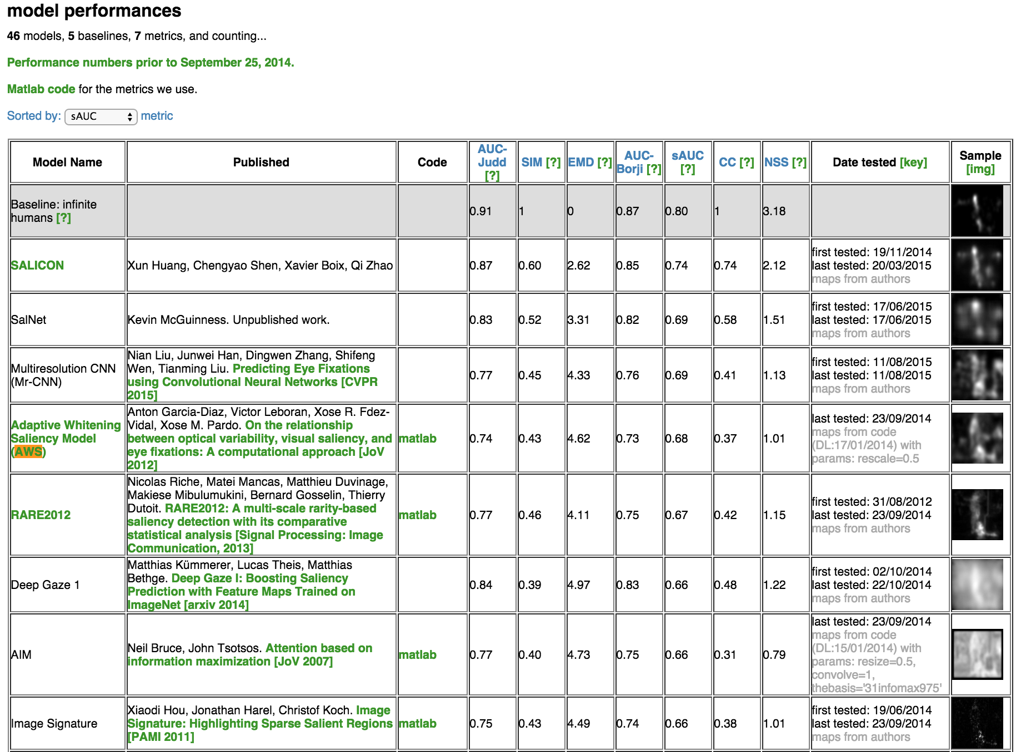


Slide 20
Other Benchmarks
Notes:
MUST BE HERE AROUND MIN 44 45
New directions: Complex cluttered scene processing and understanding
and BIG DATA
let me accelerate a little bit
[[Express your interest in mental disorder]]

Slide 21
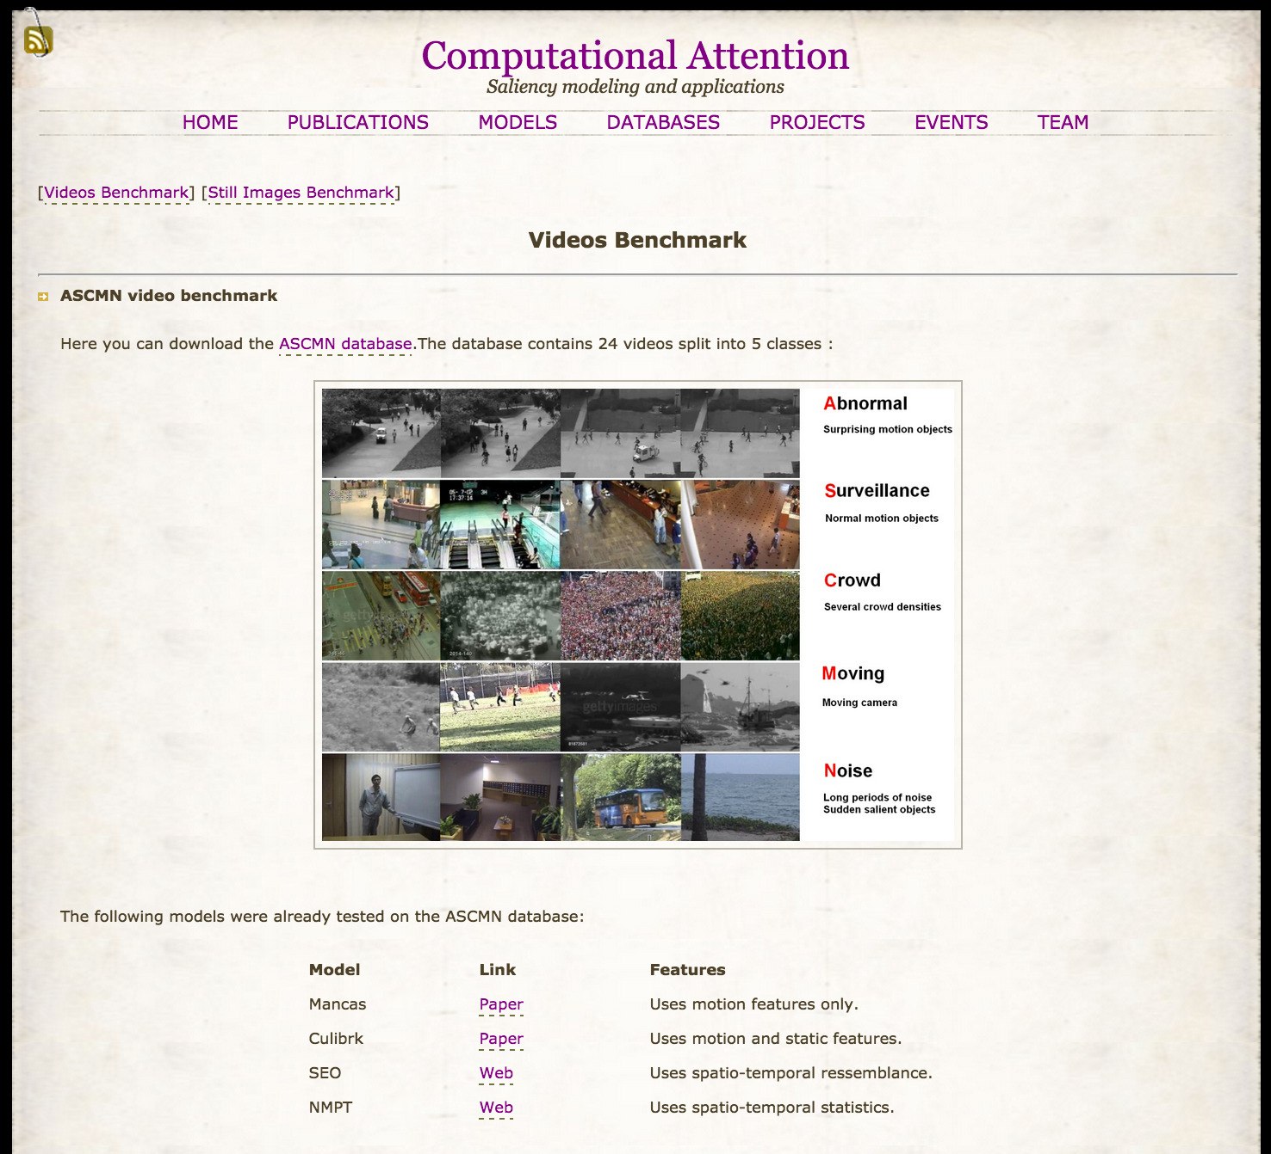

Matei Mancas

Slide 22
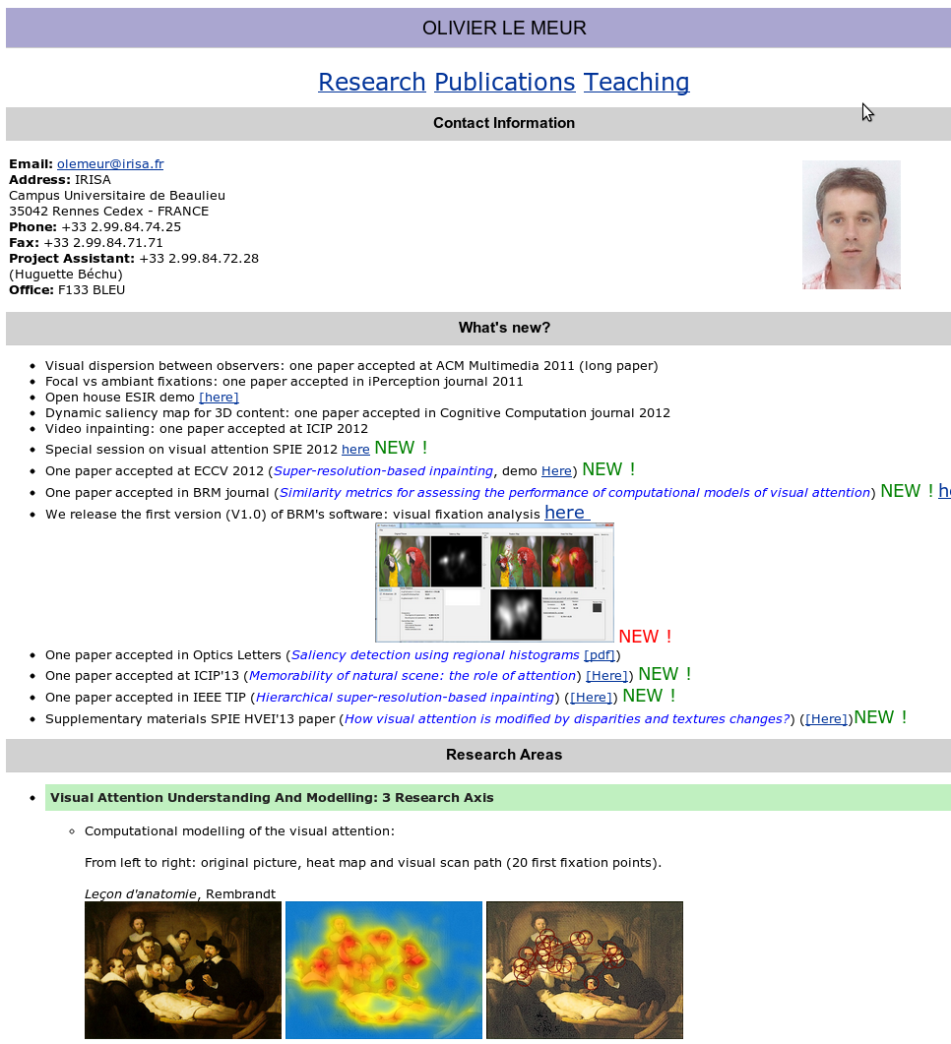
Olivier Le Meur
Recent works on
measuring scanpath

Slide 23
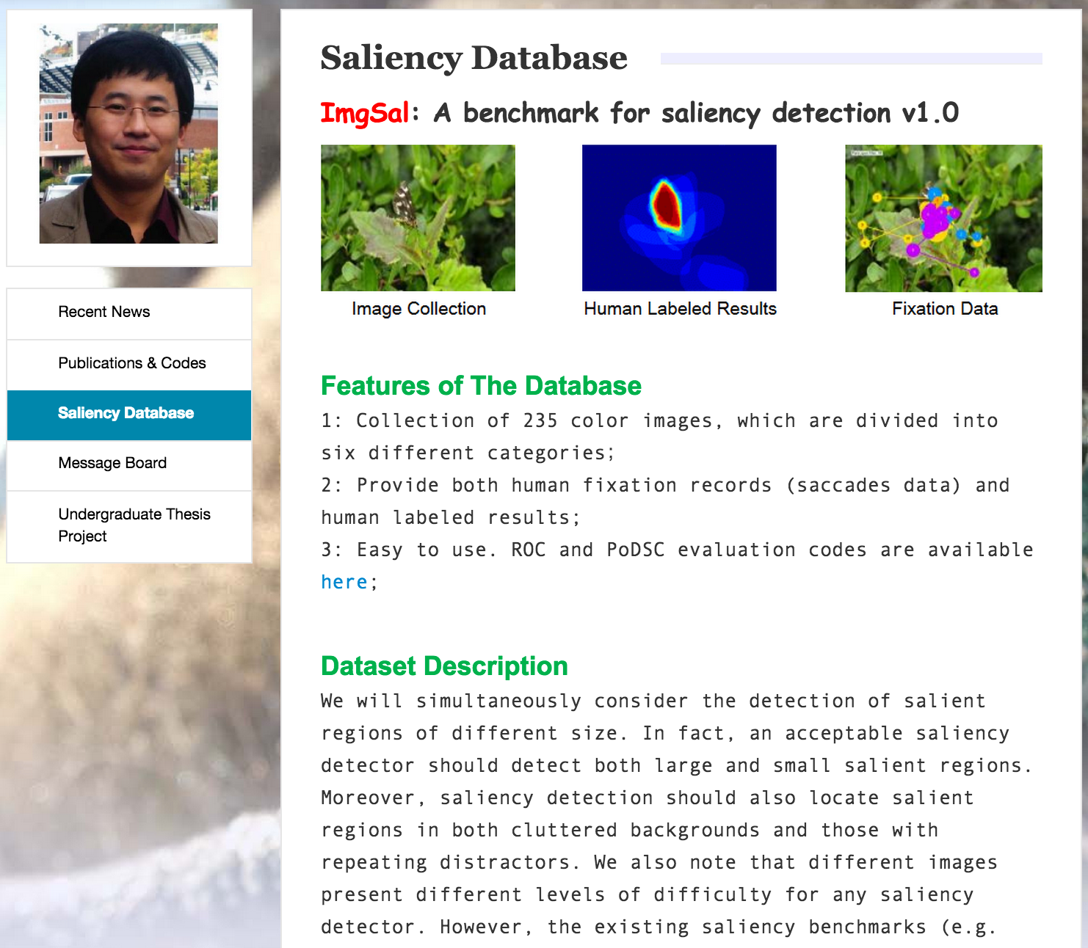
Jian Li

Slide 24
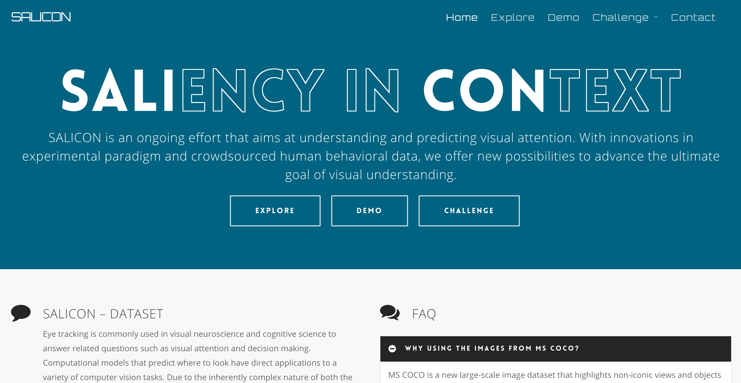

Based on MS COCO dataset
Ming Jiang*, Shengsheng Huang*, Juanyong Duan*, Qi Zhao

Slide 25


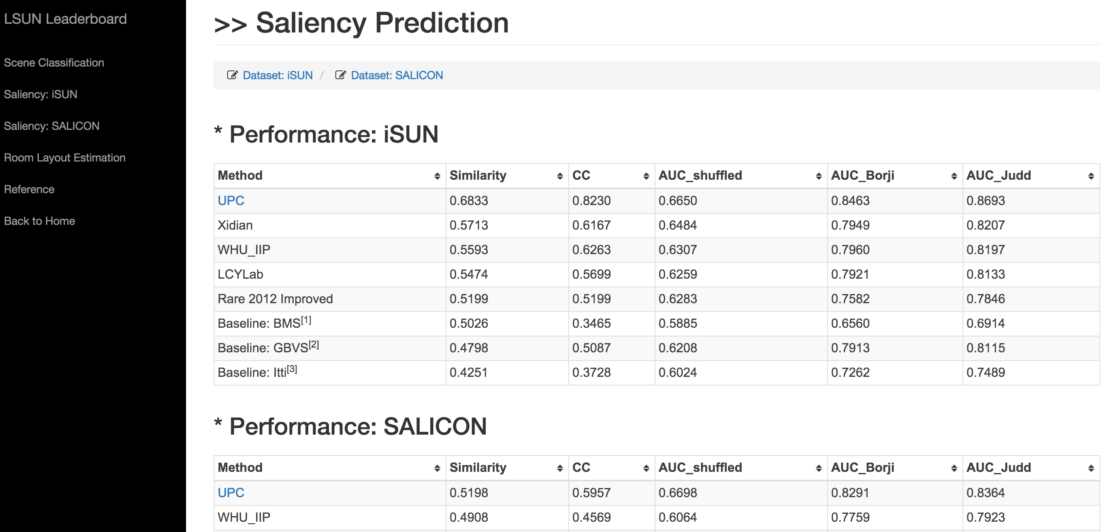

Yinda Zhang,
Fisher Yu,
Shuran Song,
Pingmei Xu,
Ari Seff,
Jianxiong Xiao
]
A CVPR 2015
Workshop

Slide 26
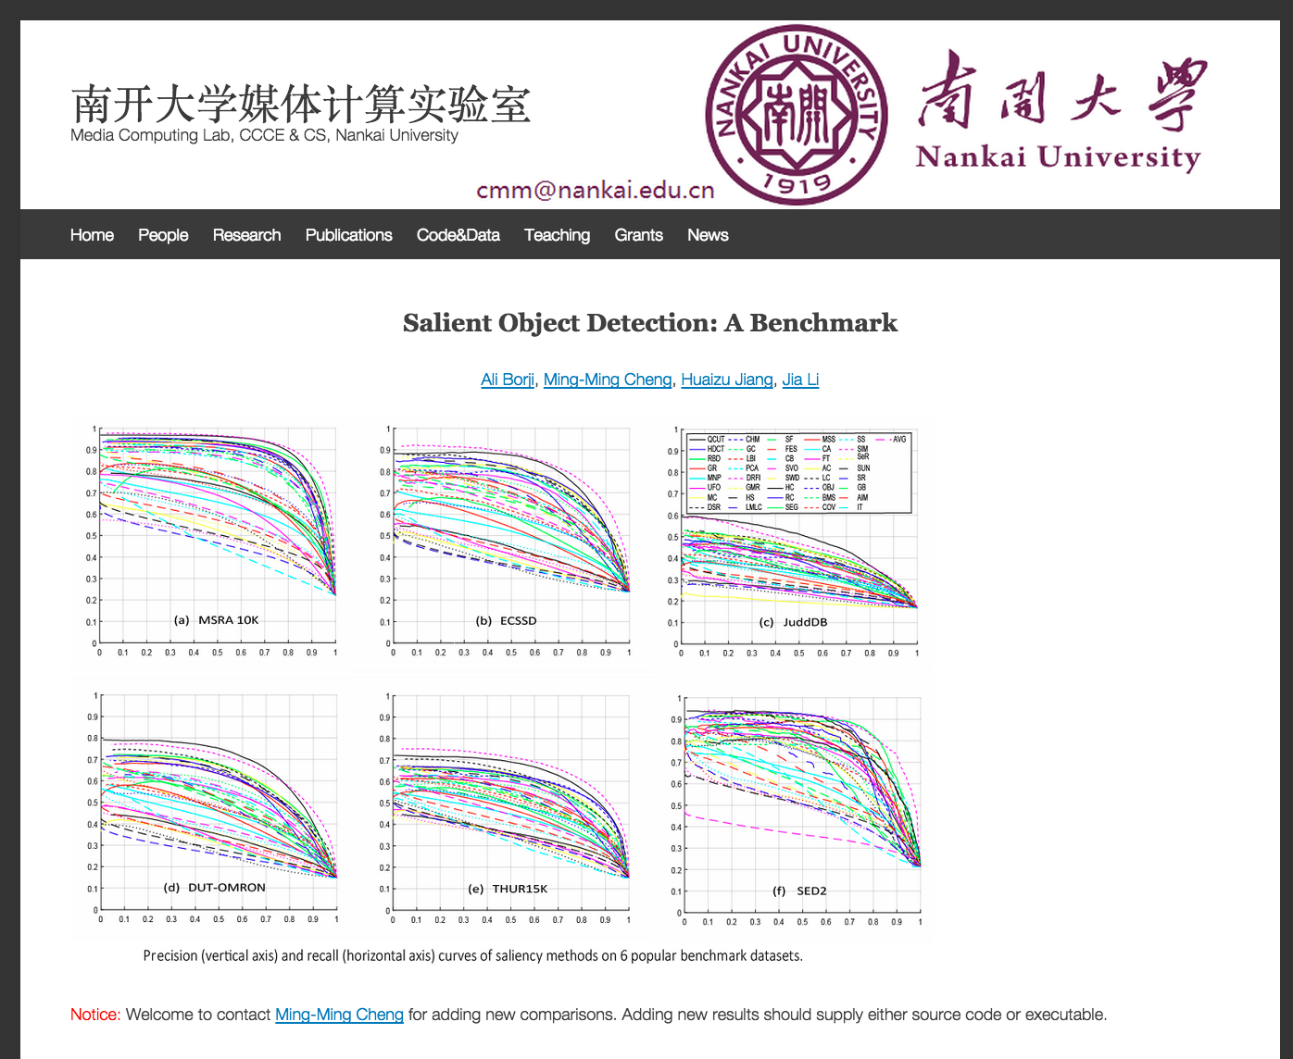
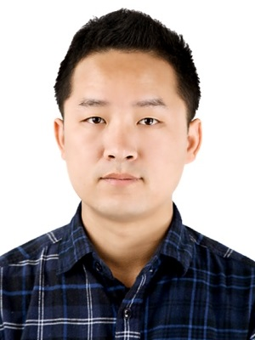
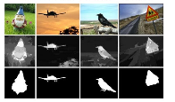

Slide 27
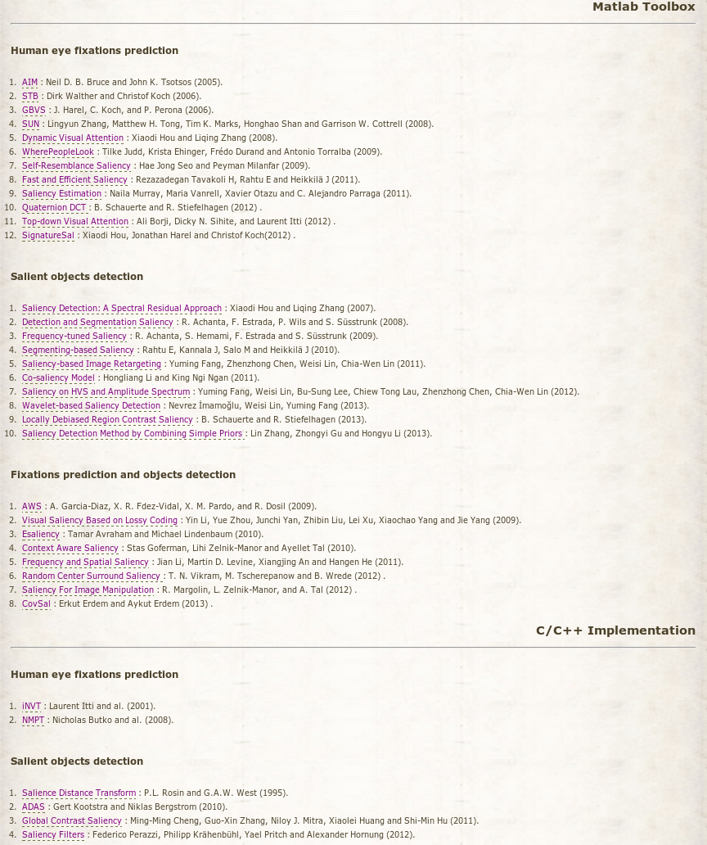

Slide 28
Outline
Model Benchmarks
Challenges
  Datasets
  Center-bias and Smoothing
  Scores
Summary & Future
￼
Notes:
I will start off with a brief introduction to the visual attention. The talk has two main parts on bottom-up and top-down visual attention. I will then mention some applications of these models and finish with a summary.
REPEAT THE QUESTION

Slide 29
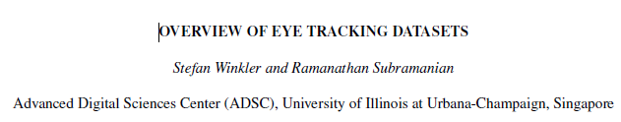
Datasets
Spatial (Still images)
  MIT
  Bruce and Tsotsos (Torronto)
  NUSEF
  Kootstra
  FIFA (Cerf)
  OSIE
  CAT2000
  Turker Gaze
  SALICON
  …
Spatio-Temporal (Videos)
  CRCNS
  DIEM
  Action in the Eye
  …
Mouse clicks
Webcam

Slide 30
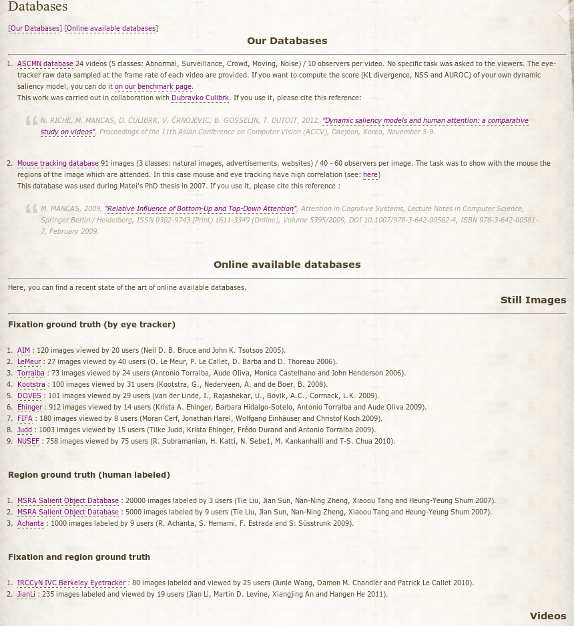

Image datastes
Matei Mancas

Slide 31
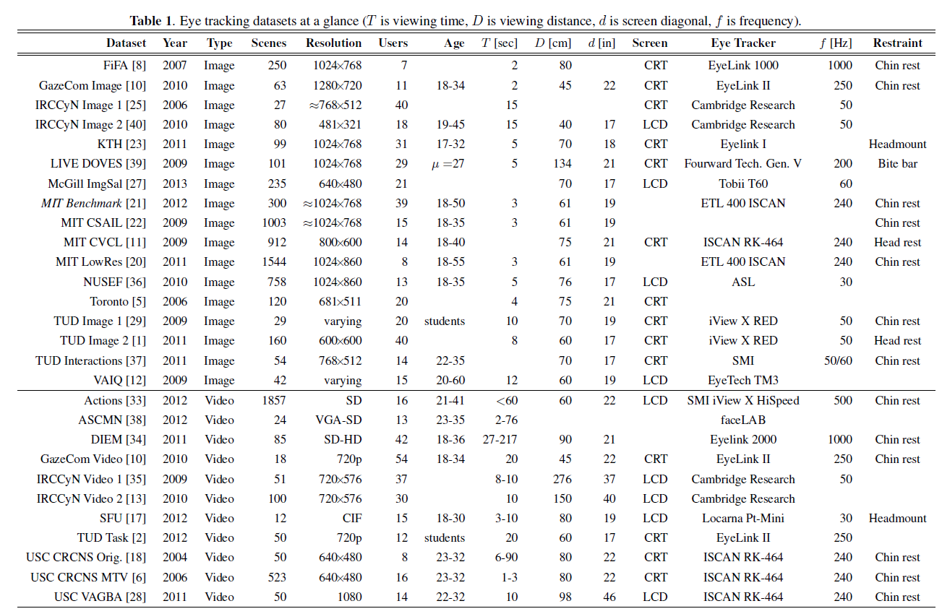
Adapted from: OVERVIEW OF EYE TRACKING DATASETS; Winkler and Subramanian

Slide 32
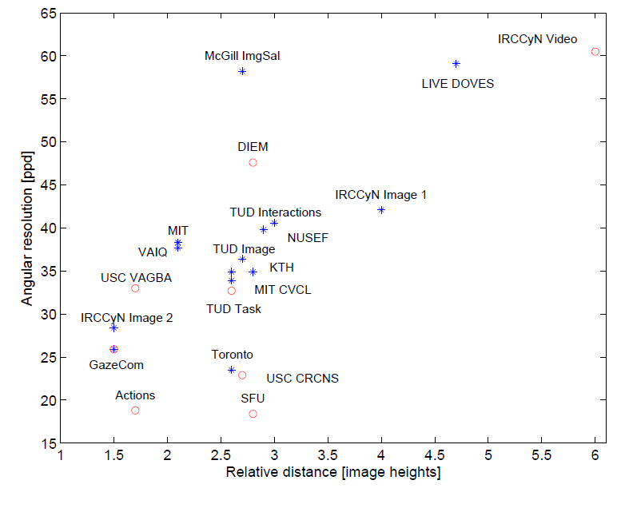

Slide 33
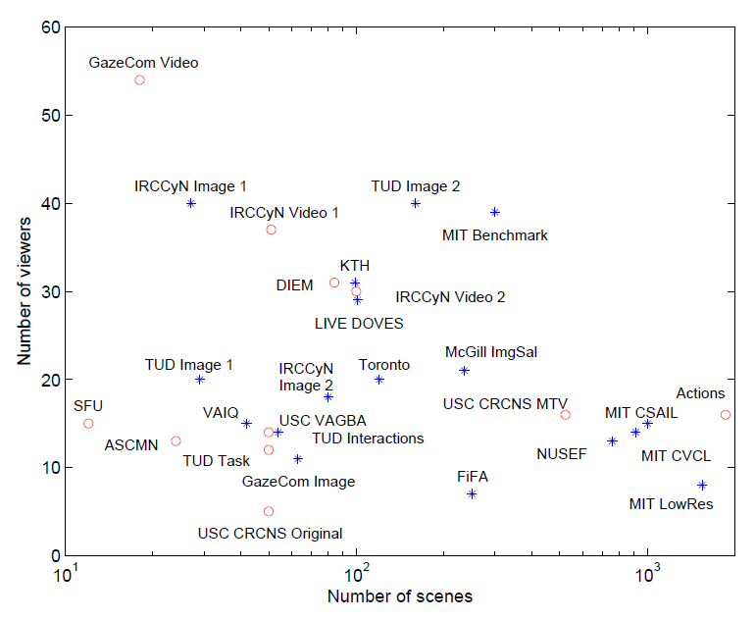

Slide 34
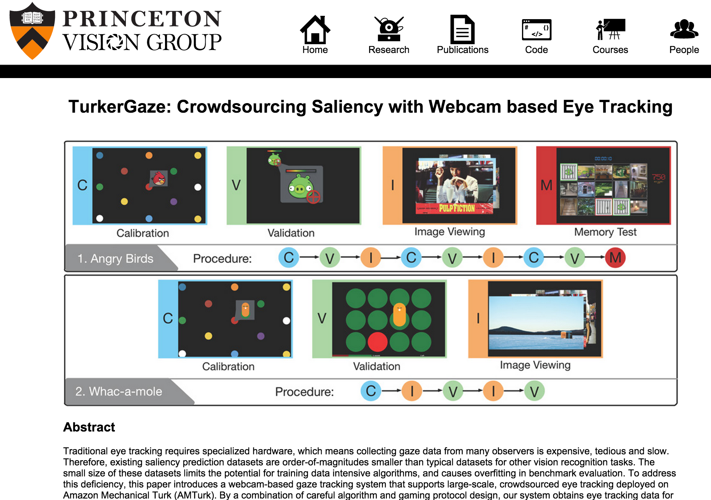
3 Subjects
20608 images
Webcam
Fully annotated
Turker Gaze/ iSUN

Slide 35
16 Subjects
10K images
Mouse clicks
Based on MS COCO dataset
Ming Jiang*, Shengsheng Huang*, Juanyong Duan*, Qi Zhao

Slide 36
24 people , 4000 images,
20 categories, 32 Billion saccades

Slide 37
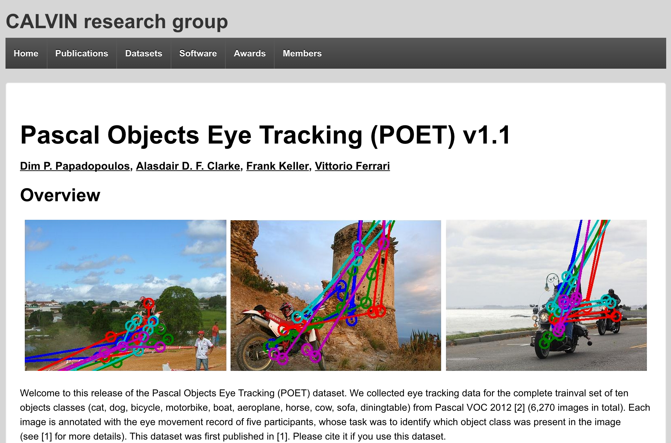

Slide 38
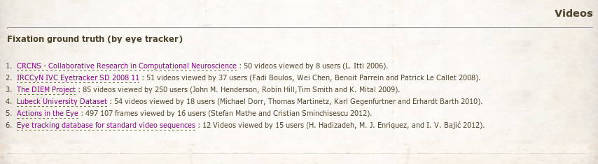
Video datastes
Marat et al., 2009
Jia Li et al., 2010
Peters and Itti, 2007
Borji et al., 2012
Shic and Scassellati, 2007
Le Meur et al., 2007

Slide 39
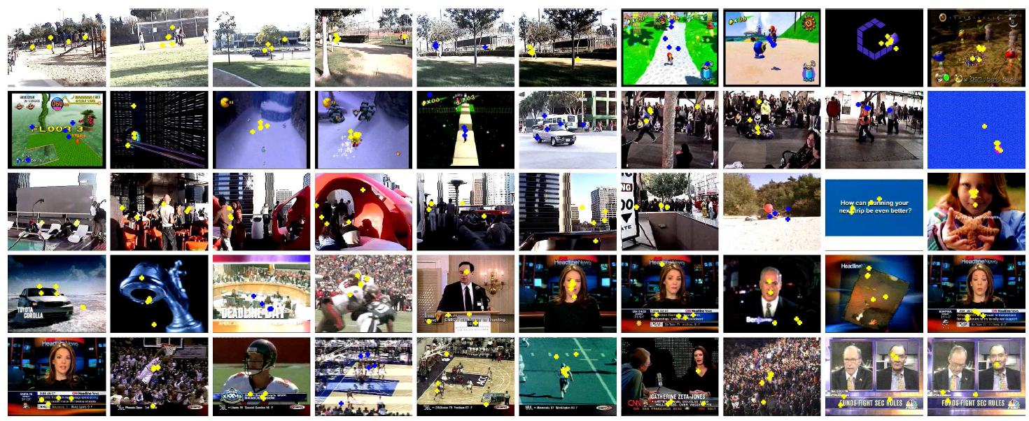
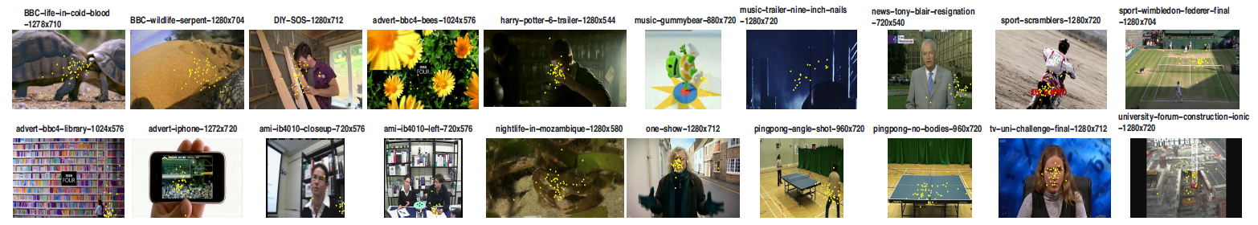
CRCNS
DIEM

Slide 40

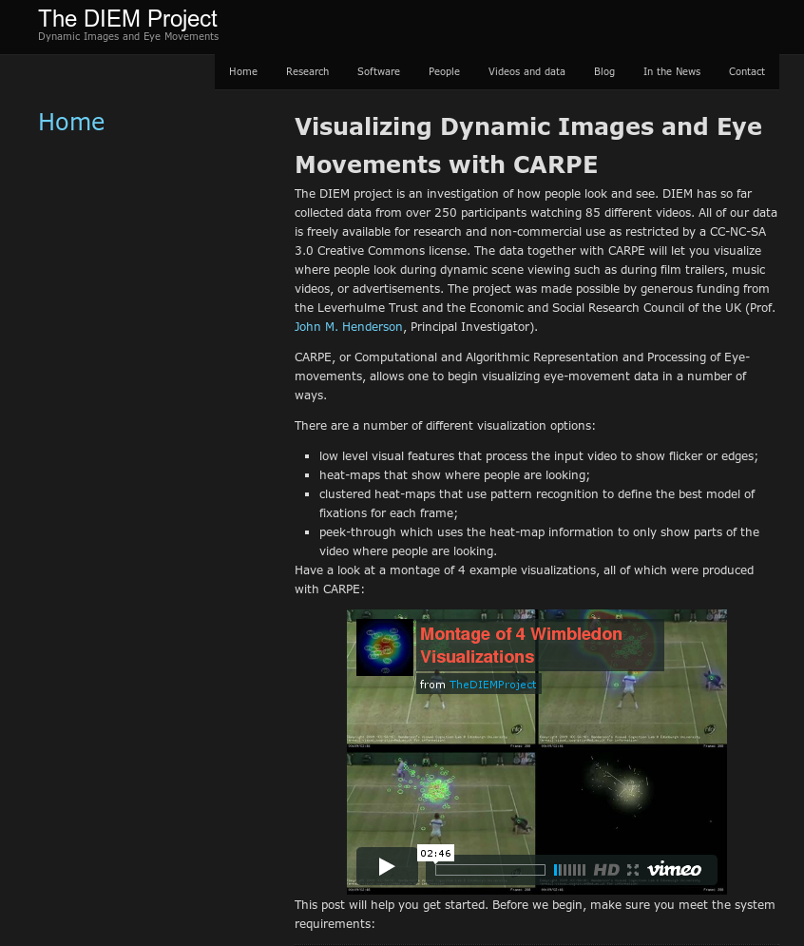
John Henderson

Slide 41
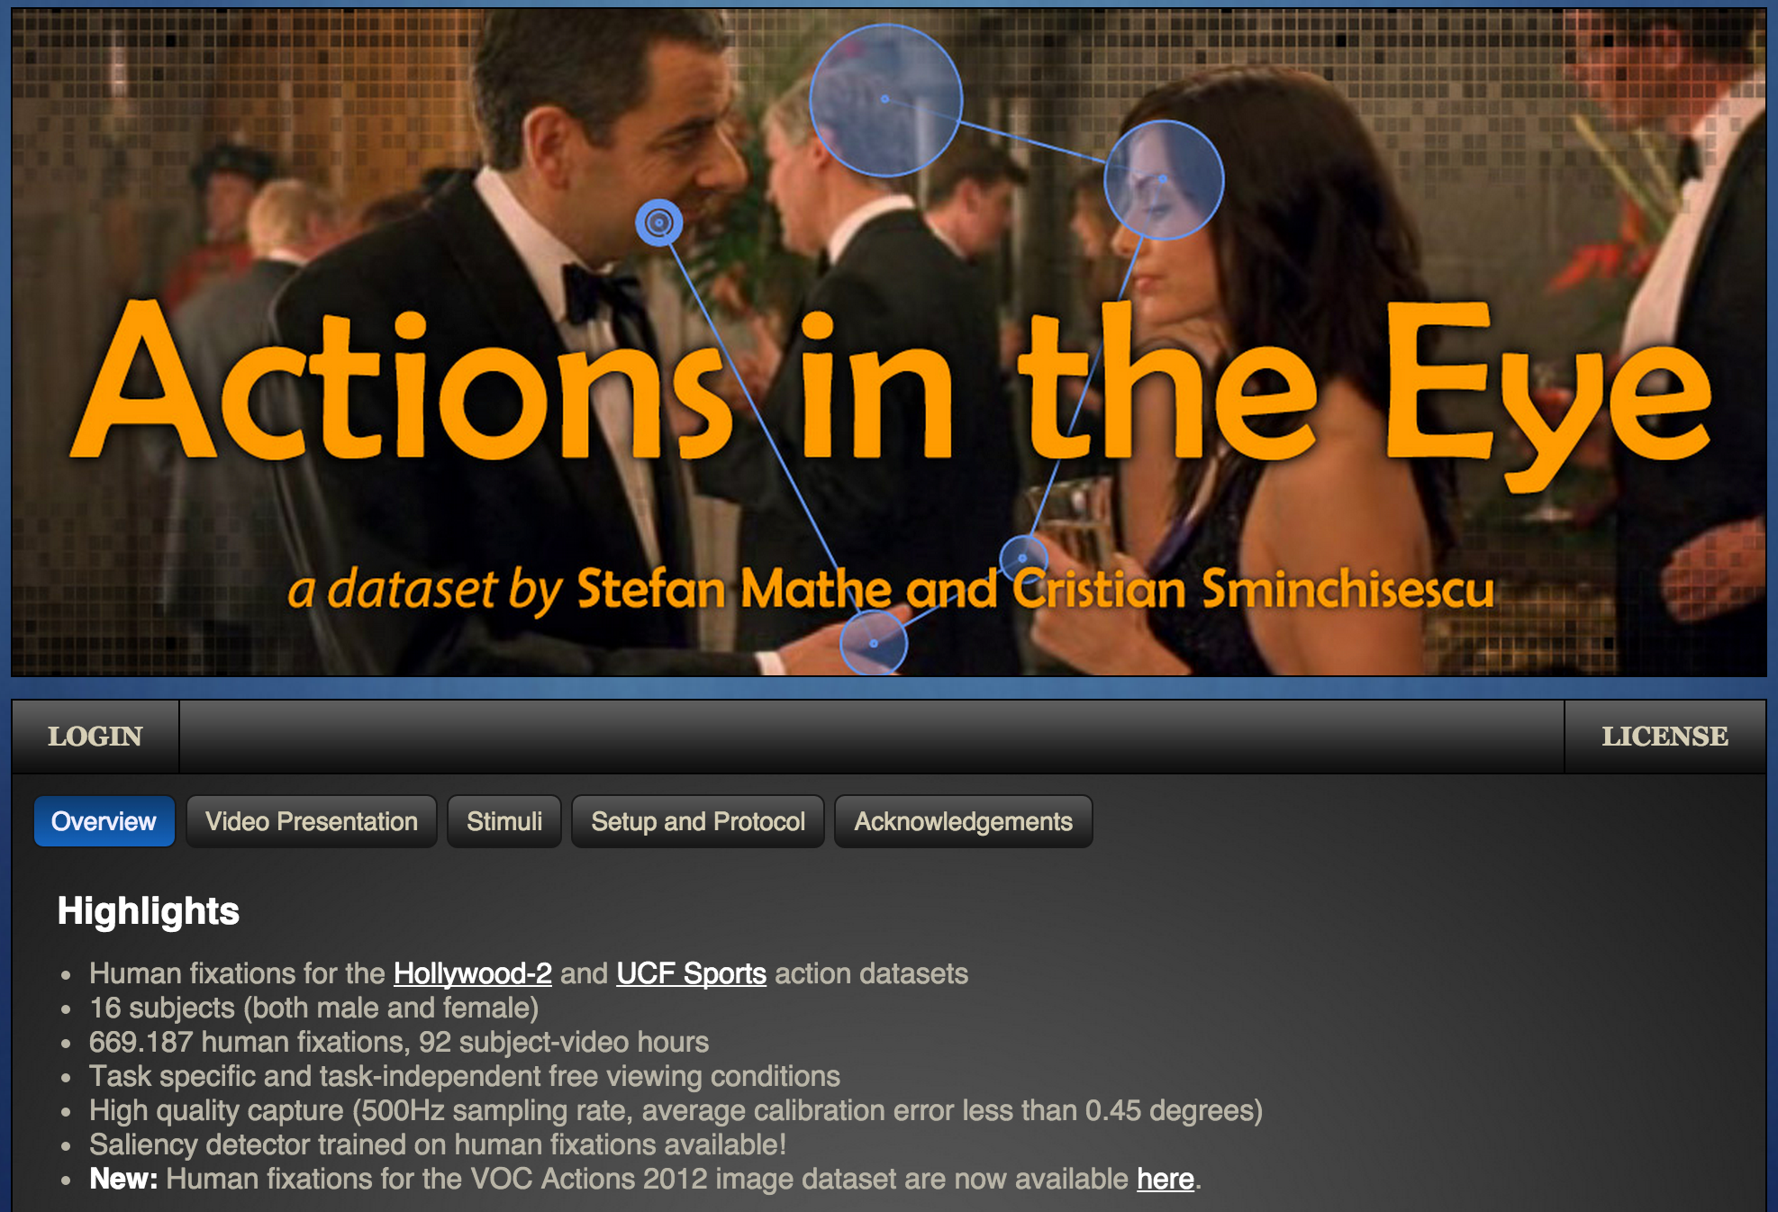

Slide 42
Salient object detection datasets
ASD Achanta et al. (stimuli from MSRA) [Obsolete!]
SOD (from Berkley dataset); Movahedi et al.
SED 1 & SED 2 (Weizmann dataset)
5K images from MSRA-B by Huaizu Jiang
ImageSal dataset
iCoseg: Interactive cosegmentation by touch
THUR15K and MSRA10K by Ming-ming Cheng

Slide 43
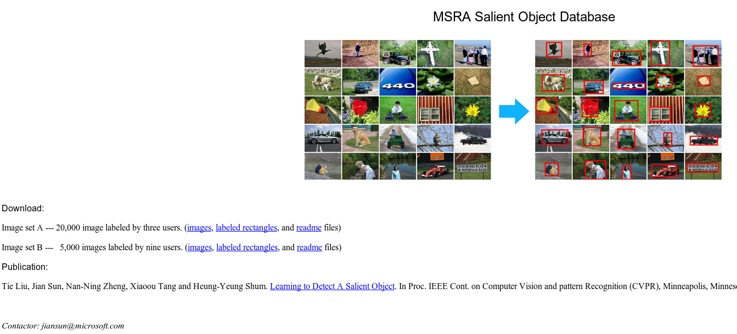
MSRA Salient Object Database

Slide 44
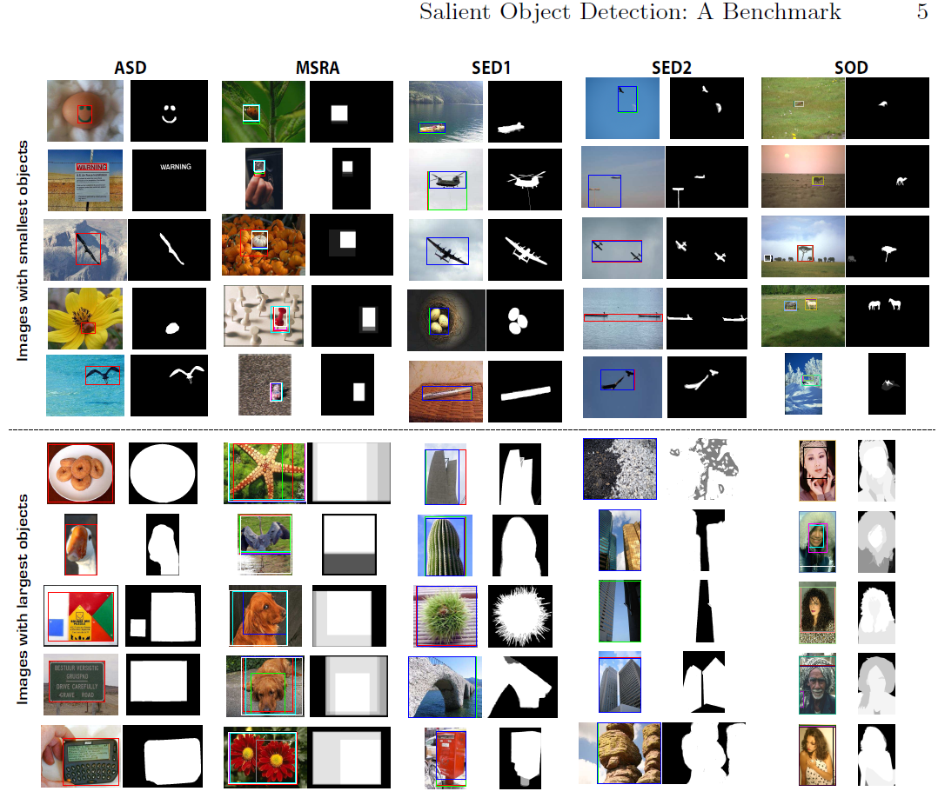

Slide 45
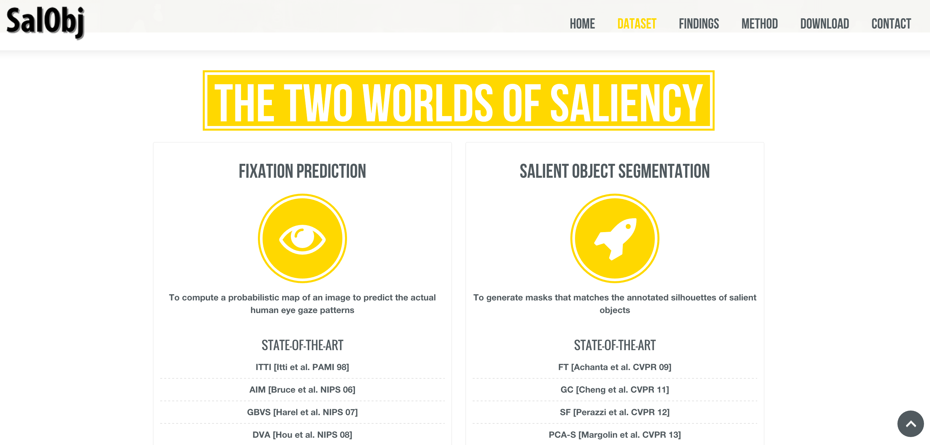
PASCAL-S
Pixel level annotations
Fixations
Multiple Objects
850 images, 12 subjects
Li et al., CVPR 2014

Slide 46
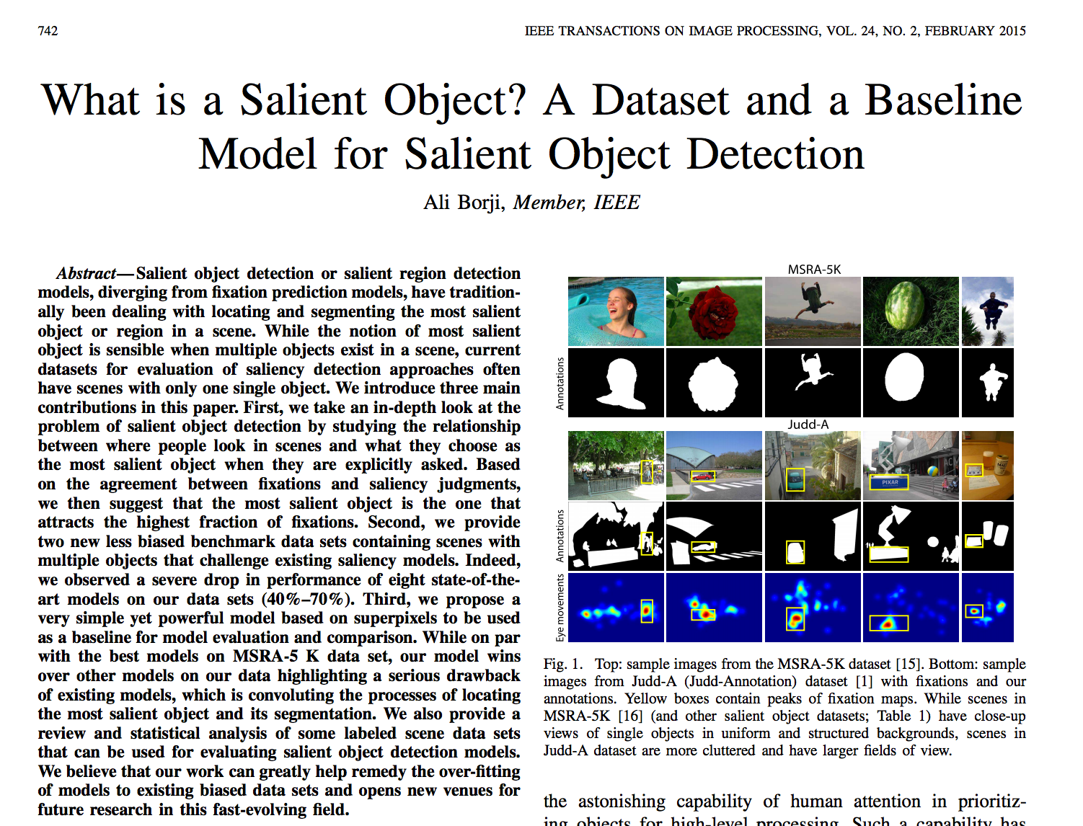
Judd-A
Pixel level annotations
Fixations
Multiple Objects
~ 1K images, 15 subjects

Slide 47
DUT OMRON

Slide 48
Outline
Model Benchmarks
Challenges
  Datasets
  Center-bias and Smoothing
  Scores
Summary & Future
￼
Notes:
I will start off with a brief introduction to the visual attention. The talk has two main parts on bottom-up and top-down visual attention. I will then mention some applications of these models and finish with a summary.
REPEAT THE QUESTION

Slide 49

Center-bias (Tatler et al., 2007, Tseng et al., 2009, Borji et al., 2011)
Observers tend to look at the center of objects for two reasons:
- Viewing strategy
- Photographer bias

Slide 50


Center-bias
Tatler et al., 2007

Slide 51

Center-bias
Salient Object Datasets
Borji, et al., 2012

Slide 52

Do objects predict fixations better than early saliency?
Einhauser et al., JOV 2008

Slide 53

Borji et al., JOV 2013

Slide 54

Smoothing
decreasing

Slide 55


Smoothing
Sweet spot

Slide 56
Outline
Model Benchmarks
Challenges
  Datasets
  Center-bias and Smoothing
  Scores
Summary & Future
￼
Notes:
I will start off with a brief introduction to the visual attention. The talk has two main parts on bottom-up and top-down visual attention. I will then mention some applications of these models and finish with a summary.
REPEAT THE QUESTION

Slide 57


Problem with sAUC
Peripheral bias
Central bias
Mean Error Rate
Saliency and Human Fixations: State-of-the-art and Study of Comparison Metrics, Riche et al., ICCV 2013
How close are we to understanding image-based saliency? Bethge et al., arXiv, 20414

Slide 58

AUC Types
Type -1
Sweeping a threshold
over the saliency map
and compute the
ratio of human
fixations above the
threshold
[Judd et al. ICCV 2009]
[Ehinger et al., 2009]

Slide 59

AUC Types
Type-2
  Positive samples come
  from the human fixations
  Negative samples are
  uniformly generated
Type-3
  Negative samples are
  taken from distributions of
  human fixations over other
  images plus other subjects
  over the image under test
Type-4
  Negative samples are saliency
  values at human fixations from
  saliency map of another image
Adapted from Hou et al., PAMI 2012

Slide 60

From WIKIPEDIA

Slide 61


Normalized Scanpath Saliency (NSS)
Peters et al., Vision Research 2005

Slide 62

AUC ?
As long as the hit rates are high, the AUC is always high regardless of the false alarm rate.
Zhao and Koch JOV 2011

Slide 63

Analysis of Scores

Slide 64

Analysis of Scores
Gaussian Blob

Slide 65

Salient object detection models

Slide 66

Model Ranking
As of Sept. 2012
SVO: Chang, K.Y., Liu, T.L., Chen, H.T., Lai, S.H.: ICCV (2011)
CBSal: Jiang, H., Wang, J., Yuan, Z., Liu, T., Zheng, N., Li, S.: BMVC (2011)
Gof.: Goferman, S., Zelnik-Manor, L., Tal, A.: CVPR (2010)
RC: Cheng, M.M., Zhang, G.X., Mitra, N.J., Huang, X., Hu, S.M.: CVPR (2011)
LiuICIP: Liu, Z., Xue, Y., Shen, L., Zhang, Z.: ICIP
Fixation prediction models score lower than salient object detection models

Slide 67

See also

Slide 68

See also

Slide 69

See also

Slide 70
Outline
Model Benchmarks
Challenges
  Datasets
  Center-bias and Smoothing
  Scores
Summary & Future
Vancouver
￼
Notes:
I will start off with a brief introduction to the visual attention. The talk has two main parts on bottom-up and top-down visual attention. I will then mention some applications of these models and finish with a summary.
REPEAT THE QUESTION

Slide 71
Where are we now …
We are much more clear than 10 years ago in saliency modeling
  Center-bias
  Smoothing
  Scores
  Datasets
  Trends
  …
Still the landscape is not much clear in some areas
  Center-bias
  The gap between models and humans
  Other areas such as mind decoding, patient diagnosis and development of top-down models and evaluating them

Slide 72
Future!
What is the best score?
What is the best way to tackle center-bias?
What is the most representative dataset?
What is the best way to take advantage of object information?
How do models behave over different categories?
How far are we from human performance and where?
How to deal with model parameters?
How to take advantage of top-down influences?
Is there a model that works consistently the best in all test cases? natural scenes vs. psychological patterns? If not, why?
How important and useful is saliency for hard problems in computer vision? e.g., object recognition and scene understanding?

Slide 73


