Slide 1
Saliency for image understanding and manipulation
Speaker: Ming-Ming Cheng
Nankai University
http://mmcheng.net/

Slide 2
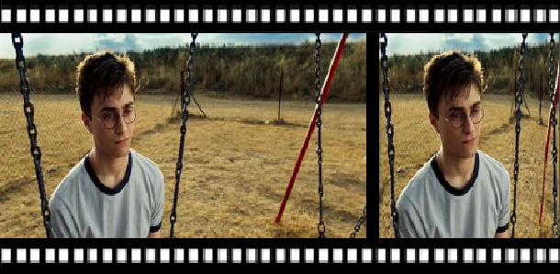
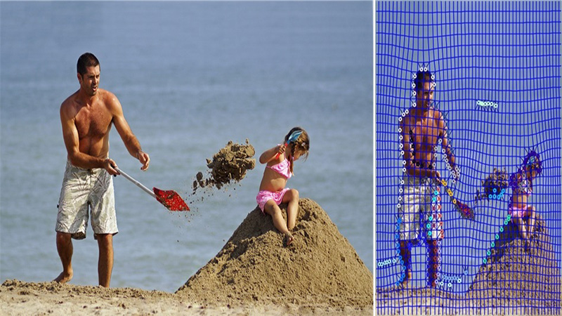
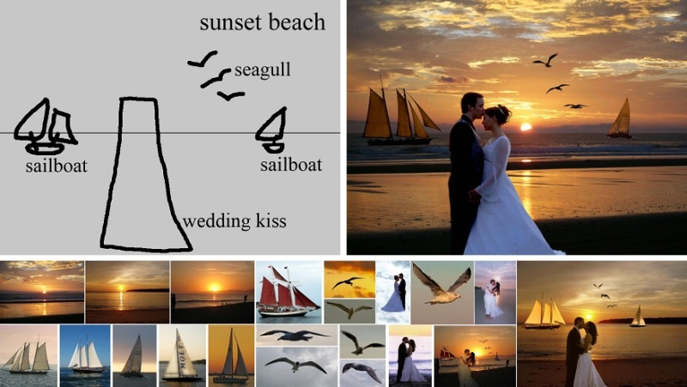

My involvement to the problem
Saliency estimation is key to many applications
Shrinkability Maps for Content‐Aware Video Resizing, CGF 2008.
A Shape‐Preserving Approach to Image Resizing, CGF 2009.
Sketch2Photo: internet image montage, ACM TOG 2009.

Slide 3
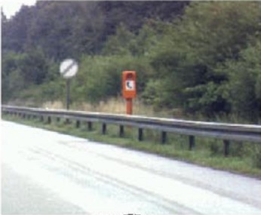
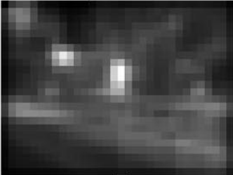
Predict fixation → detect salient object
Fixation prediction
  Predicting saliency points of human eye movement
A model of saliency-based visual attention for rapid scene analysis. PAMI 1998, Itti et al.
Saliency detection: A spectral residual approach. CVPR 2007, Hou et. al.
Graph-based visual saliency. NIPS, Harel et. al.
Quantitative analysis of human-model agreement in visual saliency modeling: A comparative study, IEEE TIP 2012, Borji et. al.
Notes:
The research of visual saliency has been investigated across many disciplines including cognitive psychology, neurobiology, and computer vision. Early research in computationally modeling visual attention mechanism focus on fixation point prediction. Starts from Itti’s famous work in IEEE TPAMI 1998, a large number of influential methods has been proposed to predict where does human looks.

Slide 4
Predict fixation → detect salient object
Eye tracker
  Cognitive psychology, neurobiology, etc.
Notes:
If you have ever been to a psychology lab, you might have a high chance of seeing an eye tracker device like what is shown in this image. By measuring human fixation point in a given visual stimuli, such eye tracker devices can provide accurate ground truth for evaluating fixation prediction methods. Such experimental setting has achieved great success in advertisement industry and human behavior researches. However, are fixation points all what we want?

Slide 5
Predict fixation → detect salient object
Saliency detection as binary segmentation
Learning to detect a salient object. CVPR 2007, Liu et. al.
Frequency-tuned salient region detection, CVPR 2009, Achanta et. al.
Global contrast based salient region detection, CVPR 2011, Cheng et. al.
Salient object detection: a benchmark, IEEE TIP 2015, Ali et. al.
Notes:
As desired by a huge amount of practical applications, there has been a growing interest of detecting entire salient objects rather than a few fixation locations. We will discuss such applications in later part of this talk. In 2007, Liu et al. tried to detect the most attention grabbing object in an image and formulate the task as a binary labeling problem.

Slide 6
Salient object detection
How to define salient objects?
  Match the human annotators’ behavior when they have been asked to pick a salient object in an image.
Global contrast based salient region detection, IEEE TPAMI 2015 (CVPR 2011), Cheng et. al.
Notes:
Here is an example for differentiate the two tasks. For this horse image, human fixation points have a high chance of locating at the head part, which is crucial important for the observer to recognized it as a horse rather than a cattle. Thus, the ideal fixation prediction results would looks like the middle image.
However, in other applications like image retrieval, photo composition, and image manipulation, finding the entire salient object is desired. Thus the right image is a pretty good prediction result for salient object detection task.
What does salient object detection methods do and how do we define it? Salient object detection is typically considered as computationally identifying such salient object regions, that match the human annotators’ behavior when they are asked to pick salient objects in an image.

Slide 7
Salient object detection
High consistency among labelers.
PASCAL-S dataset
The Secrets of Salient Object Segmentation, CVPR 2014, Li et. al.
Notes:
In a recently work by Li et al., a large scale user experiments shown that salient object segmentation is a valid problem because of the high consistency among labelers.

Slide 8
Growing interest
Salient object detection: a survey, arXiv 2014, Ali et. al.
Salient object detection: a benchmark, IEEE TIP 2015, Ali et. al.
Notes:
This is a simplified chronicle of saliency modeling. Each small shape in the figure represents a representative method published in major conferences and journals. There are mainly two waves of researches in this area.
Models in the first wave are mainly dealing with fixation prediction while models in the seconds wave mainly addressed the detection and segmentation of the most salient objects. While both trends are still active research areas in computer vision and cognitive science, salient object detection has attracted more interest recently.

Slide 9
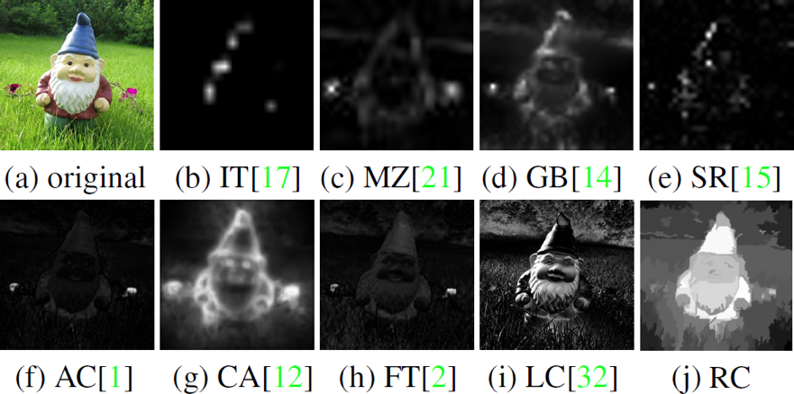
Saliency detection
Observations
  In order to uniformly highlight entire object regions, global contrast based method is preferred over local contrast based methods.
  Contrast to near by regions contributes more than far away regions.

Slide 10

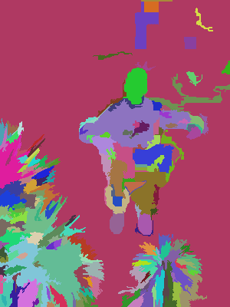
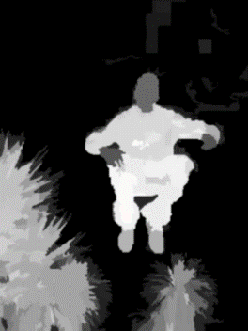
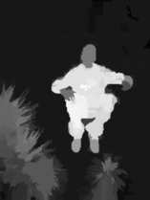
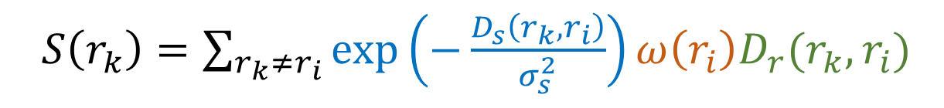
Region contrast (RC)
  Image Segmentation $σ_{s}^{2}→∞$ $σ_{s}^{2}→0.4$
  Spatial weighting
  Region size
  $S\left(r_{k}\right)=\sum_{r_{k}≠r_{i}}{\exp\left(−\frac{D_{s}\left(r_{k},r_{i}\right)}{σ_{s}^{2}}\right)}ω\left(r_{i}\right)D_{r}(r_{k},r_{i})$
  Region contrast by sparse histogram comparison.
Global Contrast based Salient Region detection. IEEE TPAMI 2015 (CVPR 2011), Cheng et al.

Slide 11
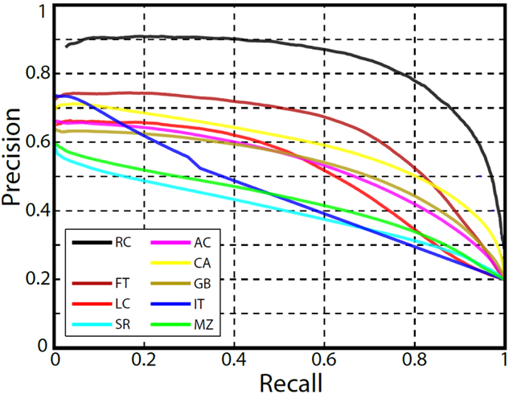
Experimental results
Dataset: MSRA1000 [Achanta09]
  Precision vs. recall

Slide 12
What makes an object salient?
Contrast
Spatial distribution
Focusness
Backgroundness
Center bais/prior
etc.
A Model of Saliency-Based Visual Attention for Rapid Scene Analysis, IEEE TPAMI 1998, Itti et al.
Salient object detection: a survey, arXiv 2014, Ali et. al.
Notes:
What makes an object salient and how can we computationally identify such salient object? In a recent survey paper, we have covered over 200 publications and summarized major hypothesis for salient object detection.

Slide 13
Content aware image resizing
A Shape‐Preserving Approach to Image Resizing, CGF 2009.

Slide 14
Image mosaic
Saliency for image Manipulation, The Visual Computer 2013, Margolin et al.
Notes:
It could also be used to generate mosaics.

Slide 15
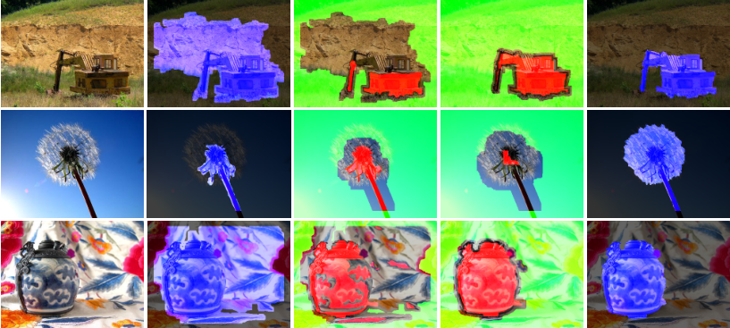
SaliencyCut
  Enables automatic initialization provided by salient object detection.
Notes:
Salient object detection and segmentation provides an interaction free mechanism for object segmentation. Even with a fixed thresholding, our method had demonstrated over 80% precision and recall in the largest salient object segmentation benchmarks. That means, the majority of the segmentation results are quite good.
For challenging examples as shown here, salient object segmentation using fixed thresholding provides quite poor results. However, they can be used to learn foreground and background appearance model. By utilizing morphological operations and iterative GrabCut, our SaliencyCut methods achieved over 90% precision and 90% recall on the largest benchmark for salient object segmentation. The final SaliencyCut results for these challenging examples could be found at the right column.
The interaction free salient object segmentation could be used to process billions of internet images, enabling a variety amount of potential applications which is not possible previously.

Slide 16
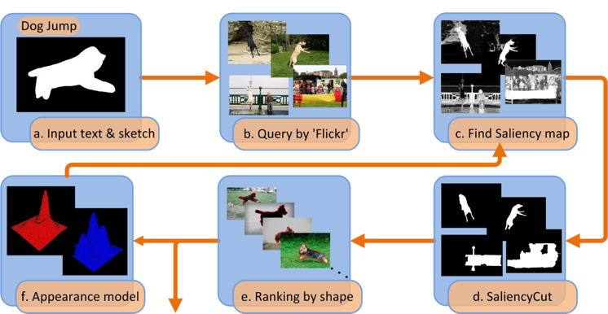
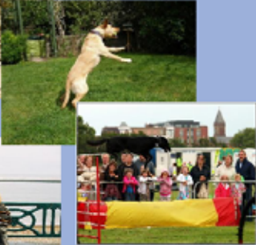
Application requirements
Is salient object detection for ‘simple’ images useful?
SalientShape: Group Saliency in Image Collections, The Visual Computer 2014. Cheng et. al.
Notes:
Many state of the art salient object detection algorithm have demonstrated promising results on datasets where images contain less ambiguous salient object, which I would like to call them as simple images.
Click →
For instance, it’s relatively easy to detect and segment the salient object region in this yellow dog image. How about this complicated one? Even humans would found it quite difficult to provide ground truth annotations. People may ask, is it useful to develop a salient object detection method that could only deal with simple images?
My suggestion is yes! In many applications, as we are going to shown soon, such ability is crucial important to the success of many real-world applications.
Here we demonstrated an image retrieval application. By detecting and segmenting salient object for thousands of internet images, we are able to support shape guided image retrieval. When drawing sketch to describe an object, people tends to draw salient object shapes rather than textures on top of objects. Although state of the art shape matching algorithm could achieve 90+% retrieval rate in the challenging MPEG7 dataset, shape retrieval in nature images is still far worse than that. After salient object segmentation, we can easily achieving promising shape retrieval results, which could intern be used for training appearance model to improve salient object detection and segmentation for those related images.

Slide 17
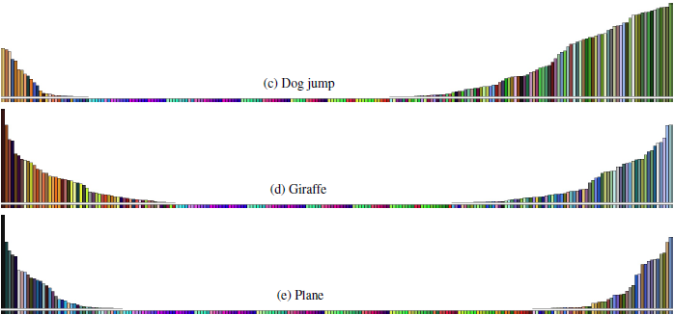
Application requirements
Illustration of learned appearance models
  Accords with our understanding of these categories
Notes:
Here, we demonstrated several examples of illustrating appearance models of the top ranking salient object shape retrieval results. We download 3000 images for each keywords and perform salient object detection and segmentation on each image. Then a shape retrieval is used to pick up salient shapes which is most close to the user draw sketch. We then illustrated the probability of different color belonging to foreground and background of those top ranked images. For each illustration, the more left the more likely the corresponding color belong to foreground. These statistical results are quite accord with our understanding of these categories.
For instance, the giraffe shows many brown and yellow color in the foreground, which are typical giraffe colors. In the background side, we found green and blue colors. If we take a picture in distance, we can easily capture the green trees as well as the giraffe itself. If we take a photo near the tall giraffe, we can easily capture the blue sky as giraffe is much taller than humans and require up view to be captured.

Slide 18

Applications
Sketch2Photo: internet image montage, ACM TOG 2009. Chen et. al.
Notes:
Here is another application of salient object detection. User input a few keywords and draw some sketch to represent what kind of picture they want to generate. The system automatically generate photorealistic images as shown in the right (top-right one, and the two in bottom right). This could be achieved by segmenting salient objects for images related with user input keyword and them perform shape retrieval to get image components for photo composition.

Slide 19
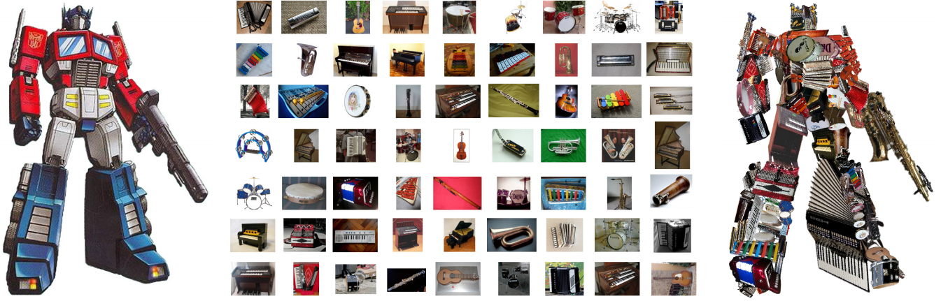
Image Collage
Arcimboldo-like Collage Using Internet Images, ACM TOG 2011. Huang et. al.

Slide 20
View selection
Web-image driven best views of 3d shapes, The Visual Computer 2012. Liu et al.
Notes:
Salient shape discover could also be used to automatically select the best view for presenting the 3D models.

Slide 21
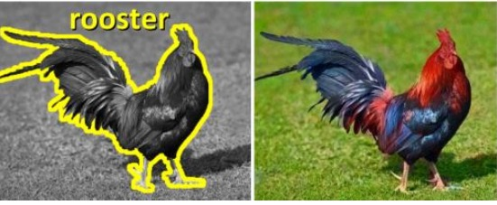
Colorization
Semantic Colorization with Internet Images, ACM TOG 2011. Chia et al.
Notes:
Here is an example of changing the gray scale image to colored one. This application also follows the salient shape retrieval pipeline to get the best candidate. Color transfer could be used to change the original grayscale image shown in the left side to colored one as shown in the right side.

Slide 22
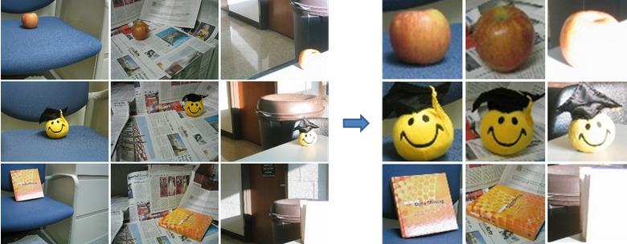
Unsupervised object discovery
Unsupervised Object Discovery via Saliency-Guided Multiple Class Learning, IEEE CVPR 2012. Zhu et al.
Notes:
Salient object detection and segmentation method could also be used replace expensive human annotation and automatically generating training data for multiple class learning algorithm.

Slide 23
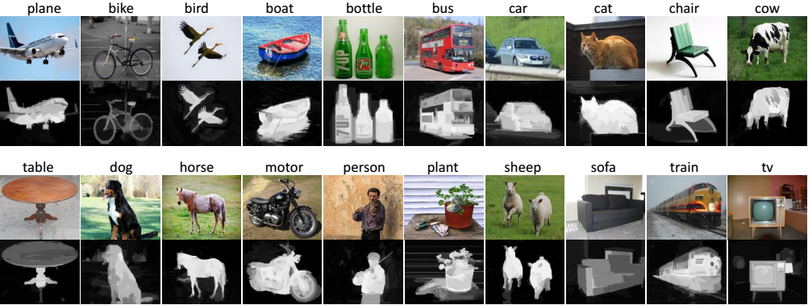
Weakly supervised sematic segmentation
Example of simple images in Flickr and saliency maps

Slide 24
Weakly supervised sematic segmentation
10% improvement over state of the art!
STC: A Simple to Complex Framework for Weakly-supervised Semantic Segmentation, Wei et al., arXiv 2015.
Notes:
In a very recent work, salient object detection and segmentation is also used to greatly improve weakly supervised semantic segmentation results by a large margin.

Slide 25
Applications: what we learnt?
Don’t ask what segments can do for you, ask what you can do for the segments.
— Jitendra Malik
Notes:
I want to borrow Prof. Jitendra Malik’s suggestion for segmentation algorithms. Don’t ask what segments can do for you, ask what you can do for the segments.
It’s less likely that salient object detection algorithm could generate perfect results for any input image in the near future. However, we can still properly use existing salient object detection methods to build robust applications.

Slide 26
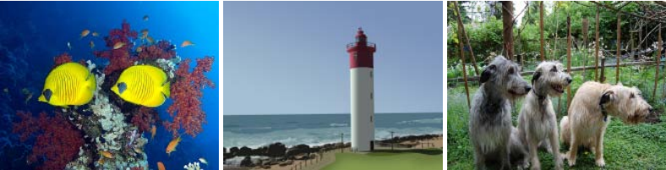
Salient Object Subitizing
Predicting the number of salient objects
  Is it possible without any object localization process?
  How fast can you tell the number of prominent objects in each of these images?
  Are we able to do it using holistic cues only?
Salient Object Subitizing, IEEE CVPR 2015, Zhang et al.
Notes:
predicting the existence and the number of salient objects in a scene using holistic cues

Slide 27
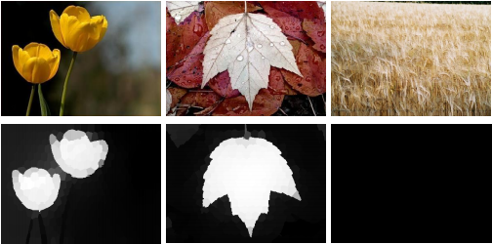
Joint Detection and Existence Prediction
Joint Salient Object Detection and Existence Prediction, Computational Visual Media, Jiang et al.

Slide 28
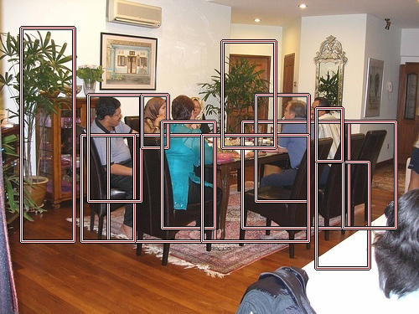
How about complicated images?
Notes:
How about complicated images. In the image as shown in this slides, or if we take a photo of current lecture room, every people is quite important and salient. How do you think the corresponding saliency map should be? A saliency maps with nearly everywhere salient is less useful for real-world applications. We may suggest that saliency map representation is not suitable for describing salient object detection for such complicated images. Instead, overlapping bounding boxes might be a more suitable representation for describing salient objects.

Slide 29

Objectness proposals
Notes:
Let’s consider visual attention mechanism in object detection. What would you expect if someone come in to this room to find his friend? Will him shaking his head in a sliding window fashion from the ceiling to the floor? Humans have a strong ability of picking potential interesting object regions and then recognize it.
Generic object detection has made great progress in recent years. However, most state-of-the-art method still requires each category specific classifiers to evaluate many image windows in a sliding window fashion. This is both non-intuitive and less efficient.
Inspired by visual attention mechanism, object proposal generation algorithms try to find a small number of image windows which contain object of any category.

Slide 30

Motivation: What is an object?
> >
Notes:
Objectness is usually represented as a value which reflects how likely an image window covers an object of any category. E.g. the red boxes contain object should have larger object score than other window which cover part of object or none object.

Slide 31
Motivation: What is an object?
An objectness measure
  A value to reflects how likely an image window covers an object of any category.
What’s the benefits?
  Improve computational efficiency, reduce the search space
  Allowing the usage of strong classifiers during testing, improve accuracy
Measuring the objectness of image window, IEEE TPAMI 2012, Alexe et. al.
Notes:
The benefits of measuring the objectness scores have 2 aspects. Firstly, since the number of regions that needs to be verified by a classifier is greatly reduced, the computation efficiency could be largely improved.
Second, as the number of image windows needs to be verified is relatively much smaller. Strong classifiers, which is typically considered as too much expensive for real word applications, could be used during testing time to improve accuracy.

Slide 32
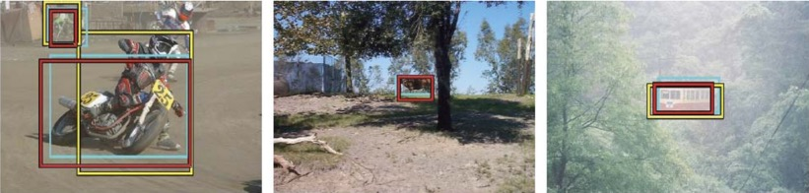
A feature integration approach
Objectness proposal generation
  A small number (e.g. 1K) of category-independent proposals
  Expected to cover all objects in an image
Measuring the objectness of image windows. PAMI 2012, Alexe, et. Al.
Notes:
Most state of the art objectness proposal generation methods typically generate a few thousand category independent proposals. There can be miss alarms which will be removed by specific classifiers later on. However, these proposal are expected to cover all objects in an image, as any missing object can’t be detected in the following process.

Slide 33
Region merging & Diversification
Region merging
  Merge two most similar regions based on region similarity.
  Update similarities between the new region and its neighbors.
Diversification
Selective Search for Object Recognition, IJCV 2013, Uijlings et. Al.
Notes:
On of the most popular object proposal methods is based on region merging using the following two steps: i) Merge two most similar regions based on region similarity; ii) Update similarities between the new region and its neighbors.
Multi-color space and segmentation could be used to improve the diversification of the proposals.

Slide 34
Local & global search
Local search
  Unsuitable for object with distinct parts
Global search
  Initialize with foreground/background seeds
  A global optimization function for each parameter set
Generating object segmentation proposals using global and local search, CVPR 2014, Rantalankila et al.
Notes:
We can consider previous local region merging approach as a local search process. It has difficulty in finding object with distinct parts. Global search strategy could be used to find complementary proposals. Such global search step contains i) Initialize with foreground/background seeds, ii) a global optimization function for each parameter set.

Slide 35

BING method
Our observation: a small interactive demo
  Take you pen and paper and draw an object which is current in your mind.
  What if we resize it to a tiny fixed size?
    E.g. 8x8. Not only changing the scale, but also aspect ratio.
BING: Binarized Normed Gradients for Objectness Estimation at 300fp, IEEE CVPR 2014 (Oral), M.M. Cheng, et. al.
Notes:
Objectness proposal would also be directly generated in forms of image window rather than region segments. In a recent work, we have proposed a simple and intuitive method for mearing the objectness of image window. To get the underlying idea, lets play a simple game.
Firstly, think of your most favorite object and imagine you take a photo of it.
Secondly, imagine what happens if you resize the object bounding box to a tiny fixed size? Notice that the resize does not only change the scale, but also aspect ratio.

Slide 36
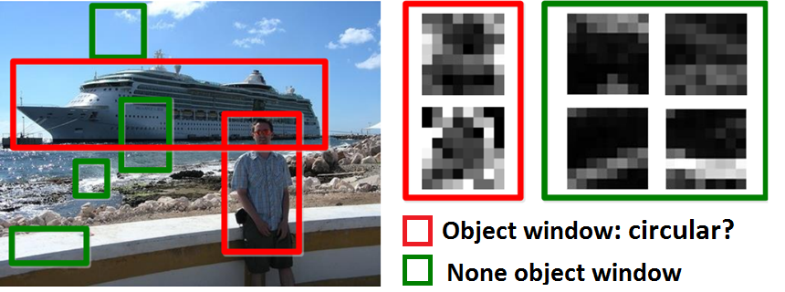
BING method
Objects are stand-alone things with well defined closed boundaries and centers.
  Finding pictures of objects in large collections of images. Springer Berlin Heidelberg, 1996, Forsyth et. al.
  Using stuff to find things. ECCV 2008, Heitz et. al.
  Measuring the objectness of image window, IEEE TPAMI 2012, Alexe et. al.
Notes:
Since objects are stand-alone things with well defined closed boundaries and center. A closed contour with an 8x8 pixel bounding box could present limited variety. As shown in this image, although the ship and the people have very different shape in the original image. Their shape in the tiny fixed 8x8 region looks very similar. Thus we proposed to use the gradient magnitude values in this region as a 64D features for measuring objectness score.

Slide 37
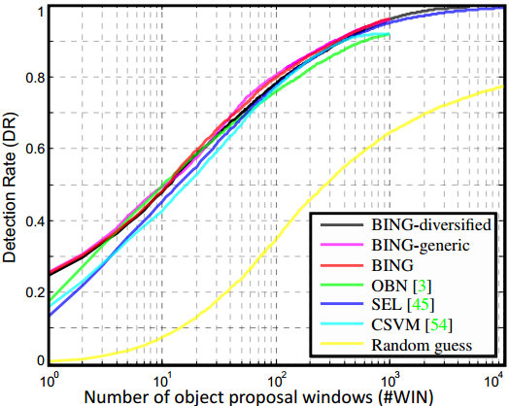
Experimental results of BING method
Notes:
Here are statistical comparisons on the challenging PASCAL 2007 dataset. This simple methods enables state of the art results, while been 1000 times faster than existing methods. When generating 1000 proposals, our method achieves 96% recall rate under PASCAL criteria of intersection over union score of 0.5.
When requiring larger intersection union scores, this method might be difficult to get good proposals as the 8x8 region lost two much shape details. E.g. the raised arm of a human body could be missed.

Slide 38
Combining boxes and regions
Improving Object Proposals with Multi-Thresholding Straddling Expansion, IEEE CVPR 2015, Chen, et. al.
Notes:
Elegant methods has also been proposed to combine the accuracy of region level proposals and the speed of bounding box proposals. In this work, initial bounding box proposals could be quickly refined by region level information.

Slide 39
Combining boxes and regions
Experimental results
Improving Object Proposals with Multi-Thresholding Straddling Expansion, IEEE CVPR 2015, Chen, et. al.
Notes:
There are rapid development in the area of object proposal generation. Although high detection rate has been achieved for state of the art object proposal methods, they still suffer from less accurate bounding boxes positions, evidenced by low intersection over union scores.

Slide 40
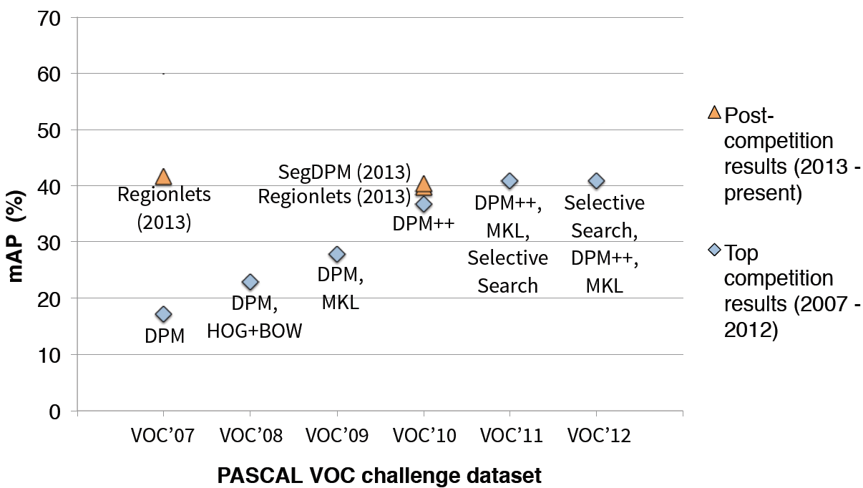
Applications
BING++
R-CNN (2014)
R-CNN (2014)
R-CNN (2014)
Rich feature hierarchies for accurate object detection and semantic segmentation, CVPR 2014 (Oral), Girshick et al.
BING++: A Fast High Quality Object Proposal Generator at 100fps, arXiv, Zhang et al.
Notes:
Here is a slides from a recent CVPR paper to summarize the progress in the task of PASCAL object detection compilation. Every year, the winner will share their experience of developing cutting edge object detection methods. Different teams will get inspired by each other, and there are consistent accuracy improvement in the first few years till sliding window + DPM based framework gets to a place to be difficult to improve. Notice that top competition results in each year are shown in blue.
The orange color, which demonstrate very impressive results, are all based on object proposals rather than sliding windows. Each of them are object proposals plus adaboost or plus deep learning. Such significant improvement in detection results suggest that object proposals are not only intuitively sound, but also practically useful.

Slide 41
Future work in objectness proposals
High detection rate under large IoU
Running speed
Small number of proposals
Exploring more applications
Notes:
Future work could be focused on improving the following aspect…..

Slide 42
Other research problems
New research topics lies in the requirements of applications

Slide 43
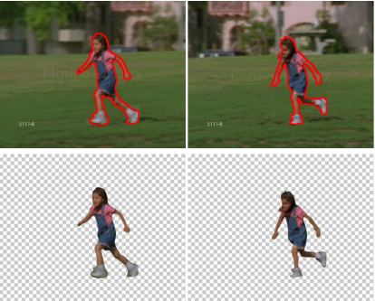
Primary object auto-segmentation
Fast Appearance Modeling for Automatic Primary Video Object Segmentation, IEEE TIP 2016, Yang et al.

Slide 44
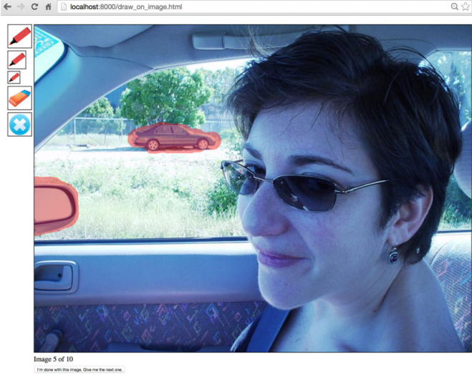
Finding Distractors
Finding Distractors In Images, IEEE CVPR 2015, Fried et al.
Notes:
Distractors are the regions of an image that
draw attention away from the main subjects and reduce the
overall image quality. Removing distractors — for example, using in-painting — can improve the composition of an image.

Slide 45
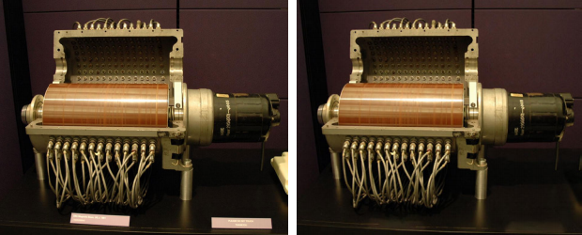
Finding Distractors
Finding Distractors In Images, IEEE CVPR 2015, Fried et al.
Notes:
Distractors are the regions of an image that
draw attention away from the main subjects and reduce the
overall image quality. Removing distractors — for example, using in-painting — can improve the composition of an image.

Slide 46
Thanks!
Tutorial webpage:
http://saliency.mit.edu/ECCVTutorial/ECCV_saliency.htm

