Slide 1
Readership
Critical Analysis
Precision
Conciseness
Logical Writing
Balance
Completeness
Improving Writing Quality–Style
Readership, critical analysis, precision, etc.
Ming-Ming Cheng
College of Computer Science
2022/05/18
Style

Slide 2
Table of Contents
Readership Critical Analysis Precision Conciseness Logical Writing Balance Completeness
Readership
Critical Analysis
Precision
Conciseness
Logical Writing
Balance
Completeness
Style

Slide 3

Readership
Critical Analysis
Precision
Conciseness
Logical Writing
Balance
Completeness
Fig.: Sections 4.1-4.7.
Style

Slide 4
Improving writing quality–style
Readership Critical Analysis Precision Conciseness Logical Writing Balance Completeness
Good writing displays several characteristics: Take into account who the readers are. Contain critical analysis.
Should be precise, concise, logical, balanced and complete.
Don’t underestimate the professionalism of reviewers.
Style

Slide 5
Readership: who & what
Readership Critical Analysis Precision Conciseness Logical Writing Balance Completeness
Before starting writing, consider who the intended readers are, and what they know.
They are experts in one field, but you have to explain to them the knowledge of another field.
They are not professionals, you need to give them professional knowledge. They are familiar with your field, how to write properly.
Style

Slide 6
Readership: examples of who & what
Readership Critical Analysis Precision Conciseness Logical Writing Balance Completeness
Example 1
If you are writing a paper on computational relativity for an astrophysics journal, you can assume that your readers are familiar with physics, but may be less familiar with advanced computing techniques.
Example 2
If writing such a paper for a scientific computing journal, the readers may be more familiar with computer science, but less so with relativity.
Style

Slide 7
Readership: examples of who & what
Readership Critical Analysis Precision Conciseness Logical Writing Balance Completeness
Example 3
If you are writing an undergraduate textbook, the readers will know a lot less than if you are writing a research monograph.
Example 4
If you want to use PID method in your paper, but PID is a classical scheme in engineering. At this time, you do not need to explain its principles in details, which will make the reviewers think you paper is worthless.
Style

Slide 8
Readership: tips
Readership Critical Analysis Precision Conciseness Logical Writing Balance Completeness
Start by assessing what the readers are likely to know about the subject area.
Do not assume that the readers shares your knowledge of the background to the problem (e.g. , applications, current state-of-the-art).
The reader may not share your understanding of the problem itself (they may not even know anything).
Style

Slide 9
Readership: examples of tips
Readership Critical Analysis Precision Conciseness Logical Writing Balance Completeness
Example 1
The ‘well-know radiation transport problem’ may not be well-known at all if your readers are biologists and not physicists.
Example 2
If you use special physical equations in the field of control, you need to explain their principles. Because your readers in the control field are not necessarily familiar with these.
Style

Slide 10
Readership: consider the readers’ familarity
Readership Critical Analysis Precision Conciseness Logical Writing Balance Completeness
Consider the extent to which readers are likely to be familiar with the approach you take in your paper.
Are similar approaches common for problems of this kind? Or do you have a new approach?
Have you taken an approach which is well-known in some other area, but
not to the current readership?
Make sure your paper is innovative. Plagiarism is strictly prohibited!
Style

Slide 11
Readership: your gain
Readership Critical Analysis Precision Conciseness Logical Writing Balance Completeness
Establishing what readers are likely to be familiar with should give you clear guidance:
What to assume. What to explain.
How much explanation is needed.
Things that may be obvious to you may not be obvious to the reader.
Style

Slide 12
Critical Analysis
Readership Critical Analysis Precision Conciseness Logical Writing Balance Completeness
When writing your paper, your aim should be to provide the reader with insight
and understanding.
The most significant difference between good papers and weak papers is
critical analysis.
The difference can run right through the paper.
Do not just state what has been done previously, but compare their approach to your own work and that of others.
Discuss the strong and weak points of other authors’ work.
Style

Slide 13
Critical Analysis: an example
Readership Critical Analysis Precision Conciseness Logical Writing Balance Completeness
Smith’s text detector [3] is fast, but only works for Roman characters. Li’s text detector [4] is more general and can also handle Chinese text, but is much slower. Our novel approach is almost as fast as Smith’s method, can handle Chinese text like Li’s method, and can also handle a wide range of special mathematical symbols.
Style

Slide 14

Critical Analysis: describe your work
Readership Critical Analysis Precision Conciseness Logical Writing Balance Completeness
Do not just say what you did, but start by saying what the aims are and why. Say what alternatives you considered.
Say why you chose the alternatives you did–you should justify your approach.
Style

Slide 15
Critical Analysis: an example
Readership Critical Analysis Precision Conciseness Logical Writing Balance Completeness
The first step of our text detector looks for strokes which make up a character. Although a general approach would try to find arbitrary polynomial curves, this would both be slow, and unreliable due to ambiguity of shape. Instead, we simply look for straight lines and circular arcs. For recognition purposes, these are adequate to distinguish one character from another in most cases. The remaining cases are handled by a separate procedure described later.
Style

Slide 16
Critical Analysis: an example
Readership Critical Analysis Precision Conciseness Logical Writing Balance Completeness
Remember that stating something, and explaining it, are quite different. As well as giving the approach, you should explain the reasoning behind it.
The shapes seen in the two images are identical. Therefore at most one point in image A can correspond to one point in image B. We thus find a key point in image A by ..., and then find the corresponding point in image B by....
Style

Slide 17
Critical Analysis: compare in results
Readership Critical Analysis Precision Conciseness Logical Writing Balance Completeness
Do not just state the results obtained by your method, but compare them to the results of other methods.
If the results are better, explain why
The novel use of gold in our mechanism allows it to be heavier than one made of plastic, increasing frictional forces.
If the results are unexpectedly inferior, explain why
Unfortunately, dilithium failed to catalyse the reaction as expected. Although initial exper- iments were promising, alternative sources of dilithium failed to give such good results. Ultimately it was established that an im-purity within the original dilithium was responsible for the catalysis, not the dilithium itself.
Style

Slide 18
Critical Analysis: compare in results
Readership Critical Analysis Precision Conciseness Logical Writing Balance Completeness
Carefully justify why you carried out the test in the way you did.
To ensure that our system would be suitable for both law enforcement and sports broad- cast tasks, we tested our system on cars moving at speeds between 20 and 200 miles per hour.
Discuss what could be done to improve your results.
While our speed measurement system works well for most video, it can fail for grey cars which have too similar a colour to the road. An improved gradient detector could be a more sensitive way to determine the car’s location in such cases.
Style

Slide 19
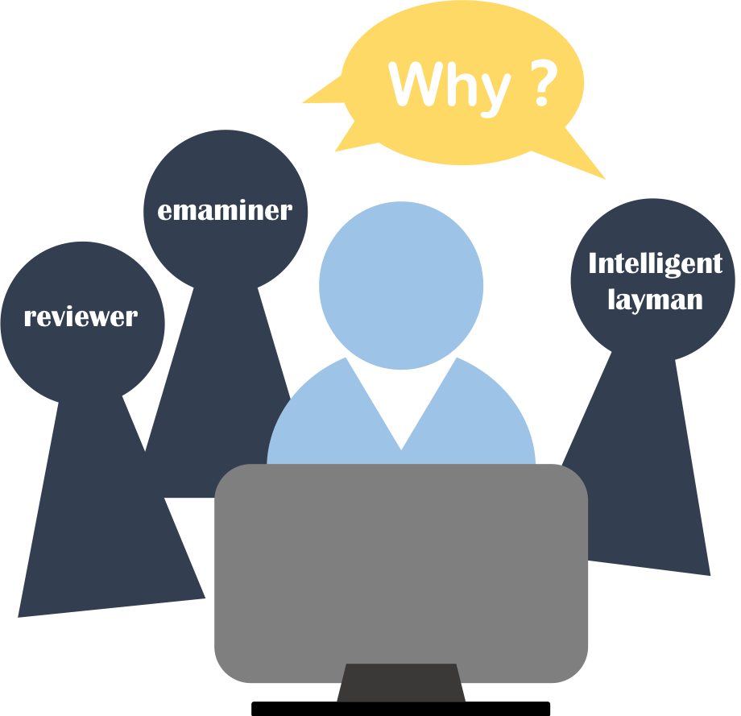
Critical Analysis: tips
Readership Critical Analysis Precision Conciseness Logical Writing Balance Completeness
Try to imagine a reviewer, or an examiner, or perhaps an intelligent layman, sitting next to you as write, who keeps asking you ‘why’?
Style

Slide 20
Precision: be careful
Readership Critical Analysis Precision Conciseness Logical Writing Balance Completeness
Precision means making careful use of language. Make sure that what you write is what you really mean. Avoid ambiguous or vague statements.
For example, do not use ‘etc.’ unless the items referred to are obvious to the reader.
It is acceptable to write
The days of the week are Monday, Tuesday, etc.
It is not acceptable to write
We have tested our algorithm for speed, robustness, etc.
Do not write like this↗
Ming-Ming Cheng Nankai University
Style
2022/05/18
20 / 46

Slide 21
Precision: be careful
Readership Critical Analysis Precision Conciseness Logical Writing Balance Completeness
Being precise also means not omitting anything significant.
Definitions of concepts specific to your paper.
Units when giving a measurement.
Be careful not to state conjectures as facts.
Precise writing should advoid phrases like
It is obvious that...
which often means ‘I cannot be bothered to explain why...’ or worse ‘I do not know how to convince you that...’.
Statements should be based on evidence, not opinion or belief.
Style

Slide 22
Precision: avoid vague phrases
Readership Critical Analysis Precision Conciseness Logical Writing Balance Completeness
‘Possibly’ or ‘maybe’ is often an indication that something has not been thought through properly,
or is lacking in justification,
or has not been adequately tested.
Do not write like this↓
Examples
We use Ding’s algorithm as it is possibly faster than Dong’s algorithm. This segmentation procedure normally works.
Style

Slide 23
Precision: quantitative description
Readership Critical Analysis Precision Conciseness Logical Writing Balance Completeness
Statements and ideas should be presented quantitatively, not just qualitatively, to add to precision.
An example
For images of size 1024×1024, our C++ implementation of Ding’s algorithm, on a 4GHz PC with an AX23 processor (running Linux), is 2.7 times faster than Dong’s algorithm.
Make full and clear notes (on any papers, decisions, alternatives...).
Document any computer programs that you write.
Collect information as you go along, and recording it carefully.
Style

Slide 24
Precision: you should know
Readership Critical Analysis Precision Conciseness Logical Writing Balance Completeness
It is your responsibility to make sure you are understood.
If reviewers misunderstand you, your paper may be rejected even if the underlying work is good.
If readers of your paper misunderstand you, they may misjudge you when summarising your work in their papers, or build faulty solutions to real world problems.
Make sure you do not misrepresent the work of others.
Make sure you read their work carefully, and understand it clearly before describing or summarising it.
You are directly responsible for your paper.
Style

Slide 25
Conciseness: enough, not redundant
Readership Critical Analysis Precision Conciseness Logical Writing Balance Completeness
Conciseness means using just enough words to get the information across, while not leaving anything out.
Do not write like this↓
For example, the text
Let us look at Figure 1. From the figure, it can be seen that...
could much more briefly be written
Figure 1 shows that...
Style

Slide 26
Conciseness: enough, not redundant
Readership Critical Analysis Precision Conciseness Logical Writing Balance Completeness
Avoid using long, rambling paragraphs or sentences, the key points can become hard to follow in amongst all the extra words.
One of the main causes of overlong sentences is a lack of clear thinking–the re- sulting vagueness is often embodied in extra words like ‘essentially’, ‘probably’ and ‘generally’.
Do not write like this↓
For example,
Essentially, the optimisation process...
could more briefly be written
Essentially,The optimisation process...
Style

Slide 27
Conciseness: enough, not redundant
Readership Critical Analysis Precision Conciseness Logical Writing Balance Completeness
Try to get clear in your mind what you want to say and need to say before starting to write.
Other redundant words which can be omitted are those which add no new information.
For example,
large size⇒large, as large refers to size.
Conciseness also means not explaining concepts which are already familiar to the intended readership.
For example,
no need to explain the definition of Lagrange’s method in detail, just mention it briefly: By using Lagrange’s method, it can be derived as...
Style
27 / 46

Slide 28
Conciseness: enough, not redundant
Readership Critical Analysis Precision Conciseness Logical Writing Balance Completeness
When you do need to explain something, make sure you really do give an
explanation.
State something at greater length is not an explanation. Do not repeat an idea in different words.
Both make the paper longer but not clearer.
Do not write like this↓
The image should be large. In other words, it should be at least 1024×768 pixels.
should be replaced by
The image should be at least 1024×768 pixels in order that any text within it is clearly readable.
Style

Slide 29
Conciseness: enough, not redundant
Readership Critical Analysis Precision Conciseness Logical Writing Balance Completeness
Avoid prose where a shorter way of conveying information is more suitable. Use a bullet-pointed list, which makes the distinct ideas clear at a glance.
Three groups of experiments are implemented by considering the following conditions:
Case 1: Nonzero initial conditions. The initial values of the two TORAs are
x₁(0) = −0.14m, x₂(0) = −0.03m, θ₁(0) = −30deg, θ₂(0) = 45deg.
Case 2: External disturbances to the translational displacement of each cart. As shown in Fig. 4, three waves of external disturbances are added to x₁(t ) and x₂(t ) at about 1.5s, 3.1s, and 5.2s.
Case 3: External disurbances to the rotational angle of each rotor. As shown in Fig. 5, four waves of the external · · ·
Style

Slide 30
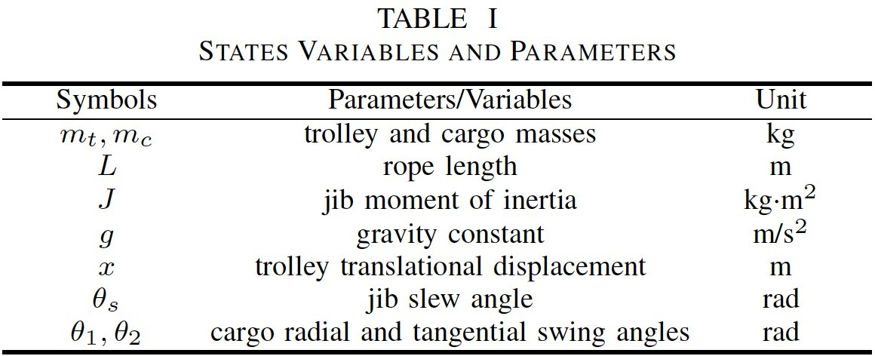
Conciseness: enough, not redundant
Readership Critical Analysis Precision Conciseness Logical Writing Balance Completeness
A table (or graph) can often be the shortest and best way of presenting numerical results, with additional explanation in the text.
Similarly, a pseudocode listing can be the best way to present an algorithm.
Fig.: Use a table to describe system parameters.
Style

Slide 31
Conciseness: no more complicated
Readership Critical Analysis Precision Conciseness Logical Writing Balance Completeness
Conciseness may also be interpreted at a higher level.
Make things no more complicated than they need to be.
Avoid present what are actually quite simple ideas in complicated-looking mathematical notation.
Avoid using long words, prefer simpler and shorter words.
Do not write like this↓
Carry out the necessary modifications to the settings to achieve the greatest pos- sible intensity.
can be written much more simply as
Change the settings to give maximum brightness.
Style

Slide 32
Conciseness: jargon
Readership Critical Analysis Precision Conciseness Logical Writing Balance Completeness
Some papers use jargon to make simple ideas sound more academic. Jargon should only be used if everyday language
would require a much longer phrase in its place, or could be misleading or ambiguous.
Example 1–codec
A ‘codec’ is a device or computer program capable of encoding or decoding a data stream or signal. There is no good everyday word for this concept, and a phrase would clearly be longer.
Style

Slide 33
Conciseness: jargon
Readership Critical Analysis Precision Conciseness Logical Writing Balance Completeness
Some papers use jargon to make simple ideas sound more academic. Jargon should only be used if everyday language
would require a much longer phrase in its place, or could be misleading or ambiguous.
Example 2–adaxial
Leaves on some plants are highly curved, and the phrase ‘upper surface’ may lead to confusion: the same surface may be uppermost at the base of the leaf, but facing downwards at the tip of the leaf. Referring to the ‘adaxial’ surface is unambiguous.
Style

Slide 34
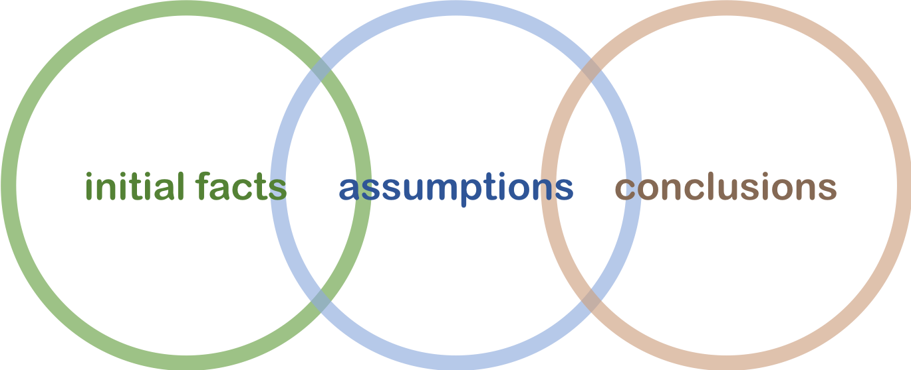
Logical Writing: step by step
Readership Critical Analysis Precision Conciseness Logical Writing Balance Completeness
Being logical means that any arguments you give follow a sound chain of rea- soning step by step from the initial facts and assumptions through to the conclusions
~~~~~~~~~~~ ~~~~~~~~~~~~~ ~~~~~~~~~~~~
It should be clear how each idea is derived from the previous one.
Reasons and justifications should be given for you assertions.
Style

Slide 35
Logical Writing: present in an order
Readership Critical Analysis Precision Conciseness Logical Writing Balance Completeness
Logical writing also means presenting the material in an order which the reader will find easy to understand.
If you are describing a series of events or steps of a procedure, please describe them in their correct time sequence.
Compare
The anode should be lowered into (step 2) the electrolyte, but before this is done, the anode must be carefully cleaned (step 1).
with
First, carefully clean (step 1) the anode, then lower it into (step 2) the electrolyte.
Style

Slide 36
Logical Writing: tips
Readership Critical Analysis Precision Conciseness Logical Writing Balance Completeness
If instructions are in the wrong order, the reader may fail to follow them correctly, with undesirable consequences.
If explanations are in the wrong order, it is harder to follow the argument. Concepts should be defined before they are used.
An example: The image is first segmented to give a TextNet. A TextNet is a graph whose nodes...and edges...This TextNet is used to...
Ideas should build upon each other.
Forward references should be avoided, except for things briefly explained in an introduction or overview.
Style

Slide 37
Balance: allocate space
Readership Critical Analysis Precision Conciseness Logical Writing Balance Completeness
Another important aspect of writing is balance.
Allocate an amount of space in your paper according to the importance of the topic.
For example
The related work section is important, but your own ideas are even more impor- tant. It follows that the related work should only be a small part, say 10%–15% of the paper.
If you approach has two main steps of equal importance and difficulty of concept, roughly equal space should be given to them.
Style

Slide 38
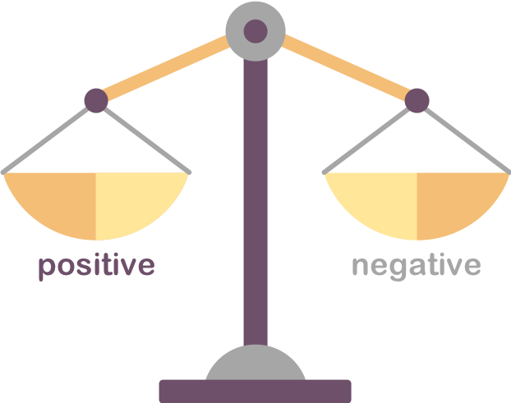
Balance: allocate space
Readership Critical Analysis Precision Conciseness Logical Writing Balance Completeness
Balance also has another meaning–showing both sides of an argument.
Discuss negative aspects as well as the positive.
Style

Slide 39
Balance: Example 1
Readership Critical Analysis Precision Conciseness Logical Writing Balance Completeness
Discuss negative aspects as well as the positive aspects.
The benefits of initially sorting the data are that queries can be answered in just a few seconds, rather than minutes. The disadvantage is that the system is unavailable for several hours while sorting takes place.
Style

Slide 40
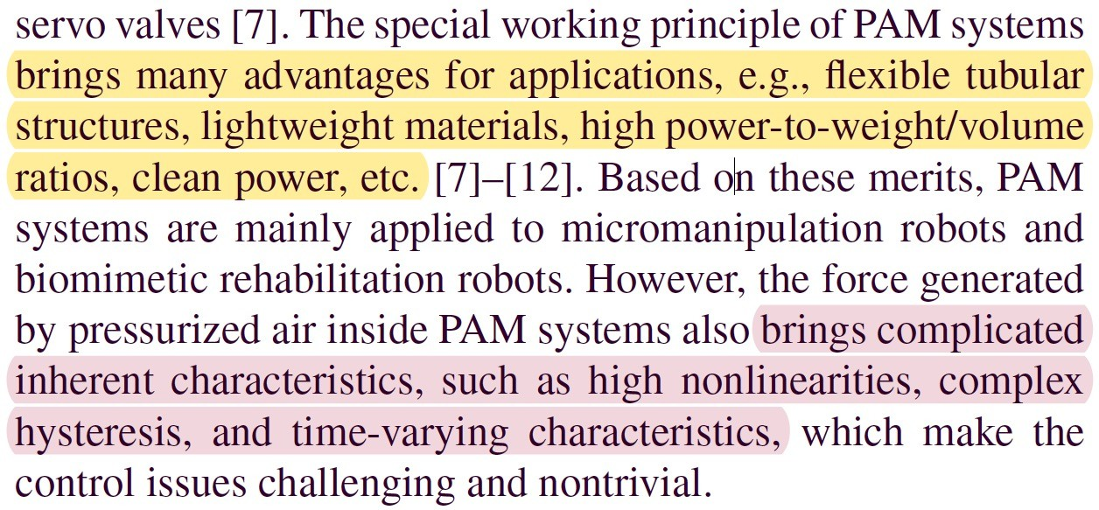
Balance: Example 2
Readership Critical Analysis Precision Conciseness Logical Writing Balance Completeness
Style

Slide 41
Completeness: in sufficient detail
Readership Critical Analysis Precision Conciseness Logical Writing Balance Completeness
Make sure that all steps are described and explained in sufficient detail that others can reproduce your work.
If a step is your novel contribution, then clearly you must explain it in detail.
If an idea is a standard approach in your community, you should at least give a reference to aid readers who are not experts in your field.
If using another author’s work, again give a reference, and briefly sum- marise the idea.
Style

Slide 42
Completeness: Example 1
Readership Critical Analysis Precision Conciseness Logical Writing Balance Completeness
Give a reference
We use Li’s method [27] for finding side views of cars in images. It works by first finding circles which are assumed to be the wheels, then checking if there are windows in appropriate locations.
Style

Slide 43
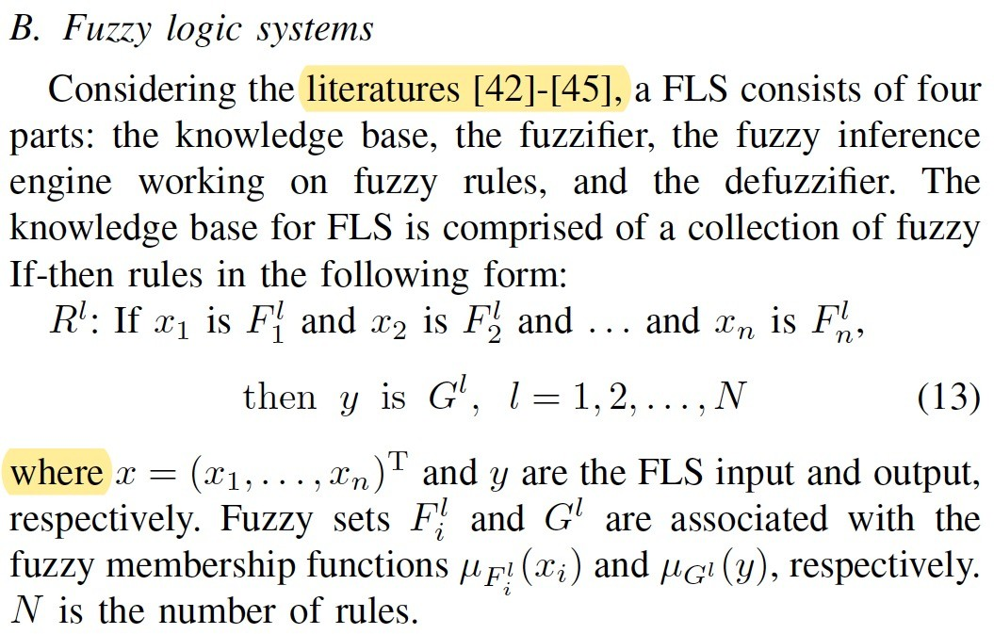
Completeness: Example 2
Readership Critical Analysis Precision Conciseness Logical Writing Balance Completeness
Fig.: Provide references and explain briefly before using the fuzzy method. (Adaptive Fuzzy Output Feedback Control of MIMO Nonlinear Systems with Unknown Dead-Zone Inputs, IEEE TFS, 2012)
Style

Slide 44
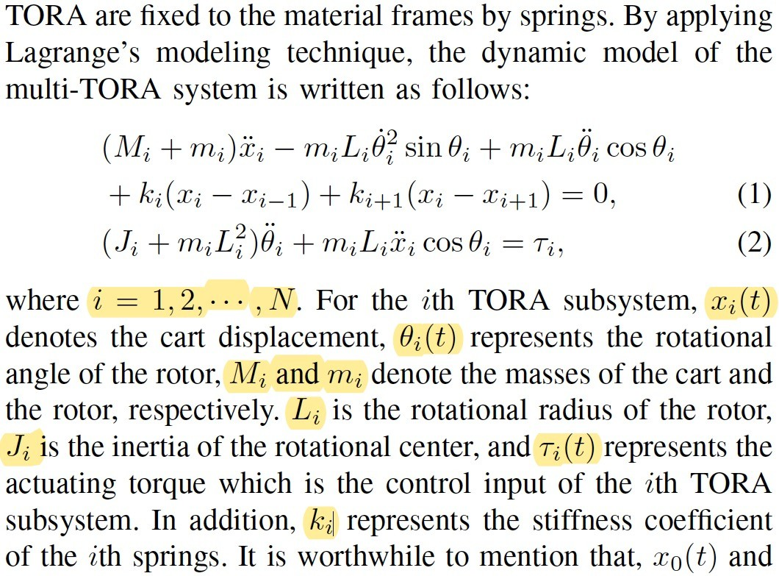
Readership Critical Analysis Precision Conciseness Logical Writing Balance Completeness
Completeness: every symbol is fully defined
Make sure that every mathematical symbol used in the paper is fully defined
and explained.
Style

Slide 45
Completeness: tips
Readership Critical Analysis Precision Conciseness Logical Writing Balance Completeness
Never ignore the completeness of the paper, otherwise it will leave a bad im- pression on the reviewers. If some obvious requirement is ignored, the readers cannot follow the author’s meaning.
Make sure that you explicitly state all of your assumptions.
If you paper concerns a procedure, carefully describe all inputs and outputs.
State typical values used for parameters.
Carefulness and rigor are the keys to success.
Style

Slide 46
Readership
Critical Analysis
Precision
Conciseness
Logical Writing
Balance
Completeness
Q & A?
Style

