Slide 1
Towards Weakly Supervised Image Understanding (WSIU)
Speaker: Ming-Ming Cheng
Nankai University
http://mmcheng.net/
Notes:
Title: Weakly Supervised Image Understanding
Abstract: Semantic segmentation of nature images is a fundamental problem in computer vision. While significant research progresses have been made in the last few years, the success of most existing method highly rely on large scale accurate pixel accurate annotations. However, humans effortlessly learn robust and accurate visual cognitive modes without the requirement of huge amount of pixel accurate semantic annotation. During childhood, we learn to robustly recognize and precisely locate the object regions with limited supervision from parents and other sources. Inspired by this process, our research focus on human cognitive inspired weakly supervised image understanding, by utilizing visual attention, category independent edge detection, region clustering etc., we observed consistent performance boost in weakly supervised image upstanding.
理解图像中的语义信息是计算机视觉的基础问题。虽然近年来相关研究取得迅猛发展，但是现有最优方案太过依赖于海量高质量的图像标注。与此相对，人类可以毫不费劲的通过简单的指导信息学习精确的语义标注。受这个现象启发，报告人将介绍一系列基于底层图像处理技术的弱监督图像场景分类。

Slide 2

Understanding Visual Information
Image by kirkh.deviantart.com

Slide 3
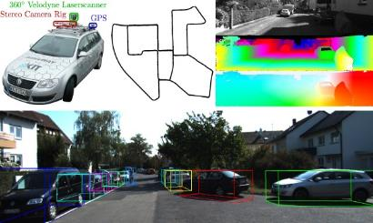

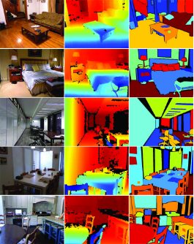



Dataset Annotation

Slide 4
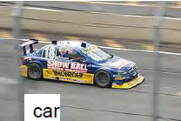

Dataset Annotation
PASCAL 11:
  10? workers
  27.374 bounding boxes
ImageNet:
  25.000 workers
  11.231.732 images labeled with one word
My mother:
  213.841 segmented objects
  Job offer: I am looking for more parents
CVML 2012, Antonio Torralba

Slide 5
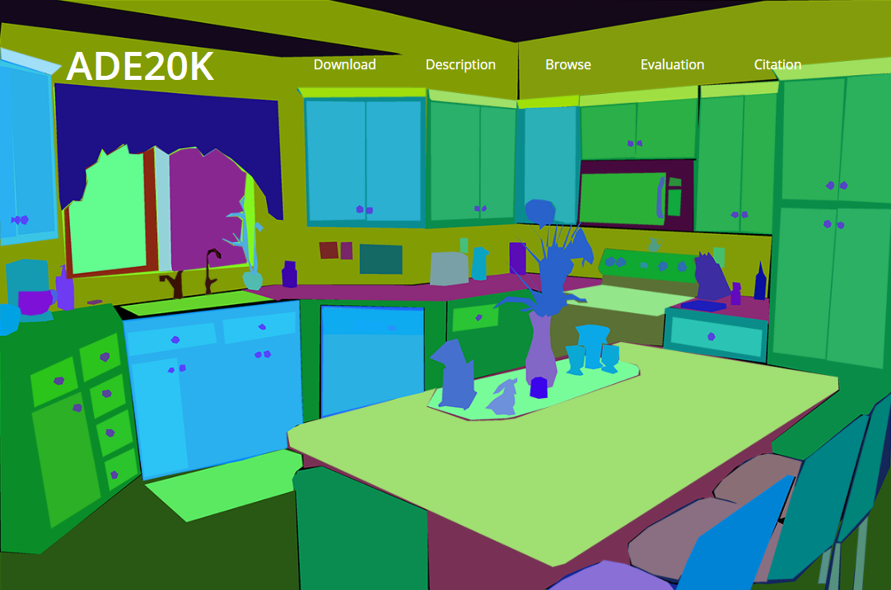
Dataset Annotation

Slide 6
Towards WSIU
Graphics/vision applications
Editing
Synthesis
Web images
Light weighted semantic parsing
Semantic segmentation
Interaction
Low level vision
Attention
Boundary
Segmentation
Notes:
r

Slide 7
Visual attention: motivation
Notes:
Generic object detection has made great progress in recent years. However, most state-of-the-art method still requires each category specific classifiers to evaluate many image windows in a sliding window fashion.

Slide 8
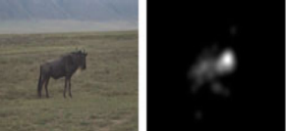

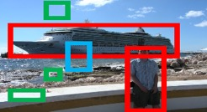

Visual attention
fixation prediction
Salient object detection
Objectness proposals
Deeply supervised salient object detection with short connections, IEEE CVPR 2017.
Salient Object Detection: A Discriminative Regional Feature Integration Approach, IJCV 2017.
Salient Object Detection: A Benchmark, IEEE TIP 2015.
Global Contrast based Salient Region Detection, IEEE TPAMI 2015.
BING: Binarized Normed Gradients for Objectness Estimation at 300fps, IEEE CVPR 2014.

Slide 9

Global Contrast based Salient Region Detection, IEEE TPAMI, 2015, MM Cheng, et. al. (2nd most cited paper in CVPR 2011)

Slide 10

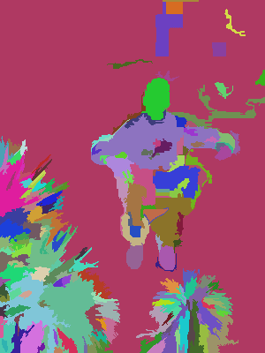
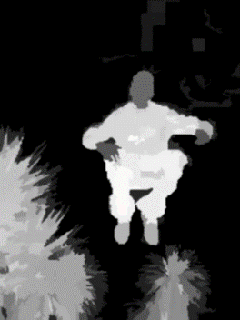
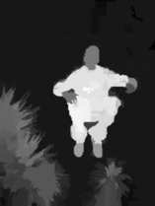
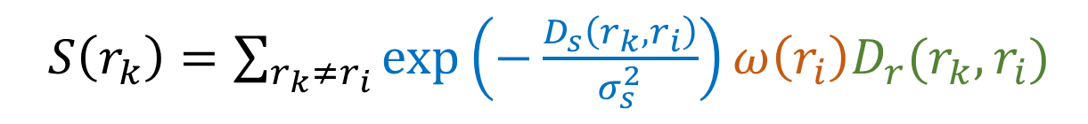
Core idea: region contrast (RC)
  Image Segmentation $σ_{s}^{2}→∞$ $σ_{s}^{2}→0.4$
  Spatial weighting
  Region size
  $S\left(r_{k}\right)=\sum_{r_{k}≠r_{i}}{\exp\left(−\frac{D_{s}\left(r_{k},r_{i}\right)}{σ_{s}^{2}}\right)}ω\left(r_{i}\right)D_{r}(r_{k},r_{i})$
  Region contrast by sparse histogram comparison.

Slide 11
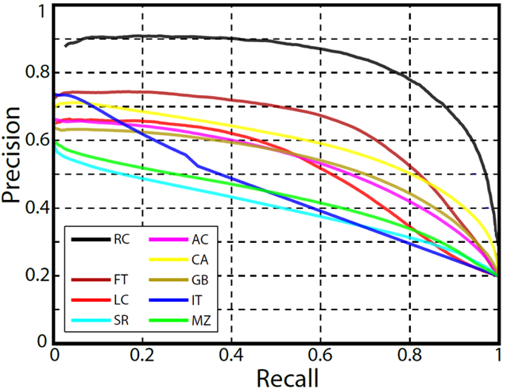
Experimental results
Dataset: MSRA1000 [Achanta09]
  Precision vs. recall

Slide 12
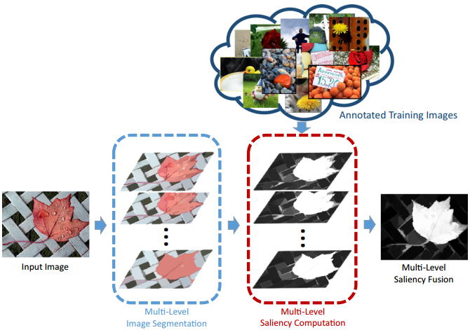
Supervised feature integration
Salient Object Detection: A Discriminative Regional Feature Integration Approach, IJCV 2017.
Salient Object Detection: A Benchmark, IEEE TIP 2015.

Slide 13
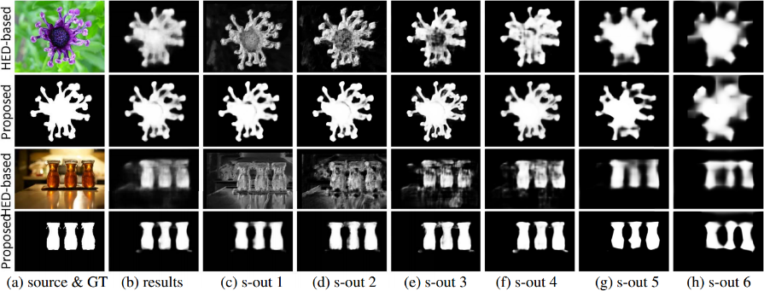
Going with deep models
Deeply supervised salient object detection with short connections, IEEE CVPR 2017.

Slide 14
Bridging between multi-levels

Slide 15
Bridging between multi-levels

Slide 16
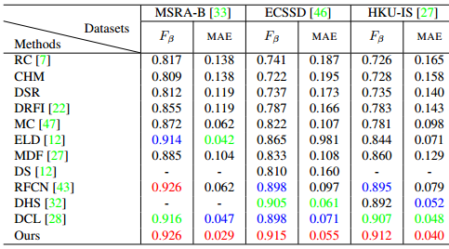
Messages from numbers

Slide 17

Sample Applications

Slide 18
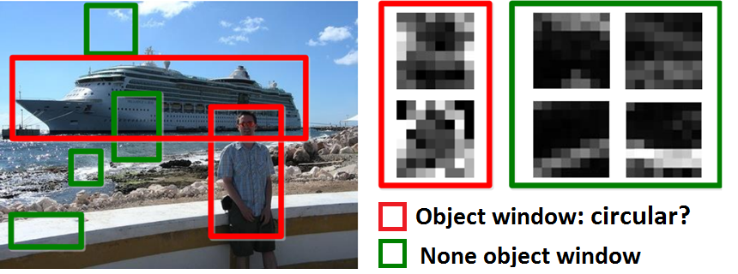
Methodology: observation
Objects are stand-alone things with well defined closed boundaries and centers.
Little variations could present in such abstracted view.
  Finding pictures of objects in large collections of images. Springer Berlin Heidelberg, 1996, Forsyth et. al.
  Using stuff to find things. ECCV 2008, Heitz et. al.
  Measuring the objectness of image window, IEEE TPAMI 2012, Alexe et. al.

Slide 19
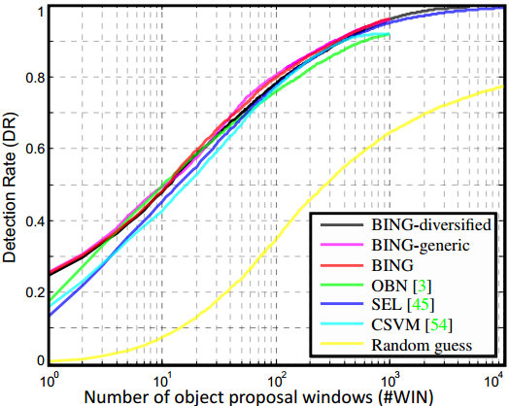
Experimental results
Proposal quality on PASCAL VOC 2007

Slide 20
Experimental results
Computational time
  A laptop with an Intel i7-3940XM CPU
  20 seconds for training on the PASCAL 2007 training set!!
  Testing time 300fps on VOC 2007 images
Method | [1] | OBN [2] | CSVM [3] | SEL [4] | Our BING
Time (seconds) | 89.2 | 3.14 | 1.32 | 11.2 | 0.003
Category-Independent Object Proposals With Diverse Ranking, PAMI 2014, Endres et. al.
Measuring the objectness of image windows. PAMI 2012, Alexe, et. al.
Proposal Generation for Object Detection using Cascaded Ranking SVMs. CVPR 2011, Zhang et. al.
Selective Search for Object Recognition, IJCV 2013, Uijlings et. al.

Slide 21
Towards WSIU
Graphics/vision applications
Editing
Synthesis
Web images
Light weighted semantic parsing
Semantic segmentation
Interaction
Low level vision
Attention
Boundary
Segmentation

Slide 22
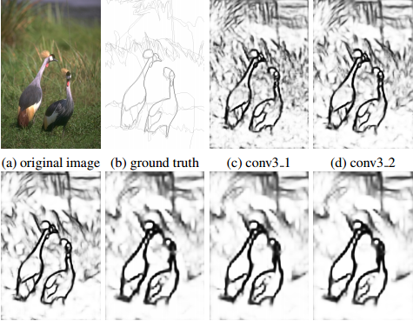
Boundary
Richer Convolutional Features for Edge Detection, IEEE CVPR 2017.

Slide 23
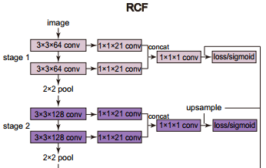
Notes:
Traditional deep learning architecture only use the final conv-layer in each stage, which is defined by all conv-layers between two pooling layers. The proposed RCF architecture extends HED to use instead ALL the layers in each stage.

Slide 24
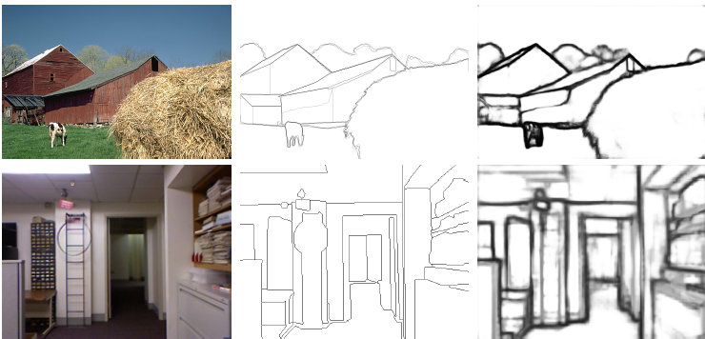
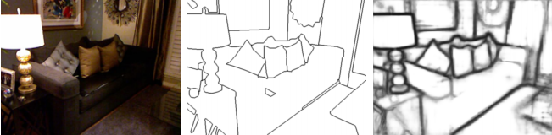
Samples
image
G-Truth
results
Notes:
Some examples of RCF. From top to bottom: BSDS500, NYUD, Multicue-Boundary, and Multicue-Edge. From left to right: origin image, ground truth, RCF edge map, origin image, ground truth, and RCF edge map.

Slide 25
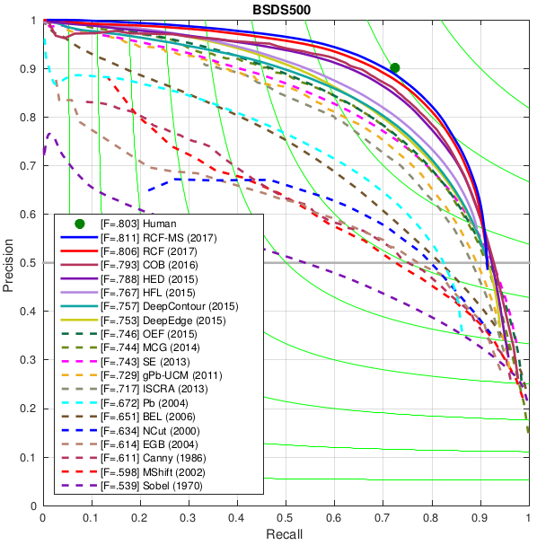
50+ years of boundary detection
Since
Rebert (1965)

Slide 26
Towards WSIU
Graphics/vision applications
Editing
Synthesis
Web images
Light weighted semantic parsing
Semantic segmentation
Interaction
Low level vision
Attention
Boundary
Segmentation

Slide 27
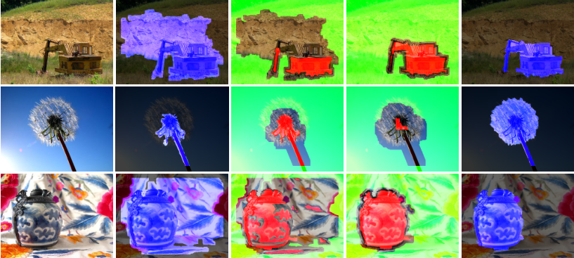
SaliencyCut
  Iterative refine: iteratively run GrabCut to refine segmentation
  Adaptive fitting: adaptively fit with newly segmented salient region
  Enables automatic initialization provided by salient object detection.
Global Contrast based Salient Region Detection, IEEE TPAMI 2015.

Slide 28
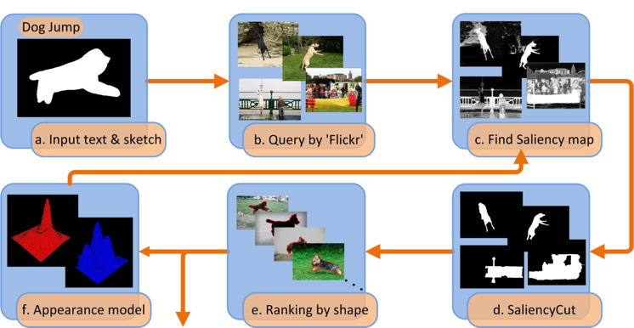
Salient shape
Is salient object detection for ‘simple’ images useful?
SalientShape: Group Saliency in Image Collections, TVC 2016.

Slide 29
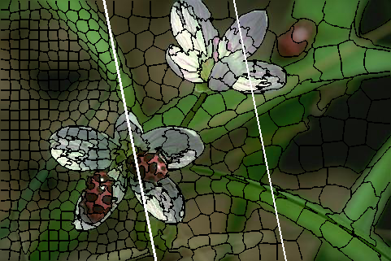
Over Segmentation
FLIC: Fast Linear Iterative Clustering with Active Search, AAAI 2018.

Slide 30
Over Segmentation

Slide 31
Over Segmentation
Traversal Order
Joint assignment and update

Slide 32
Results

Slide 33
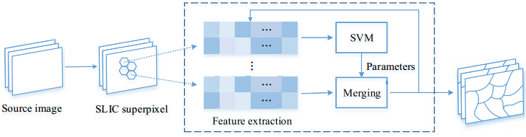
Segmentation
HFS: Hierarchical Feature Selection for Efficient Image Segmentation, ECCV 2016.

Slide 34
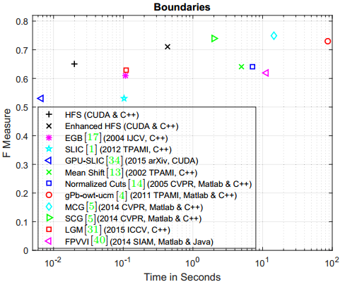
Segmentation
HFS: Hierarchical Feature Selection for Efficient Image Segmentation, ECCV 2016.

Slide 35
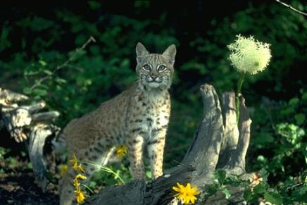

Some unpublished results

Slide 36
Towards WSIU
Graphics/vision applications
Editing
Synthesis
Web images
Light weighted semantic parsing
Semantic segmentation
Interaction
Low level vision
Attention
Boundary
Segmentation

Slide 37
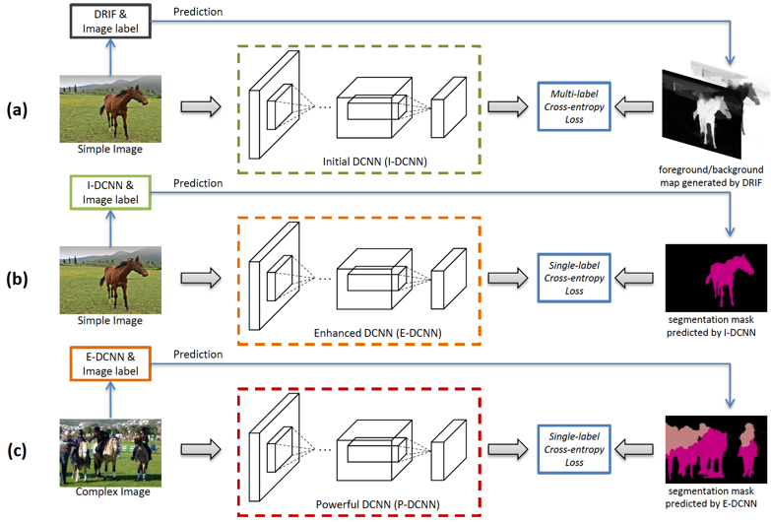
STC
10% improvement over state of the art!
STC: A Simple to Complex Framework for Weakly-supervised Semantic Segmentation, IEEE TPAMI 2017.
Notes:
10.6% improvement over “P. O. Pinheiro and R. Collobert, “From image-level to pixellevel
labeling with convolutional networks,” IEEE CVPR, 2015.”

Slide 38
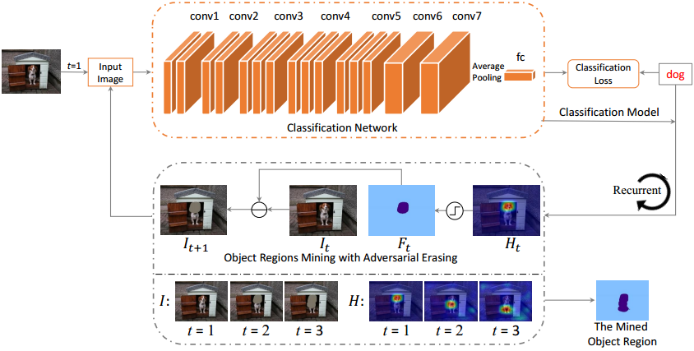
Interaction
Object Region Mining with Adversarial Erasing: A Simple Classification to Semantic Segmentation Approach, IEEE CVPR (oral) 2017.

Slide 39
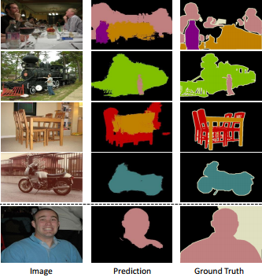
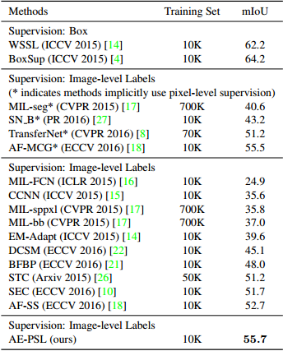
Results

Slide 40
Interaction
Bottom-Up Top-Down Cues for Weakly-Supervised Semantic Segmentation, EMMCVPR 2017.

Slide 41
Results

Slide 42
Towards WSIU
Graphics/vision applications
Editing
Synthesis
Web images
Light weighted semantic parsing
Semantic segmentation
Interaction
Low level vision
Attention
Boundary
Segmentation

Slide 43
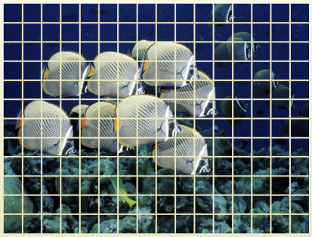
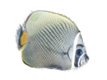







Motivation
…
Objects
Scene
Layering
…
Pixels/patches
Notes:
Most existing methods work on image at pixel or patch level. Pixels are the natural for computers.
However, we humans think in terms of objects. So allowing such object level interaction is more intuitive.

Slide 44
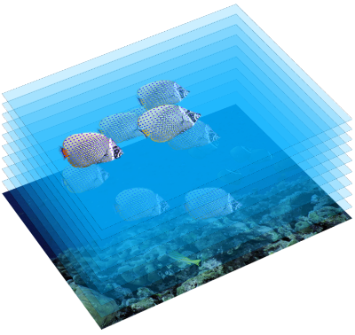
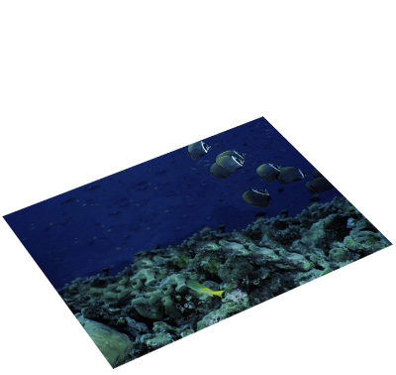
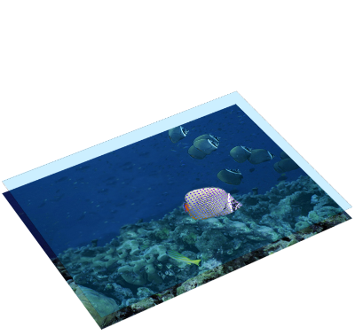
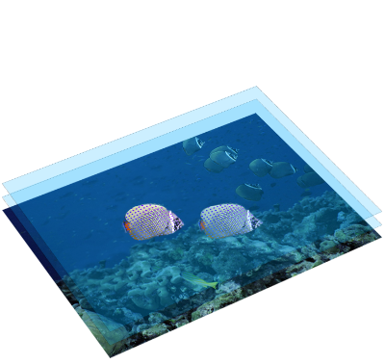
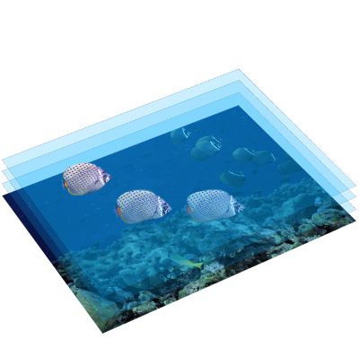
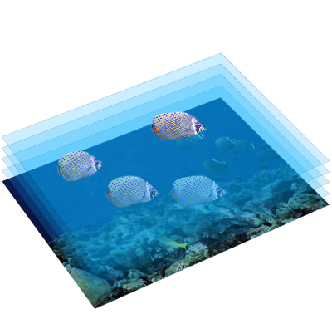
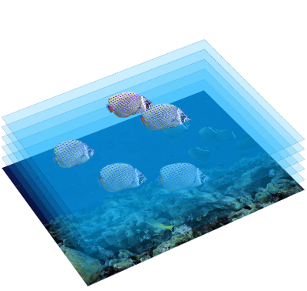
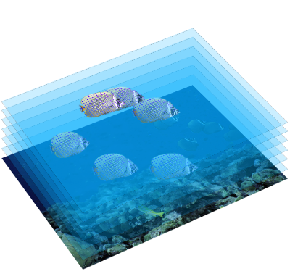
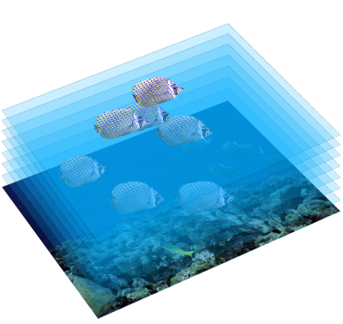
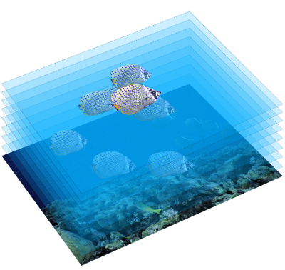

Motivation
Rough depth ordering is possible for a single image with repeated elements
RepFinder: Finding Approximately Repeated Scene Elements for Image Editing, ACM TOG 2010.
Notes:
As we show in this work, ->in such scenes with repeated elements we can infer such rough depth information.

Slide 45

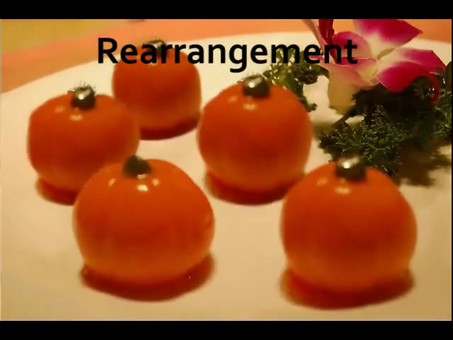
Image rearrangement
Source image
Notes:
In this example, we change relative position of these persimmons to make them in a line. In order to have correct perspective relations. We further change their layering order.

Slide 46
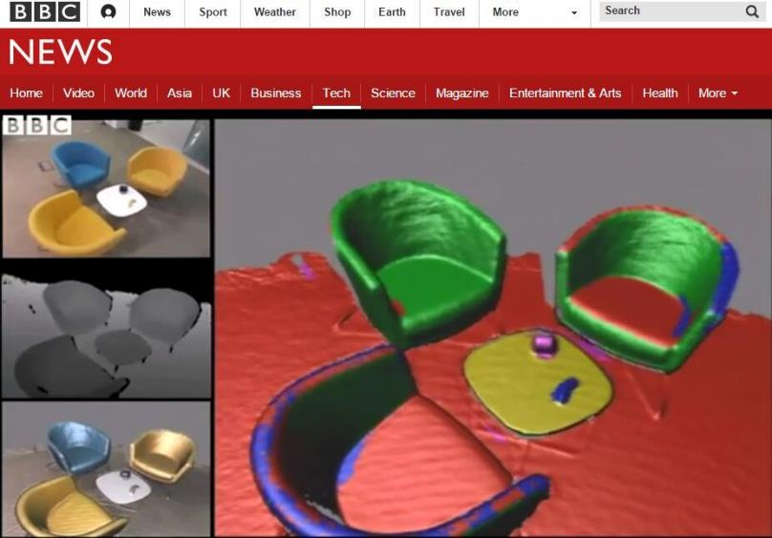

Slide 47
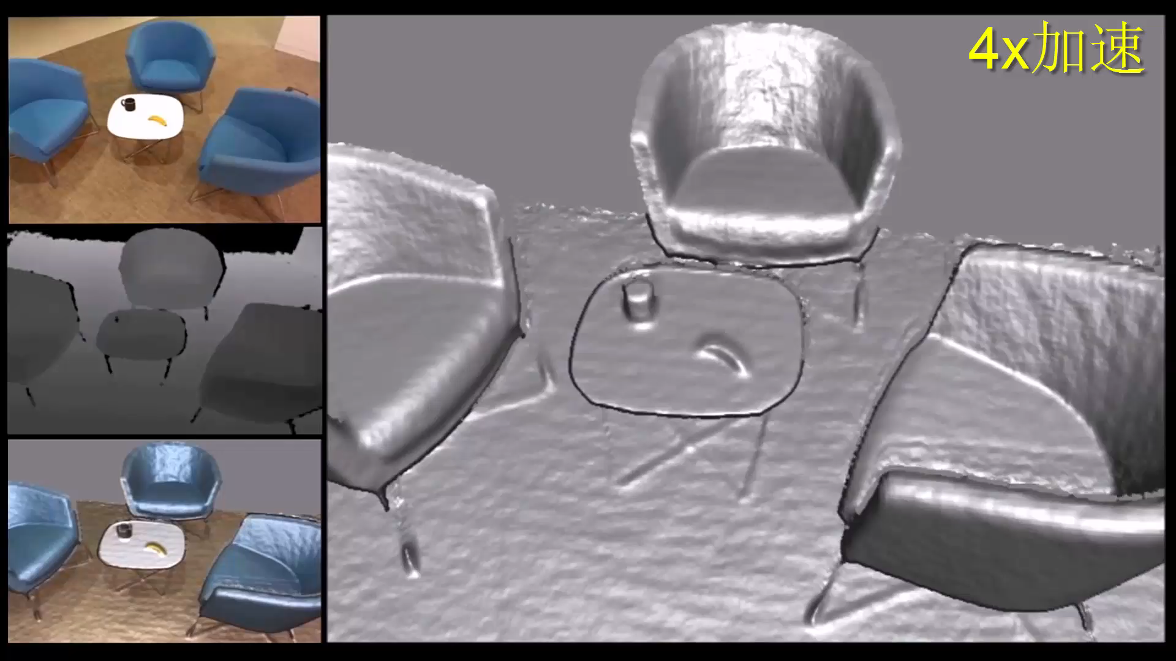

Slide 48
Towards WSIU
Graphics/vision applications
Editing
Synthesis
Web images
Light weighted semantic parsing
Semantic segmentation
Interaction
Low level vision
Attention
Boundary
Segmentation

Slide 49
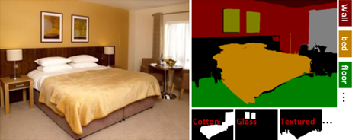
ImageSpirit: Verbal Guided Image Parsing, ACM TOG, 2014

Slide 50
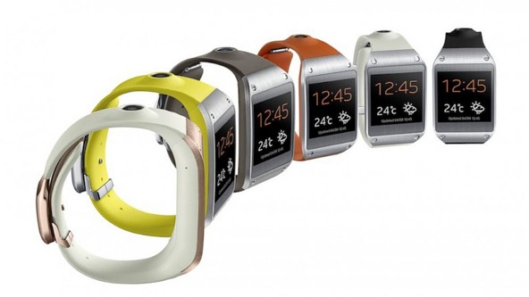


Motivations

Slide 51






Verbal guided image parsing
Make the wood cabinet in bottom-middle lower
nouns
Adjective
Verb/Adverb
Object Attributes
Commands
Multi label CRF

Slide 52
Towards WSIU
Graphics/vision applications
Editing
Synthesis
Web images
Light weighted semantic parsing
Semantic segmentation
Interaction
Low level vision
Attention
Boundary
Segmentation

Slide 53

Sketch2Photo
Sketch2photo: internet image montage, ACM TOG 2009.

Slide 54
Towards WSIU
Graphics/vision applications
Editing
Synthesis
Web images
Light weighted semantic parsing
Semantic segmentation
Interaction
Low level vision
Attention
Boundary
Segmentation

Slide 55
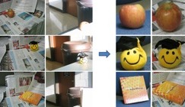
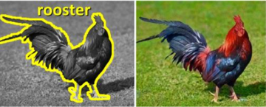




Dealing with web images
UCSD, Zhuowen Tu,
CVPR 12
NUS, Ping Tan
ACM TOG 11
MIT, Rubinstein
CVPR 13
Columbia, Shihfu Chang
CVPR 12
NUS Shuicheng Yan
PAMI 17
北理工 黄华
ACM TOG 11

Slide 56


free

Slide 57
Thanks!

Slide 58
Outline of the survey
Low level vision
  Attention: CVPR 11, CVPR 14, TPAMI 15, IEEE TIP 15, IJCV 17, CVPR 17
  Boundary: CVPR 17
  Segmentation: TVC 14, CGF 15, ECCV 15, TPAMI 15
Light weighted semantic parsing
  Semantic segmentation: TPAMI 17, CVPR (oral) 17
  Interaction: TOG 15, TOG 10, TOG 12
Graphics/vision applications
  Editing: TOG 14
  Synthesis: TOG 09
  Web images: CVPR 12, TOG 11, CVPR 12, CVPR 13, TOG 12

Slide 59
Students (2016 - )
Qibin Hou
  Deeply supervised salient object detection …, Q Hou, MM Cheng, X Hu, Z Tu, A Borji, IEEE CVPR, 2017.
  Intelligent Visual Media Processing: When Graphics Meets Vision, MM Cheng, Q Hou, SH Zhang, PL Rosin. JCST, 2017.
Yun Liu
  Richer Convolutional Features for Edge Detection, Y Liu, MM Cheng, X Hu, K Wang, X Bai, IEEE CVPR, 2017.
  HFS: Hierarchical Feature Selection for ... MM Cheng, Y Liu, Q Hou, J Bian, P Torr, SM Hu, Z Tu. ECCV, 2016.
Jia-Wang Bian
  GMS: Grid-based Motion … Feature correspondence, JW Bian, W Lin, … , MM Cheng IEEE CVPR, 2017.

Slide 60

NPR

