Slide 1
Saliency Detection via Graph-Based Manifold Ranking
Speaker: Ming-Ming Cheng
Nankai University
http://mmcheng.net/

Slide 2
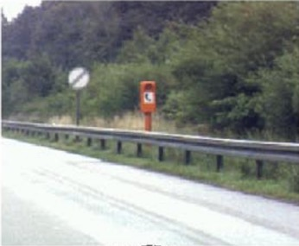
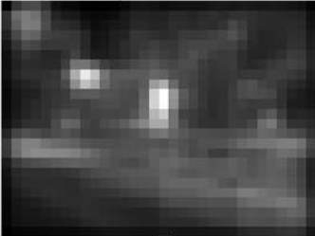

Related works: saliency detection
Fixation prediction
  Predicting saliency points of human eye movement
A model of saliency-based visual attention for rapid scene analysis. PAMI 1998, Itti et al.
Saliency detection: A spectral residual approach. CVPR 2007, Hou et. al.
Graph-based visual saliency. NIPS, Harel et. al.
Quantitative analysis of human-model agreement in visual saliency modeling: A comparative study, IEEE TIP 2012, Borji et. al.
A benchmark of computational models of saliency to predict human fixations, TR 2012.
Notes:
cognitive psychology, neurobiology

Slide 3
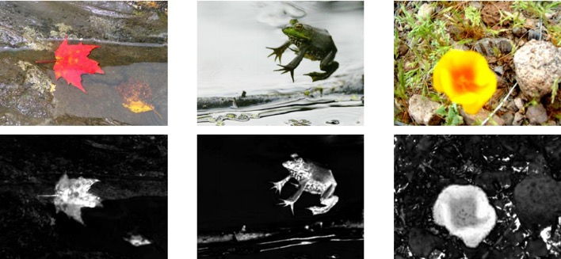
Related works: saliency detection
Salient object detection
  Detect the most attention-grabbing object in the scene
Learning to detect a salient object. CVPR 2007, Liu et. al.
Frequency-tuned salient region detection, CVPR 2009, Achanta et. al.
Global contrast based salient region detection, CVPR 2011 (PAMI 2015), Cheng et. al.

Slide 4
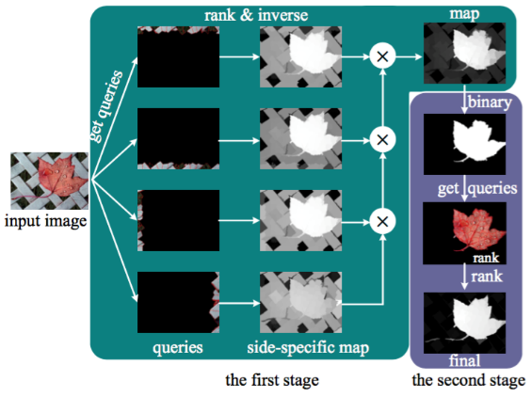
Related works: saliency detection
Salient object detection: a benchmark, IEEE TIP 2015
Saliency Detection via Graph-Based Manifold Ranking, CVPR 2013

Slide 5
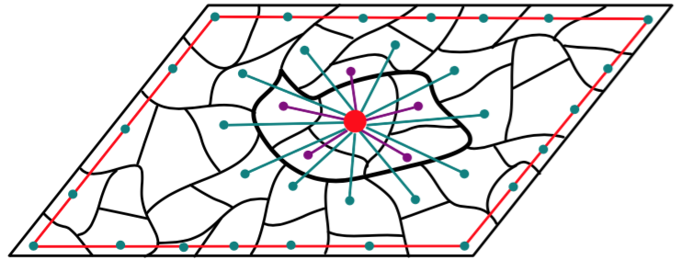
Related works: saliency detection
Saliency Detection via Graph-Based Manifold Ranking, CVPR 2013
  Every region is associated with its neighbors

Slide 6
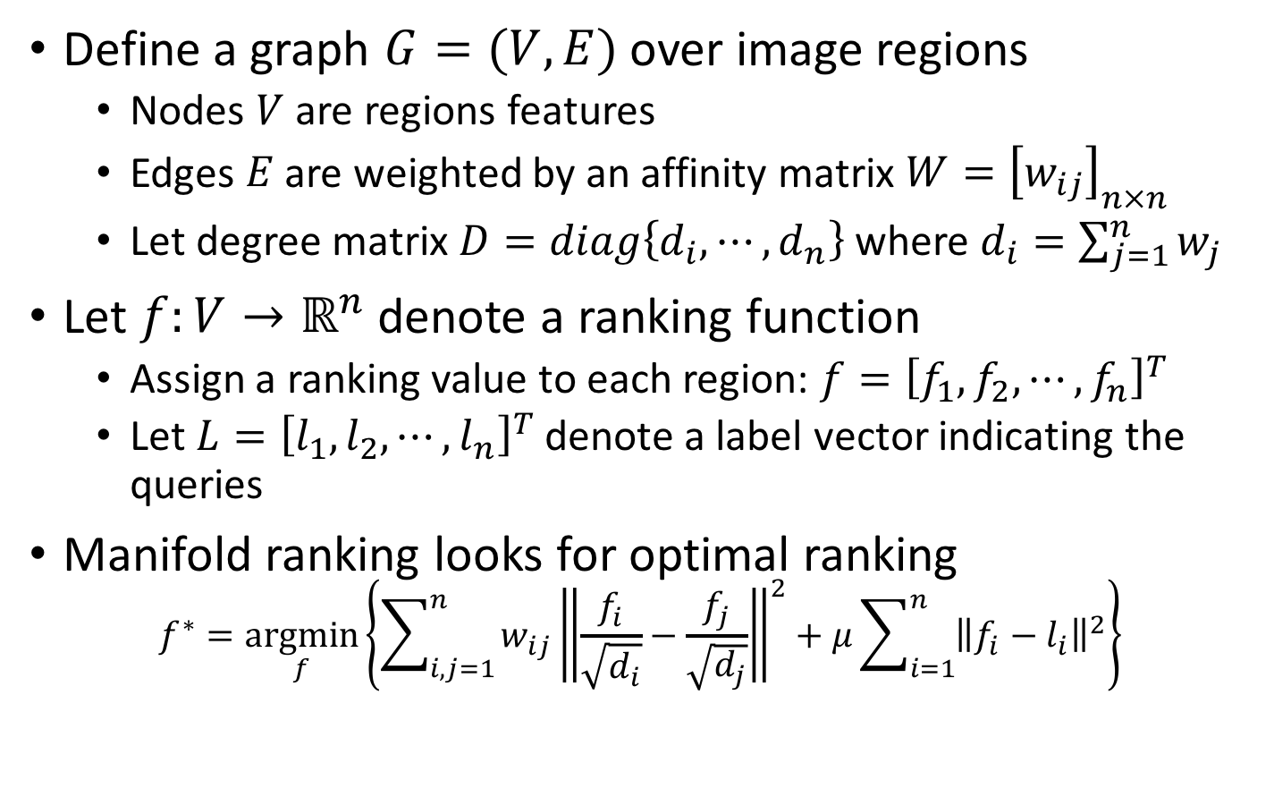
Graph based manifold ranking
Define a graph $G=(V,E)$ over image regions
  Nodes $V$ are regions features
  Edges $E$ are weighted by an affinity matrix $W={\left[w_{ij}\right]}_{n×n}$
  Let degree matrix $D=diag\left\{d_{i},⋯,d_{n}\right\}$ where $d_{i}=\sum_{j=1}^{n}{w_{j}}$
Let $f:V→ℝ^{n}$ denote a ranking function
  Assign a ranking value to each region: $f={\left[f_{1},f_{2},⋯,f_{n}\right]}^{T}$
  Let $L={\left[l_{1},l_{2},⋯,l_{n}\right]}^{T}$ denote a label vector indicating the queries
Manifold ranking looks for optimal ranking
$$f^{∗}=\underset{f}{argmin}\left\{\sum_{i,j=1}^{n}{w_{ij}}{\left\|\frac{f_{i}}{\sqrt{d_{i}}}−\frac{f_{j}}{\sqrt{d_{j}}}\right\|}^{2}+μ\sum_{i=1}^{n}{{\left\|f_{i}−l_{i}\right\|}^{2}}\right\}$$

Slide 7
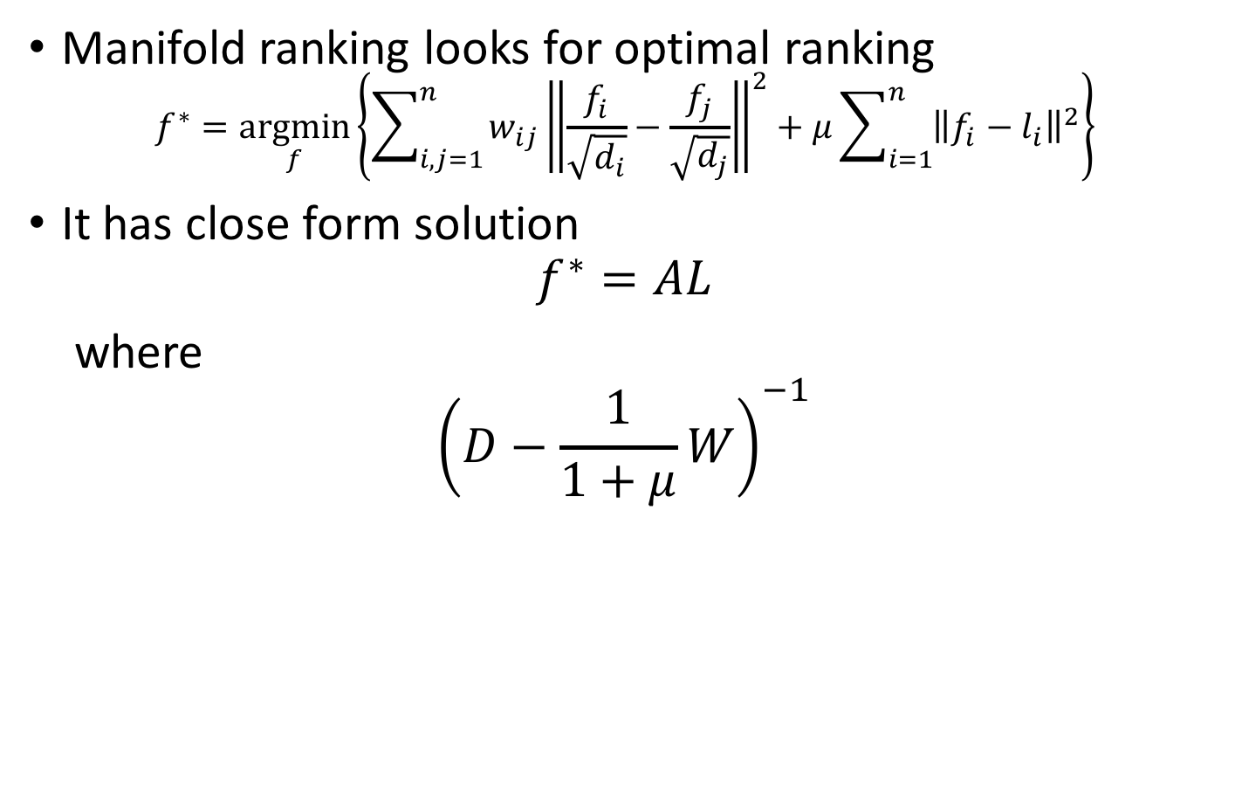
Graph based manifold ranking
Manifold ranking looks for optimal ranking
$$f^{∗}=\underset{f}{argmin}\left\{\sum_{i,j=1}^{n}{w_{ij}}{\left\|\frac{f_{i}}{\sqrt{d_{i}}}−\frac{f_{j}}{\sqrt{d_{j}}}\right\|}^{2}+μ\sum_{i=1}^{n}{{\left\|f_{i}−l_{i}\right\|}^{2}}\right\}$$
It has close form solution
$$f^{∗}=AL$$
where
$${\left(D−\frac{1}{1+μ}W\right)}^{−1}$$
Ranking on data manifolds, Zhou et al. NIPS 2004.
Saliency detection via graph-based manifold ranking, IEEE CVPR 2013

Slide 8
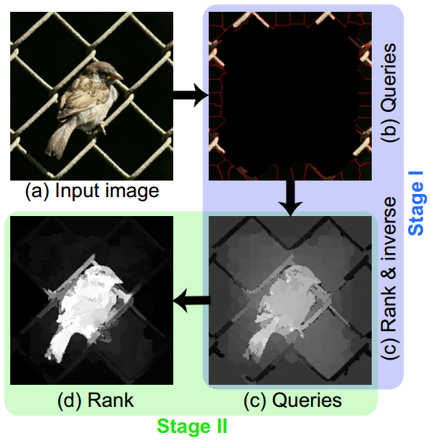
SaliencyRank

Slide 9

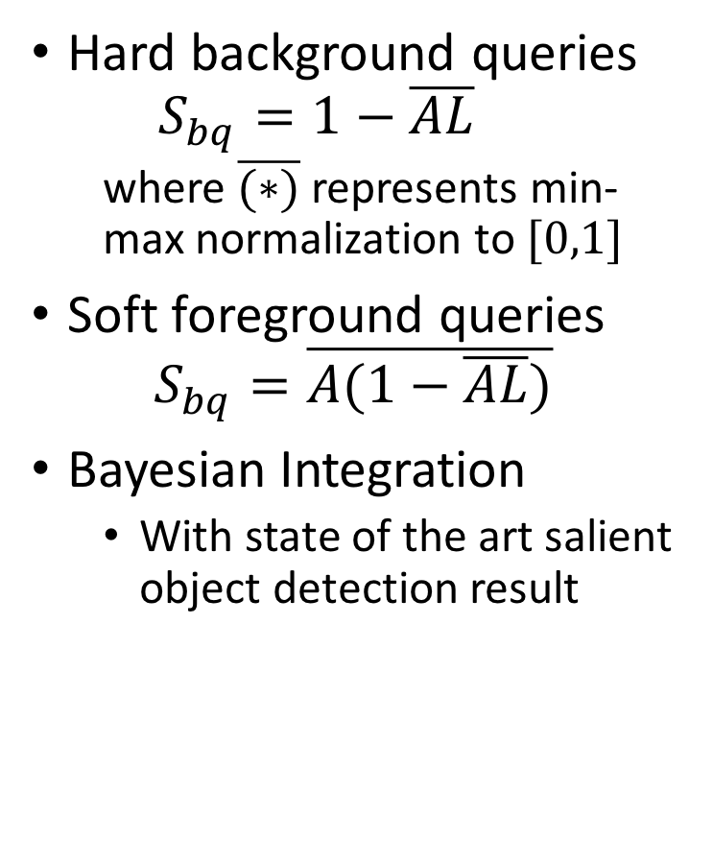
SaliencyRank
Hard background queries
  $$S_{bq}=1−\overline{AL}$$
  where $\overline{(∗)}$ represents min-max normalization to $[0,1]$
Soft foreground queries
$$S_{bq}=\overline{A(1−\overline{AL})}$$
Bayesian Integration
  With state of the art salient object detection result

Slide 10
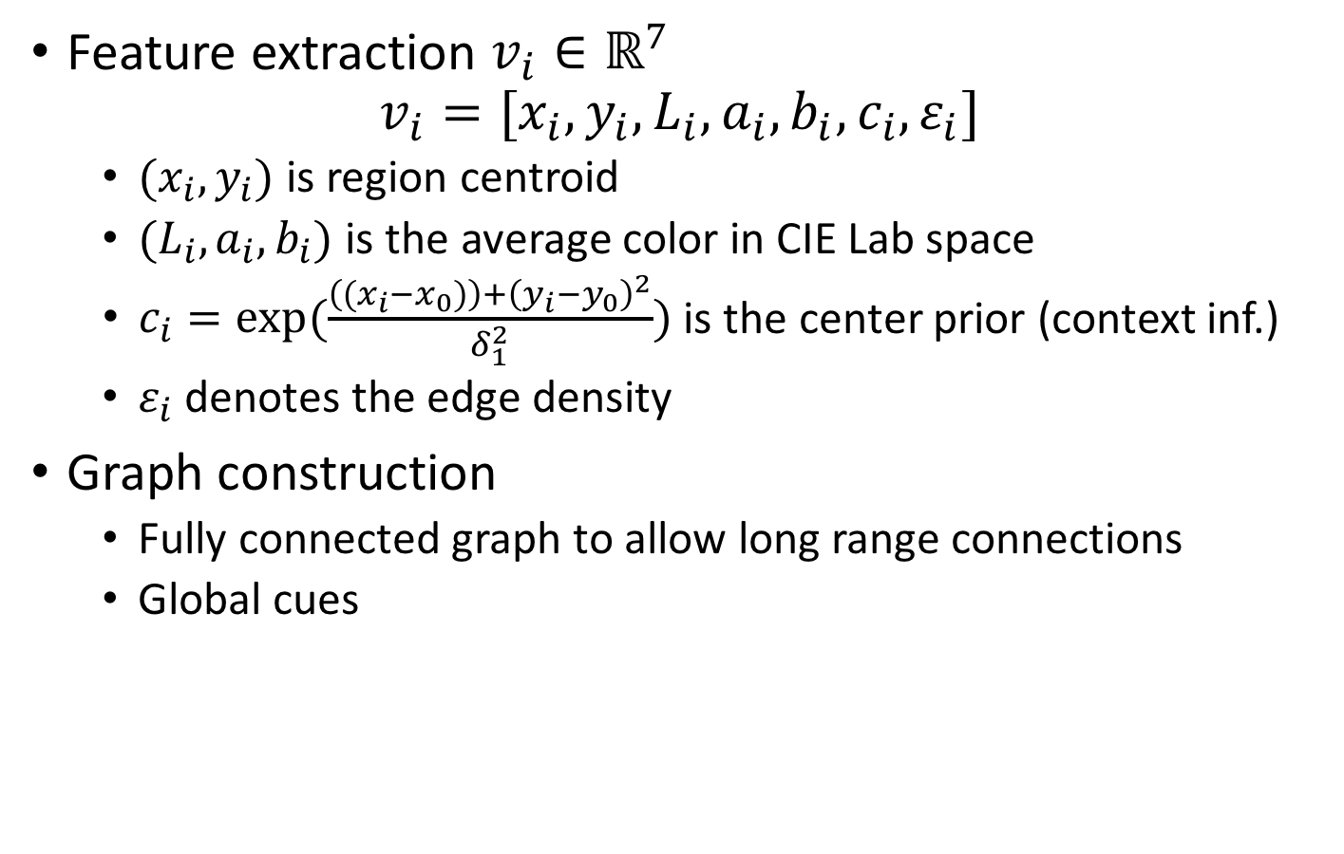
SaliencyRank
Feature extraction $v_{i}∈ℝ^{7}$
$$v_{i}=[x_{i},y_{i},L_{i},a_{i},b_{i},c_{i},ε_{i}]$$
  $(x_{i},y_{i})$ is region centroid
  $(L_{i},a_{i},b_{i})$ is the average color in CIE Lab space
  $c_{i}=\exp{(\frac{\left((x_{i}−x_{0})\right)+{\left(y_{i}−y_{0}\right)}^{2}}{δ_{1}^{2}})}$ is the center prior (context inf.)
  $ε_{i}$ denotes the edge density
Graph construction
  Fully connected graph to allow long range connections
  Global cues

Slide 11
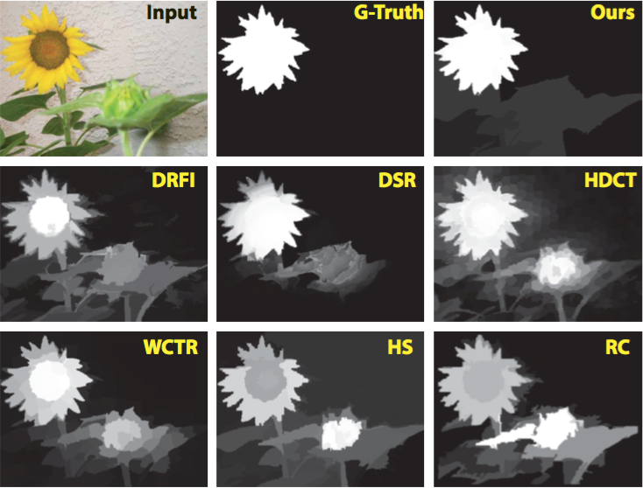
Experimental results

Slide 12
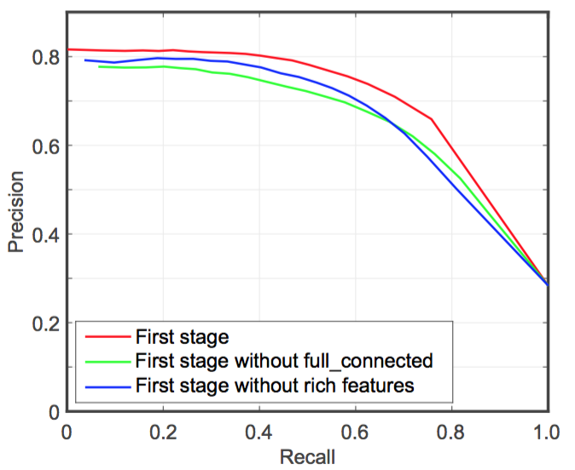
Experimental results
Design choices
  Fully connected structure

Slide 13
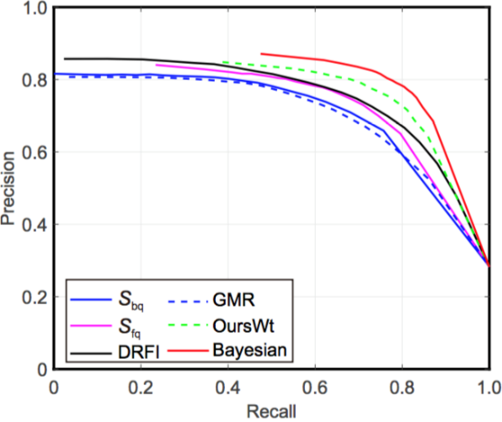
Experimental results
Design choices
  Fully connected structure
  Integration

Slide 14
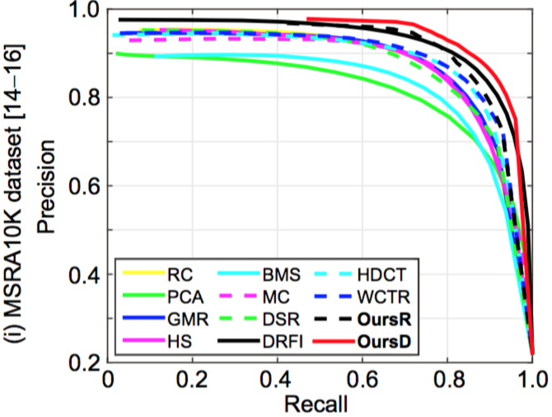
Experimental Evaluation
Quantitative evaluation

Slide 15
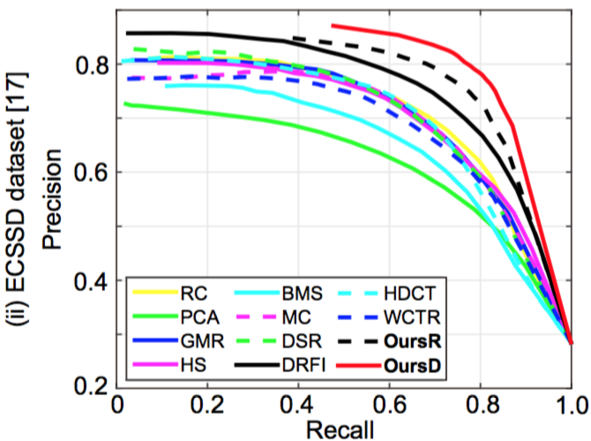
Experimental Evaluation
Quantitative evaluation

Slide 16
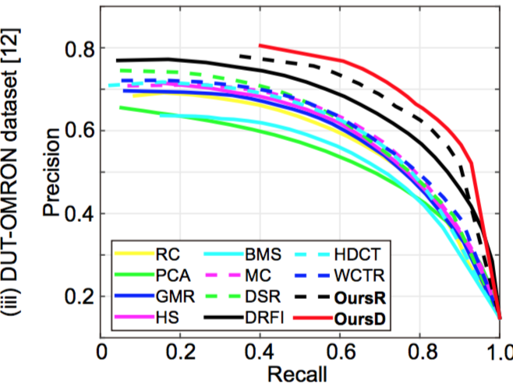
Experimental Evaluation
Quantitative evaluation

Slide 17
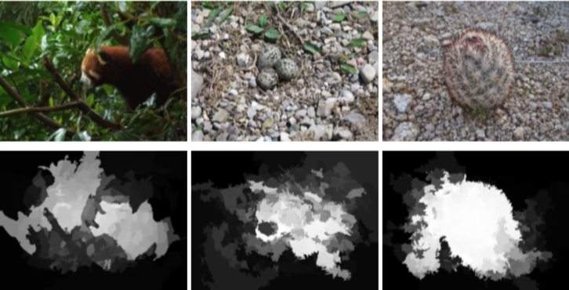
Limitations
Very similar color in both foreground & background
Heterogeneous backgrounds & low light foreground

Slide 18
Discussions
Consider both foreground and background cues
  Incorporates local grouping cues & boundary priors
Focus on robust background detection
  Explore background prior via intrinsic structure of the image
Complementary to existing methods
  Bayesian integration with the proposed methods refresh state of the art

Slide 19
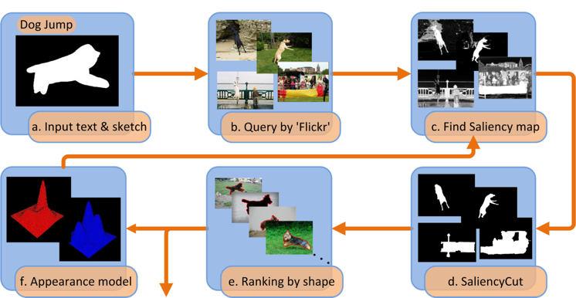
Applications
Is salient object detection for ‘simple’ images useful?
SalientShape: Group Saliency in Image Collections, The Visual Computer 2014. Cheng et. al.

Slide 20
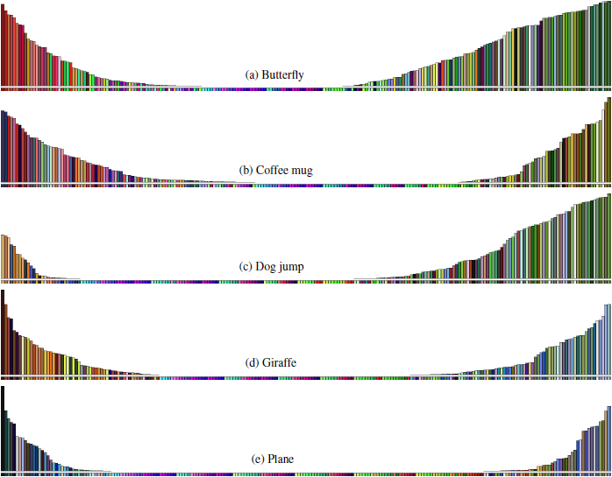
Applications
Illustration of learned appearance models
  Accords with our understanding of these categories

Slide 21
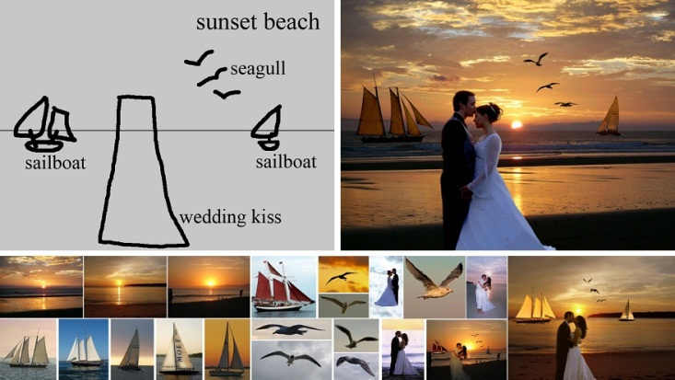
Applications
T Chen, MM Cheng, P Tan, A Shamir, SM Hu, Sketch2photo: internet image montage, ACM TOG. (SIGGRAPH Asia), vol. 28, no. 5, 124:1-10, 2009.

Slide 22

Applications
J.Y. Zhu, J. W, Y. Xu, E. Chang, Z. Tu, Unsupervised Object Class Discovery via Saliency-Guided Multiple Class Learning, IEEE TPAMI 2015 (CVPR 2012).
Notes:
Adopt saliency detection to convert unsupervised learning into multiple instance learning
validates the usefulness of saliency detection to output “noisy input” for a top-down method to extract common patterns

Slide 23
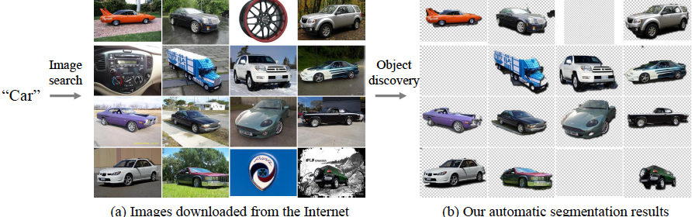
Application
Rubinstein, M., Joulin, A., Kopf, J., & Liu, C. Unsupervised joint object discovery and segmentation in internet images. IEEE CVPR 2013.
Notes:
Common object patterns should be salient within each image, while being sparse with respect to smooth transformations across images.
Used the proposed saliency measure and showed that saliency-based segmentation produces state-of-the-art results on co-segmentation benchmarks, without using co-segmentation!

Slide 24
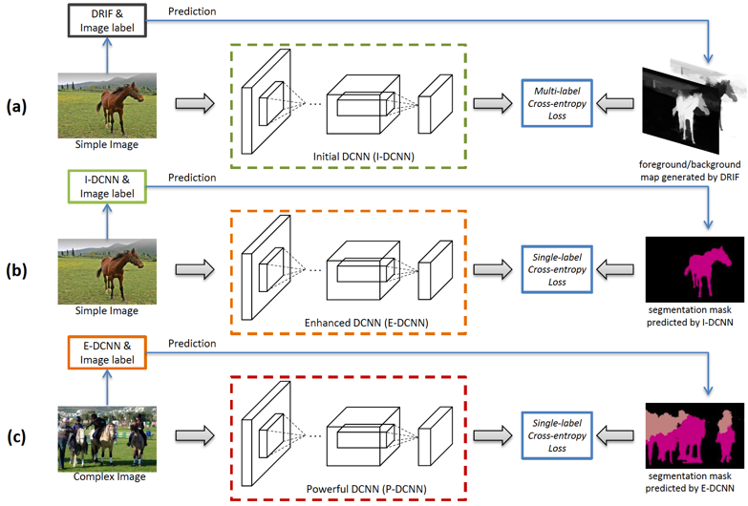
Applications
10% improvement over state of the art!
STC: A Simple to Complex Framework for Weakly-supervised Semantic Segmentation, arXiv 2015, Wei et al.
Notes:
10.6% improvement over “P. O. Pinheiro and R. Collobert, “From image-level to pixellevel
labeling with convolutional networks,” IEEE CVPR, 2015.”

Slide 25
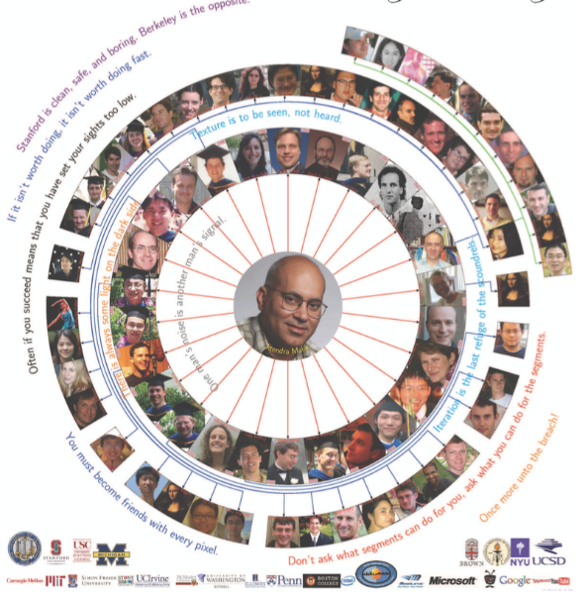
Applications
  Don’t ask what segment can do for you, ask what you can do for the segment.

Slide 26
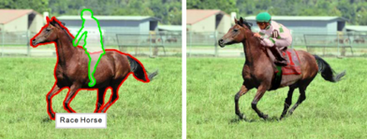
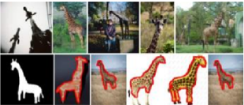
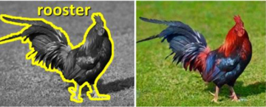
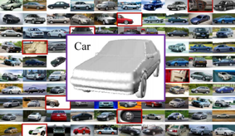
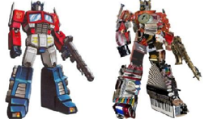
Applications
[EuroGraphics 12] [Vis. Comp. 14]
[ACM TOG 11] [Vis. Comp. 13] [ACM TOG 11]

Slide 27
Thanks
Q&A

