Slide 1
边缘检测年度进展概述
Ming-Ming Cheng
Media Computing Lab, Nankai University
Email: cmm@nankai.edu.cn
URL: http://mmcheng.net/

Slide 2
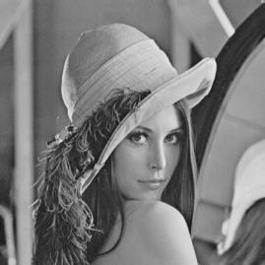
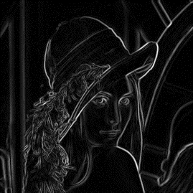
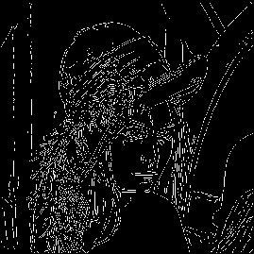
Early pioneering methods
Locate sharp changes in the intensity function
  Sobel, Canny, Laplacian, …

Slide 3
Data driven methods
Learning the probability distributions of features
  Konishi et al. [1] proposed the first data-driven method
  Low-level cues such as color, intensity, gradient, texture, etc.
Employ various classification paradigm
  Popular method: Pb, gPb, StructuredEdge
Berkeley segmentation Dataset
[1] Konishi S, Yuille A L, Coughlan J M, et al. Statistical edge detection: Learning and evaluating edge cues[J]. IEEE TPAMI, 2003, 25(1): 57-74.

Slide 4
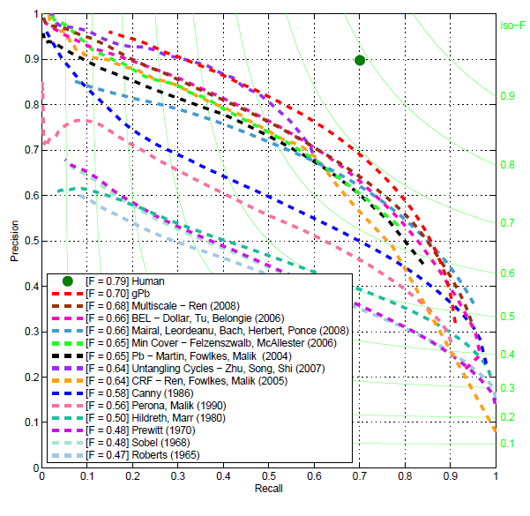
45 years of boundary detection
Source: Arbelaez

Slide 5
Limitations of previous methods
Semantically meaningful edge detection
  Requires object-level (high level) information

Slide 6
Recent CNN based methods
N⁴-Fields, ACCV 2014
DeepEdge, CVPR 2015
DeepContour, CVPR 2015
HFL, ICCV 2015
HED, ICCV 2015
RCF, CVPR 2017

Slide 7
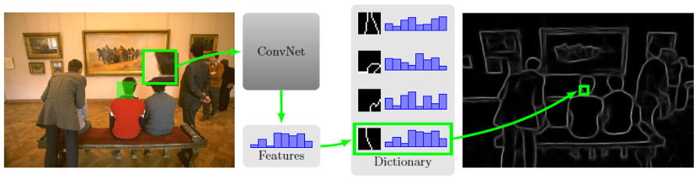
N⁴-Fields
Ganin Y, Lempitsky V. N⁴-fields: Neural network nearest neighbor fields for image transforms[C]//ACCV. Springer International Publishing, 2014: 536-551.
Notes:
0.75

Slide 8
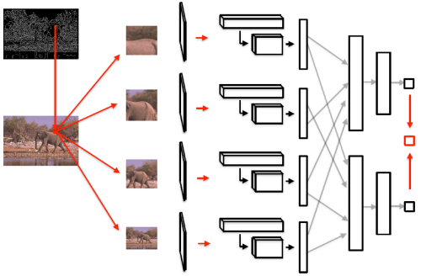
DeepEdge
Candidate contour points ← Canny edge
Patches at 4 scales run through the CNN
Two branches for: classification & regressor.
Bertasius G, Shi J, Torresani L. Deepedge: A multi-scale bifurcated deep network for top-down contour detection[C]//CVPR. 2015: 4380-4389.
Notes:
They run the Canny edge detector to extract candidate contour points. Then, around each candidate point, they extract patches at four different scales and simultaneously run them through the KNet. They connect the convolutional layers to two separately-trained network branches. The first branch is trained for classification, while the second branch is trained as a regressor. At testing time, the scalar outputs from these two sub-networks are averaged to produce the final score.

Slide 9
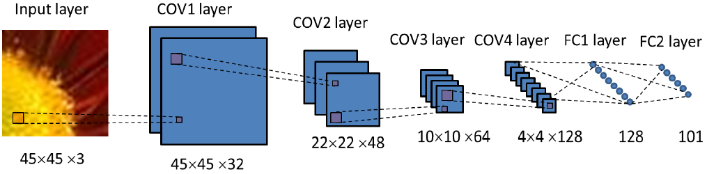
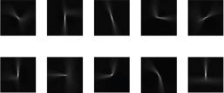
DeepContour
Multi-class shape classification
New CNN loss for positive vs. negative
Shen W, Wang X, Wang Y, et al. Deepcontour: A deep convolutional feature learned by positive-sharing loss for contour detection[C]//CVPR. 2015: 3982-3991.
Notes:
0.76

Slide 10
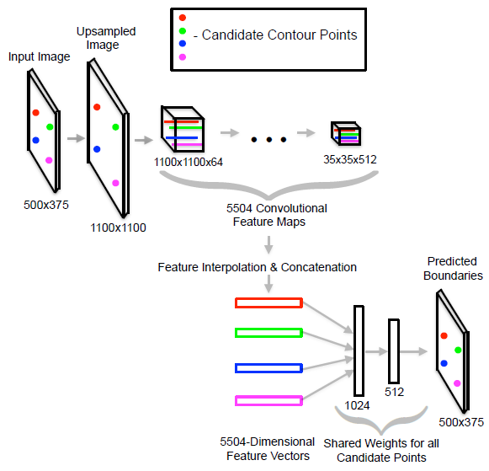
HFL
Candidate contour points
Unsample image to feed through VGG net, which was pre-trained for high level task
Bertasius G, Shi J, Torresani L. High-for-low and low-for-high: Efficient boundary detection from deep object features and its applications to high-level vision[C]//ICCV. 2015: 504-512.
Notes:
0.77

Slide 11
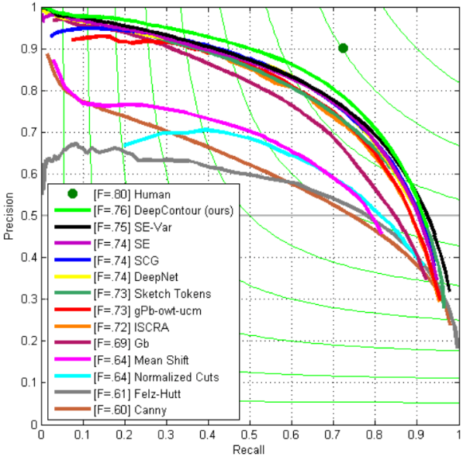
Results of making local decisions

Slide 12
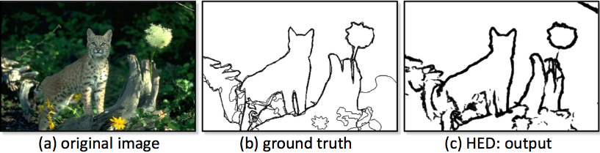
HED
Holistically-Nested Edge Detection
  Holistic: image to image fashion
Xie S, Tu Z. Holistically-nested edge detection[C]//ICCV. 2015: 1395-1403.

Slide 13
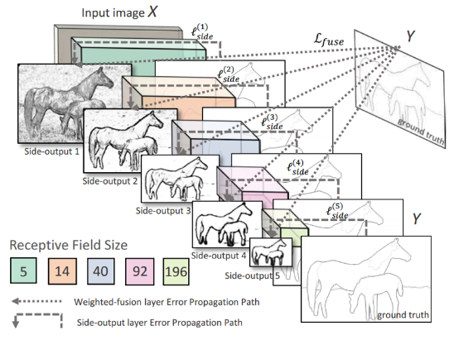
HED
Holistically-Nested Edge Detection
  Holistic: image to image fashion
  Multi-scale and multi-level feature learning
Notes:
Side-output layers are inserted after convolutional layers. Deep supervision is imposed at each side-output layer, guiding the side-outputs towards edge predictions with the characteristics. One weighted-fusion layer is added to automatically learn how to combine outputs from multiple scales. The entire network is trained with multiple error propagation paths (dashed lines).

Slide 14
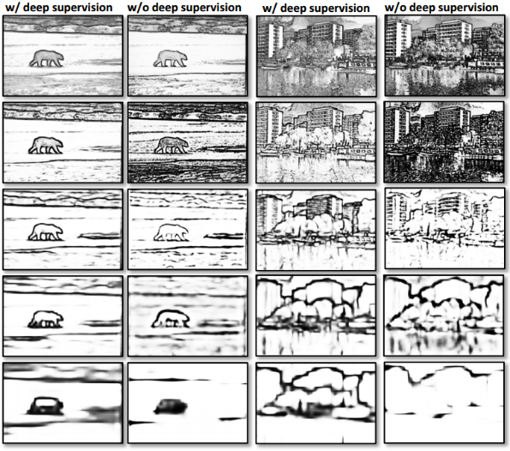
HED
Illustration: how deep supervision helps side-output layers to produce multi-scale dense predictions.
Notes:
Two examples illustrating how deep supervision helps side-output layers to produce multi-scale dense predictions. Note that in the left column, the side outputs become progressively coarser and more “global”, while critical object boundaries are preserved.

Slide 15
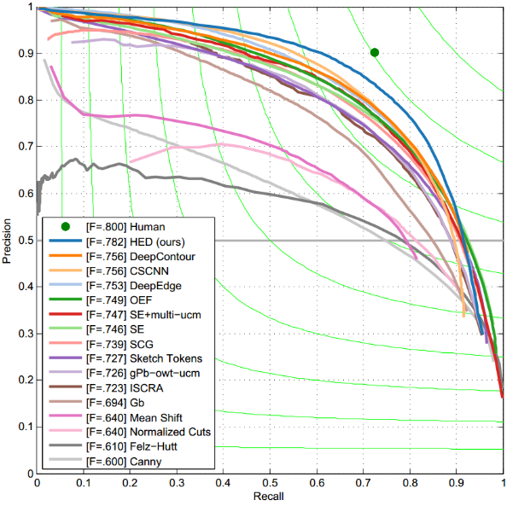
Results

Slide 16
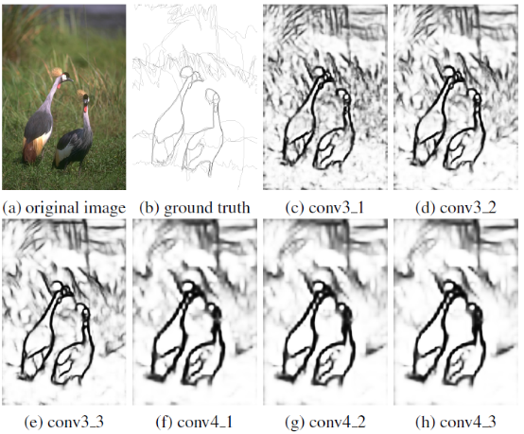
RCF: Richer Convolutional Features
Motivation: intermediate layers contain lots of useful fine details
Key idea: combining ALL the meaningful convolutional features
Liu Y, Cheng M M, Hu X, et al. Richer Convolutional Features for Edge Detection[C]//CVPR. 2017.
Notes:
We build a simple network based on VGG16 to produce side outputs of conv3_1, conv3_2, conv3_3, conv4_1, conv4_2 and conv4_3. One can clearly see that convolutional features become coarser gradually, and the intermediate layers conv3_1, conv3_2, conv4_1, and conv4_2 contain lots of useful fine details that do not appear in other layers.

Slide 17
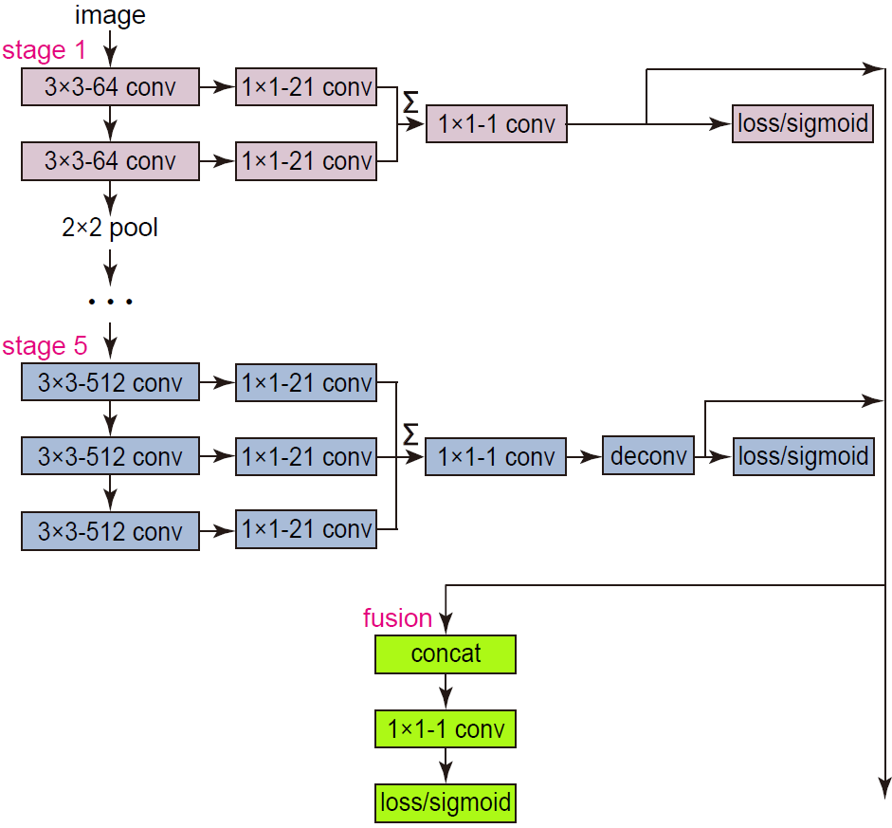
RCF: Richer Convolutional Features
Use ALL convolutional layer, instead of last layer of each stage.
Liu Y, Cheng M M, Hu X, et al. Richer Convolutional Features for Edge Detection[C]//CVPR. 2017.
Notes:
Utilize the CNN features from all the conv layers can be potentially generalized to other vision tasks.

Slide 18
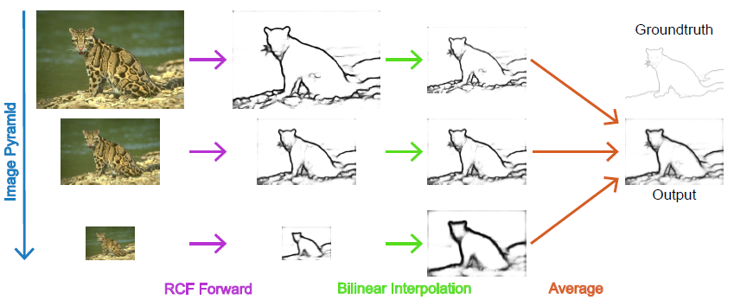
Multiscale Fusion
Explicit multi-scale processing.
Liu Y, Cheng M M, Hu X, et al. Richer Convolutional Features for Edge Detection[C]//CVPR. 2017.

Slide 19
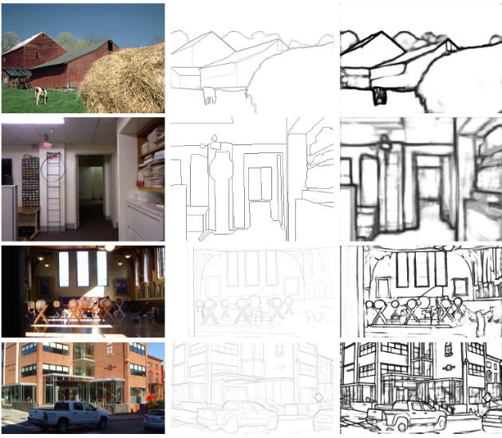
Samples
image
G-Truth
results
Notes:
Some examples of RCF. From top to bottom: BSDS500, NYUD, Multicue-Boundary, and Multicue-Edge. From left to right: origin image, ground truth, RCF edge map, origin image, ground truth, and RCF edge map.

Slide 20
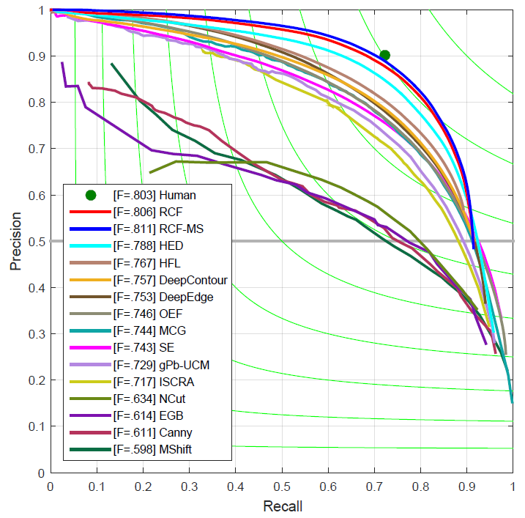
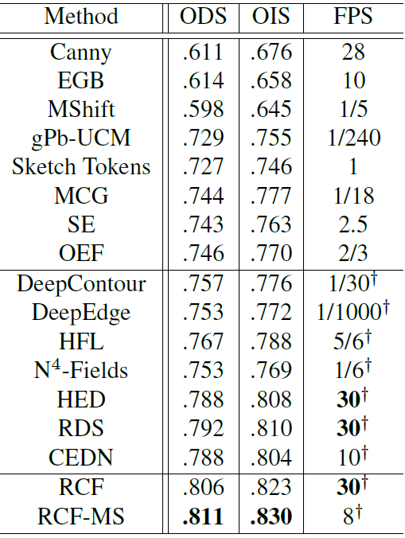
Evaluation on BSDS500
Open Source
Source code: https://github.com/yun-liu/rcf

Slide 21
