Slide 1
Cognitive Inspired Image/Video Processing
Speaker: Ming-Ming Cheng
Nankai University
http://mmcheng.net/
Notes:
认知规律启发的图像视频智能处理
报告15-17分钟，提问3-5分钟

Slide 2
Image/Video Understanding
Lack of tech. that accords human cognitive
  Sliding window → visual attention mechanism?
Notes:
如何从海量的图像视频中准确的发现、获取有效信息，是制约众多智能计算与服务的主要瓶颈。许多经典方法并不符合人类的认知规律。
例如，传统方法利用滑动窗口机制来检测物体，效率低下。这种机制并不符人类观察世界的经验，相信在做的老师们没有人会在找物体的时候从天花板一直扫到地面，去查看每一个位置。人类的视觉注意机制可以快速地帮我们定位可能的候选区域。
How to extract useful information from images is a bottle lack for many applications. Unfortunately, many state of the art methods are less efficient and don’t accord with our human visual perception.
For instance, traditional methods use sliding window mechanism to detect objects. In real-world, we never slid our head from ceiling to floor row by row to find objects. Human visual attention mechanism enables us to easily accomplish this task.

Slide 3



Image/Video Understanding
Lack of tech. that accords human cognitive
  Sliding window → visual attention mechanism?
  Pixel/Patch → Human perception: objects, attributes?
RGB, RGB, RGB, RGB, RGB, RGB, RGB, RGB, RGB, RGB, …
Objects, spatial relations, semantic properties, 3d, actions, human pose, …
Notes:
又如，图像在计算机中以像素为基本单位进行存储与表达，而人类则以物体，属性等语义信息对图像进行理解和记忆，导致像素或者区块级别的直接图像编辑操作使用时并不方便。
如何突破思维定式，提出符合人类认知规律的分析理论与高效算法，是我们研究的重点。
RGB pixels are nature image representations for computers. However, we humans think in terms of objects and semantic attributes ect. For instance, none of us could recognize the RGB value in the 3rd row and 5th column of this image. But we can easily find that there is a human and a ship in this picture. How to enable intuitive image manipulation experience at object level accords with our human mental data representation.

Slide 4


Global Contrast based Salient Region Detection, IEEE TPAMI, 2015, MM Cheng, et. al. (CVPR 2011)

Slide 5
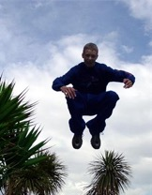
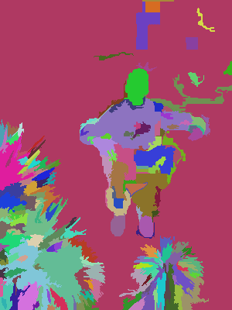
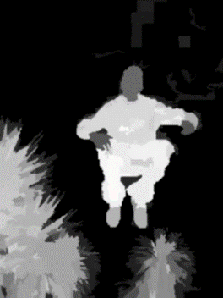
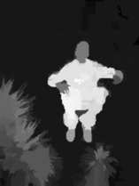

Core idea: region contrast (RC)
  Image Segmentation $σ_{s}^{2}→∞$ $σ_{s}^{2}→0.4$
  Spatial weighting
  Region size
  $S\left(r_{k}\right)=\sum_{r_{k}≠r_{i}}{\exp\left(−\frac{D_{s}\left(r_{k},r_{i}\right)}{σ_{s}^{2}}\right)}ω\left(r_{i}\right)D_{r}(r_{k},r_{i})$
  Region contrast by sparse histogram comparison.
free

Slide 6
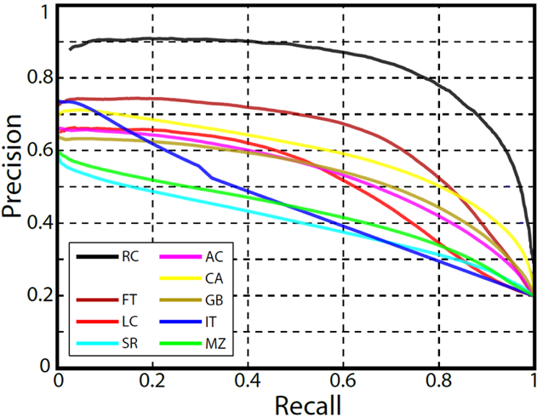
Experimental results
Dataset: MSRA1000 [Achanta09]
  Precision vs. recall

Slide 7
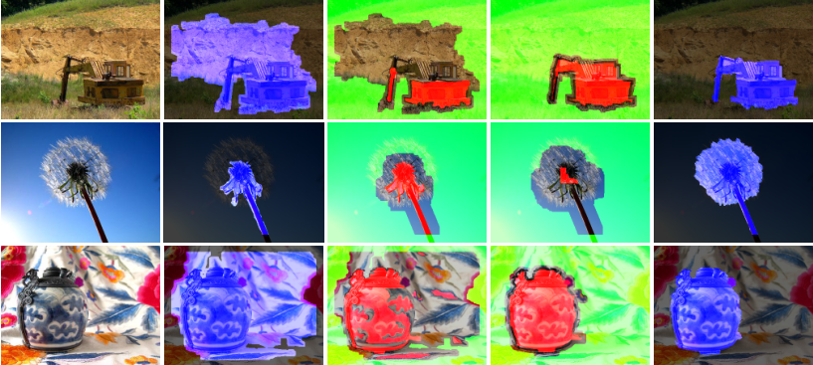
SaliencyCut
  Iterative refine: iteratively run GrabCut to refine segmentation
  Adaptive fitting: adaptively fit with newly segmented salient region
  Enables automatic initialization provided by salient object detection.

Slide 8
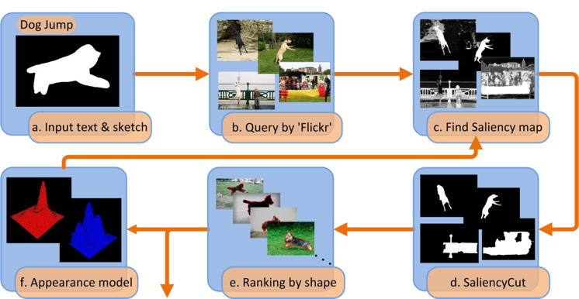
Applications
Is salient object detection for ‘simple’ images useful?
SalientShape: Group Saliency in Image Collections, The Visual Computer 2014. Cheng et. al.

Slide 9
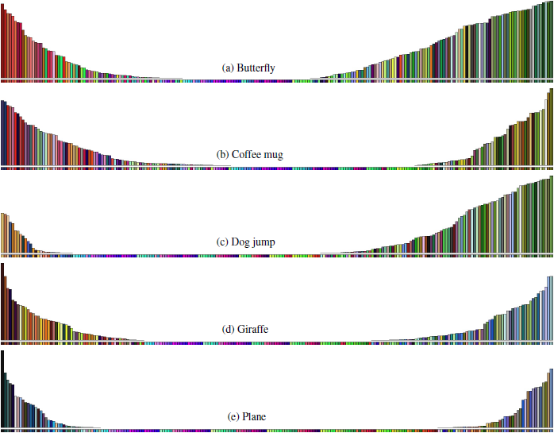
Applications
Illustration of learned appearance models
  Accords with our understanding of these categories

Slide 10
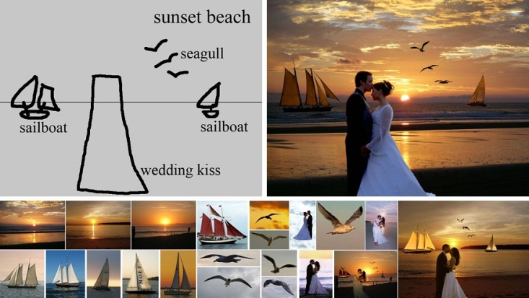
Applications
T Chen, MM Cheng, P Tan, A Shamir, SM Hu, Sketch2photo: internet image montage, ACM TOG. (SIGGRAPH Asia), vol. 28, no. 5, 124:1-10, 2009.

Slide 11
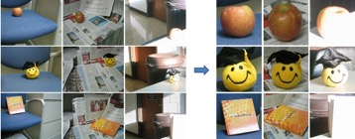
Applications
J.Y. Zhu, J. W, Y. Xu, E. Chang, Z. Tu, Unsupervised Object Class Discovery via Saliency-Guided Multiple Class Learning, IEEE TPAMI 2015 (CVPR 2012).
Notes:
Adopt saliency detection to convert unsupervised learning into multiple instance learning
validates the usefulness of saliency detection to output “noisy input” for a top-down method to extract common patterns

Slide 12
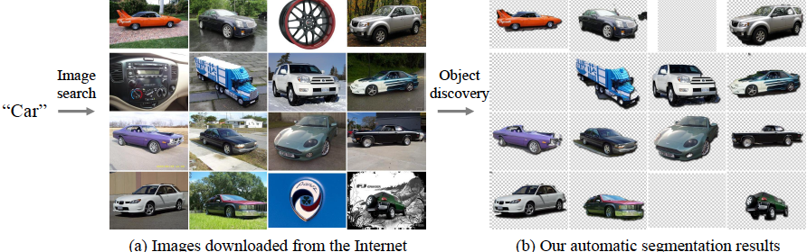
Applications
Rubinstein, M., Joulin, A., Kopf, J., & Liu, C. Unsupervised joint object discovery and segmentation in internet images. IEEE CVPR 2013.
Notes:
Common object patterns should be salient within each image, while being sparse with respect to smooth transformations across images.
Used the proposed saliency measure and showed that saliency-based segmentation produces state-of-the-art results on co-segmentation benchmarks, without using co-segmentation!

Slide 13
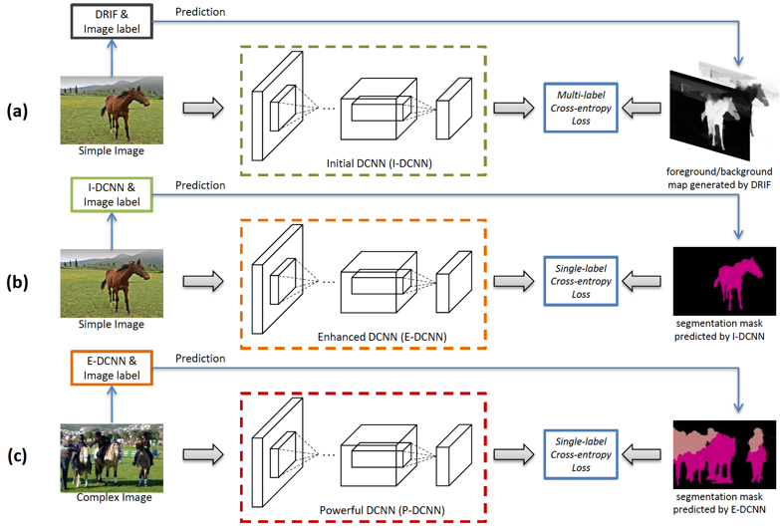
Applications
10% improvement over state of the art!
STC: A Simple to Complex Framework for Weakly-supervised Semantic Segmentation, arXiv 2015, Wei et al.
Notes:
10.6% improvement over “P. O. Pinheiro and R. Collobert, “From image-level to pixellevel
labeling with convolutional networks,” IEEE CVPR, 2015.”

Slide 14
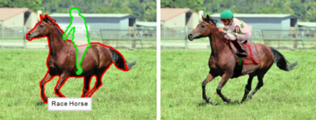
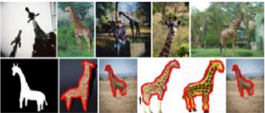
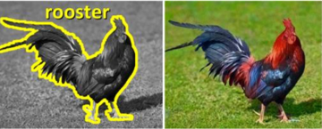
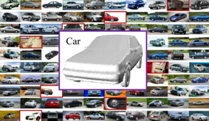
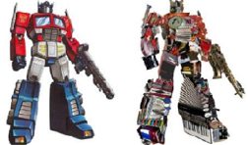
Applications
[EuroGraphics 12] [Vis. Comp. 14]
[ACM TOG 11] [Vis. Comp. 13] [ACM TOG 11]
  See the 1000+ citations of our PAMI 2015 (CVPR 2011) paper for more.

Slide 15


Additional resources
Project page: http://mmcheng.net/salobj/
Benchmark
  Salient Object Detection: A Benchmark, A. Borji, M.M. Cheng, H. Jiang, J. Li, IEEE TIP, 2015.
  Salient Object Detection: A Survey, A. Borji, M.M. Cheng, H. Jiang, J. Li, arXiv eprint, 2014.
  http://mmcheng.net/salobjbenchmark
DenseCut for Realtime GrabCut
  DenseCut: Densely Connected CRFs for Realtime GrabCut, Computer Graphics Forum, 2015
free
free

Slide 16
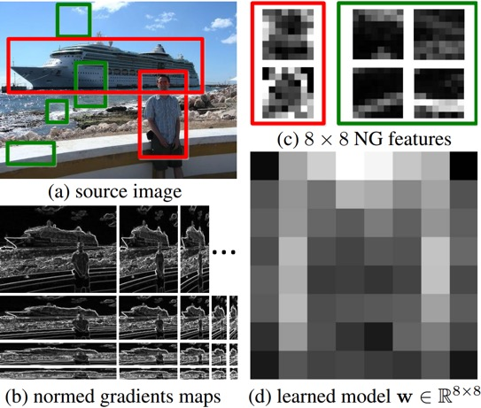
BING: Binarized Normed Gradients for Objectness Estimation at 300fp, IEEE CVPR 2014 (Oral), M.M. Cheng, et. al.

Slide 17
Motivation: What is an object?
> >
Notes:
Objectness is usually represented as a value which reflects how likely an image window covers an object of any category.

Slide 18

Methodology: observation
Our observation: a small interactive demo
  Take you pen and paper and draw an object which is current in your mind.
  What the object looks like if we resize it to a tiny fixed size?
    E.g. 8x8. Not only changing the scale, but also aspect ratio.

Slide 19
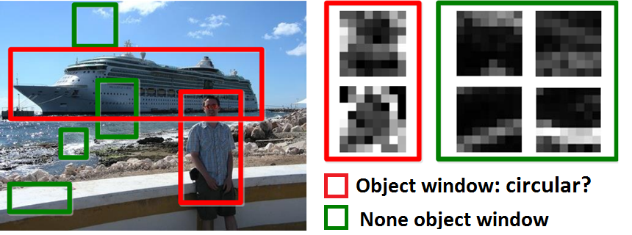
Methodology: observation
Objects are stand-alone things with well defined closed boundaries and centers.
Little variations could present in such abstracted view.
  Finding pictures of objects in large collections of images. Springer Berlin Heidelberg, 1996, Forsyth et. al.
  Using stuff to find things. ECCV 2008, Heitz et. al.
  Measuring the objectness of image window, IEEE TPAMI 2012, Alexe et. al.

Slide 20

Methodology
Normed gradients (NG) + Cascaded linear SVMs
  Normed gradient means Euclidean norm of the gradient

Slide 21

Methodology
Normed gradients (NG) + Cascaded linear SVMs
  Detect at different scale and aspect ratio
  An 8x8 region in the normed gradient maps forms a 64D feature for an window in source image
  Simultaneous Object Detection and Ranking with Weak Supervision, NIPS 2010, Blaschko et. al.
  Proposal Generation for Object Detection using Cascaded Ranking SVMs. CVPR 2011, Zhang et. al.
  LibLinear: A library for large linear classiﬁcation, JMLR 2008, Fan et. al.
  Learning a Category Independent Object Detection Cascade. ICCV 2011, Rahtu et. al.

Slide 22
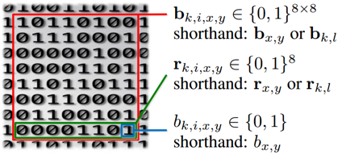
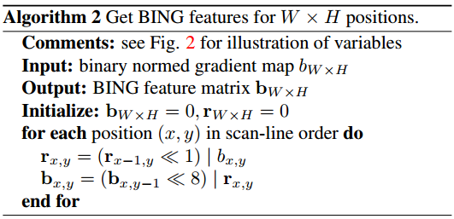
Methodology
Getting BING feature: illustration of the representations
Getting BING feature

Slide 23
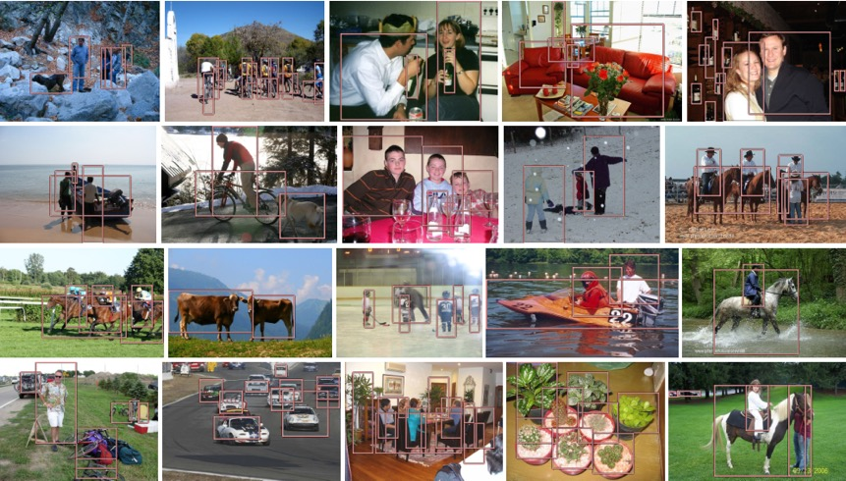
Experimental results
Sample true positives on PASCAL VOC 2007

Slide 24
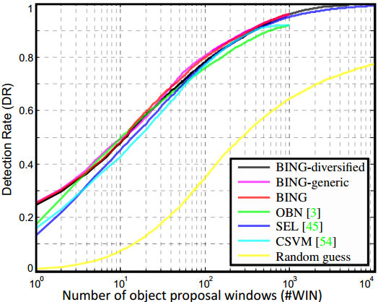
Experimental results
Proposal quality on PASCAL VOC 2007

Slide 25
Experimental results
Computational time
  A laptop with an Intel i7-3940XM CPU
  20 seconds for training on the PASCAL 2007 training set!!
  Testing time 300fps on VOC 2007 images
Method | [1] | OBN [2] | CSVM [3] | SEL [4] | Our BING
Time (seconds) | 89.2 | 3.14 | 1.32 | 11.2 | 0.003
Category-Independent Object Proposals With Diverse Ranking, PAMI 2014, Endres et. al.
Measuring the objectness of image windows. PAMI 2012, Alexe, et. al.
Proposal Generation for Object Detection using Cascaded Ranking SVMs. CVPR 2011, Zhang et. al.
Selective Search for Object Recognition, IJCV 2013, Uijlings et. al.

Slide 26
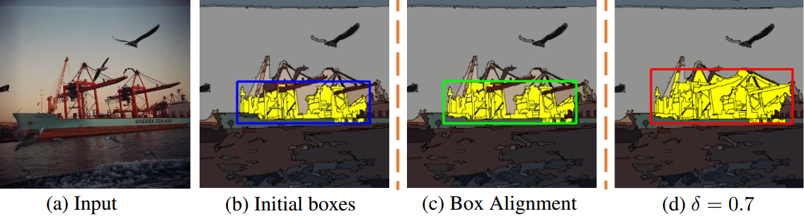
Improving object proposals
Improving object proposals with multi-thresholding straddling expansion, X. Chen, H. Ma, et al. CVPR 2015.

Slide 27
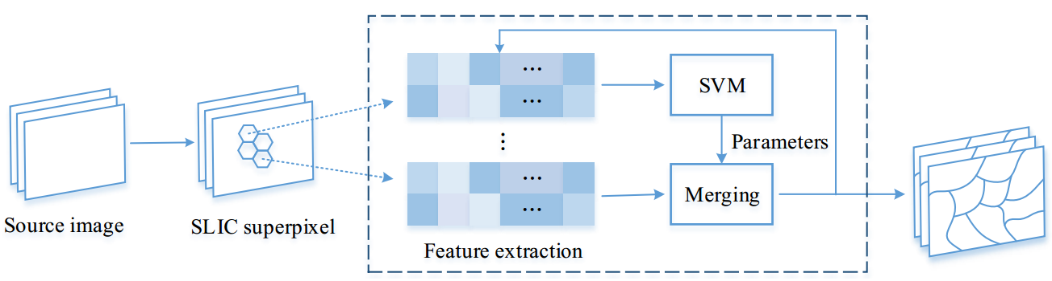
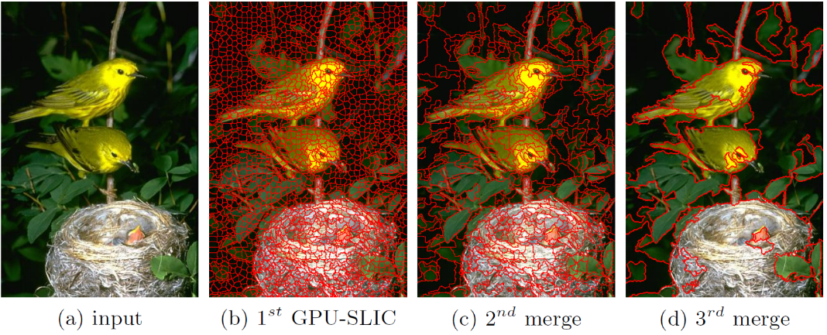
Efficient image segmentation
HFS: Hierarchical Feature Selection for Efficient Image Segmentation, MM Cheng, Y Liu, Q Hou, J Bian, P Torr, SM Hu, Z Tu, ECCV 2016.

Slide 28
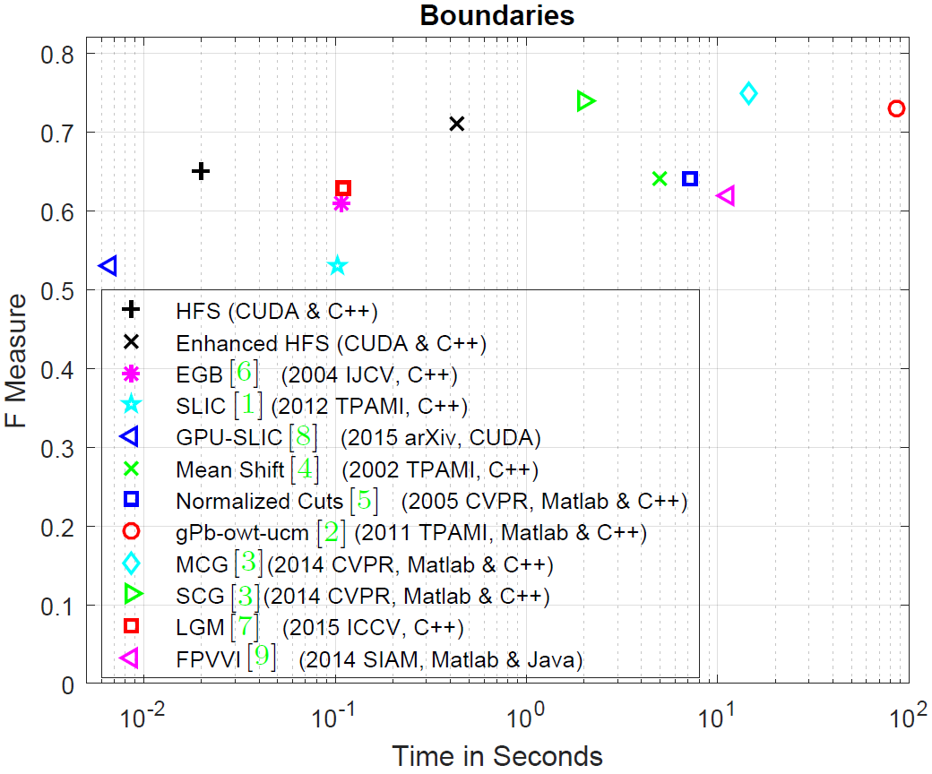
Efficient image segmentation

Slide 29
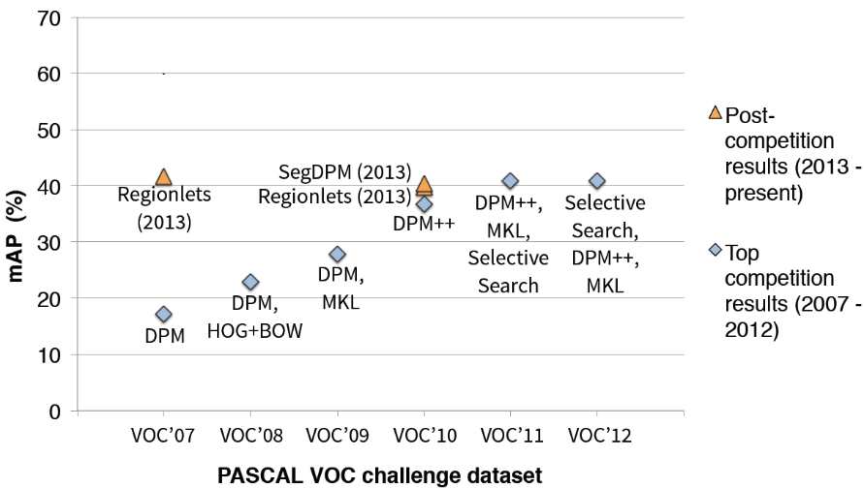
PASCAL VOC detection history
BING++
R-CNN (2014)
R-CNN (2014)
R-CNN (2014)
Rich feature hierarchies for accurate object detection and semantic segmentation, CVPR 2014 (Oral), Girshick et al.
BING++: A Fast High Quality Object Proposal Generator at 100fps, arXiv, Zhang et al.
Notes:
We rerun the experiments in Table 4 from the original submission using the same experimental settings based on the Python code of Fast-RCNN provided by the author on https://github.com/rbgirshick/fast-rcnn. In the original submission we used the Matlab implementation of Fast-RCNN. This change resulted in an increased performance for all methods as illustrated in Table 1. The trends and best performing methods for both tables are mostly the same. The Python-based detector runs at 5 frames per second(fps) on NVIDIA Titan X GPU achieving 68.7% mAP in VOC2007 test set. Therefore, combination of our fast BING++ object proposals and state of the art detector is a step towards real-time object detection in videos

Slide 30
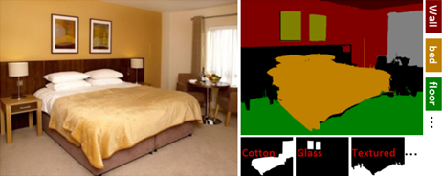
ImageSpirit: Verbal Guided Image Parsing, ACM TOG, 2014, M.M. Cheng et. al.

Slide 31
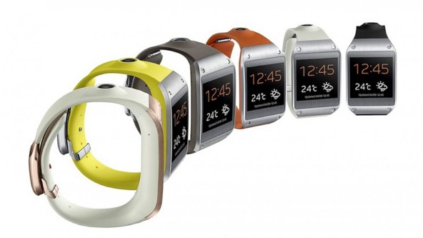


Motivations

Slide 32






Verbal guided image parsing
Make the wood cabinet in bottom-middle lower
nouns
Adjective
Verb/Adverb
Object Attributes
Commands
Multi label CRF

Slide 33
Multi-Label Factorial CRF
$$E\left(z\right)=\overset{Unary}{\overbrace{\sum_{i∈I}{ψ_{i}\left(z_{i}\right)}}}+\overset{Pairwise}{\overbrace{\sum_{i≠j∈I}{ψ_{ij}(z_{i},z_{j})}}}$$
$$ψ_{i}\left(z_{i}\right)=\overset{Object}{\overbrace{ψ_{i}^{O}\left(x_{i}\right)}}+\overset{Attributes}{\overbrace{\sum_{a}{ψ_{i,a}^{A}(y_{i,a})}}}+\overset{Joint Object−Attribute}{\overbrace{\sum_{o,a}{ψ_{i,o,a}^{OA}}\left(x_{i},y_{i,a}\right)}}+\overset{Joint Attribute−Attribute}{\overbrace{\sum_{a≠a^{′}}{ψ_{i,a,a^{′}}^{A}(y_{i,a},y_{i,a^{′}})}}}$$
Object classifiers: table, chair, etc.
Object and attributes correlation.
Correlation between attributes.
Attributes classifiers: wood, plastic, red, etc.

Slide 34
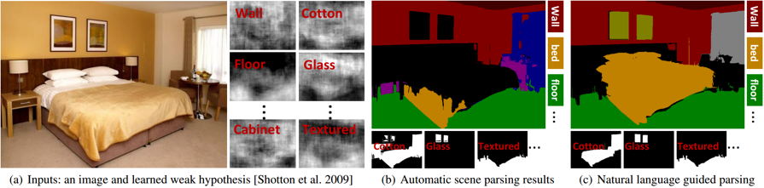
Verbal guided image parsing
Source code
  http://mmcheng.net/imagespirit/
Demo video
free

Slide 35
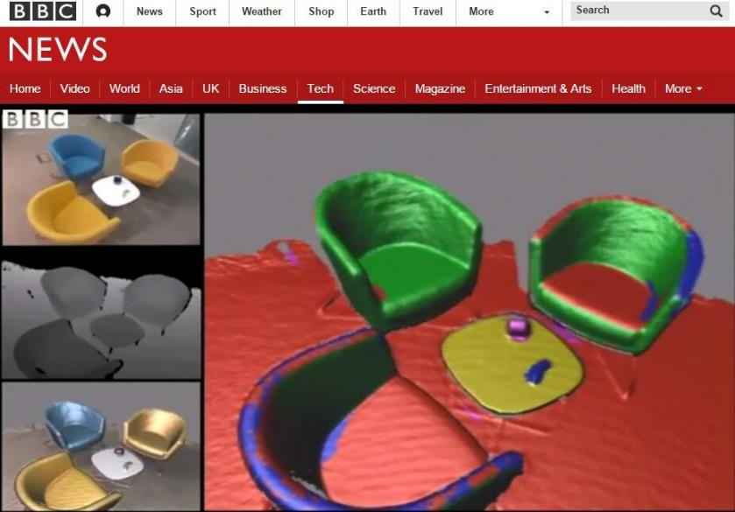
SemanticPaint

Slide 36
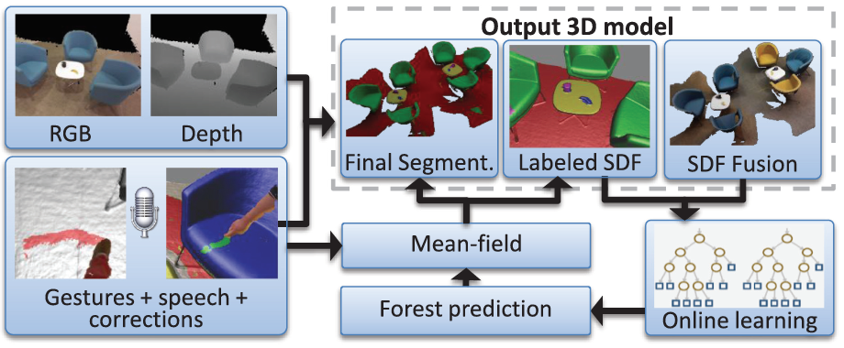
SemanticPaint
SemanticPaint: Interactive 3D Labeling and Learning at your Fingertips, ACM TOG 2016.

Slide 37
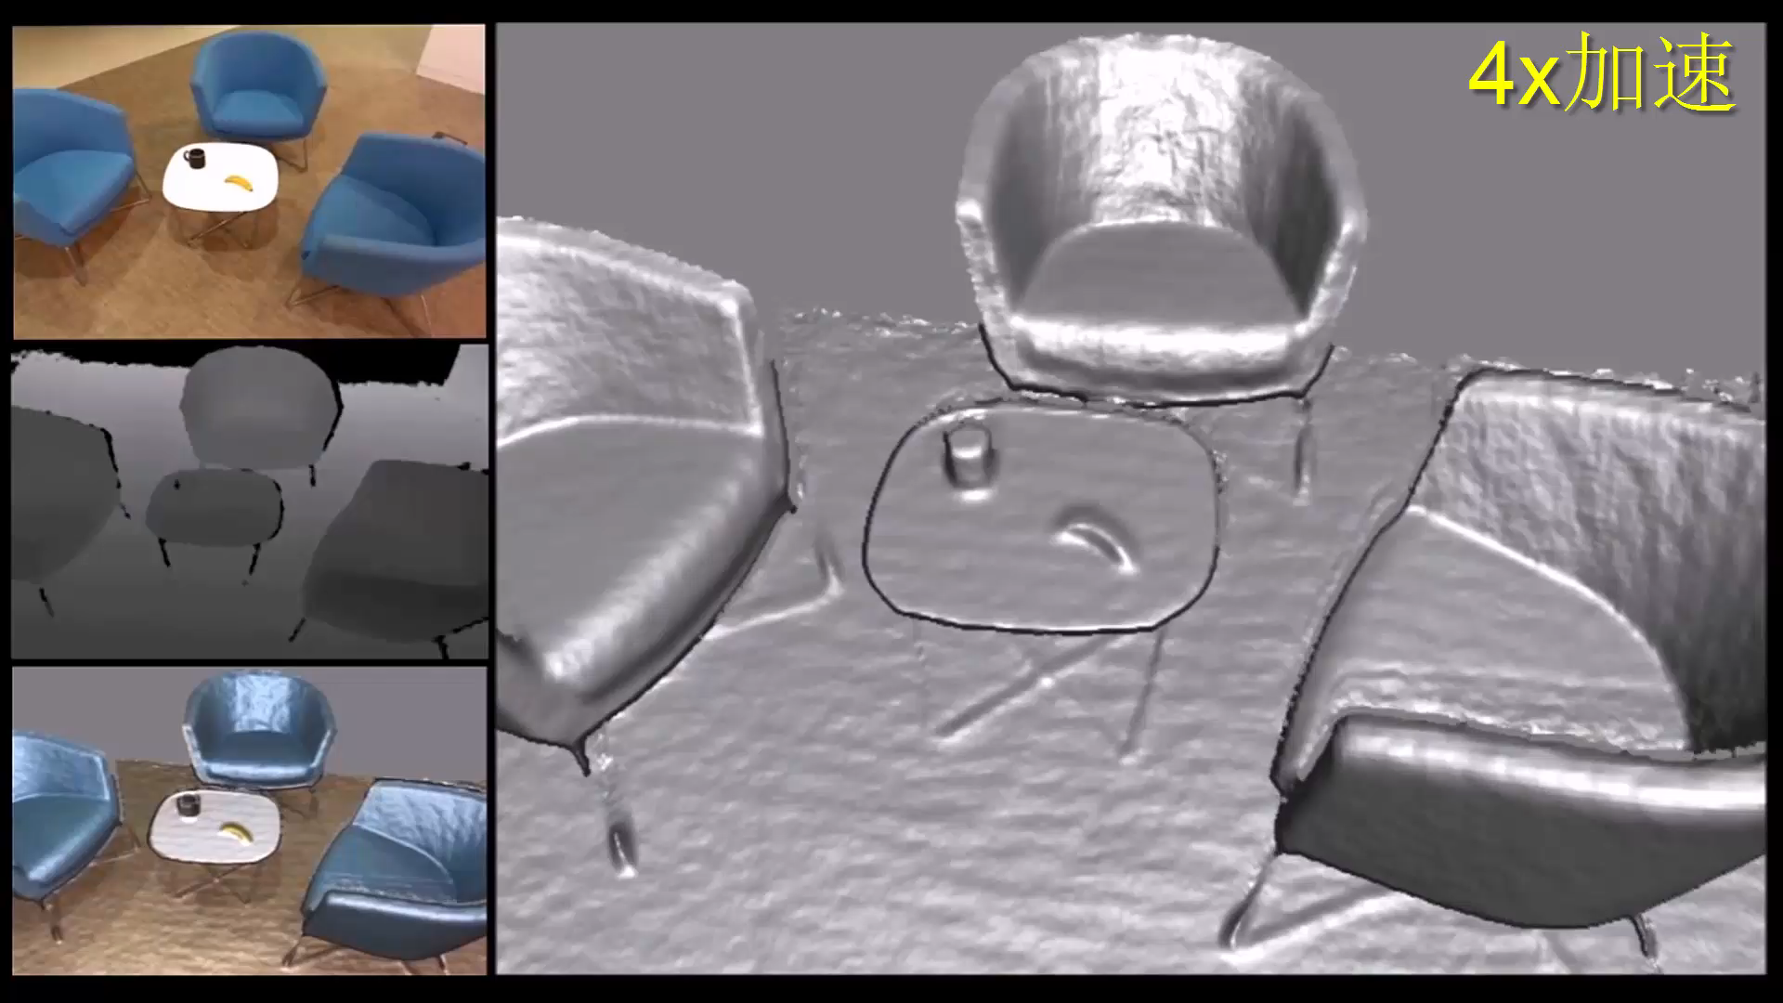
SemanticPaint: Demo

Slide 38

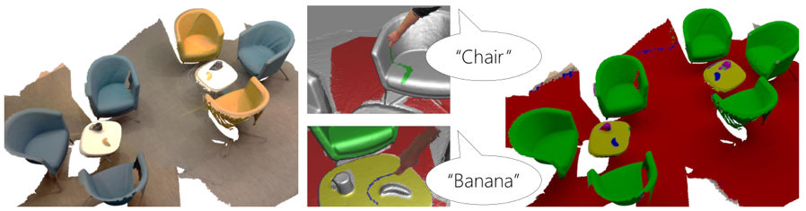
SemanticPaint
Highlight
  Personalized
  Recognition in 3D
  Learning in the environment
  User in the loop
Source code
  http://mmcheng.net/s-paint/
free

Slide 39

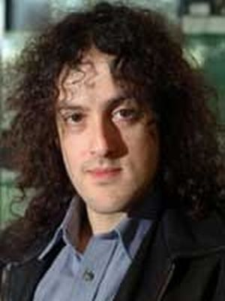




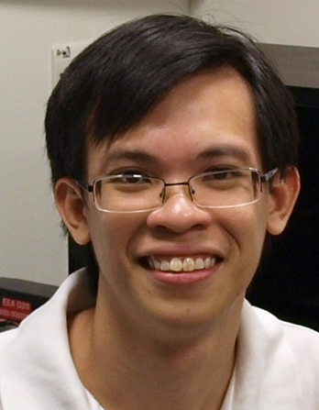



Collaborators (partial list)

Slide 40

free

Slide 41
Thanks
Q&A

