Slide 1
算力自适应与数据自适应的图像感知
程明明
南开大学计算机学院、华为昇腾生态顾问
http://mmcheng.net
Notes:
题目：开放环境下的自适应图像感知
报告简介：从图像中快速准确地获取目标信息是计算机视觉的核心任务。表示层面，鲁棒的目标检测与信息提取需要对不同粒度的信息进行高效的整合。计算层面，受体积、功耗等限制，智能算法如何适应这些算力受限设备至关重要。数据层面，许多现实应用无法收集足够标注，传统依赖数据覆盖目标场景的模式不可用。为了解决这些问题，急需设计自适应能力强的图像感知算法，包括粒度自适应、算力自适应，和数据自适应。具体来说，本报告将介绍粒度自适应的特征表达；算力自适应的高效视觉感知；和通用属性知识引导的视觉感知技术。
讲者介绍：程明明，南开大学教授，计算机系主任，国家“万人计划”青拔、“优青”。他的主要研究方向是计算机视觉和计算机图形学，在SCI一区/CCF A类国际期刊和会议上发表学术论文100余篇，论文Google学术引用2万余次，一作论文单篇最高引用4000余次，连续5年入选Elsevier中国高被引学者榜单。技术成果被应用于华为手机智能拍照、推想科技CT影像智能分析、金风科技风电设备运行监控、和中化农业病虫害识别等领域。获得ACM中国新星奖、天津市青年科技奖、吴文俊人工智能自然科学二等奖、中国图象图形学学会自然科学一等奖、教育部自然科学一等奖等奖项。现为中国图象图形学学会副秘书长，天津市人工智能学会副理事长，并担任SCI一区期刊IEEE TPAMI和IEEE TIP编委。
相关论文：
[1] Res2Net: A New Multi-scale Backbone Architecture, IEEE TPAMI 2020
[2] MS-TCN++: Multi-Stage Temporal Convolutional Network for Action Segmentation, IEEE TPAMI 2020
[3] Ordered or Orderless: A Revisit for Video based Person Re-Identification, IEEE TPAMI, 2020.[4] Deep Hough Transform for Semantic Line Detection, IEEE TPAMI， 2021.[5] Nonlinear Regression via Deep Negative Correlation Learning, IEEE TPAMI 2020[6] Leveraging Instance-, Image- and Dataset-Level Information for Weakly Supervised Instance Segmentation, IEEE TPAMI 2020

Slide 2


表示层面挑战: 特征表示粒度自适应性差
复杂场景算不准→粒度自适应性差
  复杂场景理解需要目标物体局部、整体、和环境信息
  例：特征表达不能自适应地捕捉环境信息导致错误
树桩 vs. 凳子？

Slide 3
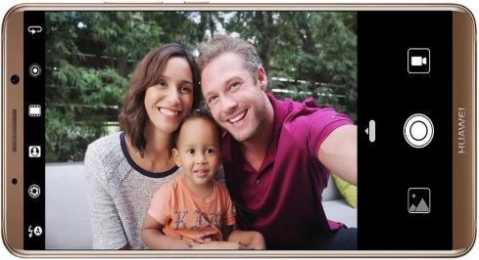
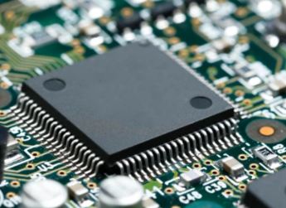
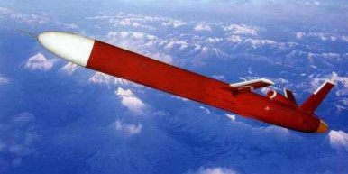
计算层面挑战: 计算方法算力自适应性差
算力受限设备算不动→算力自适应性差
  受体积、功耗等限制，许多智能设备算力非常有限
  传统算法难以在这些设备上实时运行
智能手机
导弹制导
硬件算力受限

Slide 4
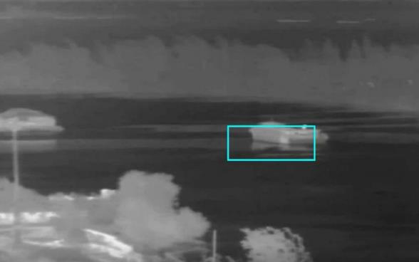
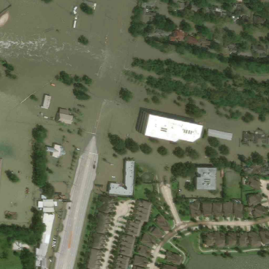
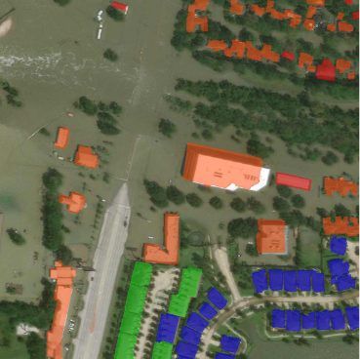
数据层面挑战: 对标注样本数据自适应性差
标注不足场景算不了→数据自适应性差
  许多现实应用无法收集足够标注
  传统依赖数据覆盖目标场景的模式不可用
敌方军舰红外数据
灾害损毁数据

Slide 5
图像自适应感知
粒度自适应特征表达
粒度
算力
算力自适应的高效视觉感知
数据
通用属性知识引导的视觉感知
自适应性

Slide 6
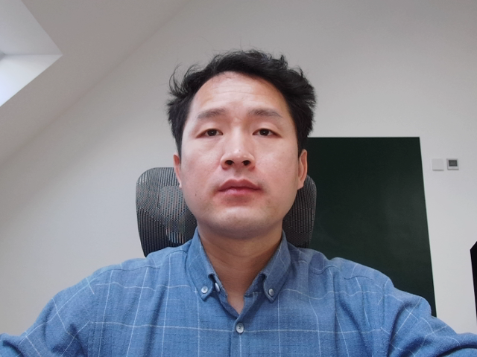
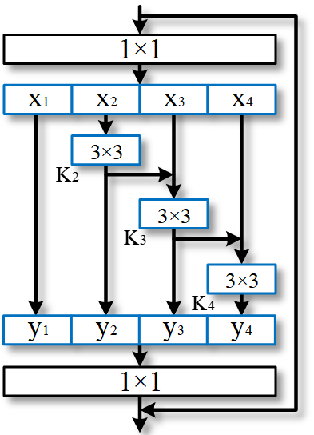
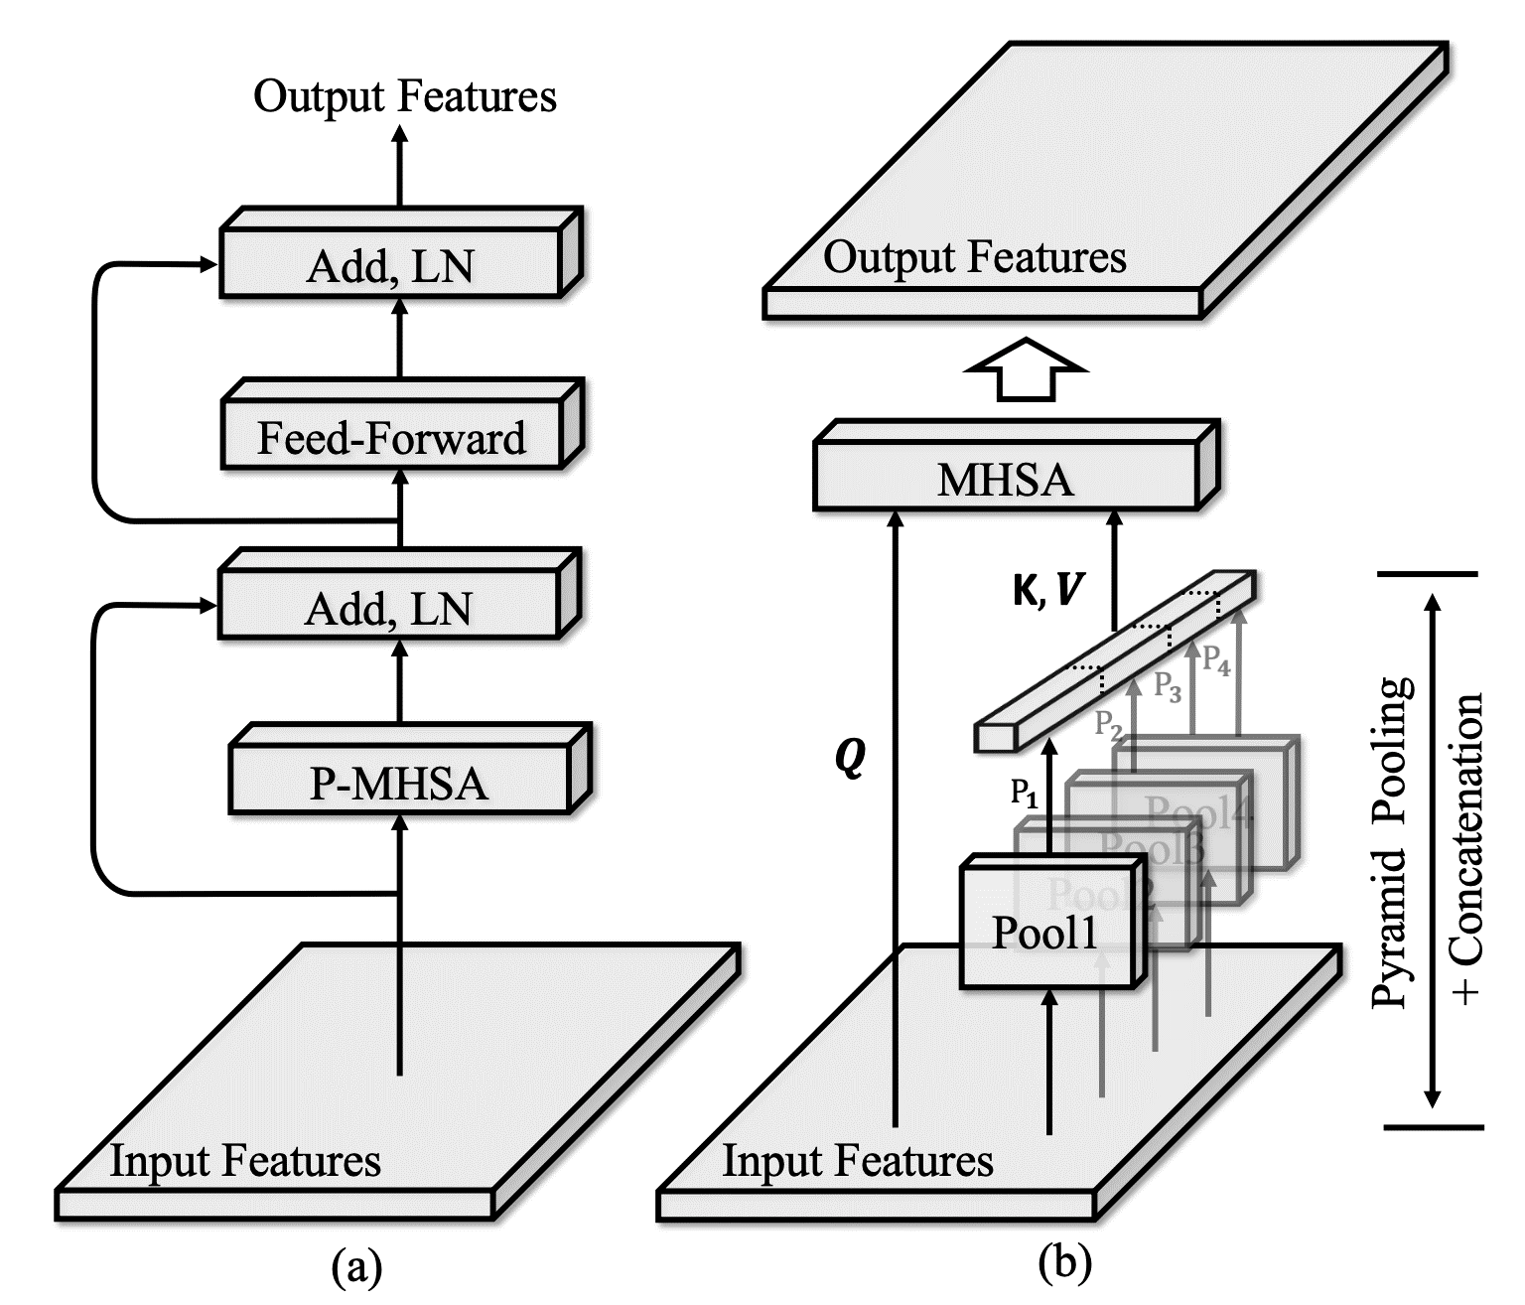
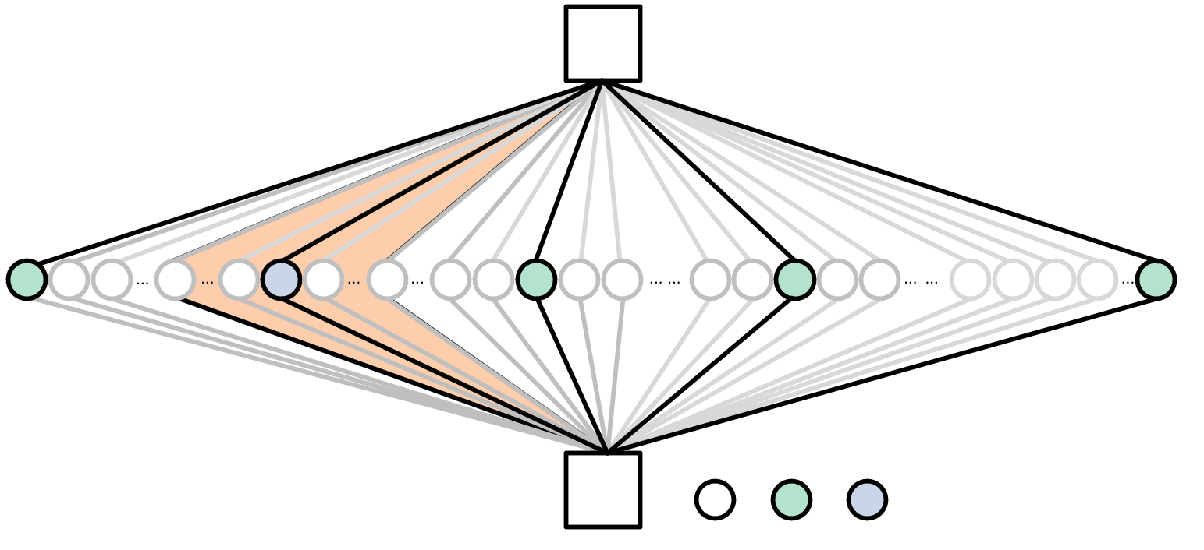
粒度自适应的图像感知
Res2Net
PAMI 2021
P2T
PAMI 2022
RF-Next
PAMI 2022

Slide 7
图像自适应感知
粒度自适应特征表达
粒度
算力
算力自适应的高效视觉感知
数据
通用属性知识引导的视觉感知
自适应性

Slide 8
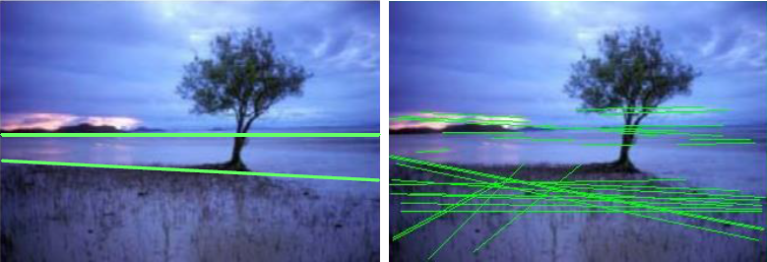

基于深度霍夫变换的语义线检测
Deep Hough Transform for Semantic Line Detection, IEEE TPAMI 2022.

Slide 9
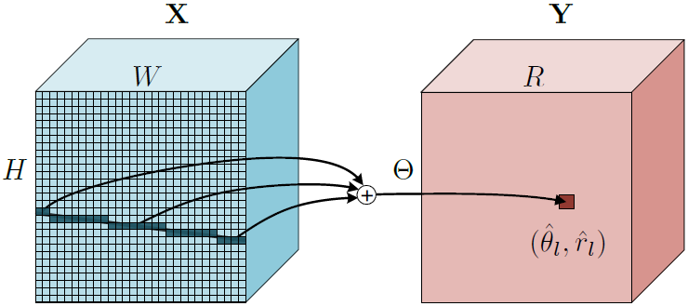
基于深度霍夫变换的语义线检测

Slide 10
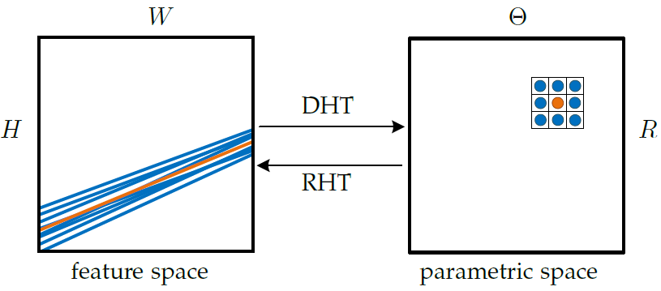
霍夫空间多尺度

Slide 11
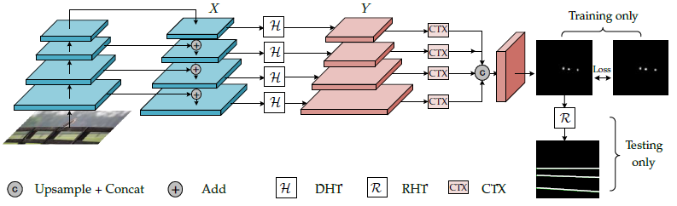
基于深度霍夫变换的语义线检测

Slide 12
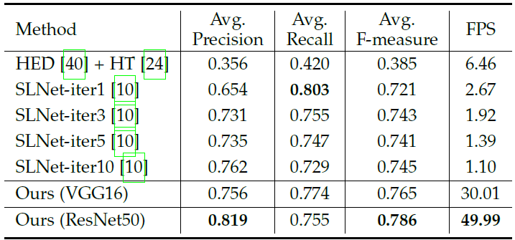
基于深度霍夫变换的语义线检测

Slide 13
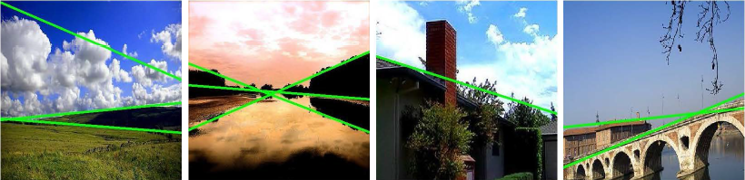
基于深度霍夫变换的语义线检测
样例结果

Slide 14
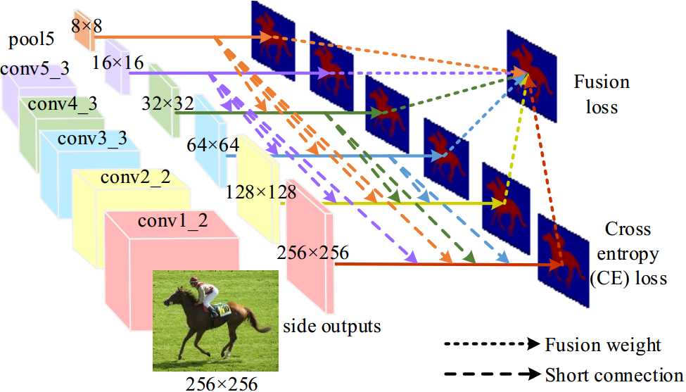
A typical salient object detection model
Deeply supervised salient object detection with short connections, IEEE TPAMI 2019

Slide 15
Problems with existing detection methods
Fixed pre-trained backbones + detection head
  Typical backbones: VGG, ResNet, Res2Net
Pre-trained backbone → most of the latency cost
Designing lightweight backbones for SOD?
  Separate the backbone and decoder design
Integral search space: simultaneously searching backbone + detection head

Slide 16
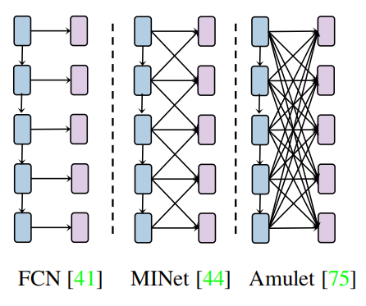
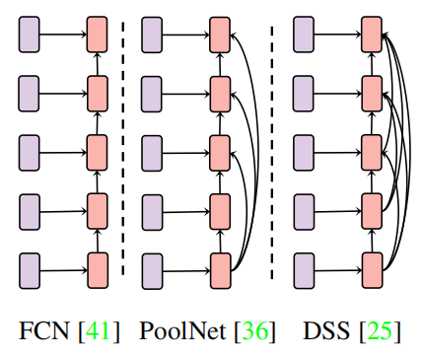
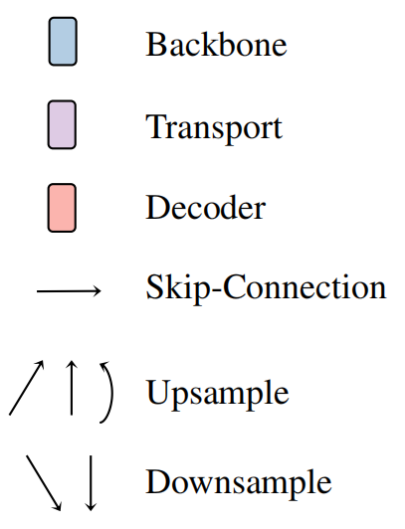
Problems with existing detection methods
Fixed pre-trained backbones + detection head
  Typical backbones: VGG, ResNet, Res2Net
feature extraction
detection head

Slide 17
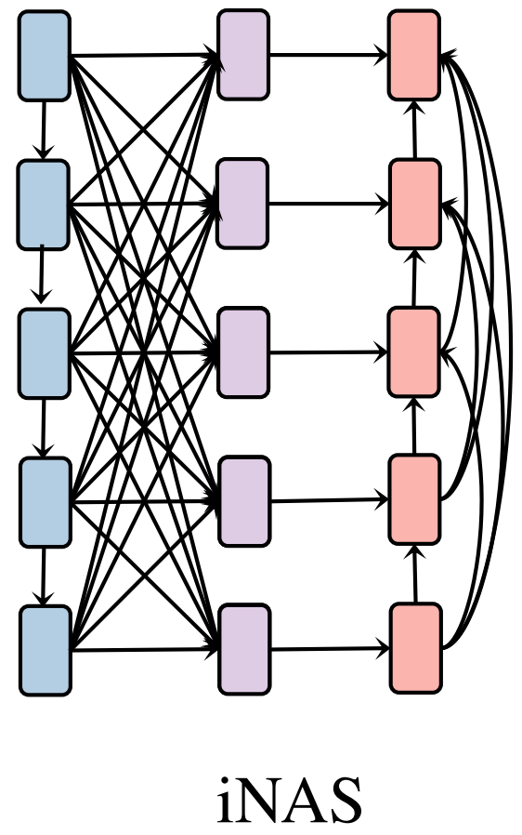
Problems with existing detection methods
Fixed pre-trained backbones + detection head
Integral search space for iNAS
feature extraction
detection head

Slide 18
Searchable saliency detection head
Transport designs: bottom-up/top-down fusion
  Connects to all levels of the backbones
  Largest: aggregate from all levels, like Amulet
  Smallest: only keeps identify branches, like FCN
Decoders
  Bottom-up prediction refinement
  Largest: like DSS
  Smallest: like FCN

Slide 19
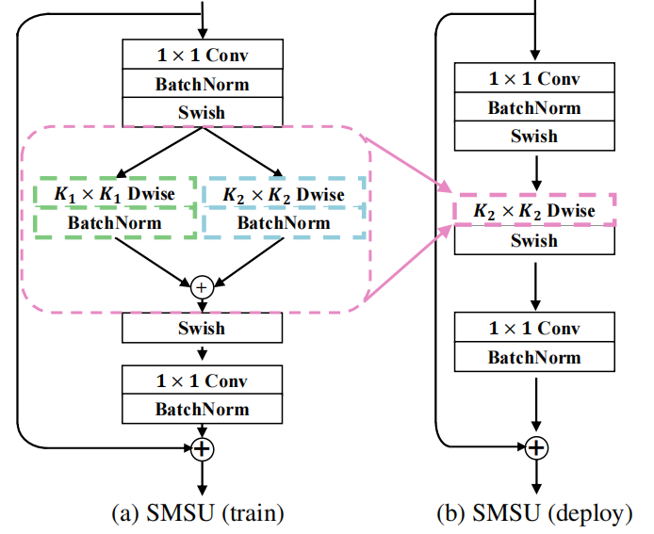
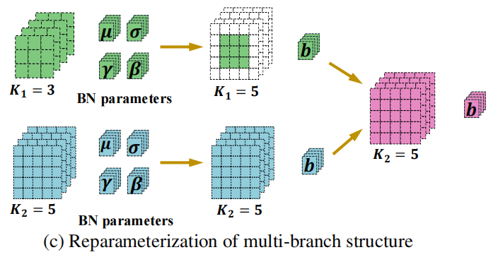
Searchable multi-scale unit (SMSU)
Multi-branch structures are not hardware-friendly
Extended to any branches

Slide 20
Searchable multi-scale unit (SMSU)
Multi-branch structures are not hardware-friendly
Extended to any branches

Slide 21
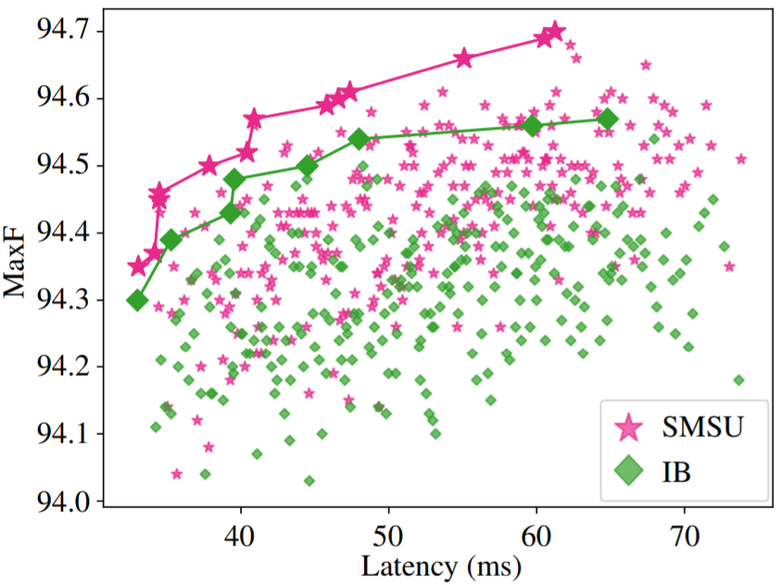
Searchable multi-scale unit (SMSU)
Best receptive field may be different at different levels
  Use SMSU as a basic search unit in the transport and decoder
Make key components searchable
  Prune redundant fusion branches
  Choose appropriate fusion kernels with latency constrains
Weight-sharing super-net
  Channels
  Layers
  Kernel combinations
  Multi-level fusions

Slide 22
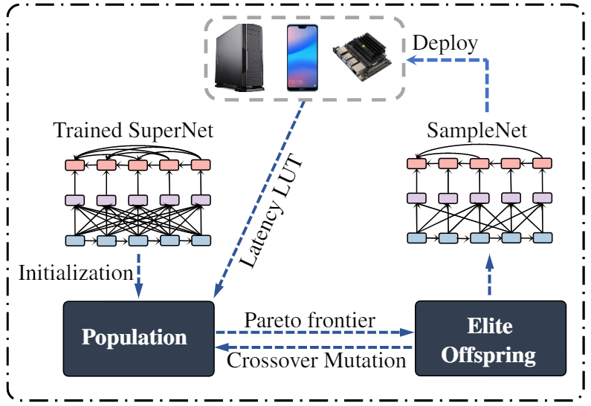
Device-aware Search
Search & Deploy:
  Benchmark on hardware and build LUT.
  Adopt evolutionary search to find Pareto frontier.
  Inherit weights from the super-net and deploy.

Slide 23
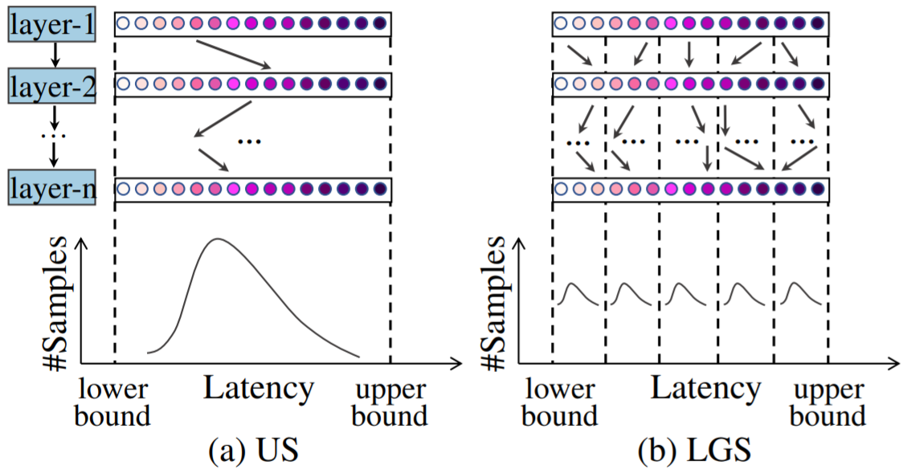
Device-aware Search
Observation & Solution
  Uniform sampling → imbalanced sampling in latency space.
  Latency-group sampling ensures balanced sampling

Slide 24
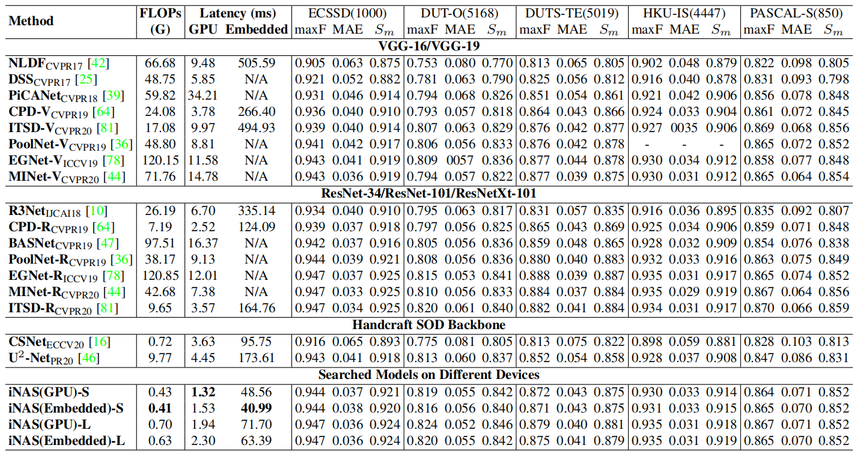
Benchmark

Slide 25
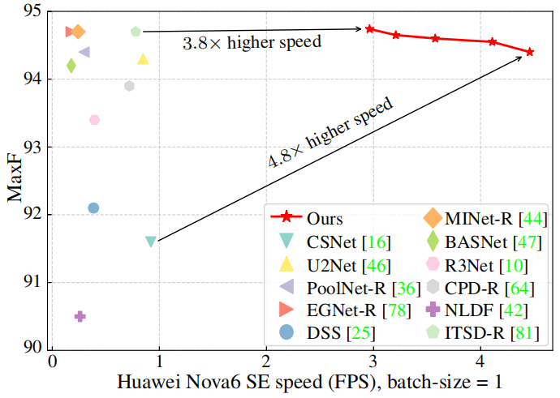
Speed comparison with existing SOD methods

Slide 26
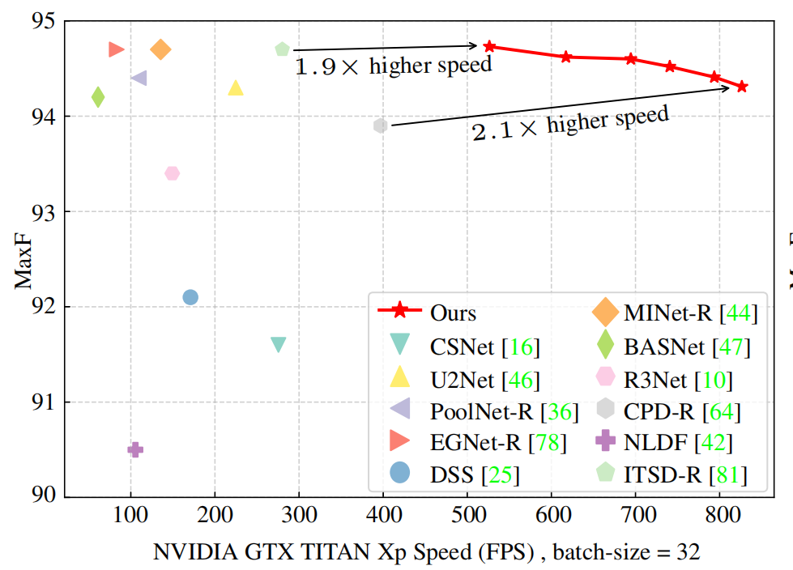
Speed comparison with existing SOD methods

Slide 27
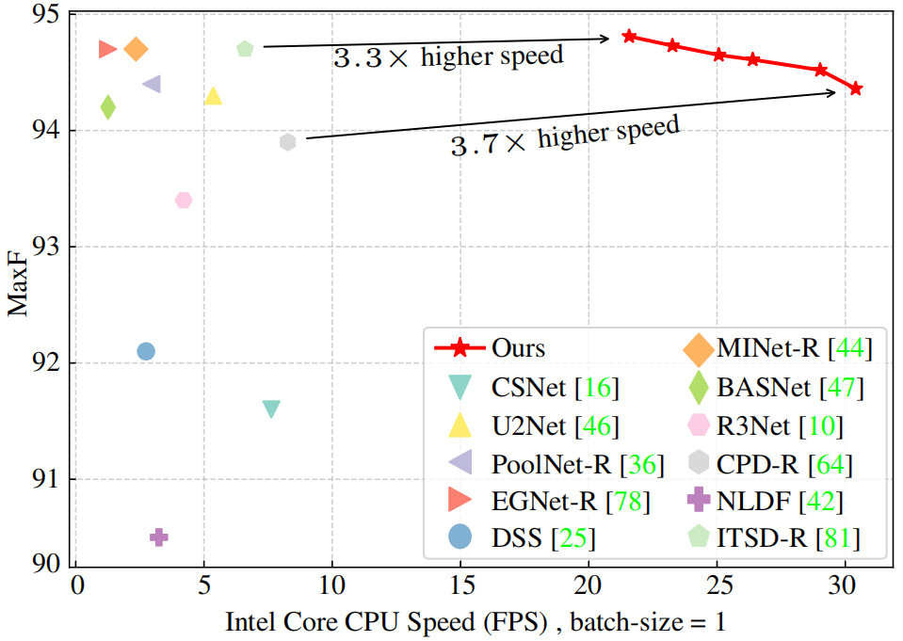
Speed comparison with existing SOD methods

Slide 28
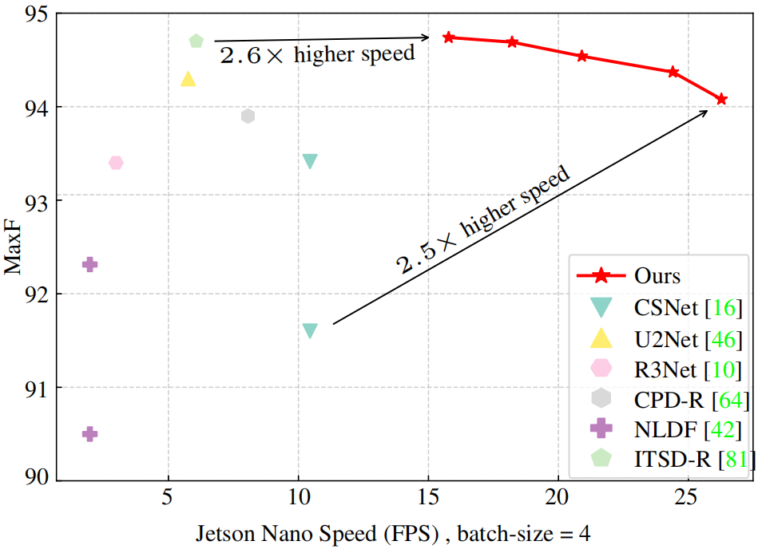
Speed comparison with existing SOD methods

Slide 29
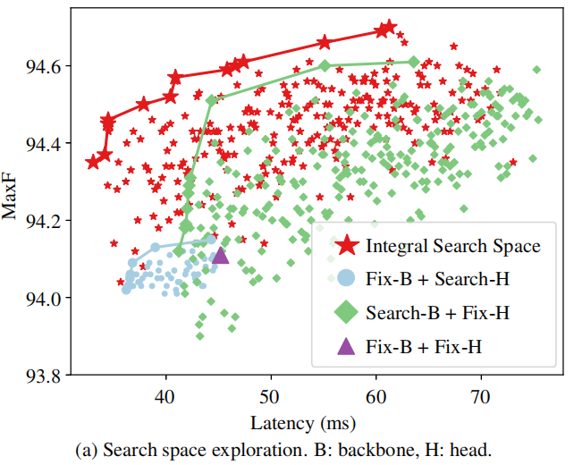
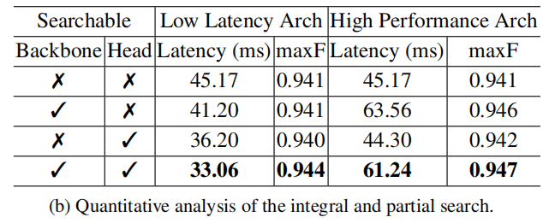
Ablation: search space

Slide 30
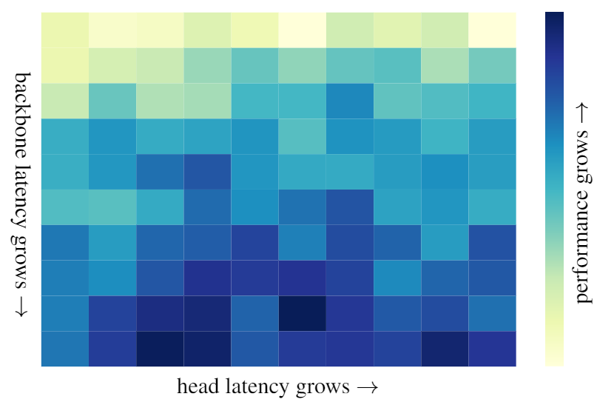
Ablation: search space
Integral vs. partial search:
  Integral search has a consistent improvement over partial search.
Observation:
  The most complex head doesn’t always achieve the best performance
Visualization of the correspondence between the backbone/head latency and the performance.

Slide 31
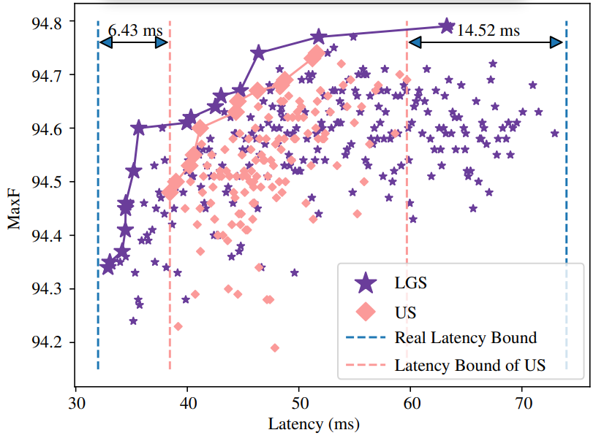
Ablation: device search
Latency group vs. uniform sampling
  US only samples 50.2% of the latency range.
  LGS samples 99% of the latency range.
Comparison of the evolution search with uniform sampling (US) and proposed LGS.

Slide 32
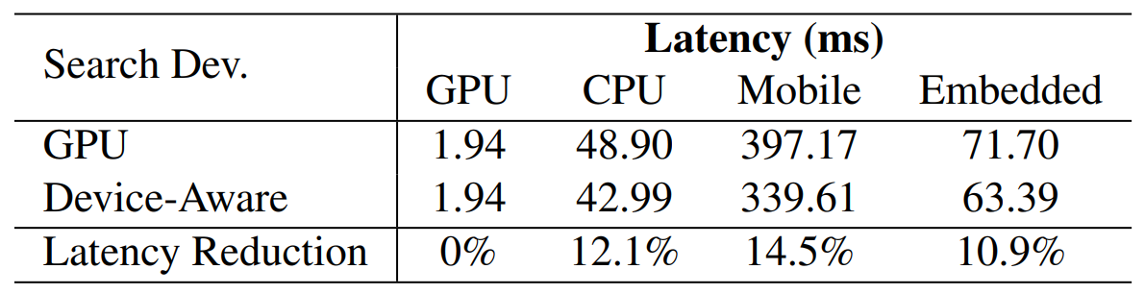
Ablation: device search
The device-aware search schema
  Baseline: search on GPU and deploy to other devices.
  Device-aware search: reduce 10.9%-14.5% model latency of adopting baseline strategy.
Comparison of searching on GPU and specialized device.

Slide 33
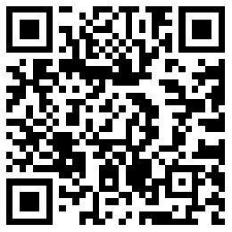
Major discovery
We identify two challenges in low-latency SOD model designs and propose iNAS to overcome those challenges.
  iNAS can seek a balance in different components’ complexities.
  iNAS can specialize different models for different devices.
iNAS paves the way for SOD applications on low-power devices.
Code is available.

Slide 34
图像自适应感知
粒度自适应特征表达
粒度
算力
算力自适应的高效视觉感知
数据
通用属性知识引导的视觉感知
自适应性

Slide 35
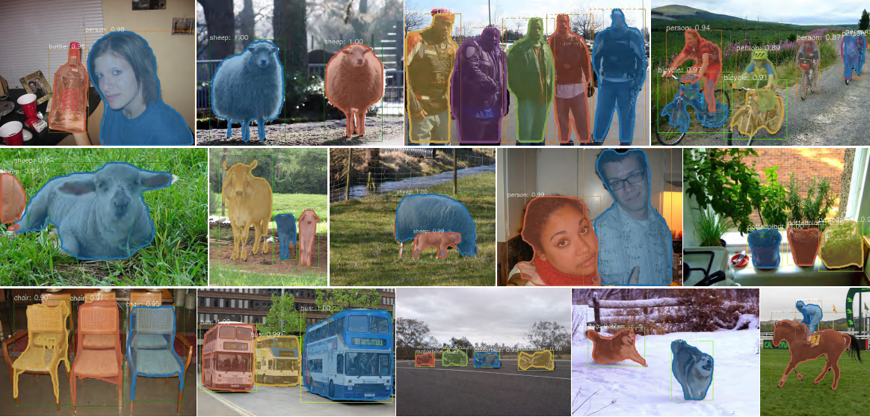
弱监督实例分割
Leveraging Instance-, Image- and Dataset-Level Information for Weakly Supervised Instance Segmentation, IEEE TPAMI, 2022.

Slide 36
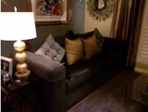
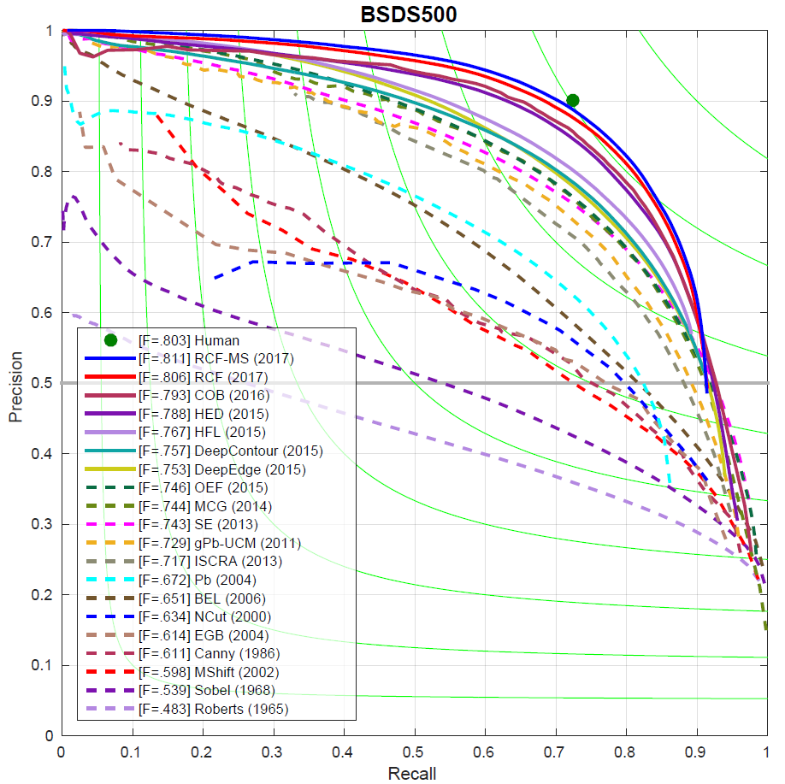
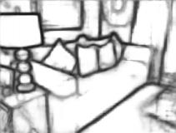
基于卷积层多尺度的边缘检测
边缘检测50+年
Since Roberts (1965)
Richer Convolutional Features for Edge Detection, IEEE TPAMI 2019.
Notes:
Some examples of RCF. From top to bottom: BSDS500, NYUD, Multicue-Boundary, and Multicue-Edge. From left to right: origin image, ground truth, RCF edge map, origin image, ground truth, and RCF edge map.

Slide 37
显著性检测：一种类别无关的基本属性
关于显著性检测技术的思考？
  显著性检测只是简单的两类语义分割吗？
  类别信息在显著性检测中起到多大作用？
  预训练模型是必须的吗？
设计一种超轻量级的模型研究语义信息在SOD中的作用
  不依赖于预训练的小模型
    例如：MobileNet v2有4.2M参数，我们的模型100K
A Highly Efficient Model to Study the Semantics of Salient Object Detection, IEEE TPAMI 2022.

Slide 38
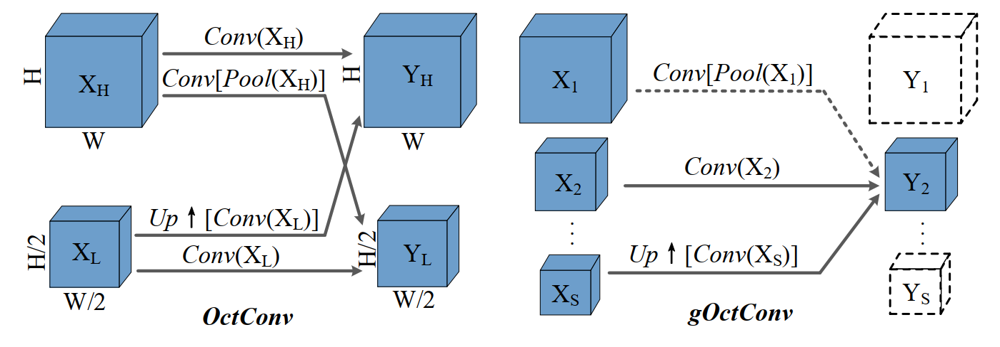
跨层动态自适应的多尺度融合

Slide 39
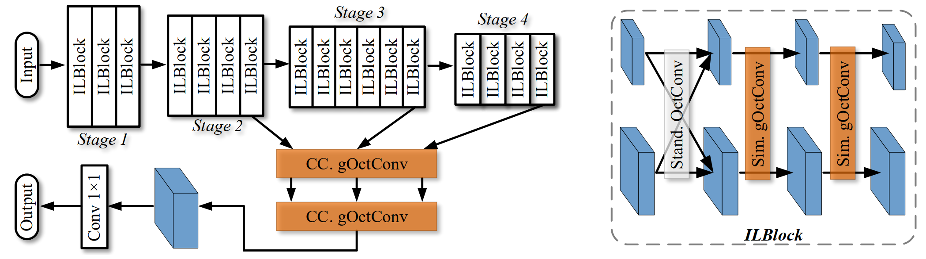
轻量级的显著性检测模型
参数量小，可以端到端训练
非常简单，避免研究语义信息过程中的歧义性
具有SOD所需的强大多尺度能力

Slide 40
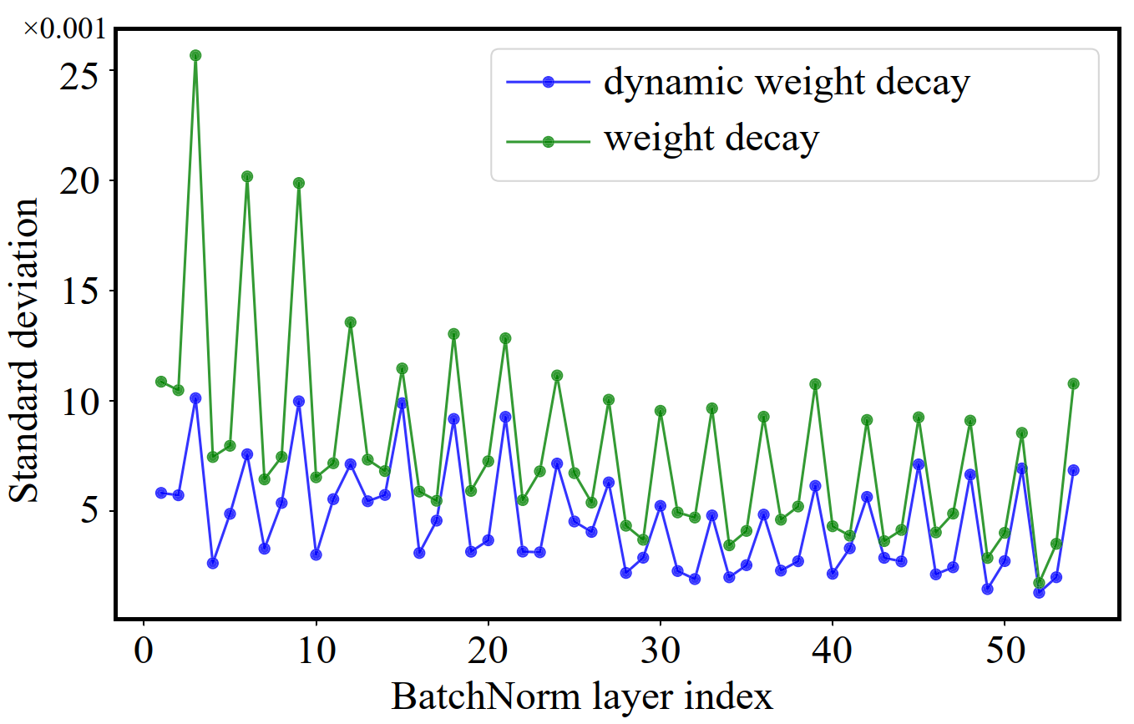
Weight decay → 自适应Channel数

Slide 41
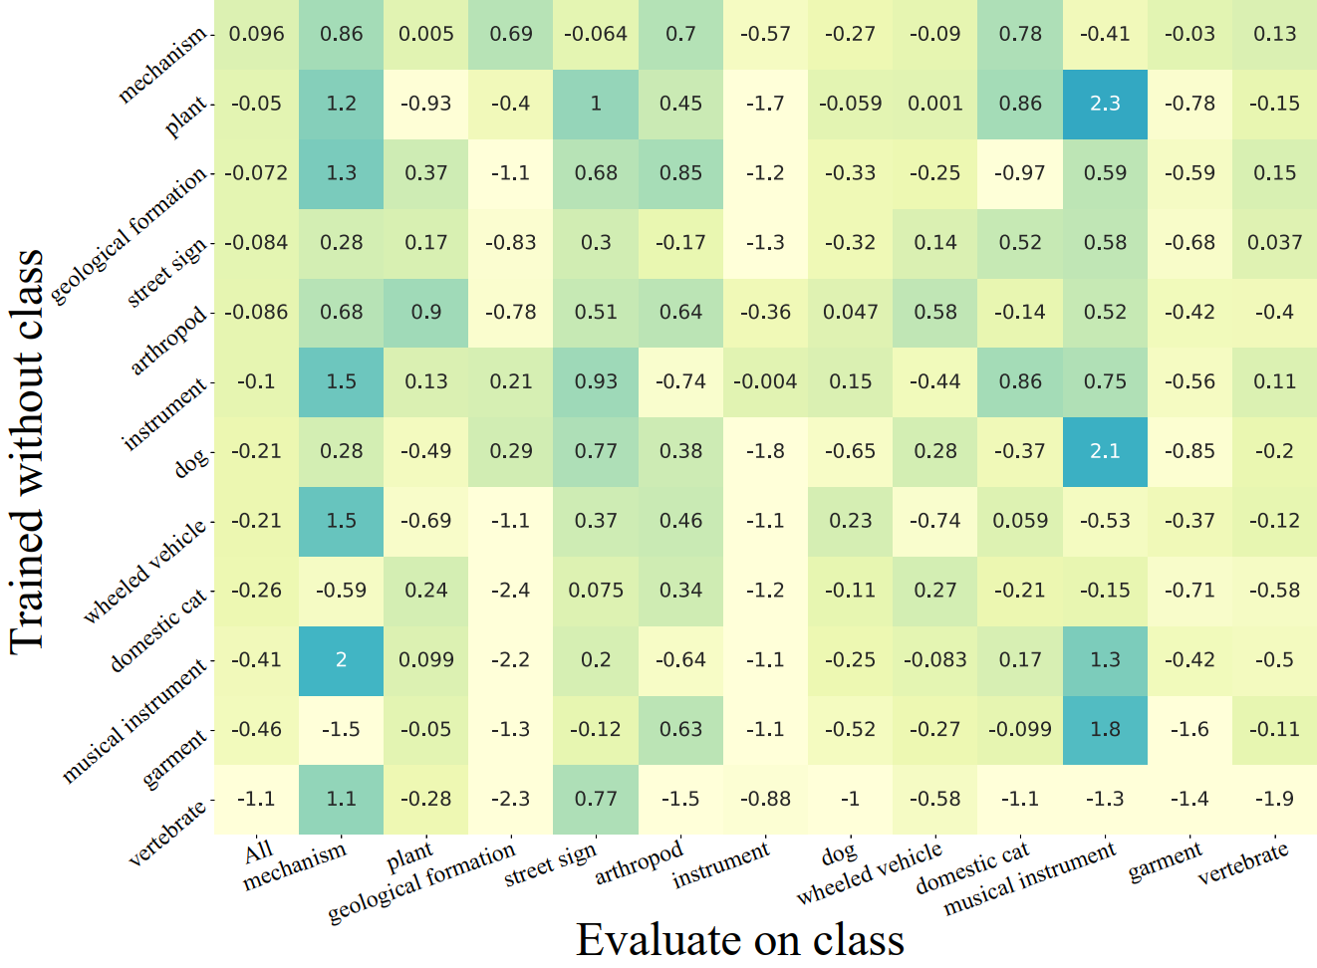
显著性检测可以处理未知类别吗？

Slide 42
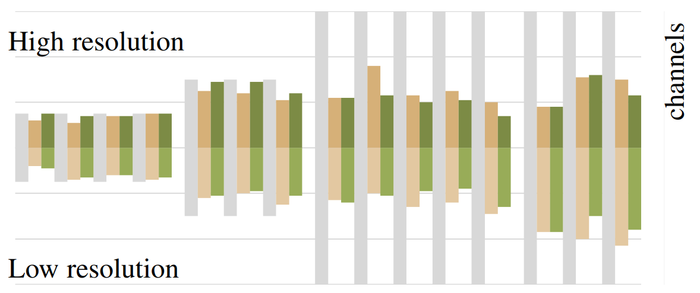
自适应通道数学习结果
默认 (灰色) ，权值衰减 (橘黄)，动态权值衰减 (绿色)

Slide 43
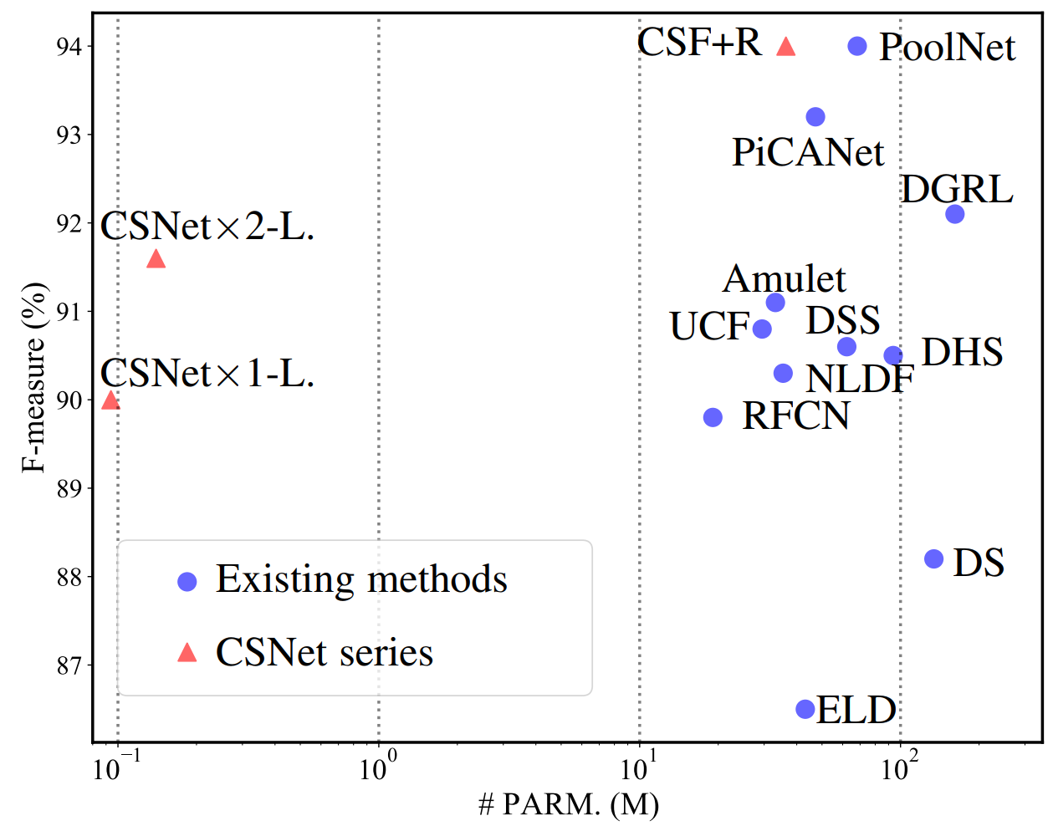
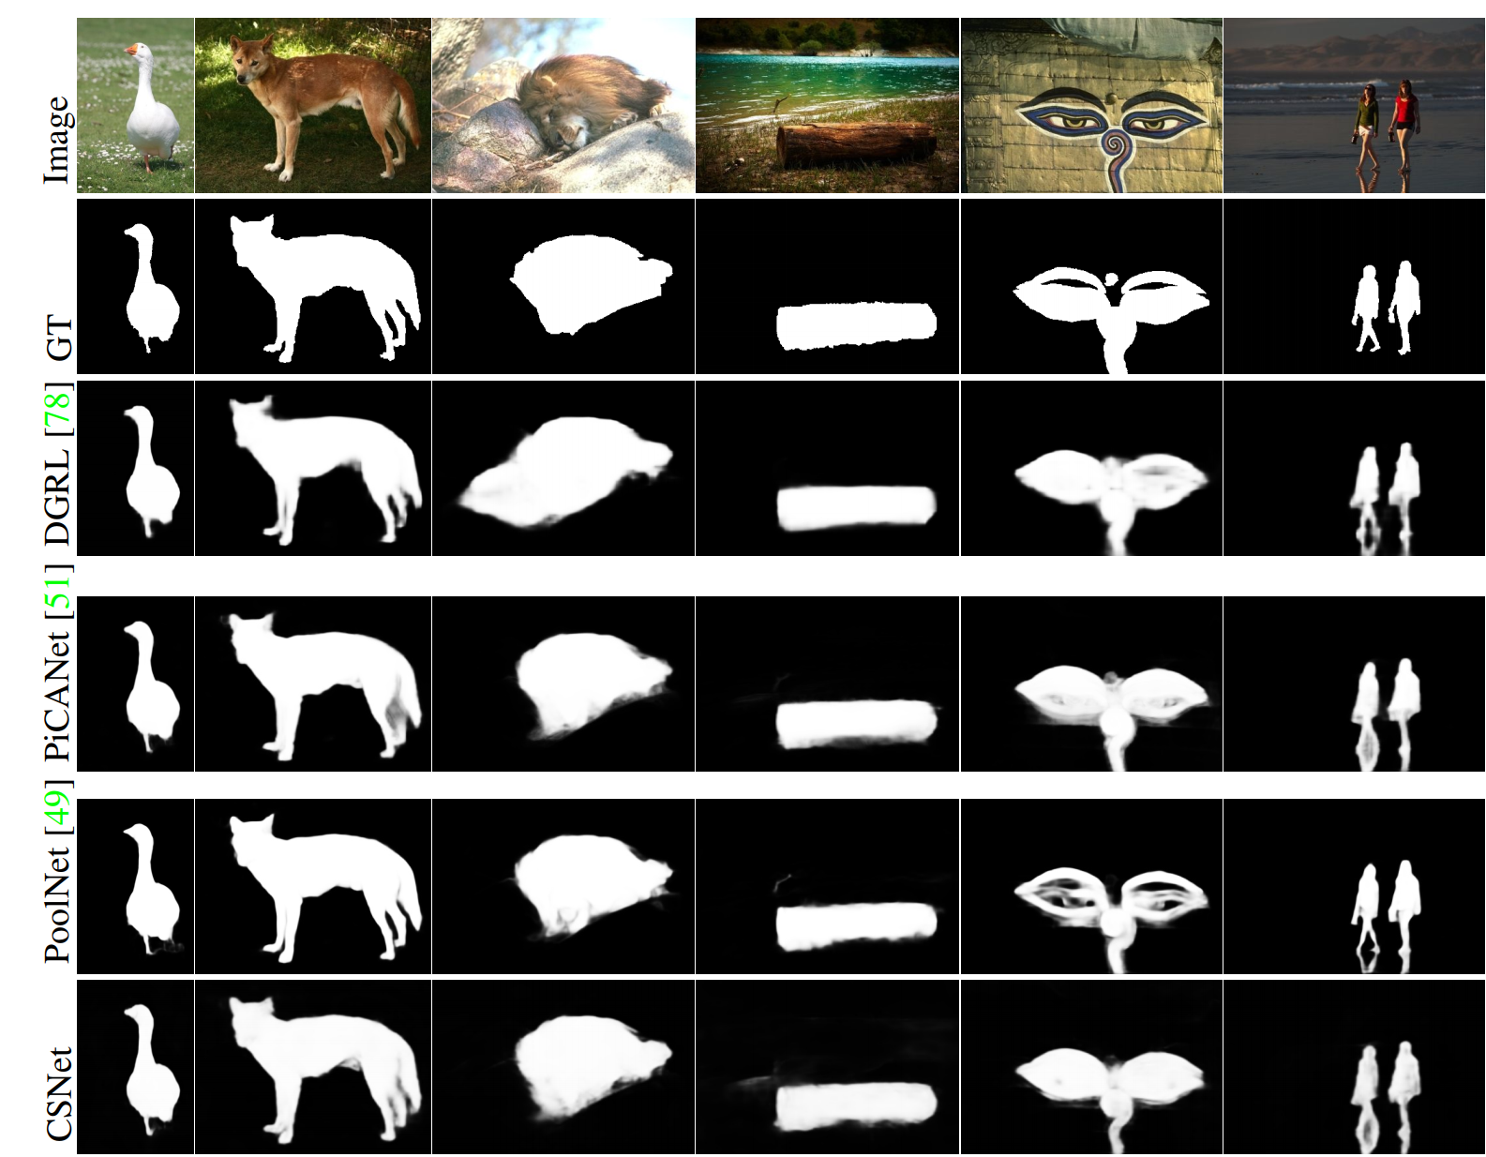
实验结果
参考
  MobileNetV2: 4.2M
  CSNet: 100K

Slide 44
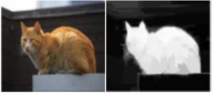
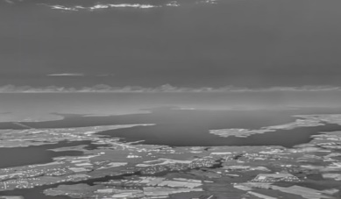


结合通用知识减少对任务相关标注数据的依赖
通用知识
专用数据
鲁棒检测
目标任务无关的通用属性

Slide 45

获取Proposal的特征和概率分布
分析并获取每一个Region Proposal的
  语义特征（semantic feature）
  概率分布（probability distribution）

Slide 46

获取Proposal的特征和概率分布
多示例学习(multiple instance learning, MIL)

Slide 47


Proposal-based MIL Loss
利用CAM获取伪标签，并计算损失

Slide 48


其他损失函数
MIL-based image classification loss
  标准的多示例学习损失函数
MIL-based center loss
  最小(大)化同(不同)类别区域特征相似性
总的损失函数

Slide 49

利用整个数据集的信息

Slide 50

Multi-way cut的近似求解
直接求解不现实
  对VOC’12数据集光CPU占用就需要${10}^{3}\sim {10}^{4}$GB
利用问题特性
  不是所有边之间都有强链接
    每个节点保留最相似的3个相邻节点
    自动形成不相连的子图
    分别求解

Slide 51

实例分割VOC’12

Slide 52

实例分割MS-COCO

Slide 53

语义分割VOC’12

Slide 54

大规模无监督语义分割
Large-scale Unsupervised Semantic Segmentation, IEEE TPAMI early access in 2022.

Slide 55


Why Unsupervised Semantic Segmentation (USS)?
Extremely expensive to annotating pixel-level labels.
  Joke: Job offer: I am looking for more parents

Slide 56

Self-supervised learning promotes the USS task
SSL models have excellent ability to extract category-related representation.
SSL models have the ability to locate objects, e.g., DINO.
Attention map from self-supervised ViT (DINO).

Slide 57

Shortcomings of existing methods for USS
Existing methods focus on small datasets
  Training efficiency $⇏$ large-scale data
  Cannot learn rich representations from large-scale data.
Lack of clear problem definition & evaluation protocol
Dataset | category | Train | USS
PASCAL VOC 2012 | 20 | 1,464 | √
Cityscapes | 19 | 2,975 | √
ADE20K | 150 | 20,210 | ×

Slide 58




















Large-Scale Unsupervised Semantic Segmentation
New task
Millions of image
Hundreds of categories
Machine
Annotator
Self-Learning
Large-scale Unsupervised Semantic Segmentation, TPAMI 2022.

Slide 59

Large-Scale Unsupervised Semantic Segmentation
LUSS Benchmark and ImageNet-S dataset

Slide 60
Large-Scale Unsupervised Semantic Segmentation
LUSS Benchmark and ImageNet-S dataset
Dataset | category | train | val | test
PASCAL VOC 2012 | 20 | 1,464 | 1,449 | 1,456
Cityscapes | 19 | 2,975 | 500 | 1,525
ADE20K | 150 | 20,210 | 2,000 | 3,000
ImageNet-S 50 | 50 | 64,431 | 752 | 1,682
ImageNet-S 300 | 300 | 384,862 | 4,097 | 9,088
ImageNet-S | 919 | 1,183,322 | 12,419 | 27,423

Slide 61

Large-Scale Unsupervised Semantic Segmentation
LUSS Benchmark and ImageNet-S dataset
919 class
100w+ images
Pixel-level annotation for val, test, and part of the training set.

Slide 62
Large-Scale Unsupervised Semantic Segmentation
Large-scale brings new challenges for LUSS task
  Simultaneously shape and category representation learning.
  Unsupervised semantic clustering of large-scale data.
  …
Large-scale also brings new opportunities
  Large-scale data provides the source for obtaining extensive representation cues.
  Large-scale data enables fairly LUSS training and evaluation.
  …

Slide 63
Evaluation protocols for LUSS task
Comprehensive evaluation of category, shape, etc.
  Full unsupervised evaluation protocol.
  Distance matching evaluation protocol.
  Semi-supervised evaluation protocol.
Fair evaluation.
  Large-scale data could avoid supervised pretrained models.
  Shape and category prior could be obtained from large-scale data.

Slide 64

Large-Scale Unsupervised Semantic Segmentation
Is fully unsupervised semantic segmentation feasible for large-scale data?
It’s working!

Slide 65

Large-Scale Unsupervised Semantic Segmentation
Non-contrastive pixel-to-pixel representation alignment.

Slide 66

Large-Scale Unsupervised Semantic Segmentation
Deep-to-shallow supervision.

Slide 67

Large-Scale Unsupervised Semantic Segmentation
Pixel-attention for pixel-label generation.

Slide 68
Large-Scale Unsupervised Semantic Segmentation
Fully unsupervised evaluation protocol
  Validation set has N images and C categories
  Model should learn to generate more than C categories
Method | Dataset | mIoU | F
PiCIE | ImageNet-S50 | 17.8 | 32.1
MaskContrast | ImageNet-S50 | 24.6 | 65.7
PASS | ImageNet-S50 | 43.3 | 70.0
PASS | ImageNet-S300 | 18.0 | 47.6
PASS | ImageNet-S919 | 11.5 | 37.1

Slide 69
Large-Scale Unsupervised Semantic Segmentation
Distance matching evaluation protocol.
Method | Dataset | mIoU | F
PixPro | ImageNet-S919 | 7.7 | 61.8
SwAV | ImageNet-S919 | 15.1 | 64.2
PASS | ImageNet-S919 | 15.6 | 64.3

Slide 70
Large-Scale Unsupervised Semantic Segmentation
Semi-supervised evaluation protocol
  1% of training with pixel-level labels.
Method | Dataset | mIoU | F
PixPro | ImageNet-S919 | 16.0 | 66.2
SwAV | ImageNet-S919 | 18.2 | 66.0
PASS | ImageNet-S919 | 19.4 | 66.6

Slide 71
Large-Scale Unsupervised Semantic Segmentation
LUSS also benefits transfer learning
  Embedding of GT categories
  Match them with embeddings in val/test set
Method | Dataset | COCO SEG (AP) | COCO DET (AP)
PixPro | ImageNet-S919 | 35.9 | 39.5
SwAV | ImageNet-S919 | 34.4 | 37.8
PASS | ImageNet-S919 | 36.5 | 40.2

Slide 72
Large-Scale Unsupervised Semantic Segmentation
Future Work
  Better representation learning methods to learn category/shape-related representations.
  Better clustering algorithm to generated categories from large-scale data.
  Better methods to generate pseudo-labels for each image in large-scale data.
  …

Slide 73

案例：与华为技术合作

Slide 74



案例：与金风科技合作应用
Notes:
这些与各行业龙头企业的合作，也使得我们的技术得以快速落地。在德国慕尼黑举行的华为Mate 10发布会上，余承东现场展示了基于我们技术的智能拍照功能。如果大家今年去过天津市科技馆的话，很可能对我们这个智能互动平台记忆深刻，见右上角的图。我们也和国内某大型风电设备公司合作，开发了智能巡检系统，由于去年试用效果显著，今年追加部署了1000多套。我们也和北京协和医院合作，开发了皮肤病智能诊断系统，已上线为患者服务，并被北京电视台报道。
中化农业：MAP慧眼

Slide 75

案例：新冠肺炎CT影像AI辅助诊断
在国内外50+家医院使用：↓时间、↑准确率
  截至3月26日，已为15.3万疑似患者服务
系统已经应用于美、意、日、俄等

Slide 76


案例：其他落地应用
天津市科技馆互动项目
中化农业病虫害识别
Notes:
这些与各行业龙头企业的合作，也使得我们的技术得以快速落地。在德国慕尼黑举行的华为Mate 10发布会上，余承东现场展示了基于我们技术的智能拍照功能。如果大家今年去过天津市科技馆的话，很可能对我们这个智能互动平台记忆深刻，见右上角的图。我们也和国内某大型风电设备公司合作，开发了智能巡检系统，由于去年试用效果显著，今年追加部署了1000多套。我们也和北京协和医院合作，开发了皮肤病智能诊断系统，已上线为患者服务，并被北京电视台报道。
中化农业：MAP慧眼

Slide 77



互动体验

Slide 78

昇腾：构筑业界最强AI算力平台，使能千行百业智能化转型
Jittor/

Slide 79
开源生态建设
基于国产平台（MindSpore或Jittor）的开源软件生态
  十多项代表性工作开源了基于国产平台的版本
  https://gitee.com/mindspore/models
DOCX行动倡议
  Demo: 方便科普和教学
  Open source: 方便同行复现与验证
  Chinese: 提供中文版论文
  eXplain: 及时回应项目主页上读者提问

Slide 80
谢谢!

