Slide 1
弱监督语义分割
程明明，侯淇彬
南开大学计算机学院

Slide 2
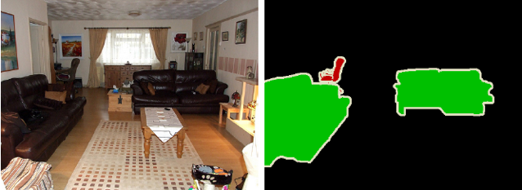
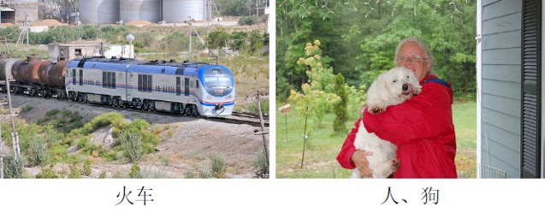
什么是语义分割
强监督
弱监督

Slide 3
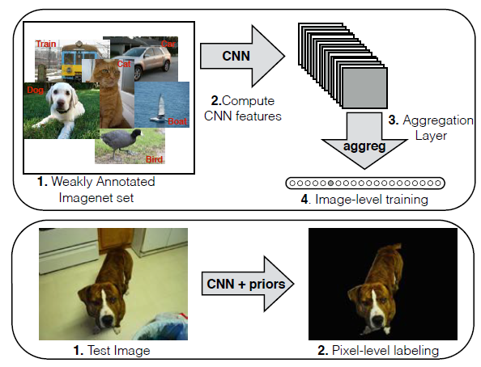
弱监督语义分割技术回顾
EM 算法¹
多实例学习²
限制条件³
位置先验⁴
种子点挖掘⁵
显著物体先验⁶
Papandreou et al. Weakly-and semi-supervised learning of a DCNN for semantic image segmentation. In ICCV, 2015.
Pinheiro et al. From image-level to pixel-level labeling with convolutional networks. In CVPR, 2015.
Pathak et al. Constrained convolutional neural networks for weakly-supervised segmentation. In ICCV, 2015.
Qi et al. Augmented feedback in semantic segmentation under image level supervision. In ECCV, 2016
Wei et al. Object Region Mining with Adversarial Erasing: A Simple Classification to Semantic Segmentation Approach. In CVPR, 2017
Hou et al. Bottom-Up Top-Down Cues for Weakly-Supervised Semantic Segmentation. In EMMCVPR, 2017

Slide 4
如何从关键字到像素级语义？
Zhou et al. Learning deep features for discriminative localization. In CVPR, 2016.

Slide 5
如何从关键字到像素级语义？
Zhou et al. Learning deep features for discriminative localization. In CVPR, 2016.
Notes:
Class Activation Mapping: the predicted class score is mapped back to the previous convolutional layer to generate the class activation maps (CAMs). The CAM highlights the class-specific discriminative regions.

Slide 6
如何从关键字到像素级语义？
Wei et al. STC: A Simple to Complex Framework for Weakly-Supervised Semantic Segmentation. In IEEE TPAMI, 2017.

Slide 7

年度进展

Slide 8
基于弱监督的语义分割技术
ECCV2018
显著性实例与聚类
弱监督全景分割
其 它
语义分割
CVPR2018
基于空洞卷积
种子区域扩散
对抗擦除策略
关系网络图
网络图像驱动
相似特征挖掘
NIPS2018
自擦除网络

Slide 9
基于注意力机制的弱监督语义分割
种子区域扩张¹
classical Seeded Region Growing
Huang et al. Weakly-Supervised Semantic Segmentation Network with Deep Seeded Region Growing. In CVPR, 2018.

Slide 10
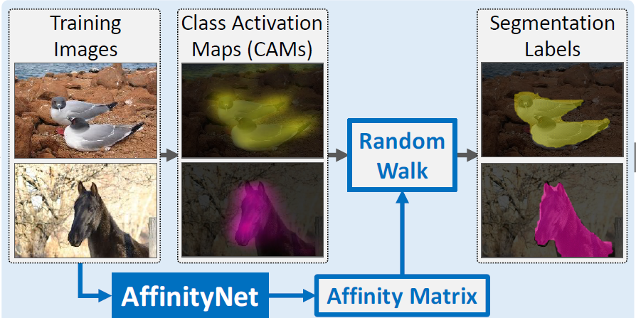
基于注意力机制的弱监督语义分割
种子区域扩张¹
相似度网络²
Ahn et al. Learning pixel-level semantic affinity with image-level supervision for weakly supervised semantic segmentation. In CVPR, 2018.

Slide 11
基于注意力机制的弱监督语义分割
种子区域扩张¹
相似度网络²
incomplete for segmentation, but sufficient for learning semantic affinities
Ahn et al. Learning pixel-level semantic affinity with image-level supervision for weakly supervised semantic segmentation. In CVPR, 2018.

Slide 12
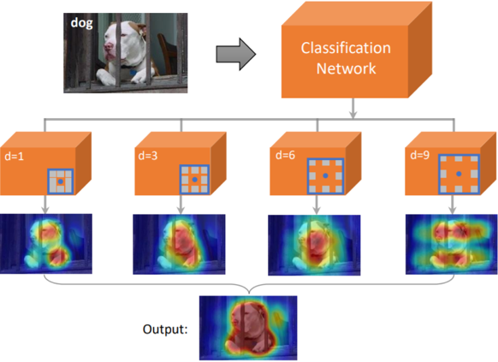
基于注意力机制的弱监督语义分割
种子区域扩张¹
相似度网络²
基于空洞卷积³
Wei et al. Revisiting Dilated Convolution: A Simple Approach for Weakly- and Semi- Supervised Semantic Segmentation. In CVPR, 2018

Slide 13
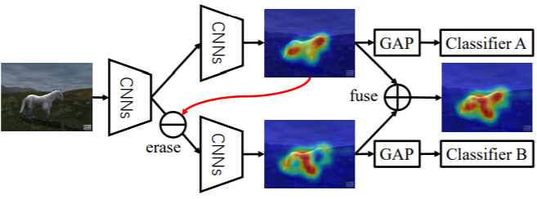
基于注意力机制的弱监督语义分割
种子区域扩张¹
相似度网络²
基于空洞卷积³
对抗擦除策略^{4,5}
Zhang et al. Adversarial Complementary Learning for Weakly Supervised Object Localization. In CVPR 2018.
Li et al. Tell Me Where to Look: Guided Attention Inference Network. In CVPR 2018.

Slide 14
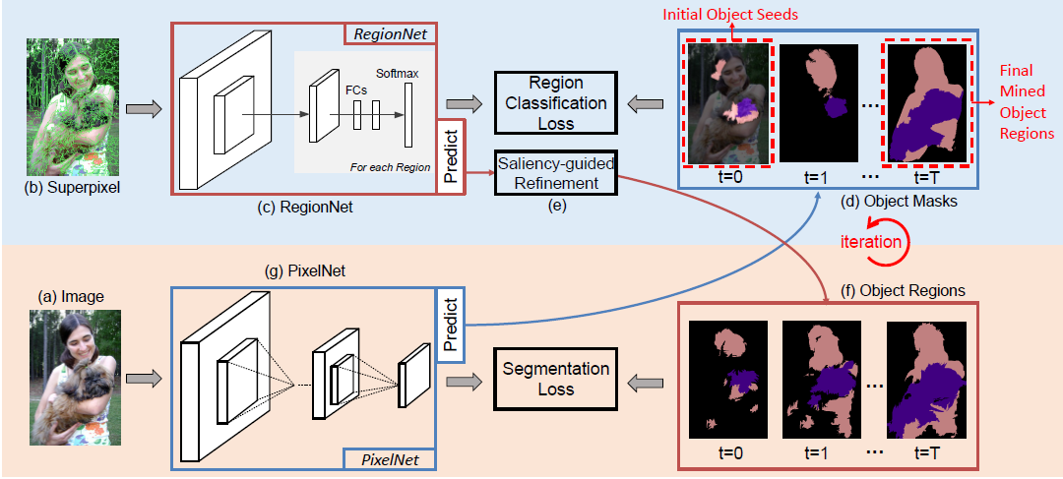
基于注意力机制的弱监督语义分割
种子区域扩张¹
相似度网络²
基于空洞卷积³
对抗擦除策略^{4,5}
相似区域挖掘⁶
small and coarse discriminative regions contain significant common features about objects
Weakly-Supervised Semantic Segmentation by Iteratively Mining Common Object Features. In CVPR 2018.

Slide 15
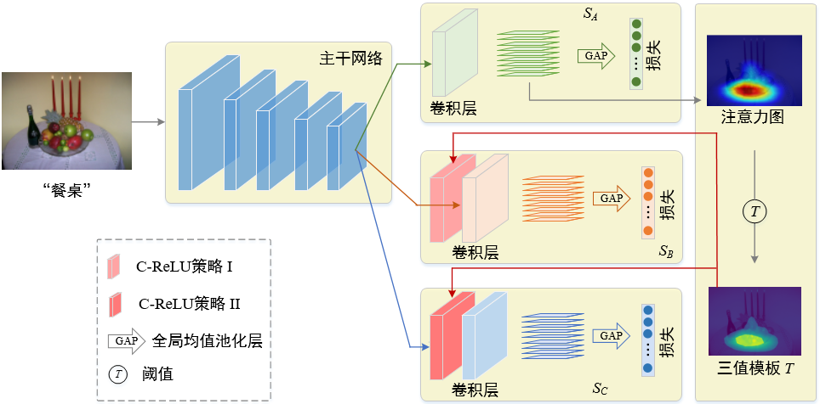
基于注意力机制的弱监督语义分割
种子区域扩张¹
相似度网络²
基于空洞卷积³
对抗擦除策略^{4,5}
相似区域挖掘⁶
自擦除策略⁷
Hou et al. Self-Erasing Network for Integral Object Attention. In Neurips 2018.

Slide 16
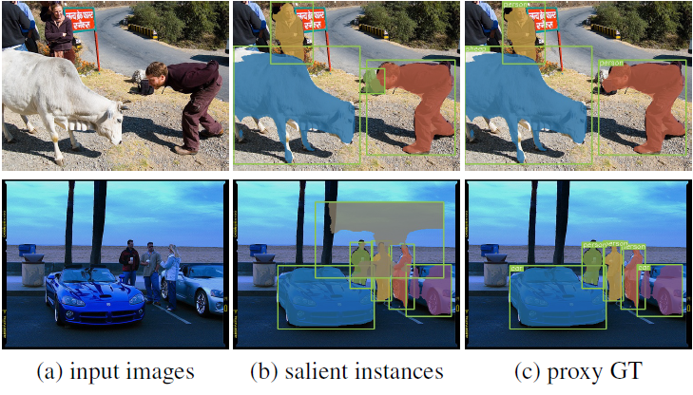
基于显著实例的弱监督语义分割
Fan et al. Associating Inter-Image Salient Instances for Weakly Supervised Semantic Segmentation. In ECCV 2018.
Fan et al. S4Net: Single Stage Salient-Instance Segmentation. In CVPR, 2019.

Slide 17
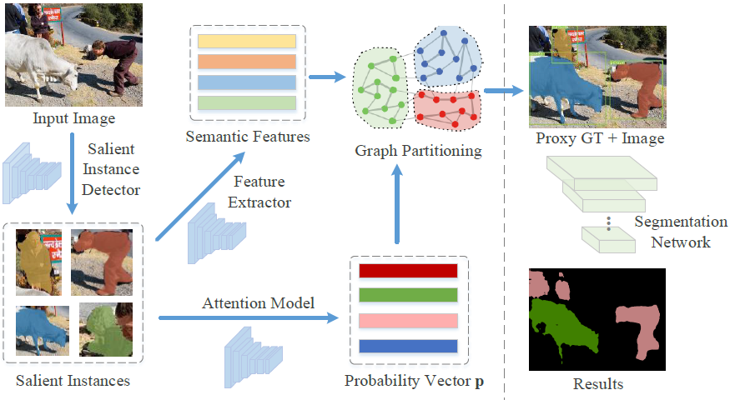
基于显著实例的弱监督语义分割
Fan et al. Associating Inter-Image Salient Instances for Weakly Supervised Semantic Segmentation. In ECCV 2018.
Fan et al. S4Net: Single Stage Salient-Instance Segmentation. In CVPR, 2019.

Slide 18
基于网络数据的弱监督语义分割
1. Shen et al. Bootstrapping the Performance of Webly Supervised Semantic Segmentation. In CVPR 2018.

Slide 19
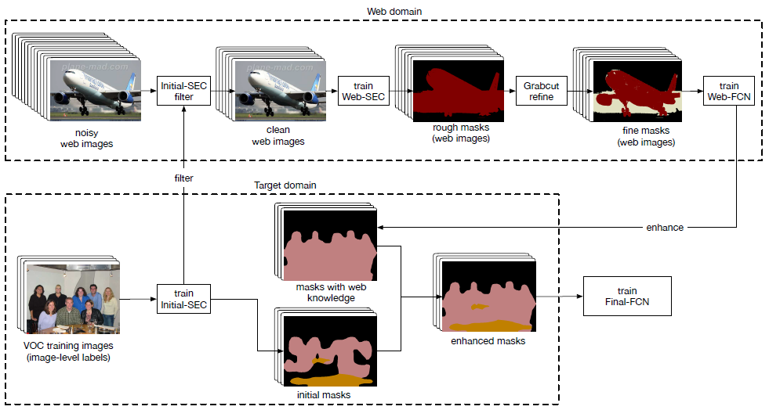
基于网络数据的弱监督语义分割
1. Shen et al. Bootstrapping the Performance of Webly Supervised Semantic Segmentation. In CVPR 2018.

Slide 20
基于外边框的弱监督语义分割
1. Li et al. Weakly- and Semi-Supervised Panoptic Segmentation. In ECCV 2018.

Slide 21
基于外边框的弱监督语义分割
1. Li et al. Weakly- and Semi-Supervised Panoptic Segmentation. In ECCV 2018.

Slide 22
总结
弱监督语义分割近年来取得了较快的发展
分割结果质量快速逼近全监督方法
  主要利用：注意力机制、显著性物体、互联网数据等辅助像素级定位
进一步探索方向
  进一步获取更加完整的注意区域
  实例级分割
  更多利用一组图像中的互信息

Slide 23
THANK YOU

