Slide 1
Weakly Supervised Semantic Segmentation
Ming-Ming Cheng
Nankai University
http://mmcheng.net/

Slide 2
Weakly supervised semantic segmentation
Main challenge: missing direct evidence for bridging between image level keyworks and pixel locations.
(a) Label: person, car, moto-bike, …
(b) GT (for evaluation only)

Slide 3


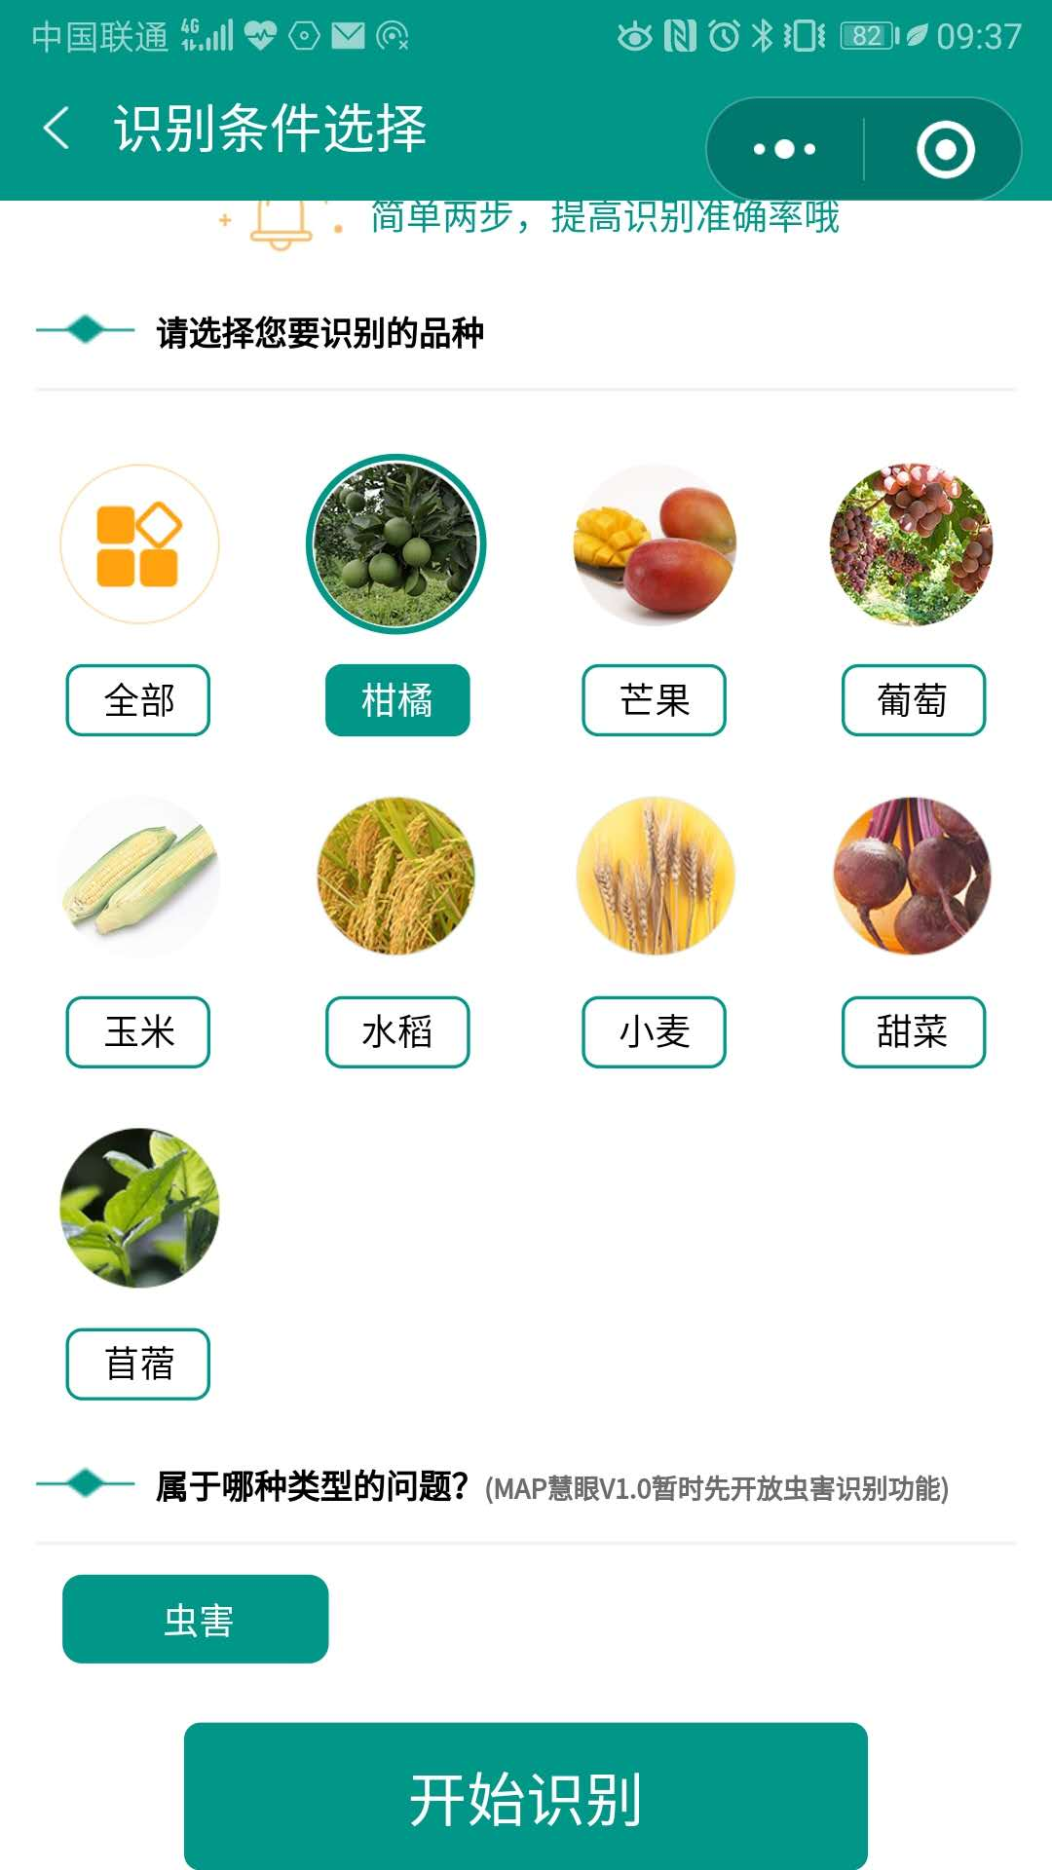
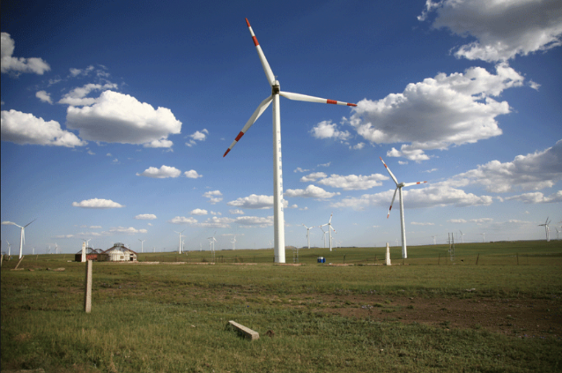
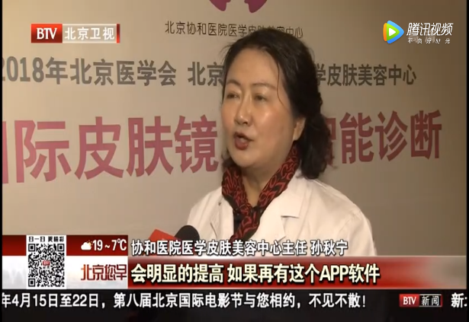
Why it is important?
Insufficient annotations in real applications
  Especially for novel categories

Slide 4
How to bridge between labels
Understanding the SOTA of these “tools”
  What are they good at?
  What are their limitations?
  How to use them efficiently?

Slide 5
What might be useful to bridge the gap?
Salient object
Edges
Richer Convolutional Features for Edge Detection, IEEE TPAMI 2019 (CVPR’17).
Deeply supervised salient object detection with short connections, IEEE TPAMI, 2019 (CVPR’17).
A Simple Pooling-Based Design for Real-Time Salient Object Detection, IEEE CVPR, 2019.

Slide 6
What might be useful to bridge the gap?
Image segmentation (grouping)
DEL: Deep Embedding Learning for Efficient Image Segmentation, IJCAI 2018.
Richer Convolutional Features for Edge Detection, IEEE TPAMI 2019 (CVPR’17).
FLIC: Fast Linear Iterative Clustering with Active Search, AAAI 2018.

Slide 7
What might be useful to bridge the gap?
Salient instances
S4Net: Single Stage Salient-Instance Segmentation, IEEE CVPR, 2019.
Salient Objects in Clutter: Bringing Salient Object Detection to the Foreground, ECCV, 2018

Slide 8
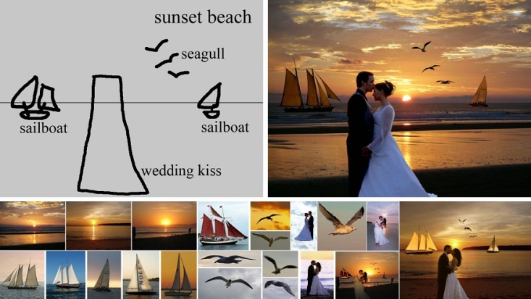
What might be useful to bridge the gap?
Image collections
Associating Inter-Image Salient Instances for Weakly Supervised Semantic Segmentation, ECCV, 2018
SalientShape: Group Saliency in Image Collections, The Visual Computer, 2014.
Sketch2Photo: Internet Image Montage, ACM TOG, 2009.

Slide 9
Understanding the SOTA of these “tools”
What are they good at?
  SOTA salient object detection methods are quite robust and generalize well to new datasets.
A Simple Pooling-Based Design for Real-Time Salient Object Detection, IEEE CVPR, 2019.

Slide 10
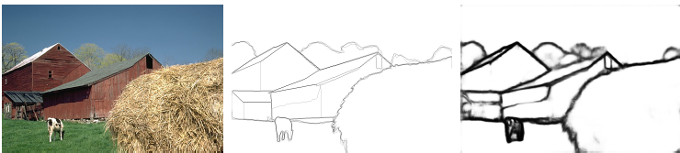
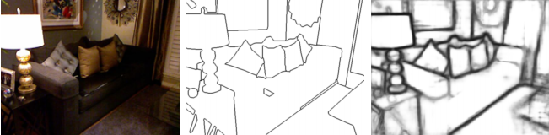
Understanding the SOTA of these “tools”
What are they good at?
  SOTA edge detection.
Deeply supervised salient object detection with short connections, IEEE TPAMI, 2019 (CVPR’17).
image
G-Truth
results

Slide 11
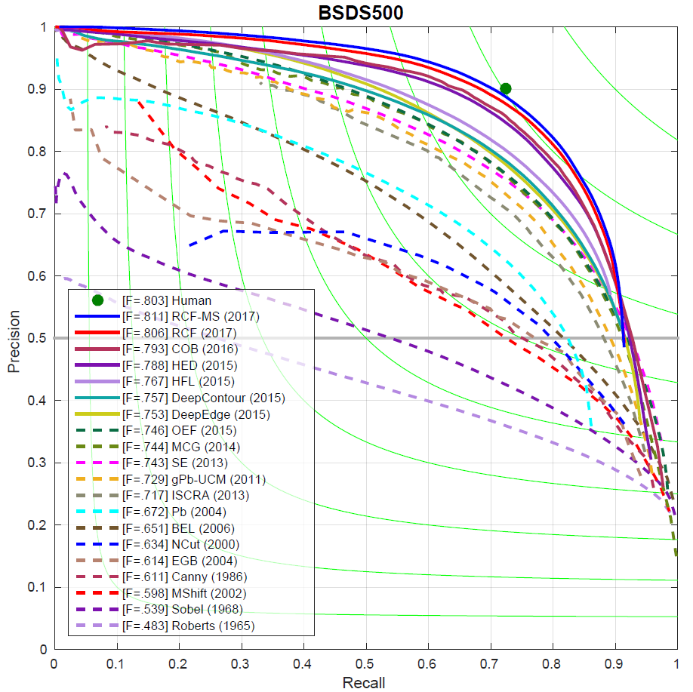
Understanding the SOTA of these “tools”
What are they good at?
  SOTA edge detection: 50+ years of boundary detection
Since Roberts (1965)
image
G-Truth
results

Slide 12
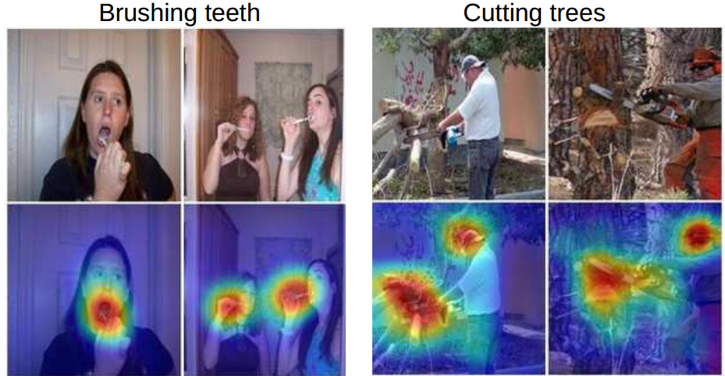
Understanding the SOTA of these “tools”
What are they good at?
  Attention
Learning deep features for discriminative localization, IEEE CVPR 2016.

Slide 13
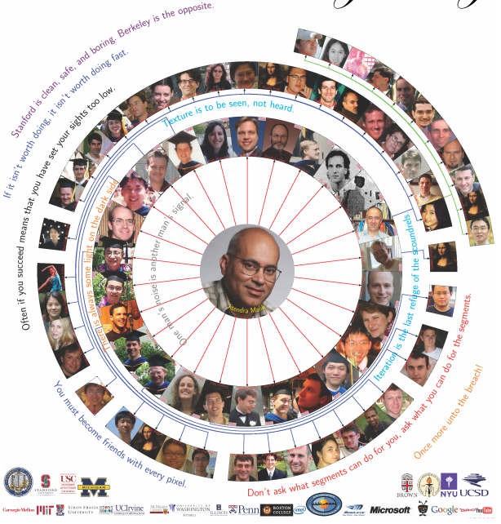
J Malik
Don’t ask what segments can do for you, ask what you can do for segments

Slide 14
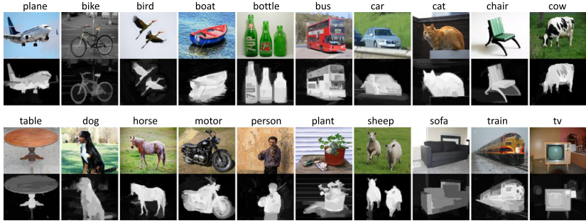
Exploring salient objects
Examples of simple images and the corresponding saliency maps generated by DRFI on the 20 classes of PASCAL VOC.
STC: A Simple to Complex Framework for Weakly-supervised Semantic Segmentation, IEEE TPAMI, 2017.

Slide 15
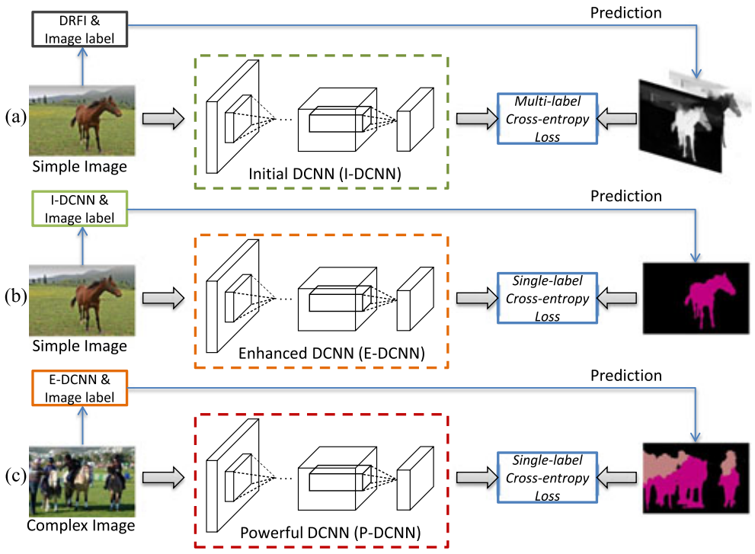
Exploring salient objects
STC: A Simple to Complex Framework for Weakly-supervised Semantic Segmentation, IEEE TPAMI, 2017.

Slide 16
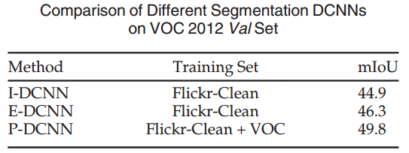
Exploring salient objects
STC: A Simple to Complex Framework for Weakly-supervised Semantic Segmentation, IEEE TPAMI, 2017.

Slide 17
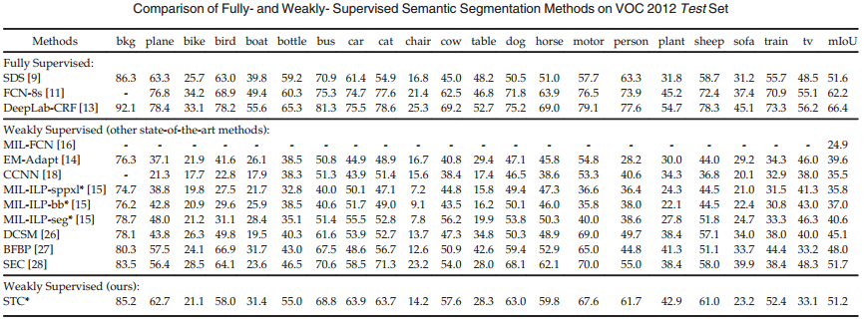
Exploring salient objects
STC: A Simple to Complex Framework for Weakly-supervised Semantic Segmentation, IEEE TPAMI, 2017.

Slide 18
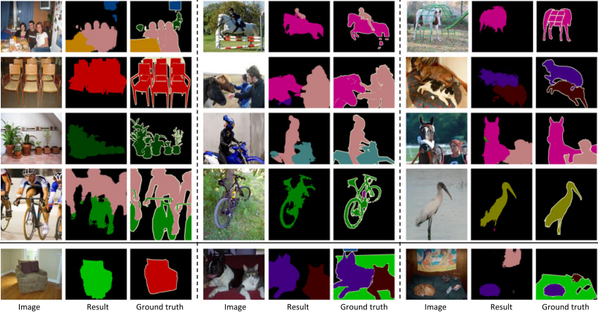
Exploring salient objects
STC: A Simple to Complex Framework for Weakly-supervised Semantic Segmentation, IEEE TPAMI, 2017.

Slide 19
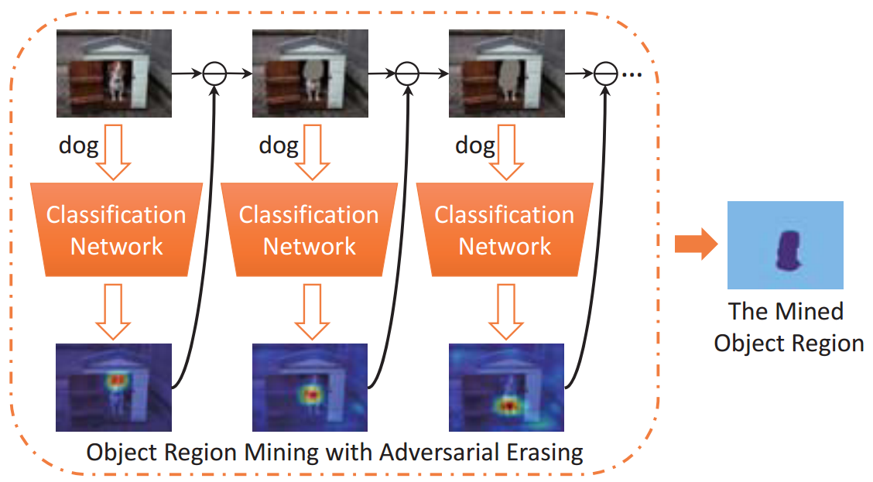
Exploring attention
Object Region Mining with Adversarial Erasing: A Simple Classification to Semantic Segmentation Approach, IEEE CVPR, 2017.

Slide 20
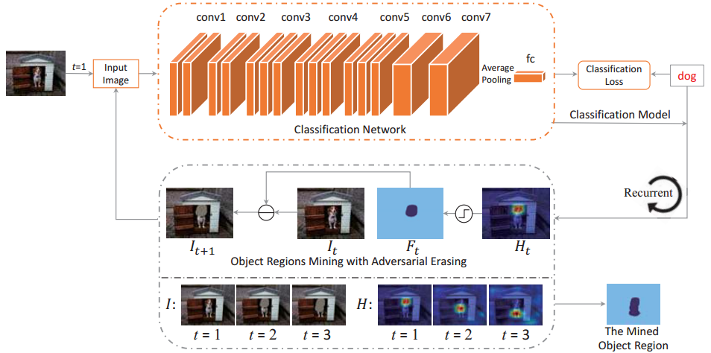
Exploring attention
Object Region Mining with Adversarial Erasing: A Simple Classification to Semantic Segmentation Approach, IEEE CVPR, 2017.

Slide 21
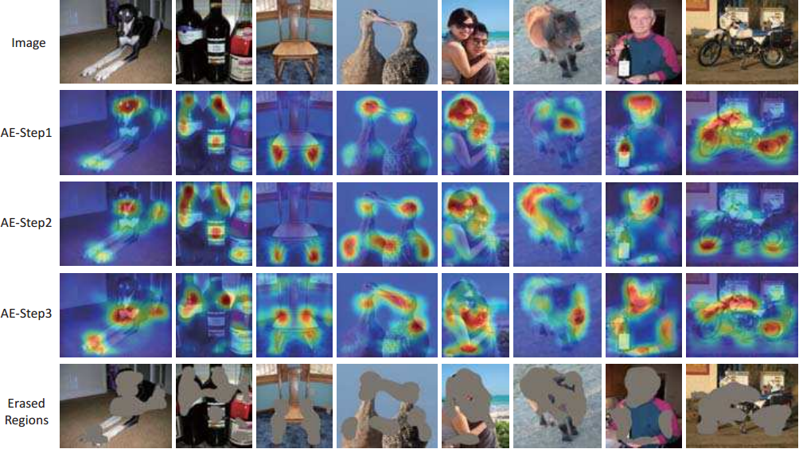
Exploring attention
Object Region Mining with Adversarial Erasing: A Simple Classification to Semantic Segmentation Approach, IEEE CVPR, 2017.

Slide 22
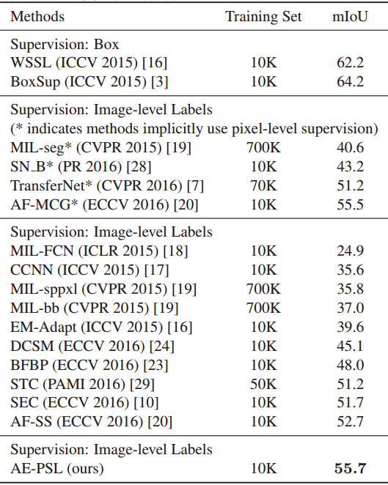
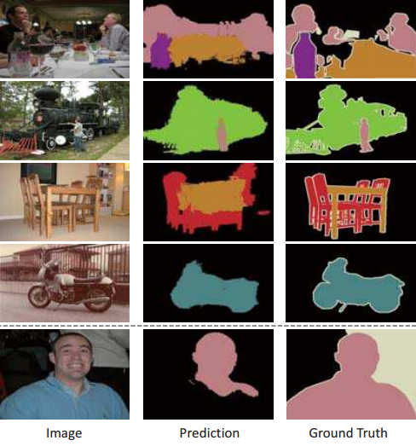
Exploring attention
Object Region Mining with Adversarial Erasing: A Simple Classification to Semantic Segmentation Approach, IEEE CVPR, 2017.

Slide 23
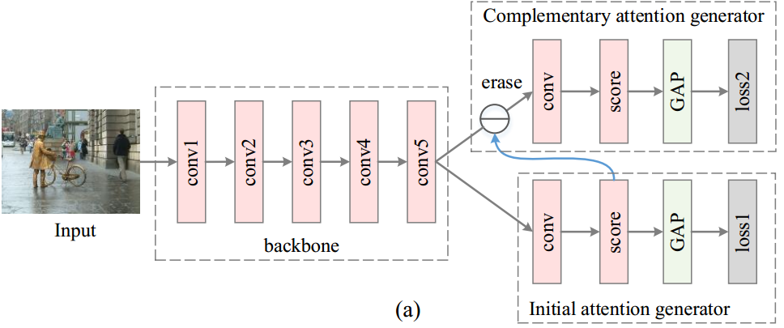
Further exploring attention
Adversarial complementary learning for weakly supervised object localization, IEEE CVPR, 2018.

Slide 24
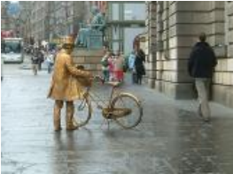
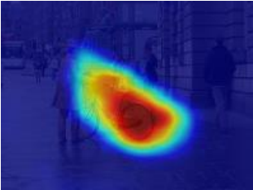
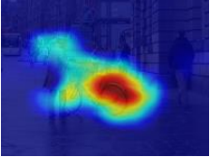
Further exploring attention
Attention leak
Adversarial complementary learning for weakly supervised object localization, IEEE CVPR, 2018.

Slide 25
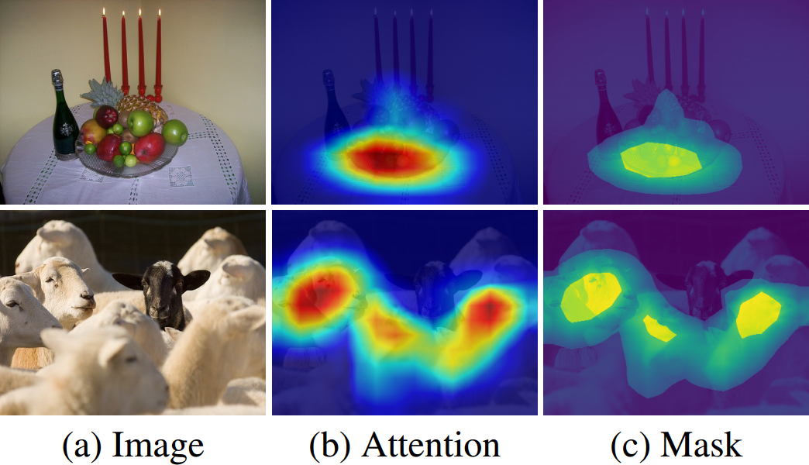
Further exploring attention
Self-Erasing Network for Integral Object Attention, NureIPS 2018.

Slide 26
Further exploring attention
Conditionally Reversed Linear Units (C-ReLUs)
  B is a binary mask, taking values from {−1, 1}
  C-ReLUs conditionally flip the signs of some features
  Exploring the contrast between the potential zone and the background zone to further discover more semantic objects from the potential zone.
Self-Erasing Network for Integral Object Attention, NureIPS 2018.

Slide 27
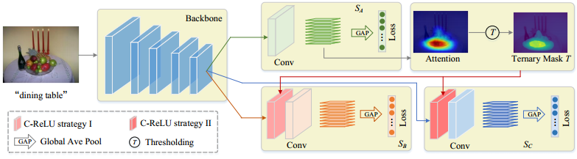
Further exploring attention
C-ReLU I
  Working on potential zones
C-ReLu II
  Working on common backgrounds
Self-Erasing Network for Integral Object Attention, NureIPS 2018.

Slide 28
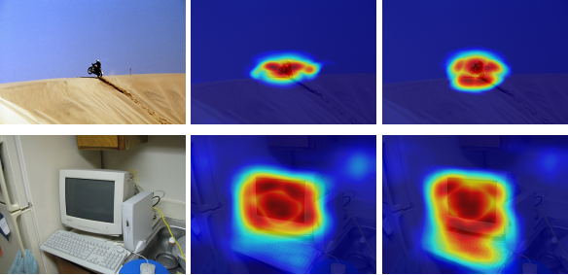
Further exploring attention
SeeNet (ours) ACoL
Self-Erasing Network for Integral Object Attention, NureIPS 2018.

Slide 29
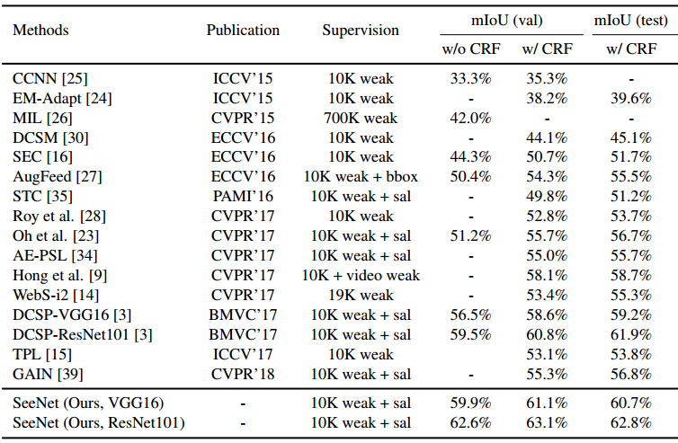
Further exploring attention
Self-Erasing Network for Integral Object Attention, NureIPS 2018.

Slide 30
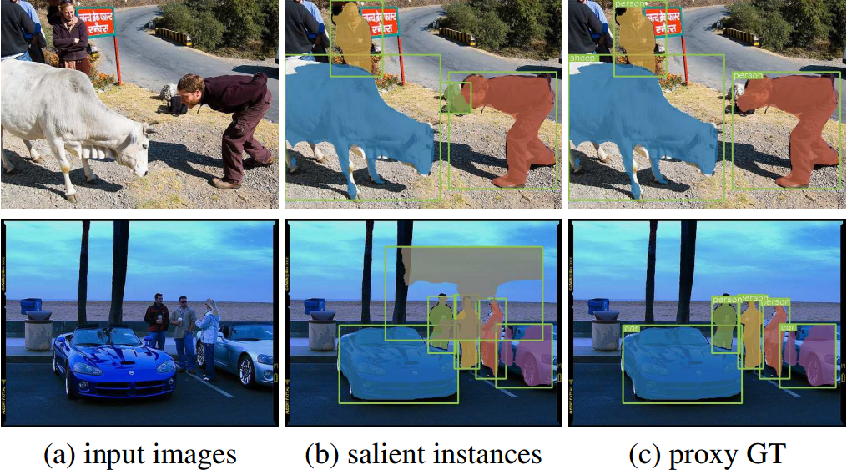
Exploring salient instances & image collections
Associating Inter-Image Salient Instances for Weakly Supervised Semantic Segmentation, ECCV 2018.

Slide 31
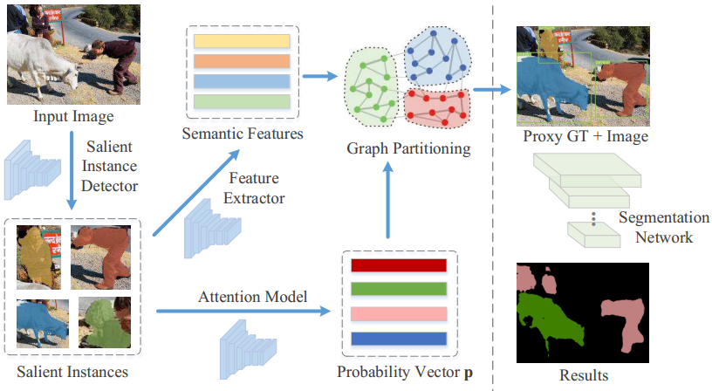
Exploring salient instances & image collections
Associating Inter-Image Salient Instances for Weakly Supervised Semantic Segmentation, ECCV 2018.

Slide 32
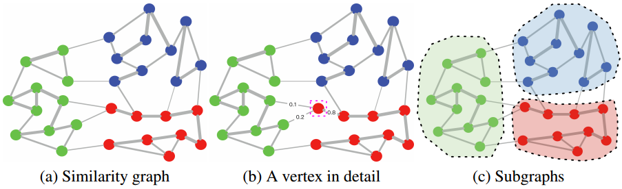
Exploring salient instances & image collections
Associating Inter-Image Salient Instances for Weakly Supervised Semantic Segmentation, ECCV 2018.

Slide 33
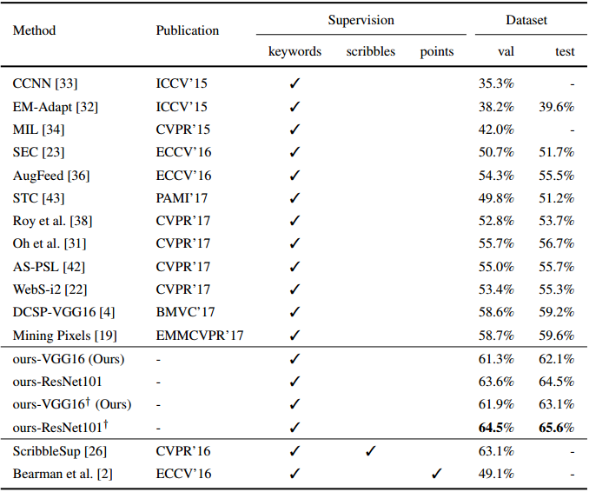
Exploring salient instances & image collections
Associating Inter-Image Salient Instances for Weakly Supervised Semantic Segmentation, ECCV 2018.

Slide 34
Summary
Insights about how to better bridge keywords & pixels
  Salient object
  Edges
  Attention
  Image collections
  Internet images
  etc.

Slide 35
Thanks!
Q&A

Slide 36
Panel discussion
Panel议题
  弱监督图像理解目前或者在不久的未来是否存在杀手级应用（killer applications）？
  在未来，弱监督物体检测、语义分割等问题上的算法性能能否逼近全监督算法的性能？
  未来弱监督图像理解的主要技术方向是什么？
  如何看待GAN技术在弱监督图像理解中的作用？
  目前的弱监督物体检测、语义分割主要是基于图像的，视频中的时序信息对于弱监督视觉理解会带来哪些机遇和挑战？
  如何看待基于混合监督的图像理解方法，如：部分数据有弱监督标记、少量样本有全监督标记、甚至部分样本存在标记缺失的情况？
Panel嘉宾：
  左旺孟（哈尔滨工业大学）、李宇峰（南京大学）
  叶齐祥（中国科学院大学）、程明明（南开大学）

