Slide 1
Smart Images
Understanding image scene for rendering, editing, and retrieval
Speaker: Ming-Ming Cheng
2012-11-19 @ VGG group of Oxford University
Notes:
Good morning everyone. I’m very happy to have the opportunity to introducing my works here. My report title is “”.

Slide 2
Contents
Introduction
Understanding images
  Saliency, segmentation, 3D configuration, non-local relation, image collections
Reusing images
  Rendering, composition, manipulation, retrieval
Conclusion & future works
Notes:
Here is a content list. I will firstly give a brief introduction to show the background and motivation of my research. A couple of algorithms for extracting useful high-level information from individual or collections of images will be introduced after that. These algorithms make use of findings in cognitive psychology and simple intuitive user assistant to get useful information about the underlying image scene.
We further use these scene level information for a number of interesting applications, including content aware image re-rendering, internet based image composition, joint manipulation, and shape based image retrieval.

Slide 3




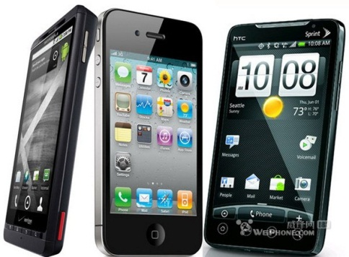
1.1 Background
Images change the way we live
Notes:
Images remain one of the most popular and ubiquitous media for capturing and documenting the world around us.
The ubiquity of acquisition devices, like cameras and smartphones,
and the growing popularity of social media have resulted in an explosion of digital images accessible in the form of personal and internet photo-collections.
Although such images form a well established communication medium for sharing experiences or blogging events, we still lack efficient and effective methods to analyze and organize such images.

Slide 4
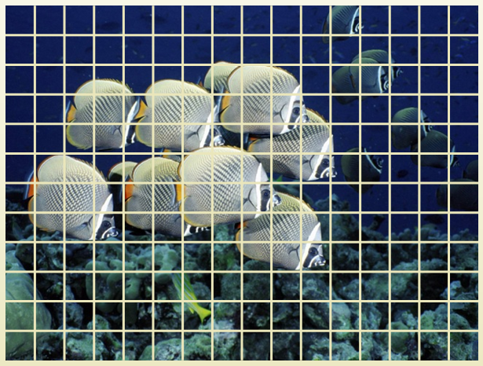

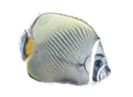



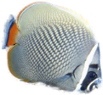


1.1 Background
Challenges
…
Pixel
Color value
Patch
…
Scene
Object
Relations
…
Notes:
The basic challenges for intuitive image manipulation and efficient organization is the difference between how images are represented in computers and human memory.
Pixels are the natural way for computers. However, we humans think in terms of objects. So allowing such object level interaction and reasoning is more intuitive.

Slide 5
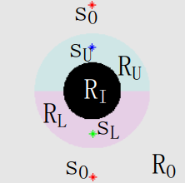
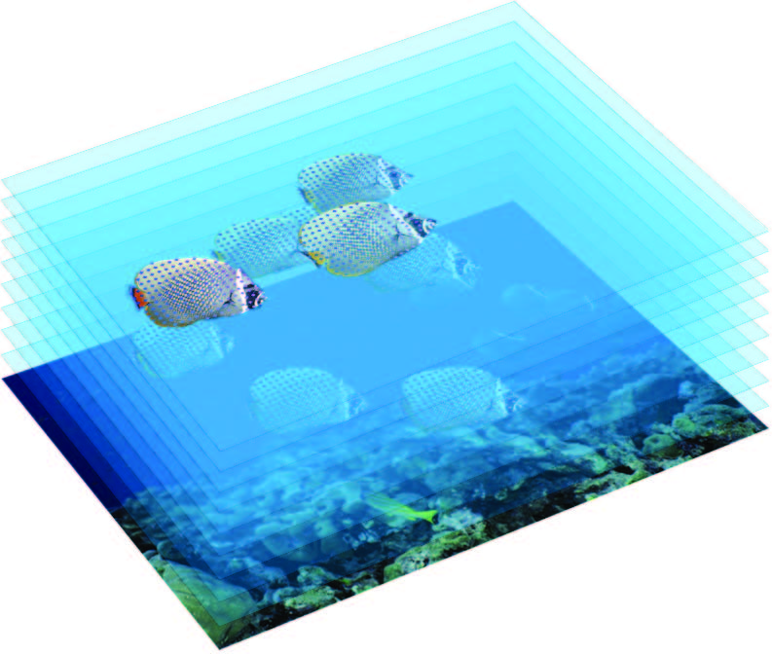
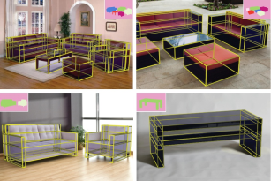
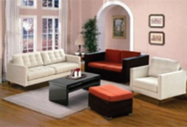
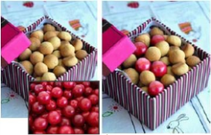

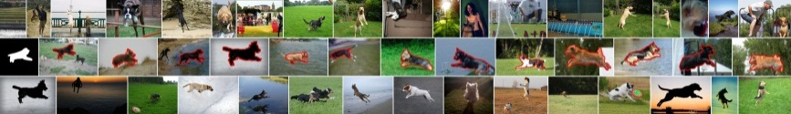
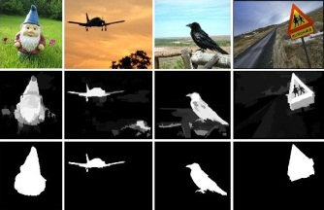
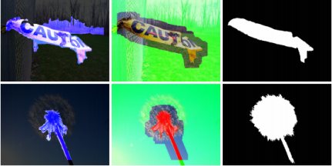
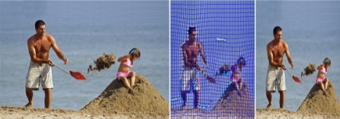
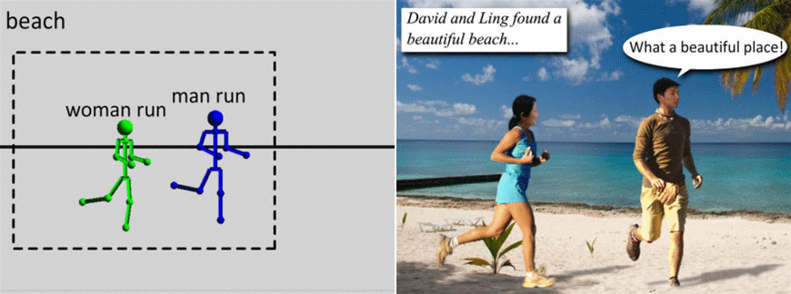
1.2 Organization
Understanding
Reusing
Smart Images
Notes:
These research efforts mainly belongs to two groups: understanding and reusing. Each emphasizes computer vision aspect and computer graphics aspect.

Slide 6
2 Understanding image structure
Understanding
Notes:
To understand the high level organization about image scene, we focus on the following issues: salient object detection, object of interest region segmentation, 3D and mutual relation estimation.

Slide 7


2.1 Saliency
MM Cheng, GX Zhang, NJ Mitra, X Huang, SM Hu, Global Contrast based Salient Region Detection, IEEE CVPR, p. 409-416, June 21-23, 2011.
Notes:
When observing an image scene, humans quickly identify the salient areas, and focus their attention on these regions to efficiently recognize objects. Such salient regions provide spatial support for extracting discriminative image signatures such as shapes, textures, color statistics,
scale information etc., and are thus useful in a large number of important image processing applications.
In order to computationally estimating salient object regions, it’s important to make use of insights from neurosciences, biology, computer vision and other fields.
Results from perceptual research indicates that the most influential factor in low-level visual saliency is contrast. In this work, we proposed a computational method for high quality salient region detection based on global contrast analysis.

Slide 8
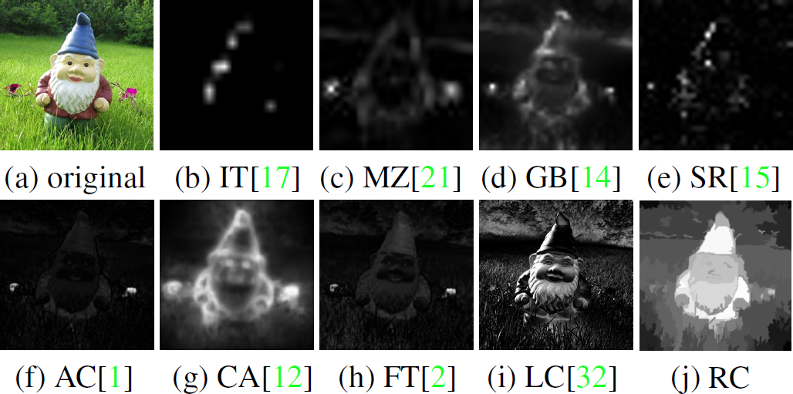
2.1 Saliency
Related works
Observations
  In order to uniformly highlight entire object regions, global contrast based method is preferred over local contrast based methods.
  Contrast to near by regions contributes more than far away regions.
Notes:
As demonstrated in this figure, most previous methods estimate the saliency of a particular image region based on immediate image neighborhoods, thus tends to highlight object boundaries rather than its entire area.
We proposed a global region contrast method based on the following observations: …

Slide 9
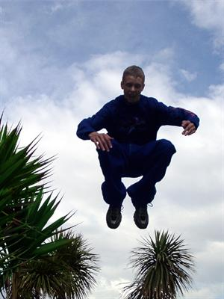
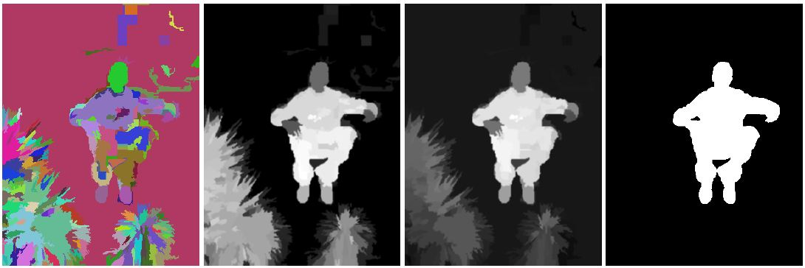

2.1 Saliency
Region Contrast (RC) method
  $$S\left(r_{k}\right)=\sum_{r_{k}≠r_{i}}{w\left(r_{i}\right)D_{r}\left(r_{k},r_{i}\right)}$$
Notes:
Our global region contrast based method is very simple. To efficiently find global contrast, we firstly over segment the input image to perceptually uniform regions. Saliency of a region r_k is defined by it’s appearance difference to all other image regions.
Here, the region level appearance distance between region r_k and r_i is measured by the color difference between this two regions. The weight of r_i is determined by the number of pixels it contains.

Slide 10

2.1 Saliency
Region Contrast (RC) method
  $$S\left(r_{k}\right)=\sum_{r_{k}≠r_{i}}{e^{−\frac{D_{s}\left(r_{k},r_{i}\right)}{δ_{s}^{2}}}}w\left(r_{i}\right)D_{r}\left(r_{k},r_{i}\right)$$
  With spatially weighted region contrast
Notes:
To further consider spatial effect, we use a Gaussian weighting term to give higher weight to near by regions. A sample result is shown in the right most figure.

Slide 11
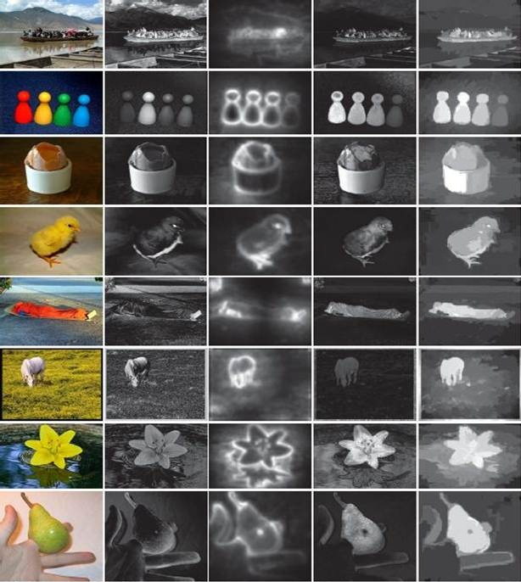
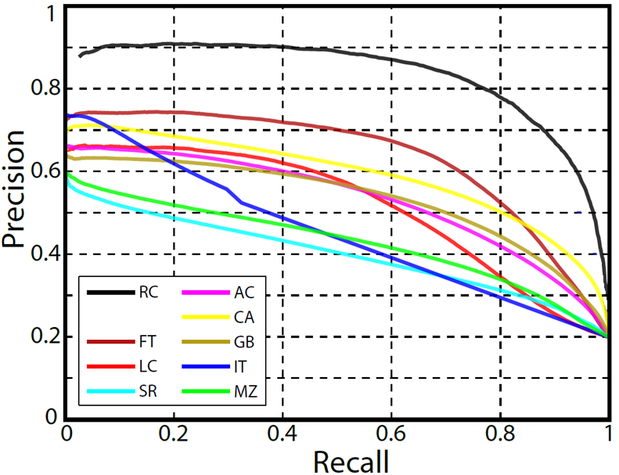
2.1 Saliency
Dataset: [Achanta09], with 1000 images
  Precision vs. recall
  Visual comparison
Source code (C++) available
  http://cg.cs.tsinghua.edu.cn/people/~cmm/saliency/
  After published in June 2011, there are more than 800 individuals requested for the source code. Google scholar citations 100+.
Notes:
To evaluate our simple global region contrast based method, we use the largest public available dataset with pixel accuracy ground truth annotation, which contains 1000 images.
We first shown the precision recall curve of the saliency maps generated by each method. As shown here, our region contrast based method significantly outperforms existing methods.
This is a visual comparison. Our region contrast based method uniformly highlight the entire salient object region.
The source code of this work is public available in the project page.

Slide 12
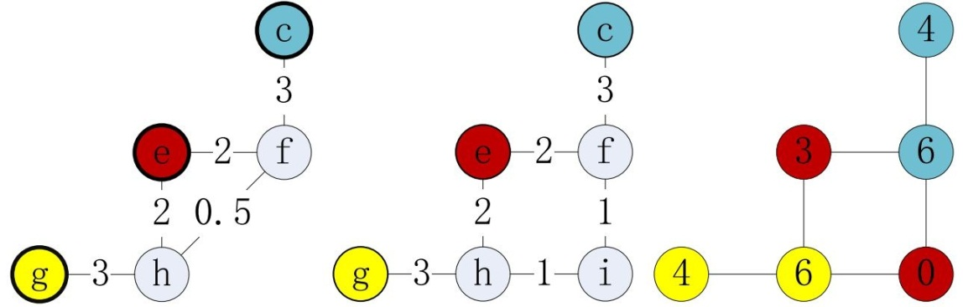
2.2 Segmentation
MM Cheng, GX Zhang, Connectedness of Random Walk Segmentation. IEEE TPAMI, 2011. 33(1): p. 200 -202.
Notes:
Object of interest image segmentation is another fundamental problem in computer graphics and computer vision. I will introduce two works related to this topic. The first one is about the connectedness property of random walks image segmentation.

Slide 13
2.2 Segmentation
Random walks segmentation
  Classical theory: L. Grady, “Random Walks for Image Segmentation”, IEEE TPAMI, vol. 28, no. 11, pp. 1768-1783, Nov., 2006.
  An important property given by this paper is that each segmented region is guaranteed to be connected to one or more seeds with that region’s label: isolated regions without seeds do not occur.
  This is important, as it implies that the random walk approach avoids the noisy or fragmented segmentations that can sometimes result from other algorithms.
Notes:
Random walks is one of the leading method in interactive image segmentation. Classical theory suggested that …
This is an important property, as …
Unfortunately, as found by our research, this property does not always hold.

Slide 14
2.2 Segmentation
Our findings
  We further assume that the algorithm works on general graphs, and generalize the segmentation problem to a special convex hull partition problem, with each graph node associated with a vector representing its possibilities of reaching each seed types.
  We proof that a new sub graph can always be constructed to replace the original one to get any possibility vector in side the convex cue decided by boundary points of this sub-graph, while not changing the possibilities associated with other parts of the original graph.
  For a graph with more than 3 label types, even allowing the algorithm to have more general weighting and assignment rule, it is still possible to replace some part of it in a way which makes the connectedness property fail.

Slide 15
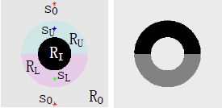
2.2 Segmentation
Random walks segmentation
  A simple counter example
  An image example
Notes:
We first give a simple counter example containing only 5 graph nodes and 3 seed points. Then we change the subpart of the graph by adding a new node (i) and assign it’s weight. In the final segmentation, the new added node don’t connect with it’s associated seed point.
We also shown an image example. In this example, there 3 types of seeds. The center part of the segmentation results don’t contains any seed points.

Slide 16
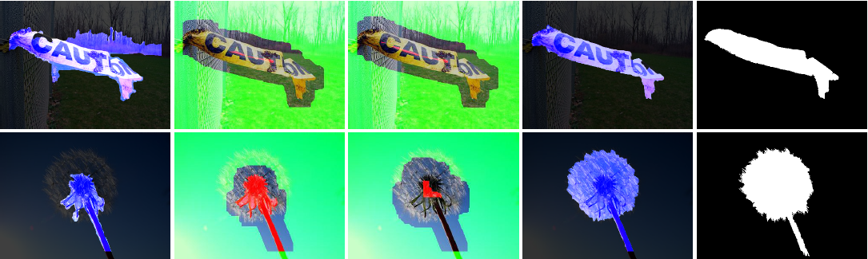
2.2 Segmentation
MM Cheng, NJ Mitra, X Huang, SM Hu, Image Saliency computation for Object Segmentation and Retrieval, submitted to IEEE TPAMI.
Notes:
Object of interest image segmentation is another fundamental problem in computer graphics and computer vision. In this work, we try to develop robust segmentation method which enable automatically initialization by saliency detection results.

Slide 17
2.2 Segmentation
SaliencyCut: an iterative GrabCut method
  Features: iterative refine & adaptive fitting
  Advantages: more robust, enabling automatic initialization
Notes:
We iteratively run GrabCut to improve the saliency detection result. After each iteration, we use dilation and erosion operations on the current segmentation result to get a new trimap for the next GrabCut iteration.
As shown in this, the region outside the dilated region is set to background, the region inside the eroded region is set to foreground, and the remaining areas are set to unknown in the trimap.
Another important feature of our SaliencyCut method is adaptive fitting. It is based on an important observation: regions closer to an initial salient object region are more likely to be part of that salient object than far-away regions. Thus, our new initialization enables GrabCut to include nearby salient regions, and exclude non-salient regions according to color feature dissimilarity. After each GrabCut iteration, SaliencyCut incorporates the constraints given by the newly obtained trimap, and train a better appearance model according to previous results.

Slide 18
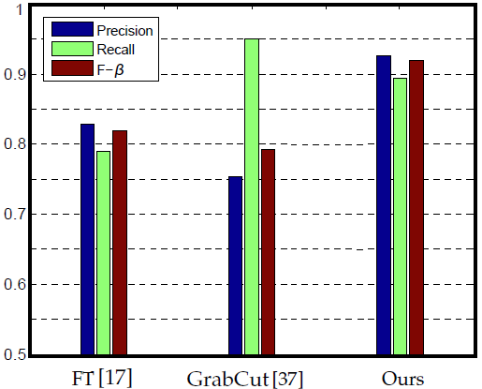
2.1 Segmentation
Dataset: [Achanta09], with 1000 images
Binary source code available
  http://cg.cs.tsinghua.edu.cn/people/~cmm/saliency/
Notes:
Here we show an comparison of our saliency cut compared with pervious best reported result and the famous GrabCut method. The results of our method have significant better precision and recall compared to alternative methods.

Slide 19
2.3 Non-local relation & 3D
MM Cheng, FL Zhang, NJ Mitra, X Huang, SM Hu, RepFinder: Finding Approximately Repeated Scene Elements for Image Editing, ACM TOG (SIGGRAPH). 29, 4, 83:1-8, 2010.
Notes:
Besides object of interest regions, 3D information and non-local relations is another kinds of important information for intuitive image editing. Here, I will introduce our work on editing approximately repeated scene elements.

Slide 20
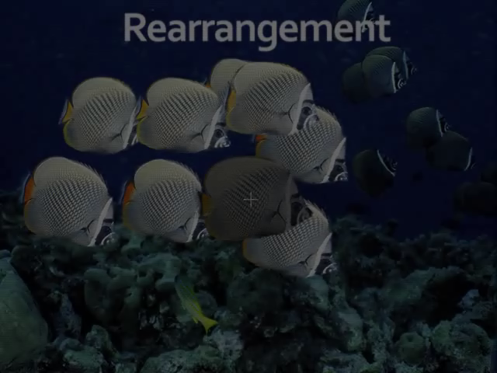
2.3 Non-local relation & 3D
Motivation
  Scene geometry enables intuitive editing
  Certain edits only need rough depth estimates
Notes:
If we want to edit this image and we have the underlying scene, a various of image editing application can be enabled. ->However, we typically don’t have depth information for images to be processed.
We can perform certain edits even with rough depth.
As we show in this work, ->in such scenes with repeated elements we can infer rough depth information.

Slide 21
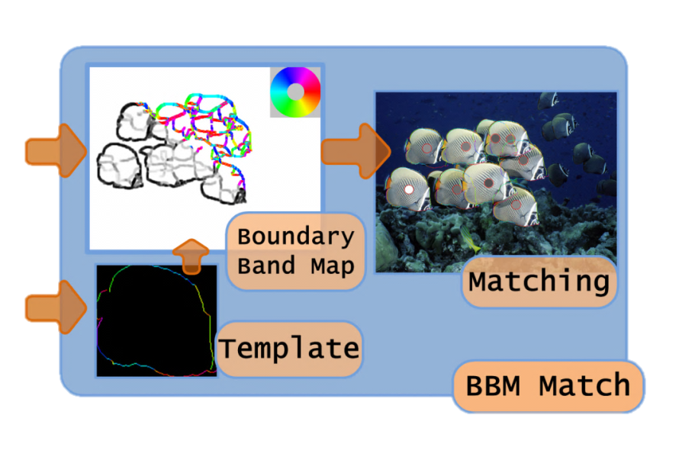
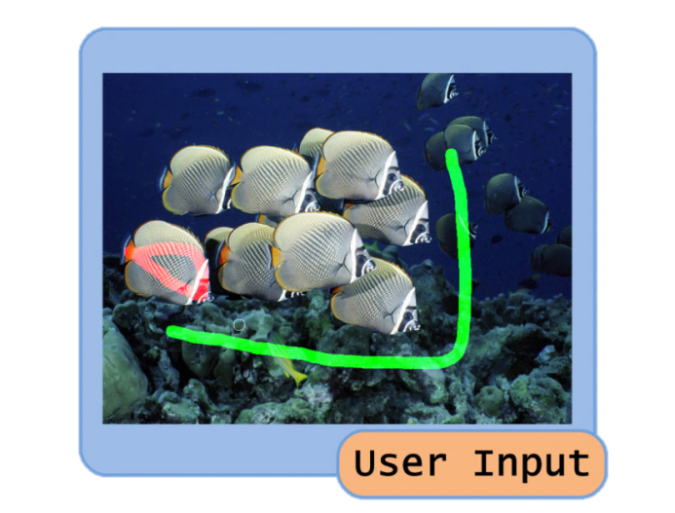
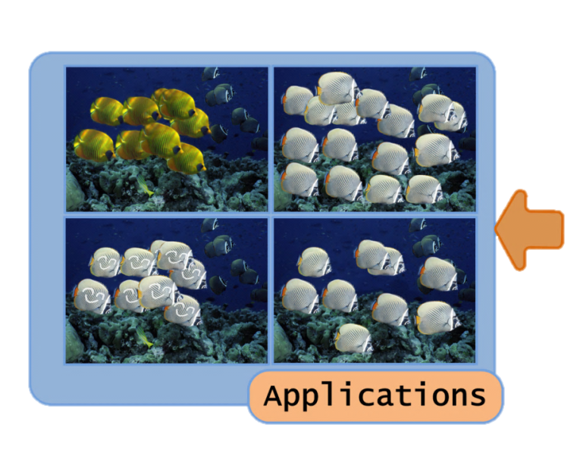
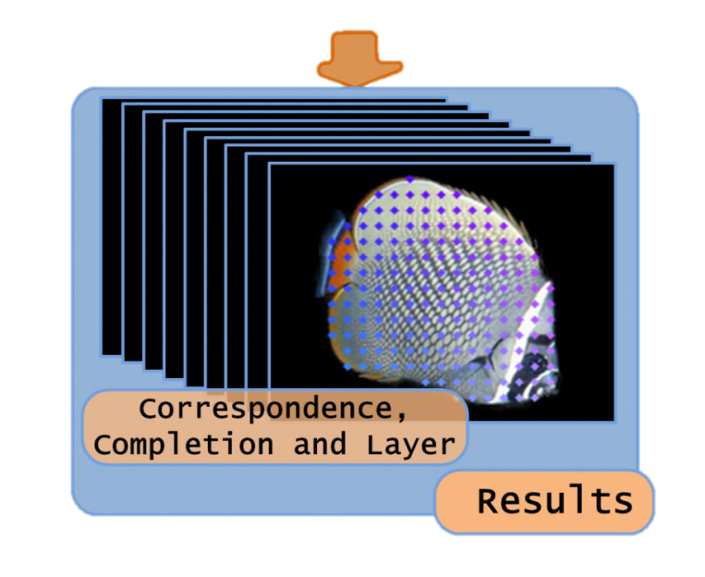
2.3 Non-local relation & 3D
Notes:
Users only need to simply select an object template and background region by simple scribbles. We use such information to get template shapes and potential object boundaries from foreground regions.
We further detect these similar objects, build dense correspondence between them, complete the occluded regions, and infer a rough layering order.
Finally we use these scene level information in a number of image editing applications.

Slide 22
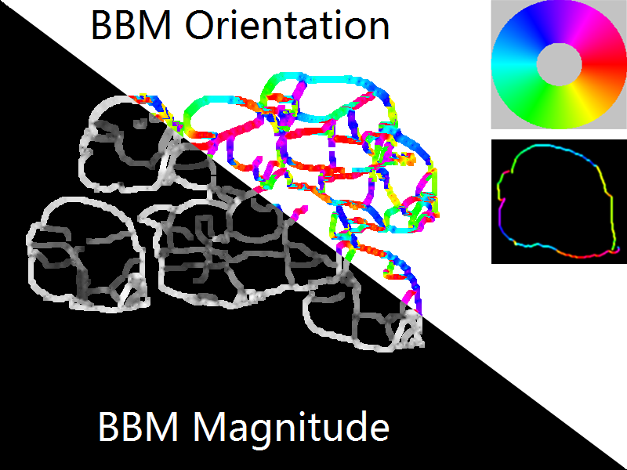
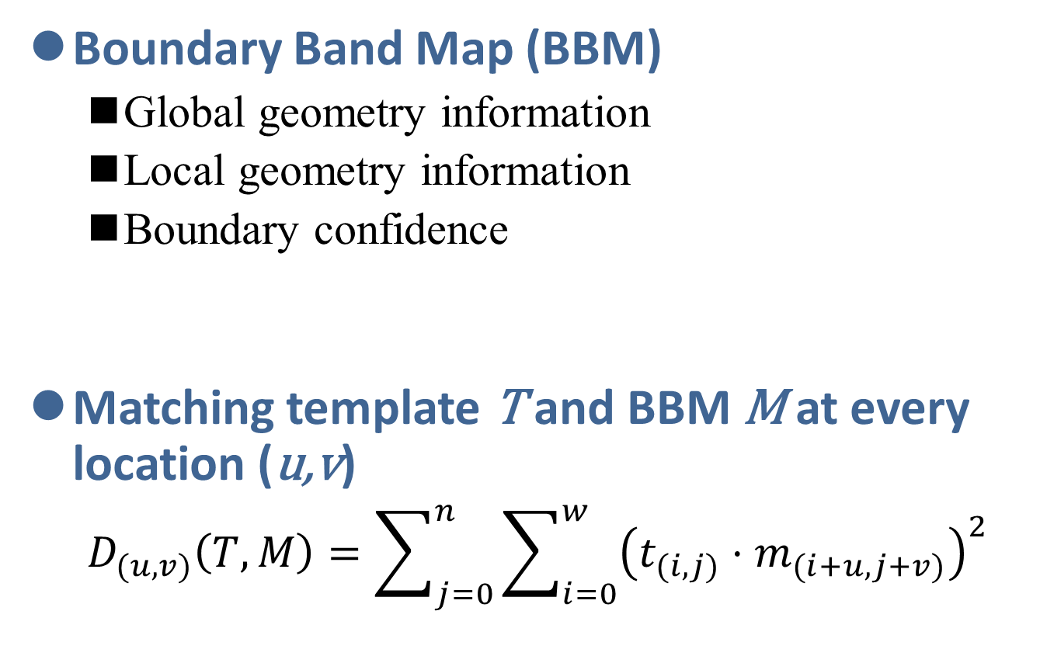
Repeated Elements Detection
Boundary Band Map (BBM)
  Global geometry information
  Local geometry information
  Boundary confidence
Matching template T and BBM M at every location (u,v)
  $$D_{(u,v)}\left(T,M\right)=\sum_{j=0}^{n}{\sum_{i=0}^{w}{{\left(t_{(i,j)}⋅m_{(i+u,j+v)}\right)}^{2}}}$$
Notes:
Local direction information are added to expanded potential boundaries to get a boundary band map, which is a matrix of 2D vector. Here, the lower left part shows vector magnitudes and upper right parts shows their color coded direction.-> We call this data representation Boundary band map, because it is a map with geometry information within a bandwidth of potential boundaries.
Our BBM has ->global geometry information represented by the bandwidth of potential boundaries, ->local geometry information represented by local directions, ->and boundary confidences represented by magnitude of 2D vectors. ->Our BBM representation handles in-plane deformations.
To match a template T with BBM M at position (u, v), we simply sum up square dot product of their associated 2D vectors. ->This is actually a convolution process and thus can be accelerated by FFT.

Slide 23
2.3 Non-local relation & 3D
Notes:
With the similar object detection results, we further infer dense correspondences between objects, complete the missing object regions and estimate their layering order.
We will demonstrate the usage and advantage of these scene information in the reusing part.

Slide 24
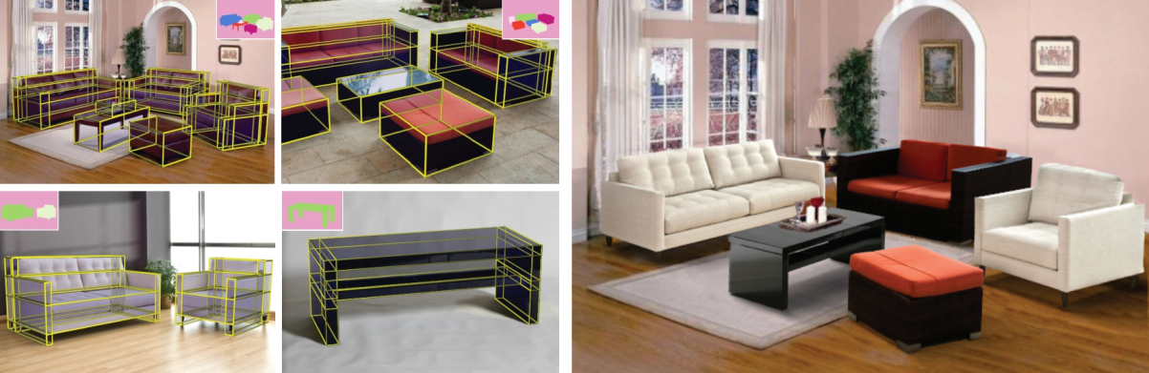
2.3 Non-local relation & 3D
Y Zheng, X Chen, MM Cheng, K Zhou, SM Hu, NJ Mitra. Interactive Images: Cuboid-proxies for Smart Image Manipulation. ACM TOG (SIGGRAPH). 31, 4, 1-10, 2012.
Notes:
Estimating 3D and non-local information is useful for understanding image scene. In this work, we develop a interactive methods to approximate scene geometry according to cuboid-proxies.

Slide 25
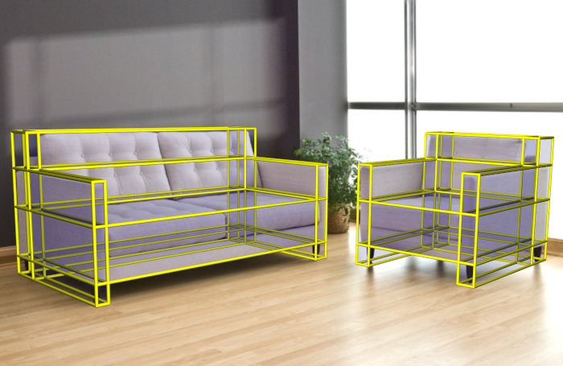
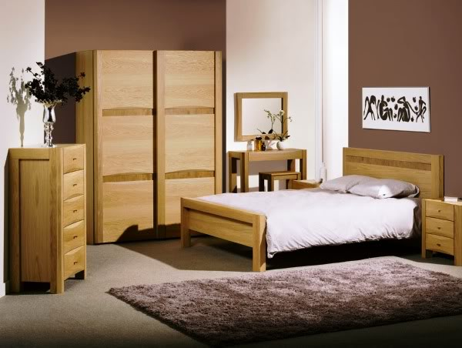

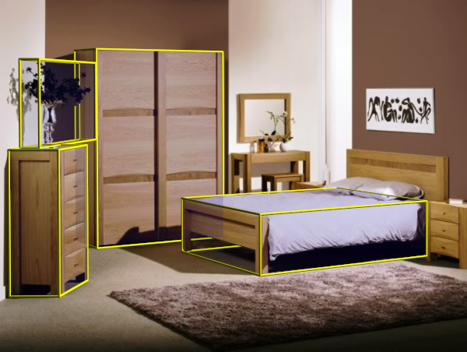
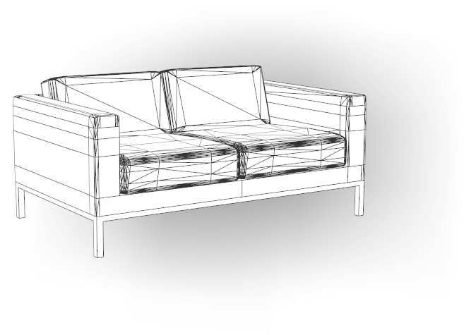
2.3 Non-local relation & 3D
Motivation
Notes:
Having 3D geometry is good for editing, but constructing such 3D geometry from images is hard.
The main thing we demonstrate in this work, is that we do not need accurate 3D models. Instead, collections of cuboid proxies are sufficient for editing images with man-made objects.
Our work focus on images in man-made context, wherein objects are simple and regular, so cuboids are good proxies. and they often share various relations like repetitions and co-planarity.

Slide 26
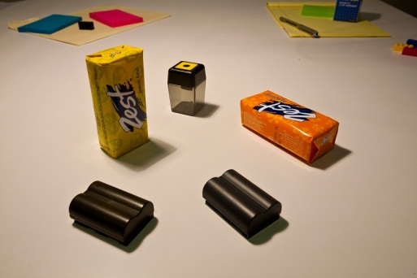
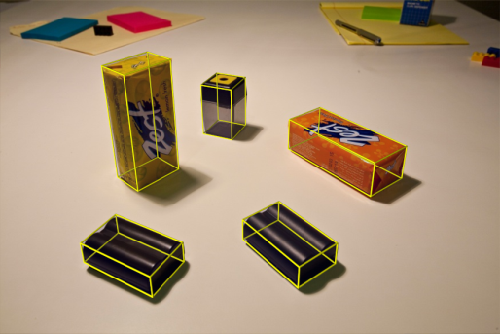
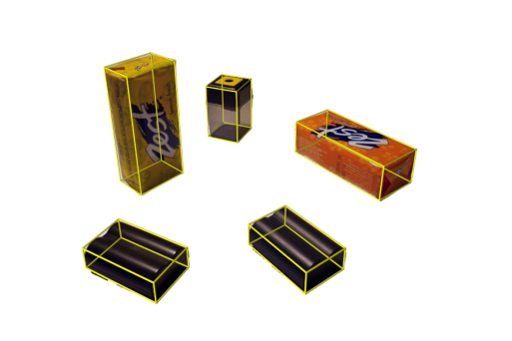
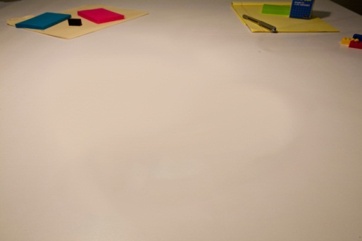
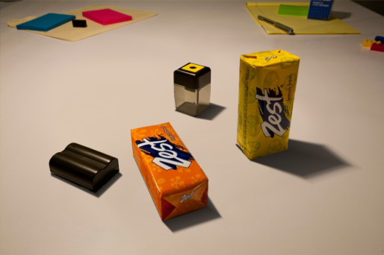
2.3 Non-local relation & 3D
Interactive Images
repetition
+
analyze
edit
Notes:
We make certain assumptions for the images we are processing,
First, we assume objects in the image rest on some horizontal surface (e.g., a tabletop or floor plane),
Second, one or more cuboid-like objects are available to help with initial calibration
Third, shadows appear mainly due to a single-point (or directional) light source
Our algorithm is an analyze-and-edit approach and it operates in two main stages. The first stage is the analysis, in which we first construct a set of cuboid proxies to approximate the image objects, along which we extract the mutual relations among the objects. Then we decompose the image into different layers, one object layer and another is the background layer. The second stage is edit, where the mutual relations are preserved during manipulation.

Slide 27

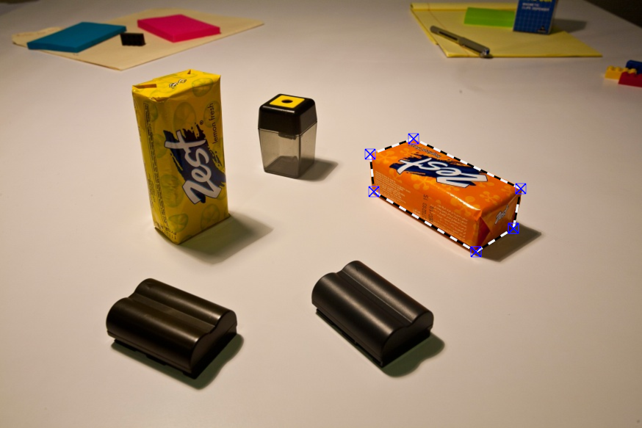
2.3 Non-local relation & 3D
Object selection and cuboid approximation
  Dominate line directions (TR)→Initial cuboid proxies (BR)
Notes:
After users select each object region, we detect six points which corresponds to six corner points of an cuboid.

Slide 28
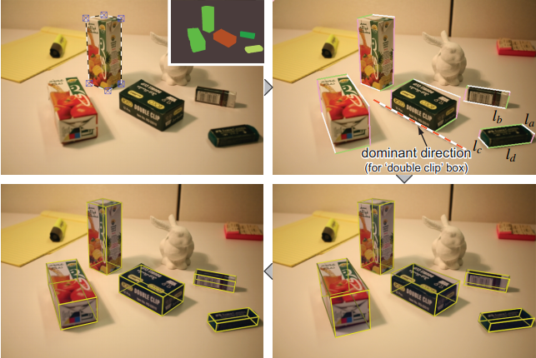
2.3 Non-local relation & 3D
Joint optimization
  Minimizing the projection error
Notes:
To optimize the cuboid to better align them to the image objects, we apply a joint optimization by minimizing the projection error.
We minimize the projection error of the cuboid points to their corresponding image points by optimizing the cuboids and camera parameters.

Slide 29
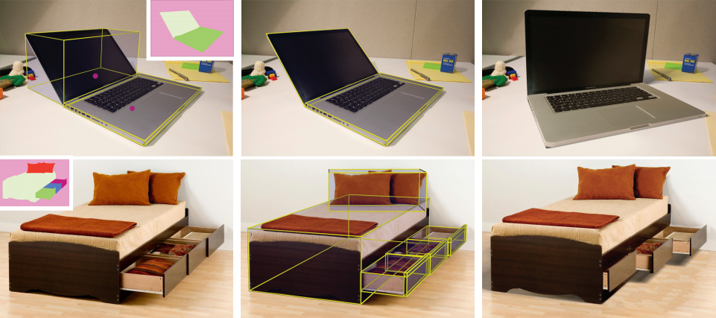
2.3 Non-local relation & 3D
Labeling non-local relations
Notes:
After getting cuboid representations, we automatically estimate most of mutual relations like repetition and co-planarity.
In some special cases, we let the user to annotate some simple relations to help the cuboid construction and their relation estimation. For example, here the user assigns a joint relation between the two cuboid, like the rotation relation in the top row and sliding relation in the bottom row.
The reuse of these simple object geometry and their mutual relations will be demonstrated in the reuse part.

Slide 30
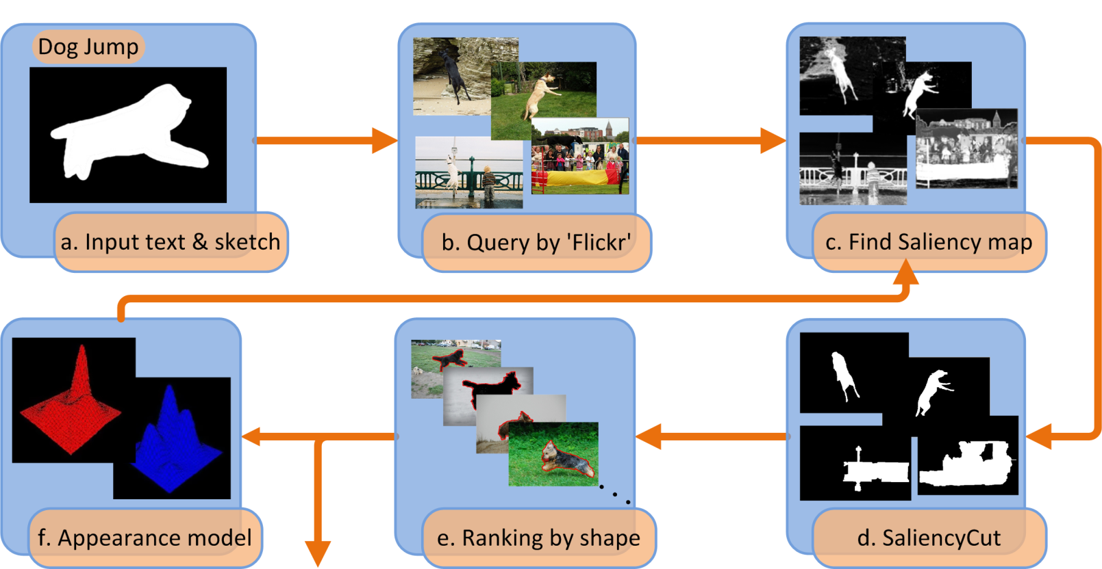
2.4 Image collections
MM Cheng, NJ Mitra, X Huang, SM Hu, SalientShape: Group Saliency in Image Collections, Submitted to CGF.
Notes:
We have demonstrated quite exciting salient object detection results for images with non-ambiguous salient object regions. There two nature questions. First, can we use saliency based object of interest region segmentation for nature images, for example, Flickr images. Second, how can we use the saliency segmentation results to enable image processing applications.
In this work, we aims at finding salient object regions of image collections from internet. Typically, such image collections are huge in size, have heterogeneous content, and are noisy due to diverse background and illumination conditions.
To do this, we firstly extract salient object regions for each individual images. Then we try to use these good saliency segmentations to help salient object segmentation of other images.

Slide 31
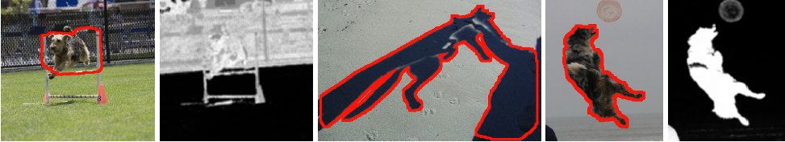
2.4 Image collections
Image collection segmentation
  Find confident good segmentation to help saliency segmentation of others
    Automatically estimate segmentation quality
    Choose good segmentation by shape comparing (less influence to diversity of appearance)
Notes:
To better segment an weakly correlated and noise image collections, we make use those good segmentation results to help others. To automatically find some good segmentations for getting shared appearance model, we firstly find better segmentation by removing those with imprecise and incomplete segmentation. As demonstrated in the first dog image here, when estimating foreground and background appearance model using the segmentation and use the estimated appearance model to re-estimate foreground and background probability, the results has a clear different from the initial segmentation. Such difference is a strong evidence of imprecise segmentation. In the middle image, there is a large part of the segmentation has be cropped by image border, making it’s shape information less discriminative. The last example here shows a good segmentation.
After removing those imprecise and incomplete segmentation, we further compare the shape of segment with the user input sketch to finally choose good segmentation. Typically shape information is less relevant to appearance, our shape based selection typically has less influence to diversity of appearance samples.
Here we need a small number of high quality segmentation results for learning good appearance model of the segmentation, thus we use strict threshould in the selection steps here.

Slide 32
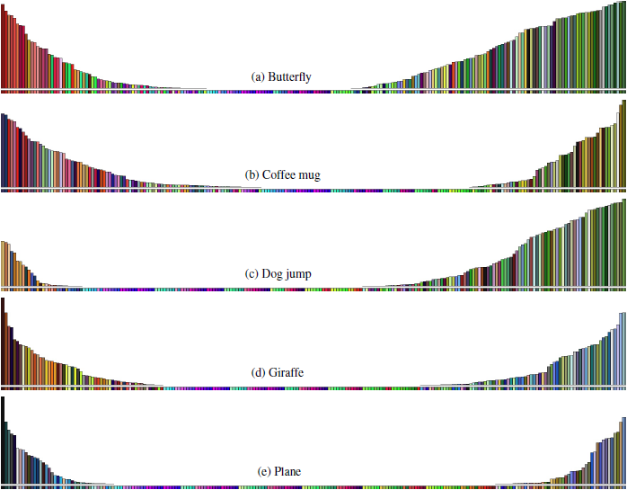
2.4 Image collections
Learned global appearance
Notes:
Here we illustrated some learned appearance model for 5 categories of images downloaded from Flickr. They are quite associated with our nature understanding of these image categories. For instance, in the first butterfly example, the foreground corresponds to varies bright colors where butterflies typically have, while the background corresponds to green leaves. In the forth giraffe example, the foreground reflect the dark yellow appearance of the typical giraffe. The background has two major colors, when having a distance view, we may typically see the tree leaves behind the giraffe. When having a close view, since giraffe is much higher than human observer, we can easily capture blue sky.
If carefully observe these learned appearance, all of them accords well with our understandings about the corresponding image categories. And we use such global appearance to act as an important factor in our energy function.

Slide 33
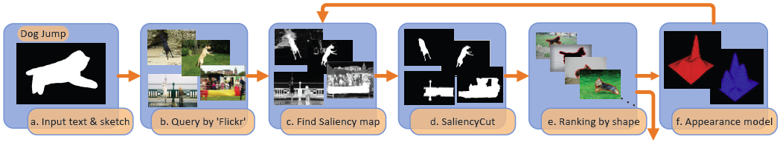
2.4 Image collections
Energy function for group saliency segmentation
  GMM based appearance model representation
  Iterate & appearance re-estimation, as in Grabcut
Appearance for group
Appearance for image I
Smoothness
Notes:
We formulate the group saliency segmentation problem under MRF framework, where the first unary term reflect the appearance model of the weekly correlated image group. The second unary term reflect the appearance for image I. The third one is the smoothness term. We use Gaussian Mixture Model to capture appearance information, while iteratively minimize the energy function and re-estimate the appearance model as in GrabCut.

Slide 34
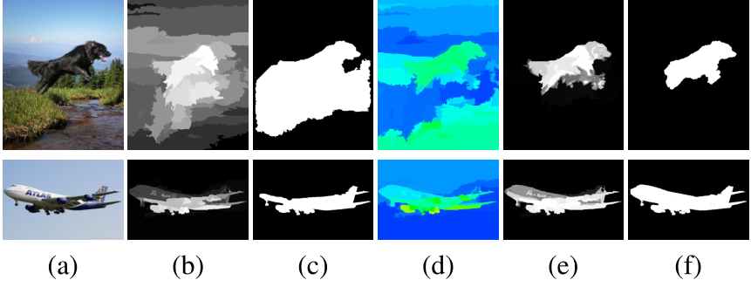
2.4 Image collections
Helping saliency detection
Notes:
Here we demonstrated two examples of using learned appearance model to help finding object of interest regions in images. In the first example, the learned global appearance (shown in subfigure (d)) to help remove unwanted grass regions in the dog image and complete the fly regions in the second image.

Slide 35

2.4 Image collections
Helping saliency detection
Notes:
Here we show statistics about such improvement for five groups of images getting from Flickr.

Slide 36
2.4 Image collections
Relations to concurrent work
  Comparison to [12ECCV] Segmentation Propagation in ImageNet
  Common: co-segmentation, segmentation transfer, global appearance by GMM, Grabcut like optimization
  Different: learning source, image set
  Advantage: carefully choose good source. Avoid the performance degrades in stages [12ECCV].

Slide 37



3 Reusing image contents
Reusing image contents

Slide 38

3.1 Rendering
GX Zhang, MM Cheng, SM Hu, RR Martin, A Shape-Preserving Approach to Image Resizing, Computer Graphics Forum, vol. 28, no. 7, pp. 1897–1906, 2009.

Slide 39










3.1 Rendering
Motivation

Slide 40
3.1 Rendering
Content aware resizing – Basic idea
  Control points: mesh + edge points
  Handles: a subset of control points

Slide 41
3.1 Rendering
Distortion Energy of Handles
Intuitive
  It is the minimal possible square distance between two shapes P’ and P, if P may be replaced by any similarity transformation of itself.
  We have proved that when P contains 3 points (P is triangle), this energy function is identical to the discrete conformal energy which is widely used in geometry processing.
Notes:
This is our definition for the distortion energy. Intuitively, the energy measures the differences between two shapes while ignoring translation and rotation. In our case, it’s the deformed position and the original position, and is the minimal possible square distance between them. If the two shapes are similar, such measurement of shape differences is 0.
We have proved that when P contains 3 points, that is to say P is a triangle, this energy function is identical to the discrete conformal energy which is widely used in geometry processing.

Slide 42
3.1 Rendering
Content aware image resizing
  Using control points driven deformation according to importance/saliency maps

Slide 43



3.1 Rendering
Content aware image resizing results
Input image
Scaling
Our

Slide 44


3.1 Rendering
Rendering results at different view
Y Zheng, X Chen, MM Cheng, K Zhou, SM Hu, NJ Mitra. Interactive Images: Proxy-based Scene Understanding for Smart Manipulation. ACM TOG (SIGGRAPH). 31, 4, 1-10, 2012.

Slide 45


3.1 Rendering
Repetition rendering
MM Cheng, FL Zhang, NJ Mitra, X Huang, SM Hu, RepFinder: Finding Approximately Repeated Scene Elements for Image Editing, ACM TOG (SIGGRAPH). 29, 4, 83:1-8, 2010.
Notes:
Here is another example.-> Our method work on scene object level and users could intuitively edit positions of these followers to create new results. This result is difficult to achieve for previous patch based method since there is no local patch ->contains red fruits and yellow followers in the original image.

Slide 46

3.2 Composition
T Chen, MM Cheng, P Tan, A Shamir, SM Hu, Sketch2photo: internet image montage, ACM TOG. (SIGGRAPH Asia), vol. 28, no. 5, 124:1-10, 2009.

Slide 47




3.2 Composition
Internet image montage

Slide 48


3.2 Composition
Internet image montage

Slide 49
3.2 Composition
Consistent composition
T Chen, P Tan, LQ Ma, MM Cheng, A Shamir, SM Hu. PoseShop: Human Image Database Construction and Personalized Content Synthesis. IEEE TVCG.

Slide 50


3.3 Manipulation
MM Cheng, FL Zhang, NJ Mitra, X Huang, SM Hu, RepFinder: Finding Approximately Repeated Scene Elements for Image Editing, ACM TOG (SIGGRAPH). 29, 4, 83:1-8, 2010.

Slide 51

3.3 Manipulation
Y Zheng, X Chen, MM Cheng, K Zhou, SM Hu, NJ Mitra. Interactive Images: Proxy-based Scene Understanding for Smart Manipulation. ACM TOG (SIGGRAPH). 31, 4, 1-10, 2012.

Slide 52
3.3 Manipulation

Slide 53





3.4 Retrieval
MM Cheng, NJ Mitra, X Huang, SM Hu, SalientShape: Group Saliency in Image Collections, Submitted to CGF.

Slide 54
4.1 Conclusion
Smart images
  Find semantic representations: accords with human mental representation.
  Developed a number of methods for saliency image regions, object of interest segmentation, layering, 3D, non-local relations estimation.
  Demonstrated a number of applications, including rendering, composition, manipulation, retrieval, etc.

Slide 55
4.2 Future works
Easy methods for geometry extraction which can deal with larger range of images
Salient shape indexing for efficient image retrieval
Use object of interest segmentation for image classification and object detection

Slide 56
References
MM Cheng, GX Zhang, NJ Mitra, X Huang, SM Hu. Global Contrast based Salient Region Detection. IEEE CVPR, June 21-23, 2011.
MM Cheng, GX Zhang, On Connectedness of Random Walks Segmentation, IEEE Trans. Pattern Anal. Mach. Intel. (TPAMI), 2011. 33(1): p. 200-202.
MM Cheng, FL Zhang, NJ Mitra, X Huang, SM Hu, RepFinder: Finding Approximately Repeated Scene Elements for Image Editing, ACM Trans. Graph. (SIGGRAPH). 29, 4, 83:1-8, 2010.
T Chen, MM Cheng, P Tan, A Shamir, SM Hu, Sketch2photo: internet image montage, ACM Trans. Graph. (SIGGRAPH Asia), vol. 28, no. 5, 124:1-10, 2009.
Y Zheng, X Chen, MM Cheng, K Zhou, SM Hu, NJ Mitra. Interactive Images: Cuboid-proxies for Smart Image Manipulation. ACM Tran. Graph. (SIGGRAPH). 31, 4, 1-10, 2012.
GX Zhang, MM Cheng, SM Hu, RR Martin, A Shape-Preserving Approach to Image Resizing, Computer Graphics Forum, vol. 28, no. 7, pp. 1897–1906, 2009.
FL Zhang, MM Cheng, J Jia, SM Hu. ImageAdmixture: Putting Together Dissimilar Objects from Groups. IEEE TVCG, to appear.
T Chen, P Tan, LQ Ma, MM Cheng, A Shamir, SM Hu. PoseShop: Human Image Database Construction and Personalized Content Synthesis. IEEE TVCG, to appear.
MM Cheng, NJ Mitra, X Huang, SM Hu, SalientShape: Group Saliency in Image Collections, Submitted to CGF.
MM Cheng, NJ Mitra, X Huang, SM Hu, Image Saliency computation for Object Segmentation and Retrieval, submitted to IEEE TPAMI.

Slide 57

Notes:
谢谢大家！

