Slide 1
Joint Salient Object Detection and Existence Prediction
Huaizu Jiang, Ming-Ming Cheng, Shi-Jie Li,
Ali Borji, Jingdong Wang
Speaker: Ming-Ming Cheng
Nankai University
http://mmcheng.net/

Slide 2
Motivation: Generic object detection
Notes:
Generic object detection has made great progress in recent years. However, most state-of-the-art method still requires each category specific classifiers to evaluate many image windows in a sliding window fashion.

Slide 3

Motivation: Semantic Segmentation

Slide 4
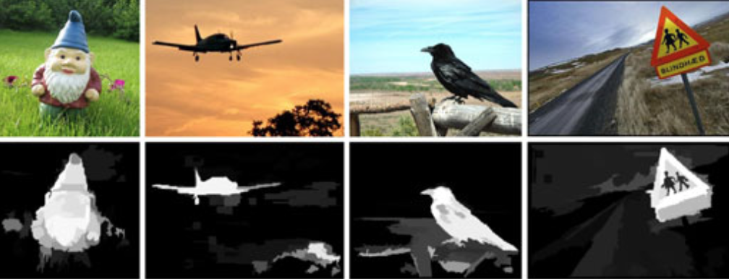

Related works: saliency detection
Salient object detection
  Detect the (most) attention-grabbing object in the scene
Learning to detect a salient object. CVPR 2007, Liu et. al.
Frequency-tuned salient region detection, CVPR 2009, Achanta et. al.
Global contrast based salient region detection, CVPR 2011 (PAMI 2015), Cheng et. al.

Slide 5

Applications
T Chen, MM Cheng, P Tan, A Shamir, SM Hu, Sketch2photo: internet image montage, ACM TOG. (SIGGRAPH Asia), vol. 28, no. 5, 124:1-10, 2009.

Slide 6
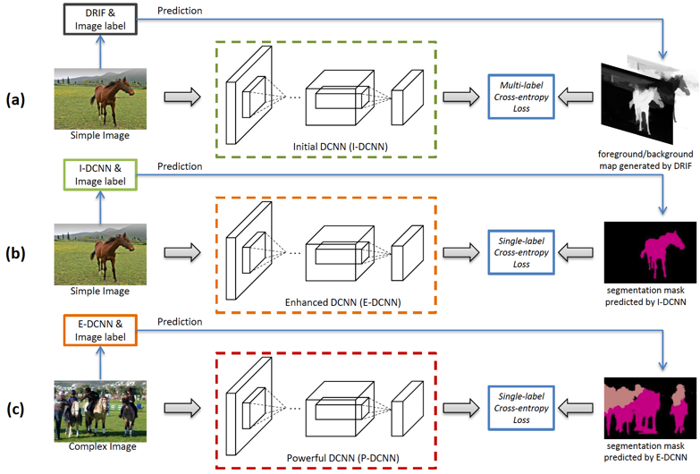
Applications
10% improvement over state of the art!
STC: A Simple to Complex Framework for Weakly-supervised Semantic Segmentation, IEEE TPAMI 2016, Wei et al.
Notes:
10.6% improvement over “P. O. Pinheiro and R. Collobert, “From image-level to pixellevel
labeling with convolutional networks,” IEEE CVPR, 2015.”

Slide 7
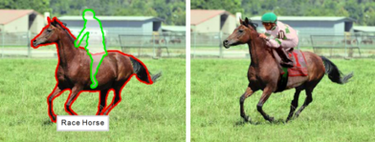
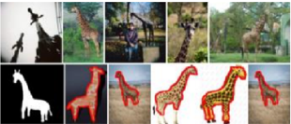
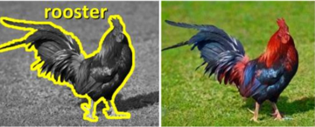
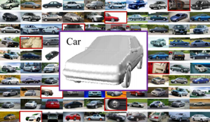
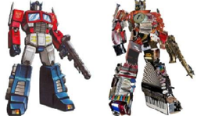
Applications
[EuroGraphics 12] [Vis. Comp. 14]
[ACM TOG 11] [Vis. Comp. 13] [ACM TOG 11]

Slide 8
Advantages and disadvantages
Advantages
  Automatic
  Light weighted
  Produce nice results for MANY images
Disadvantages
  Weak stability

Slide 9
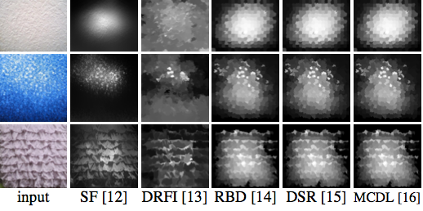
New problem?
Computer vision problems ← datasets
Existing salient object detection models
  Assume at least one salient object exists
  Not true for heterogynous contents, e.g. internet images

Slide 10
New problem?
Computer vision problems ← datasets
Existing salient object detection models
  Assume at least one salient object exists
  Not true for heterogynous contents, e.g. internet images
Salient object detection
+
Existence Prediction
Salient object detection

Slide 11
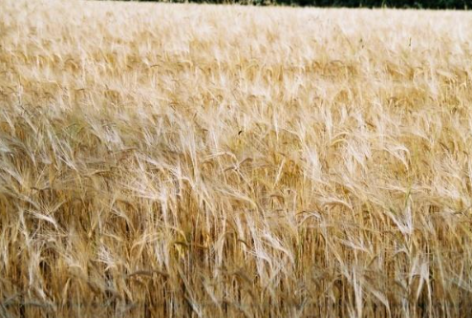
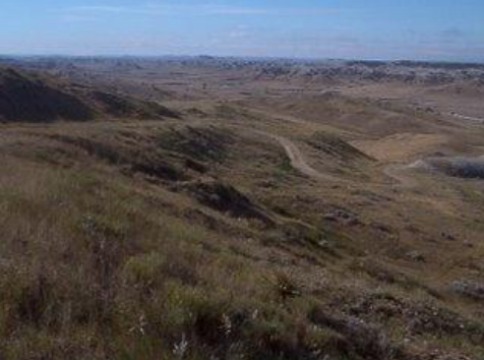

Dataset for the new problem
We collected 6182 background images
  From SUN dataset, texture dataset, Flickr, etc.
  5000 training + 1182 testing
Combined with existing SOD dataset
  MSRA10K dataset
  ECSSD dataset

Slide 12
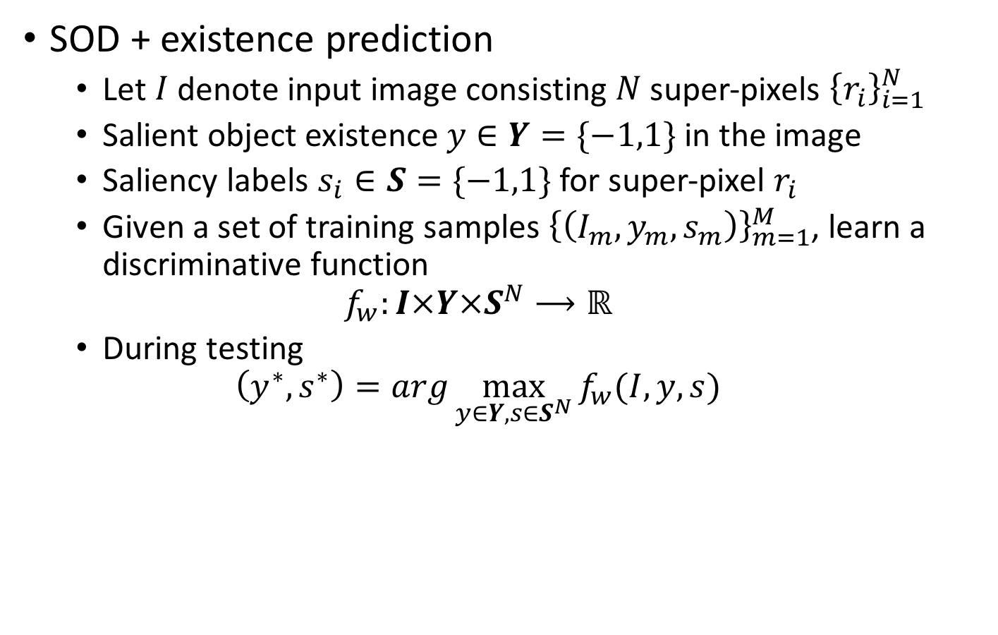
Formulate the Problem
SOD + existence prediction
  Let $I$ denote input image consisting $N$ super-pixels ${\left\{r_{i}\right\}}_{i=1}^{N}$
  Salient object existence $y∈Y=\{−1,1\}$ in the image
  Saliency labels $s_{i}∈S=\{−1,1\}$ for super-pixel $r_{i}$
  Given a set of training samples ${\left\{\left(I_{m},y_{m},s_{m}\right)\right\}}_{m=1}^{M}$, learn a discriminative function
  $$f_{w}:I×Y×S^{N}⟶ℝ$$
  During testing
  $$\left(y^{∗},s^{∗}\right)=arg\max_{y∈Y,s∈S^{N}}{f_{w}(I,y,s)}$$

Slide 13
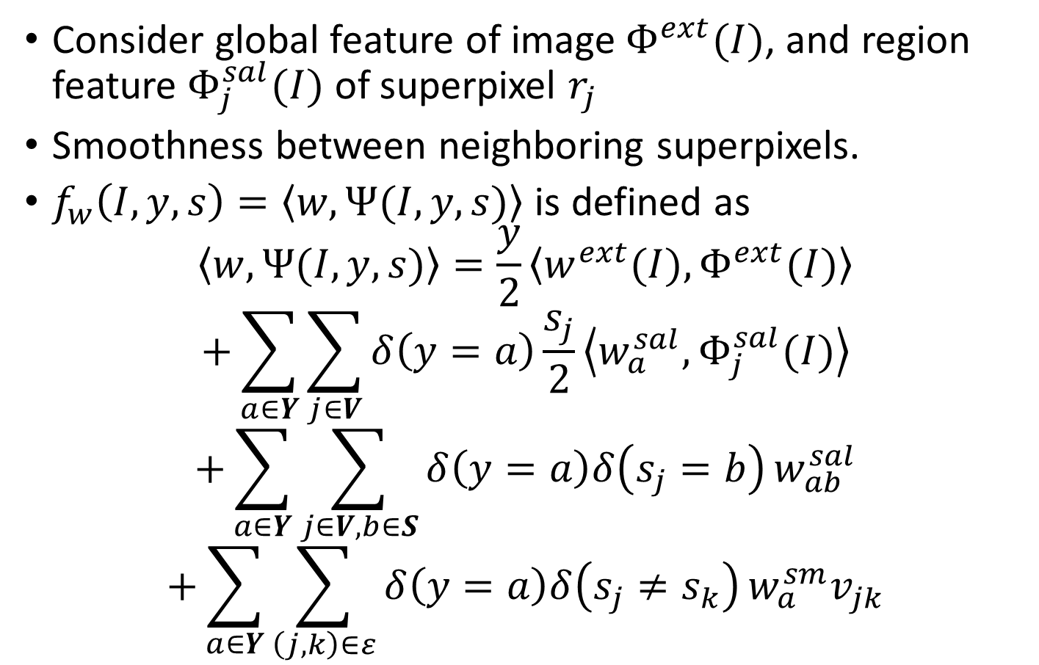
Formulate the Problem
Consider global feature of image $Φ^{ext}(I)$, and region feature $Φ_{j}^{sal}(I)$ of superpixel $r_{j}$
Smoothness between neighboring superpixels.
$f_{w}\left(I,y,s\right)=\left\langle w,Ψ(I,y,s)\right\rangle$ is defined as
$$\left\langle w,Ψ(I,y,s)\right\rangle =\frac{y}{2}\left\langle w^{ext}(I),Φ^{ext}(I)\right\rangle$$
$$+\sum_{a∈Y}{\sum_{j∈V}{δ\left(y=a\right)\frac{s_{j}}{2}}}\left\langle w_{a}^{sal},Φ_{j}^{sal}(I)\right\rangle$$
$$+\sum_{a∈Y}{\sum_{j∈V,b∈S}{δ\left(y=a\right)δ\left(s_{j}=b\right)}}w_{ab}^{sal}$$
$$+\sum_{a∈Y}{\sum_{\left(j,k\right)∈ε}{δ\left(y=a\right)δ\left(s_{j}≠s_{k}\right)}}w_{a}^{sm}v_{jk}$$

Slide 14
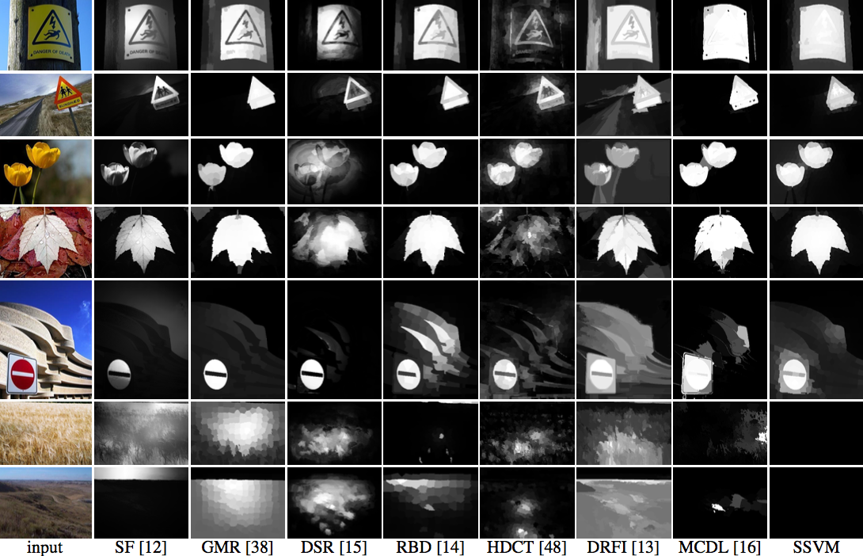
Experimental results

Slide 15
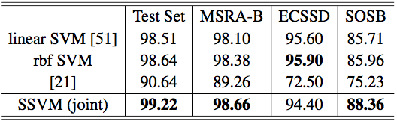
Existence prediction accuracy
Notes:
Without object segmentation, Eq. 3 becomes a standard primal linear SVM formulation

Slide 16
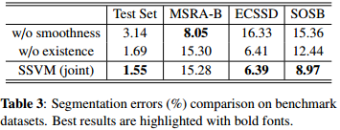
Segmentation error

Slide 17
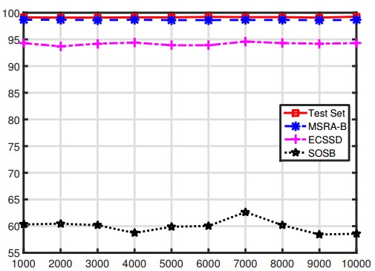
Accuracy vs. Number of Training Images
Existence prediction accuracy (%)
Number of Training images

Slide 18
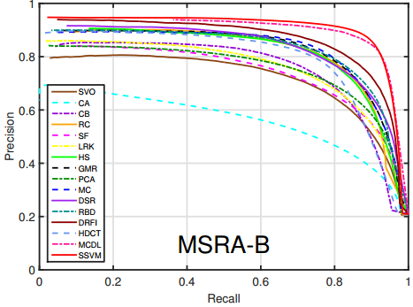
Precision recall curves comparisons

Slide 19
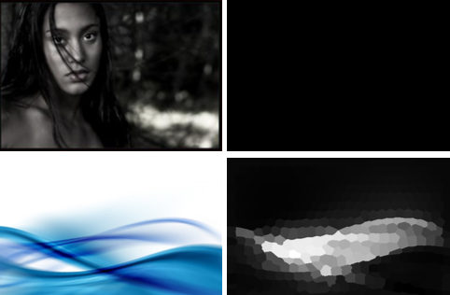
Limitations
Failure cases

Slide 20
Discussions
We propose a supervised learning approach
  for joint salient object detection and existence prediction.
  produces less false positives on background images.
  integrates both image-level and region-level classifications.
Experimental results validate the effectiveness.
Potential applications: processing vast amount of heterogeneous internet images
  Internet based image composition
  big data analysis
  semantic segmentation
  internet based colorization

Slide 21
Thanks
Q&A

