Slide 1


BING: Binarized Normed Gradients for Objectness Estimation at 300fps
Ming-Ming Cheng¹ Ziming Zhang² Wen-Yan Li¹ Philip H. S. Torr¹
¹Torr Vision Group, Oxford University ²Boston University

Slide 2
Motivation: Generic object detection
Notes:
Generic object detection has made great progress in recent years. However, most state-of-the-art method still requires each category specific classifiers to evaluate many image windows in a sliding window fashion.

Slide 3
Motivation: What is an object?
> >
Notes:
Objectness is usually represented as a value which reflects how likely an image window covers an object of any category.

Slide 4

Motivation: What is an object?
An objectness measure
  A value to reflect how likely an image window covers an object of any category [PAMI 12 Alexe et. al.].
What are the benefits?
  Improving computational efficiency by reducing the search space
  Allowing the usage of strong classifiers during testing to improve accuracy
Measuring the objectness of image window, IEEE TPAMI 2012, Alexe et. al.

Slide 5
Motivation: What is an object?
What is a good objectness measure?
  Achieve high object detection rate (DR)
    Any undetected object at this stage cannot be recovered later
  Produce a small number of proposals
    Reducing computational time of subsequent detectors
  Obtain high computational efficiency
    The method can be easily involved in various applications
    Especially for realtime and large-scale applications;
  Have good generalization ability to unseen object categories
    The proposals can be reused by many category specific detectors
    Greatly reduce the computation for each of them.

Slide 6
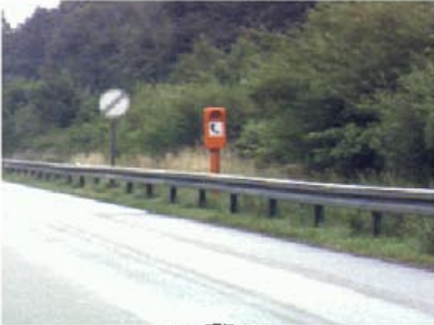
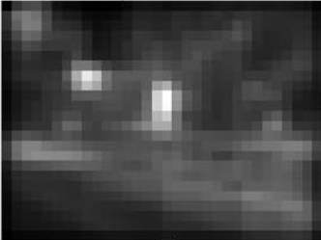
Related works
Fixation prediction
  Predicting saliency points of human eye movement
A model of saliency-based visual attention for rapid scene analysis. PAMI 1998, Itti et al.
Saliency detection: A spectral residual approach. CVPR 2007, Hou et. al.
Graph-based visual saliency. NIPS, Harel et. al.
Quantitative analysis of human-model agreement in visual saliency modeling: A comparative study, IEEE TIP 2012, Borji et. al.
A benchmark of computational models of saliency to predict human fixations, TR 2012.

Slide 7

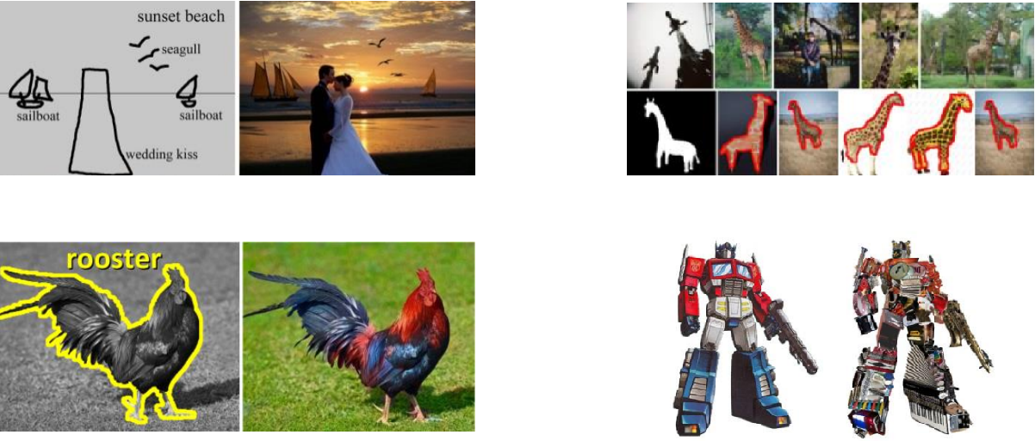

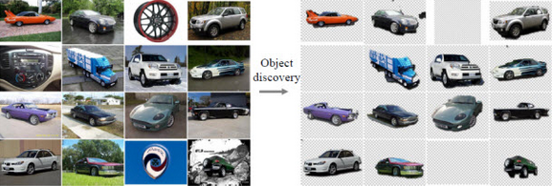
Related works
Salient object detection
  Detect the most attention-grabbing object in the scene
  Applications
Learning to detect a salient object. CVPR 2007, Liu et. al.
Frequency-tuned salient region detection, CVPR 2009, Achanta et. al.
Global contrast based salient region detection, CVPR 2011, Cheng et. al.
Salient object detection: a benchmark, Ali et. al.
[ACM TOG 09, Chen et. al.] [Vis. Comp. 13, Cheng et. al.] [CVPR 12, Zhu et. al.]
[ACM TOG 11, Chia et. al.] [ACM TOG 11, Zhang et. al.] [CVPR 13, Rubinstein et. al.]
Notes:
Robust Applications Design: automatically process many images + use efficient algorithms to select good results.
Sketch guided image composition, image retrieval, unsupervised object discovery, semantic colorization, image collage, unsupervised joint object discovery and segmentation.

Slide 8
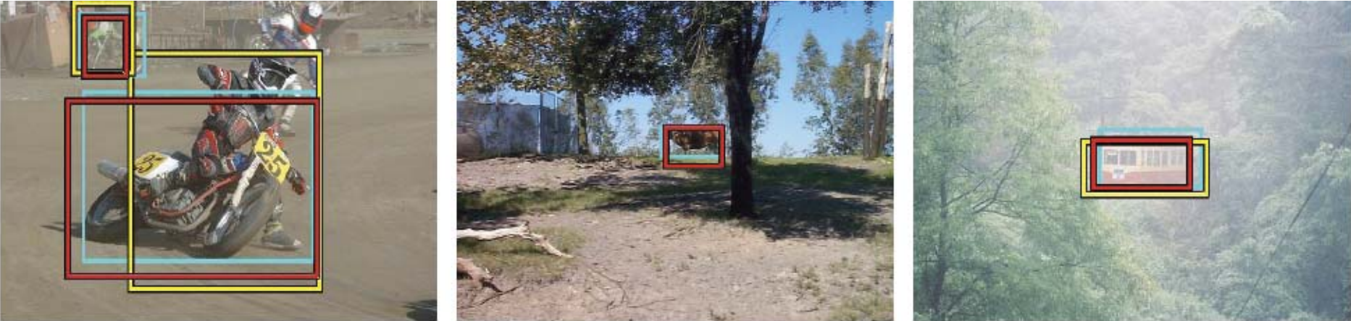
Related works
Objectness proposal generation methods
  A small number (e.g. 1K) of category-independent proposals
  Expected to cover all objects in an image
Measuring the objectness of image windows. PAMI 2012, Alexe, et. al.
Selective Search for Object Recognition, IJCV 2013, Uijlings et. al.
Category-Independent Object Proposals With Diverse Ranking, PAMI 2014, Endres et. al.
Proposal Generation for Object Detection using Cascaded Ranking SVMs. CVPR 2011, Zhang et al.
Learning a Category Independent Object Detection Cascade. ICCV 2011, Rahtu et. al.
Generating object segmentation proposals using global and local search, CVPR 2014, Rantalankila et al.

Slide 9
Related works
Proposal generation algorithm [CVPR 11, Zhang et. al.]
  Scale/aspect-ratio quantization
  Two-stage cascaded ranking SVMs
    Learning a linear classifier for each quantized scale/aspect-ratio
    Learning another global linear classifier for calibration
Other efficient search mechanism
  Branch-and-bound
  Approximate kernels
  Efficient classifiers
  …
Proposal Generation for Object Detection using Cascaded Ranking SVMs. CVPR 2011, Zhang et al.
Beyond sliding windows: Object localization by efficient subwindow search. CVPR 2008, Lampert et. al.
Classification using intersection kernel support vector machines is efficient. CVPR 2008, Maji et. al.
Efficient additive kernels via explicit feature maps. TPAMI 2012, A. Vedaldi and A. Zisserman.
Histograms of oriented gradients for human detection. CVPR 2005, N. Dalal and B. Triggs.

Slide 10

Methodology: Observation
Our observation: a small interactive demo
  Take you pen and paper and draw an object which is current in your mind.
  What the object looks like if we resize it to a tiny fixed size?
    E.g. 8x8. Not only changing the scale, but also the aspect ratio.

Slide 11
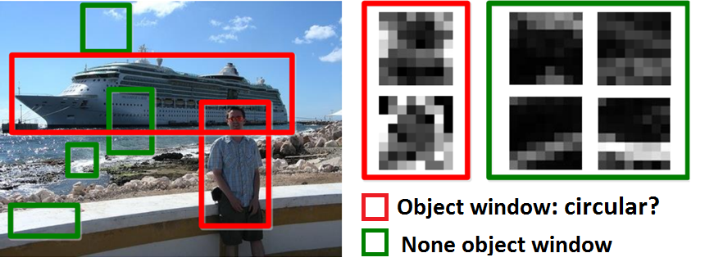
Methodology: Observation
Objects are stand-alone things with well defined closed boundaries and centers.
Little variations could present in such abstracted view.
  Finding pictures of objects in large collections of images. Springer Berlin Heidelberg, 1996, Forsyth et. al.
  Using stuff to find things. ECCV 2008, Heitz et. al.
  Measuring the objectness of image window, IEEE TPAMI 2012, Alexe et. al.

Slide 12
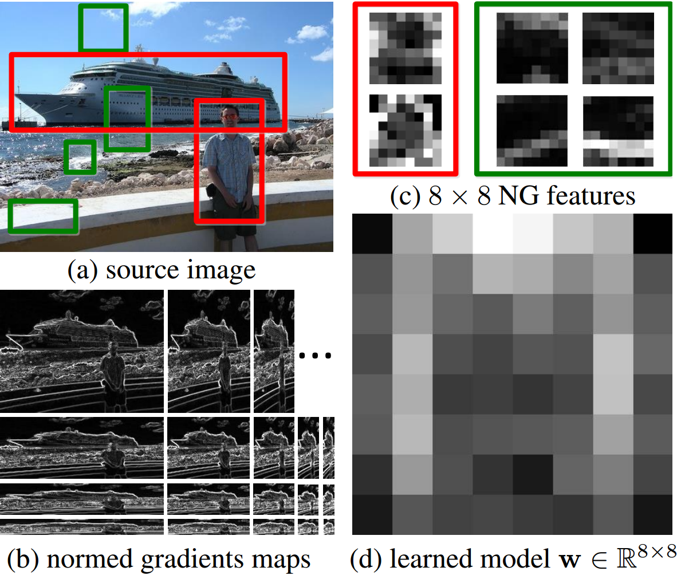
Methodology: Feature & Learning
Normed gradients (NG) + Cascaded Linear SVMs
  Normed gradient means Euclidean norm of the gradient

Slide 13
Methodology: Feature & Learning
Normed gradients (NG) + Cascaded Linear SVMs
  Detect at different quantized scale and aspect ratios
  An 8x8 region in the normed gradient maps forms a 64D feature vector for a window in the source image
  Simultaneous Object Detection and Ranking with Weak Supervision, NIPS 2010, Blaschko et. al.
  Proposal Generation for Object Detection using Cascaded Ranking SVMs. CVPR 2011, Zhang et. al.
  LibLinear: A library for large linear classiﬁcation, JMLR 2008, Fan et. al.
  Learning a Category Independent Object Detection Cascade. ICCV 2011, Rahtu et. al.

Slide 14
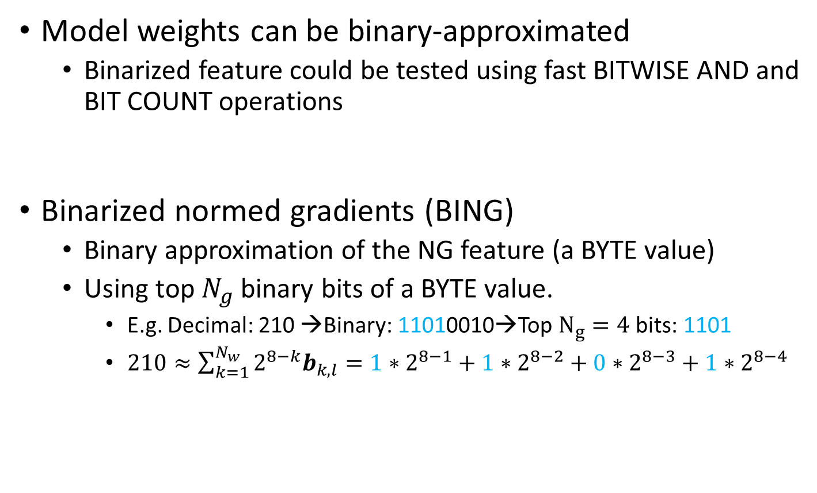
Methodology: Binarization
Model weights can be binary-approximated
  Binarized feature could be tested using fast BITWISE AND and BIT COUNT operations
Binarized normed gradients (BING)
  Binary approximation of the NG feature (a BYTE value)
  Using top $N_{g}$ binary bits of a BYTE value.
    E.g. Decimal: 210 →Binary: 11010010→Top $N_{g}=4$ bits: 1101
    $210≈\sum_{k=1}^{N_{w}}{2^{8−k}b_{k,l}}=1∗2^{8−1}+1∗2^{8−2}+0∗2^{8−3}+1∗2^{8−4}$
Efficient online structured output learning for keypoint-based object tracking. CVPR 2012, Hare et. al.

Slide 15
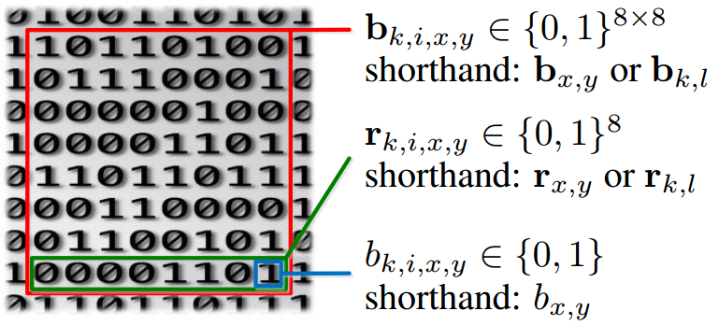
Methodology: Binarization
Getting BING features: illustration of the representation
  Use a single atomic variable (int64 & byte) to represent a BING feature and its last row.

Slide 16
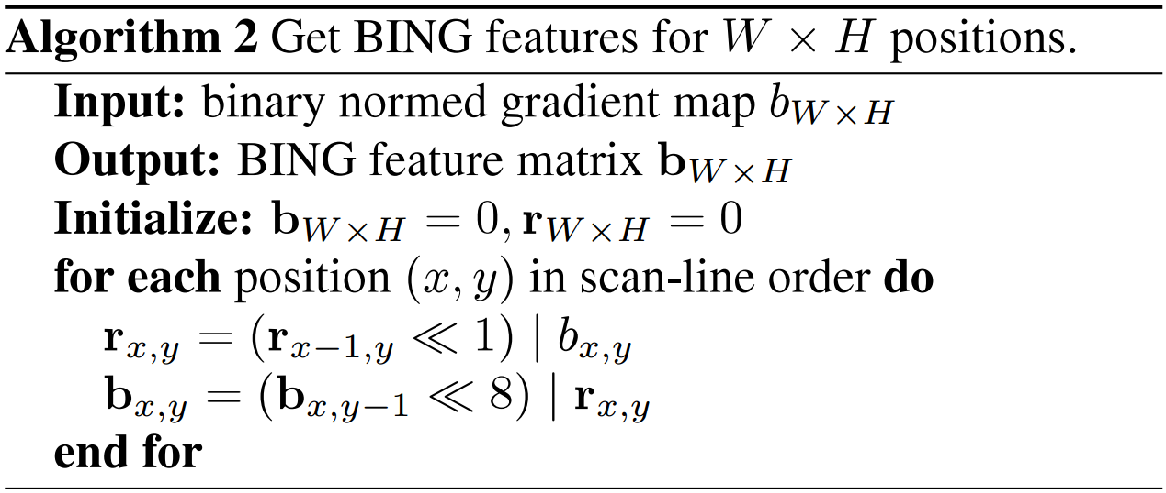
Methodology: Binarization
Getting BING features: illustration of the representation
Getting BING features

Slide 17
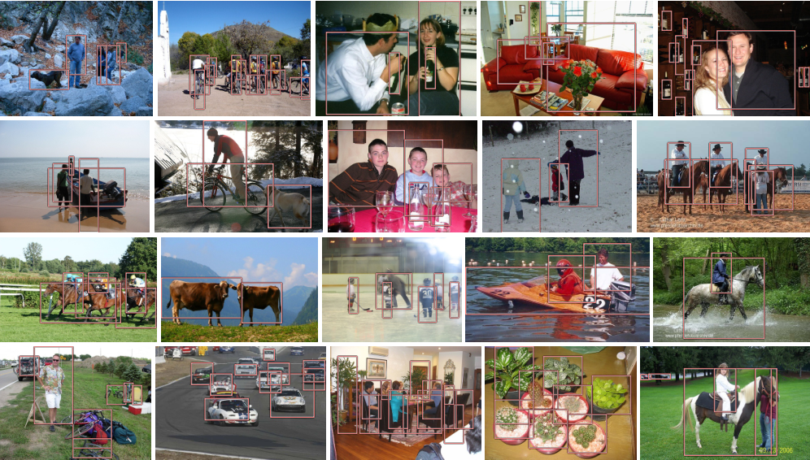
Experimental results
Samples of true-positives on PASCAL VOC 2007

Slide 18
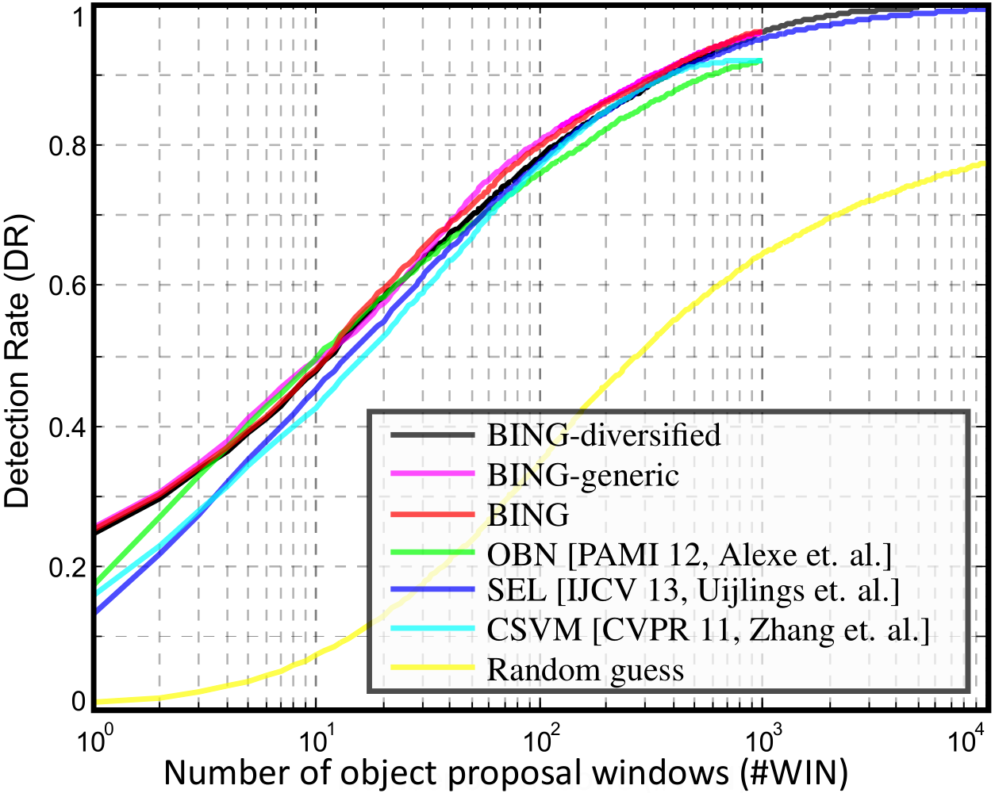
Experimental results
Proposal quality on PASCAL VOC 2007

Slide 19
Experimental results
Computational time
  A laptop with an Intel i7-3940XM CPU
  20 seconds for training on the PASCAL 2007 training set!!
  Testing time 300fps on VOC 2007 images
Methods | Time (seconds)
PAMI 14, Endres et. al | 89.2
PAMI 12, Alexe, et. al. | 3.14
CVPR 11, Zhang et. al. | 1.32
IJCV 13, Uijlings et. al. | 11.2
Our BING | 0.003
Category-Independent Object Proposals With Diverse Ranking, PAMI 2014, Endres et. al.
Measuring the objectness of image windows. PAMI 2012, Alexe, et. al.
Proposal Generation for Object Detection using Cascaded Ranking SVMs. CVPR 2011, Zhang et. al.
Selective Search for Object Recognition, IJCV 2013, Uijlings et. al.

Slide 20
Experimental results
Computational time
  Average number of atomic operations for computing objectness of each image window at different stages
 | BITWISE |  |  | FLOAT |  | INT, BYTE
 | SHIFT | |, & | CNT | + | * | +, - | min
Gradient | 0 | 0 | 0 | 0 | 0 | 9 | 2
Get BING | 12 | 12 | 0 | 0 | 0 | 0 | 0
Get score | 0 | 8 | 12 | 1 | 2 | 8 | 0

Slide 21

Conclusion and Future Work
Conclusions
  Surprisingly simple, fast, and high quality objectness measure
    Needs a few atomic operations (i.e. add, bitwise, etc.) per window
      Test time: 300fps!
      Training time on the entire VOC07 dataset takes 20 seconds!
    State of the art results on challenging VOC benchmark
      96.2% Detection rate (DR) @ 1K proposals, 99.5% DR @ 5K proposals
    Generic over classes, training on 6 classes and test on other classes
    100+ lines of C++ to implement the algorithm
Resources: http://mmcheng.net/bing/
  Source code, data, slides, links, online FAQs, etc.
  1000+ source code downloads in 1 week
  Already got many feedbacks reporting detection speed up
free

Slide 22
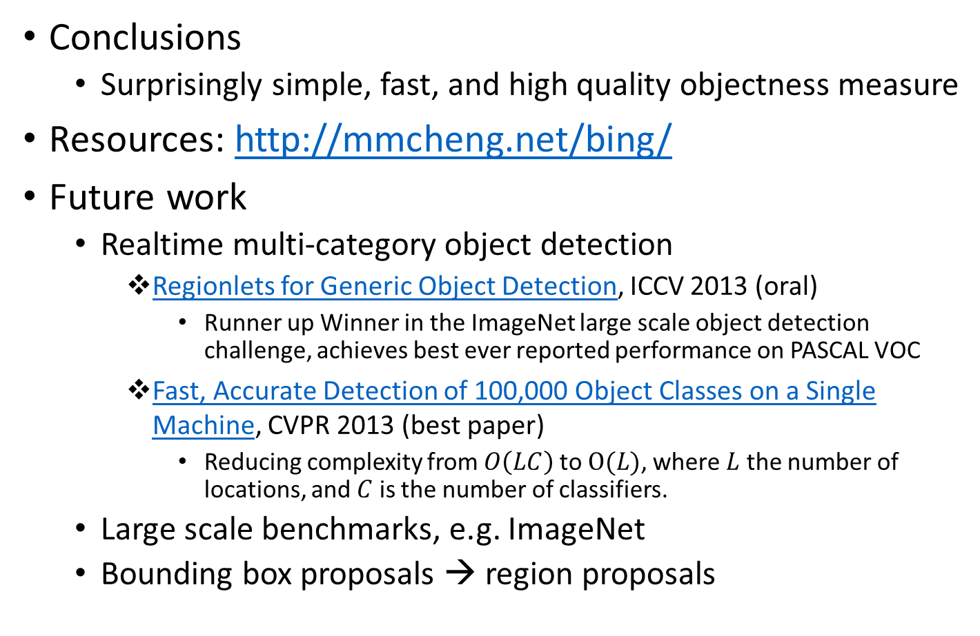
Conclusion and Future Work
Conclusions
  Surprisingly simple, fast, and high quality objectness measure
Resources: http://mmcheng.net/bing/
Future work
  Realtime multi-category object detection
    Regionlets for Generic Object Detection, ICCV 2013 (oral)
      Runner up Winner in the ImageNet large scale object detection challenge, achieves best ever reported performance on PASCAL VOC
    Fast, Accurate Detection of 100,000 Object Classes on a Single Machine, CVPR 2013 (best paper)
      Reducing complexity from $O\left(LC\right)$ to $O(L)$, where $L$ the number of locations, and $C$ is the number of classifiers.
  Large scale benchmarks, e.g. ImageNet
  Bounding box proposals → region proposals
free

Slide 23
Q&A
Notice: this is a pre-release. Feedbacks are welcome. Please
contact me via email or leave messages in the project page.
On stage demo: training and testing for VOC 2007 benchmark

