Slide 1




ImageSpirit: Verbal Guided Image Parsing
Ming-Ming Cheng¹ Shuai Zheng¹ Wen-Yan Lin³ Vibhav Vineet³ Paul Sturgess³ Nigel Crook³ Niloy Mitra² Philip Torr¹
¹Oxford University ²UCL ³Oxford Brookes University ⁴Nankai University

Slide 2
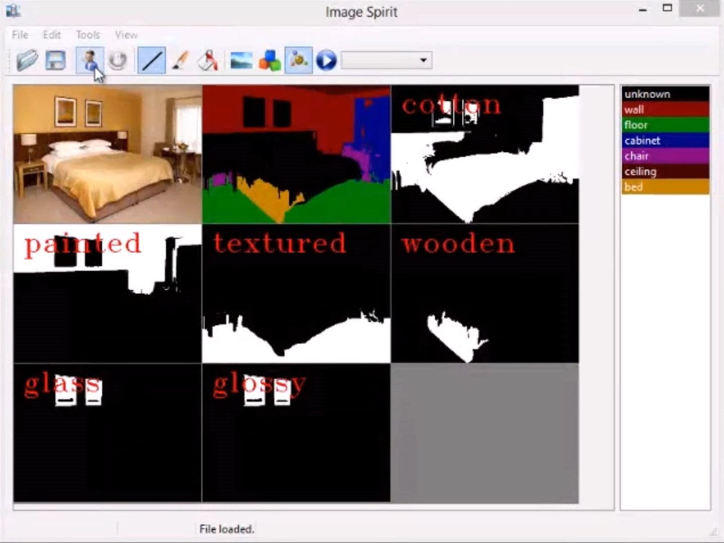
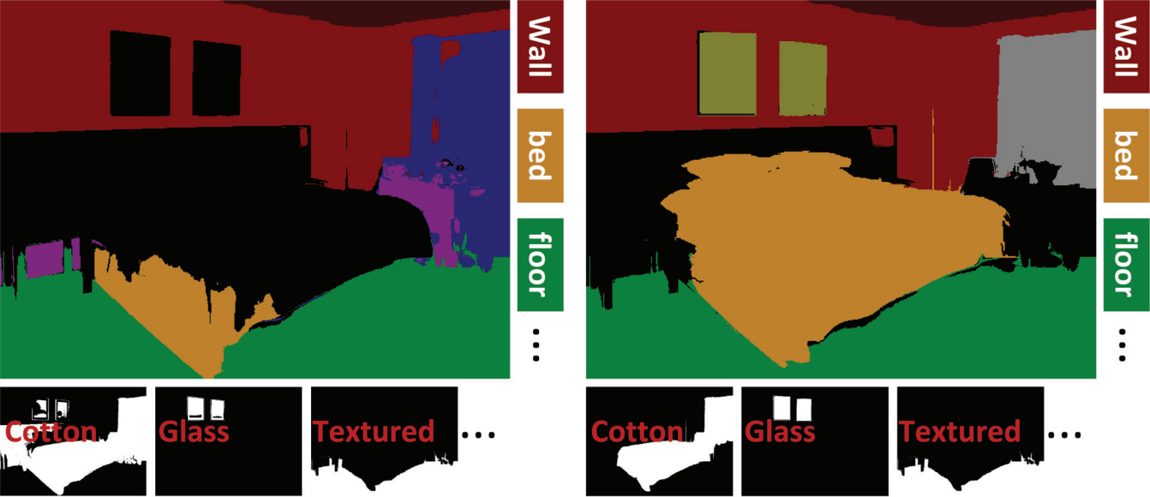
Demo: Verbal Guided Image Parsing
Notes:
In ImageSpirit, we show that users can use verbal instruction to improve the parsing results.

Slide 3
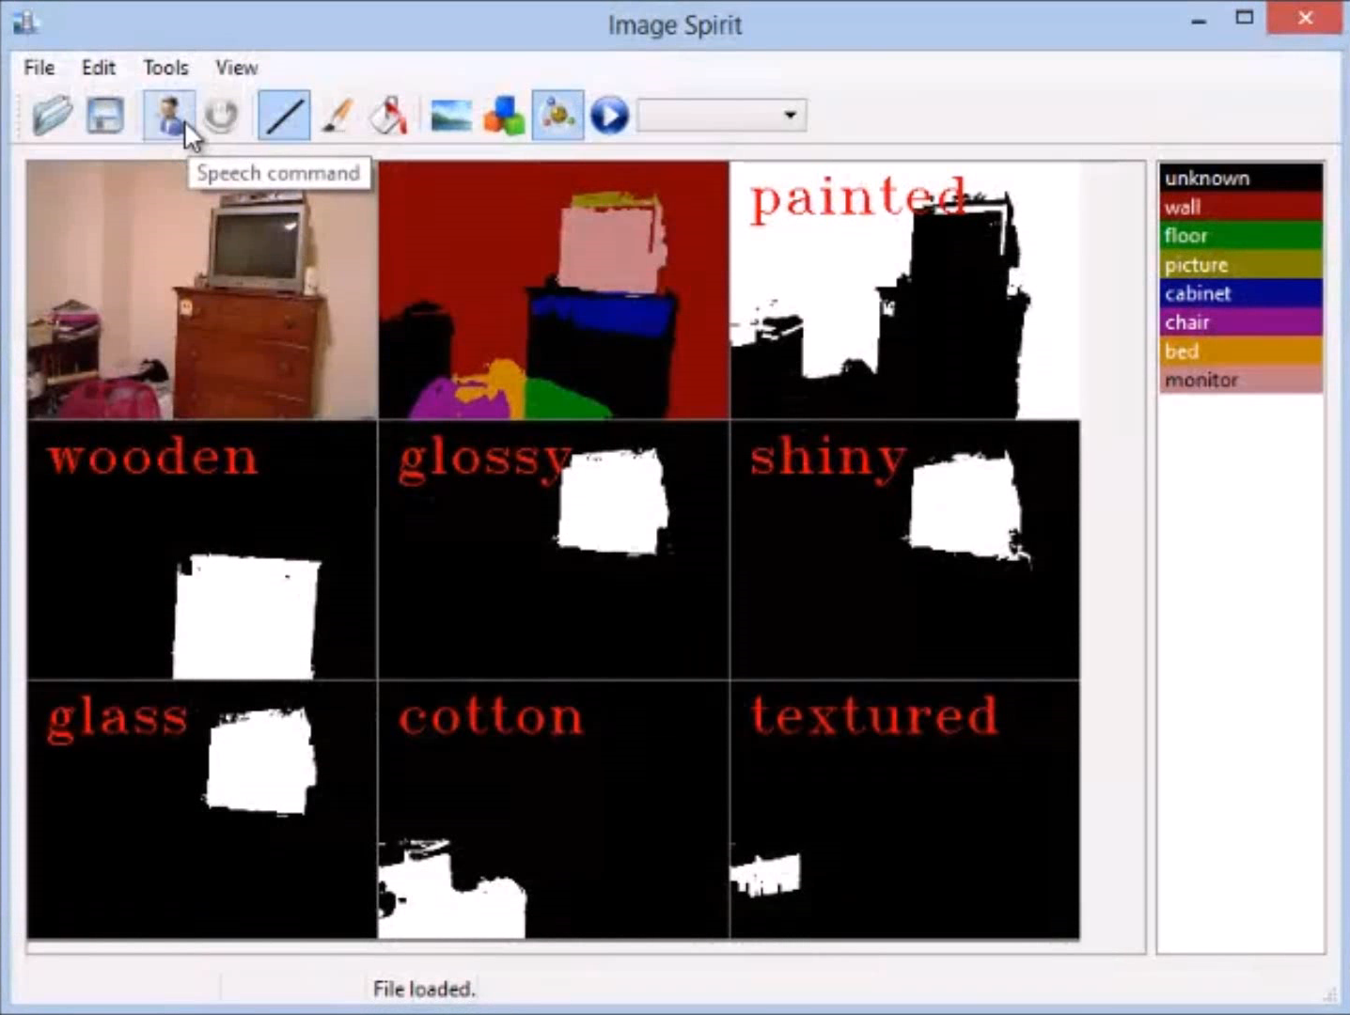
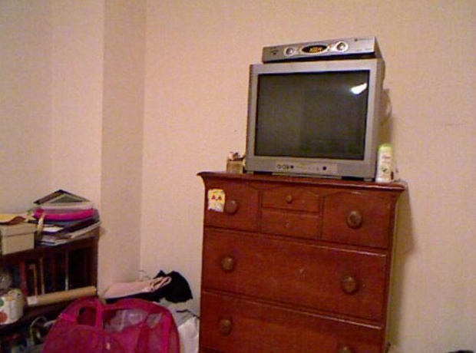
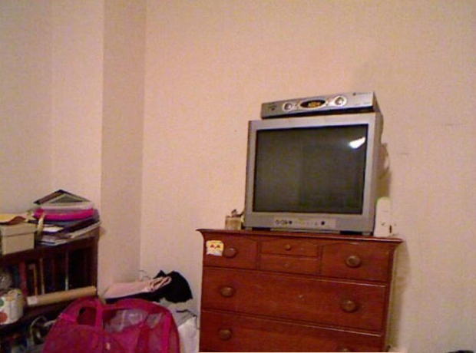
Demo: Object Deformation
Notes:
High quality image parsing can help in many applications, for example, image editing. In this demo, we define a simple, gravity rule for “cabinet” and “table” classes. This requires small objects (in our case, it is TV) above these object segments (except for aspect such as wall, floor) to have certain deformation by following this gravity. Note that, without decent image parsing results, this gravity rule is difficult to implement as there would be a great uncertainty between the small objects and background wall.

Slide 4
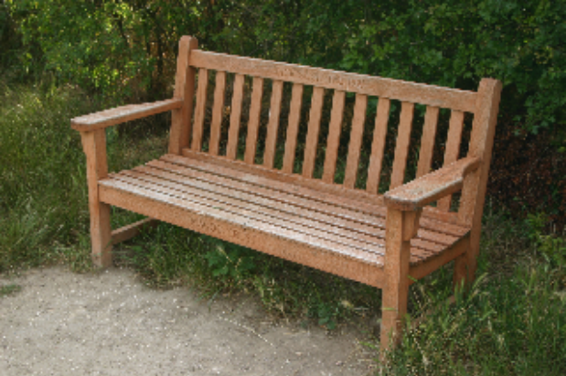
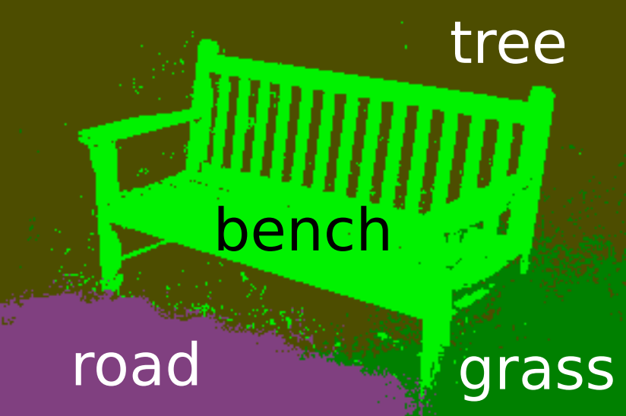

Motivation
Significant progress in semantic segmentation
Textonboost for image understanding: Multi-class object recognition and segmentation by jointly modeling texture, layout, and context. IJCV 2009, Shotton et al.
Associative hierarchical CRFs for object class image segmentation, ICCV 2009, Ladicky et al.
Efficient inference in fully connected crfs with gaussian edge potentials, NIPS 2011, P. Krähenbühl and V. Koltun.
Notes:
Significant progress has been made in semantic image segmentation. Jamie Shotton has developed a textonboost classifier and a graph-cut-inference-based CRF framework, which achieve the leading performance in semantic image segmentation for a while. Later one, Lubor Ladicky and Pushmeet Kohli show that it is possible to have further performance gain by introducing higher-order potential. Recently, Philipp Krahenbuhl and Volt Koltun show an efficient mean-field inference approach can be achieved by using permutohedral lattice.

Slide 5
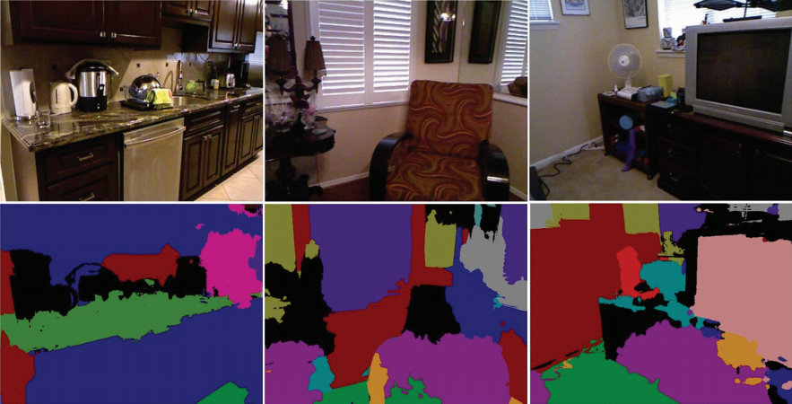
Motivation
Semantic segmentation is still by far from perfect
Methods | H-CRF [1] | DenseCRF [2]
Label accuracy | 51.0% | 50.7%
Associative hierarchical CRFs for object class image segmentation, ICCV 2009, Ladicky et al.
Efficient inference in fully connected crfs with gaussian edge potentials, NIPS 2011, P. Krähenbühl and V. Koltun.
Sample results on NYU dataset
Notes:
Automatic semantic image segmentation is still not perfectly solved, the results are still by far from perfect. For example, this result is generated by latest approaches. It is difficult to be used in real applications.

Slide 6
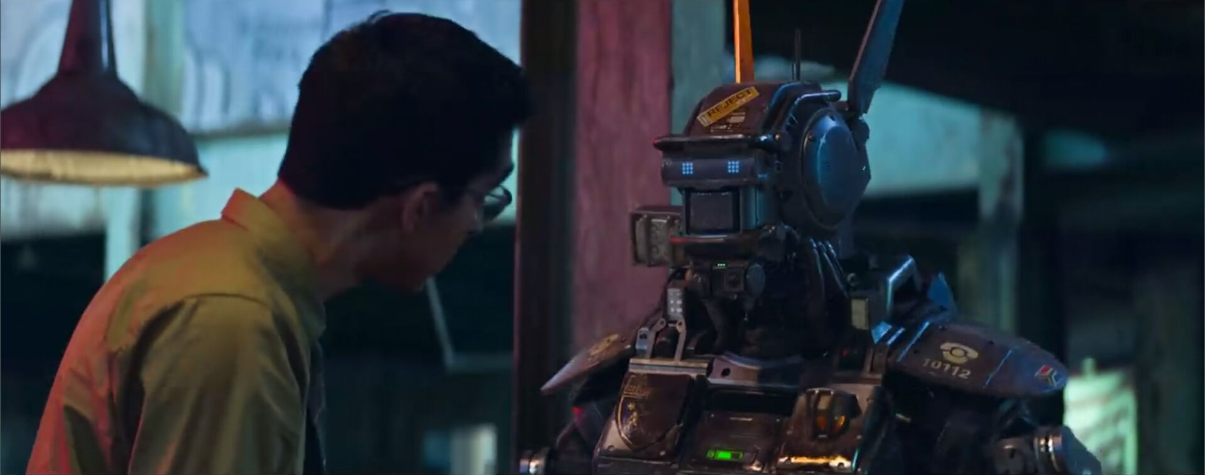
Motivation
Movie: Chappie, 2015
Notes:
Automatic semantic image segmentation is a challenging problem in Computer Vision.
It is indeed very cool to make machine like Chappie to see the world as much as we do, but we feel it is more important for now to make the machines work with us, or put human in the loop. In this paper, we are particular interested in building a system that allows users to refine the semantic image segmentation through interaction.
As shown in many other research, more training data often lead better performance. This evidence can be found in recently PASCAL VOC Challenge semantic image segmentation results. With far more better semantic image segmentation ground truth, we can train better model for object recognition and segmentation.

Slide 7
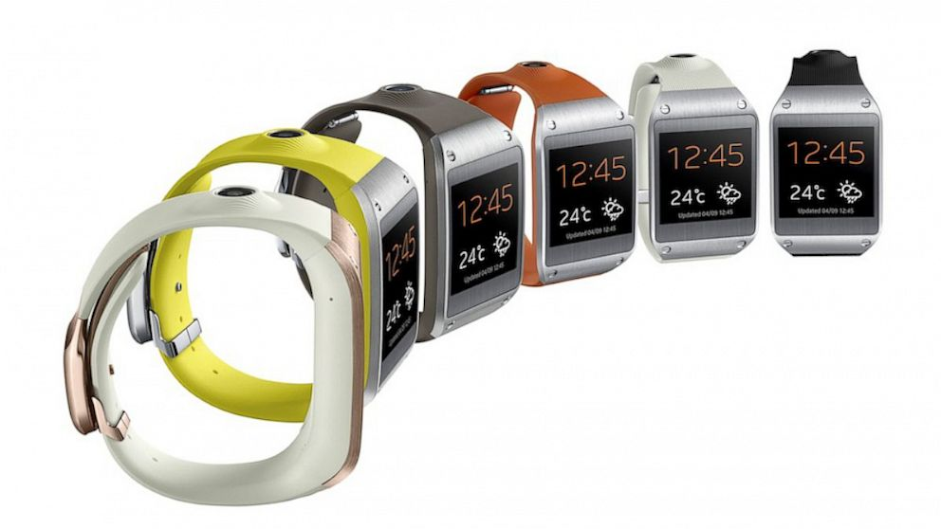

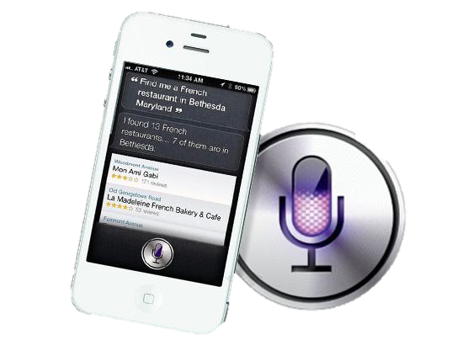
Motivation
Notes:
Speech is the most nature way of human interaction. To date, we still lack of effective tools to verbally interact with images.

Slide 8
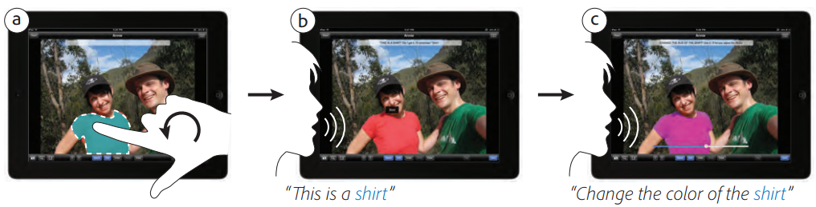
Related works
Concurrent work: PixelTone
  Sketch contour + speech commands, etc.
PixelTone: a multimodal interface for image editing. ACM SIGCHI, 2013, G.P. Laput, et al.
Notes:
One Concurrent work from Adobe is to conduct a user study to see the preference of users on touch and speech. It turns out that most users really like to use speech mode image interaction compared to the touch interaction.

Slide 9
Challenges
Semantic gap between words pixels;
Update the parse using verbal cues;
Responds at interactive rates.
Notes:
As the saying goes, “A picture is worth a thousand words”. There is a semantic gap between language and images, it is still really hard to find the pixel-wise representations for its corresponding words.
Our goal is to design an interactive system to help to refine the image parsing. How to best update the parse using verbal cues is one of the challenges.
As this is an interactive system, users often expect to have feedback in time. Ensuring the system responds at interactive rates is also one important criteria.

Slide 10
Contributions
A new interaction modality
  Enables verbal commands to guide image parsing;
A novel multi-label factorial CRF
  Integrate cues from multiple sources at interactive rates;
Demonstration of the potential of this approach
  Make conventional mouse-based tasks hands free.
Notes:
(1) a new interaction modality that enables verbal commands to guide image parsing;
(2) the development of a novel multilabel factorial CRF that can integrate cues from multiple sources at interactive rates;
(3) a demonstration of the potential of this approach to make conventional mouse-based tasks hands free.

Slide 11
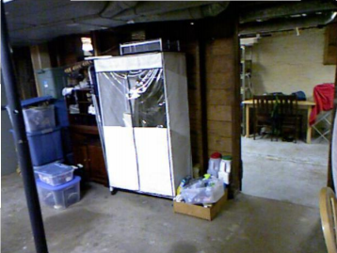
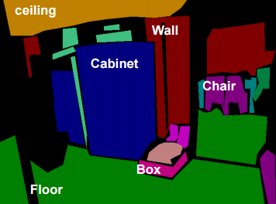
Bridge between words and pixels
Object class image segmentation
  Assigning an object class label to each pixel
  Variations → challenging. E.g. chair

Slide 12
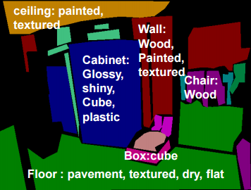
Bridge between words and pixels
Attributes: more consistent
Visual attributes are properties observable in images that have human-designated names.

Slide 13



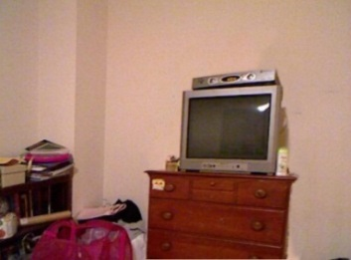


Verbal Guided Image Parsing
Make the wood cabinet in bottom-middle lower
nouns
Adjective
Verb/Adverb
Object Attributes
Commands
Multi label CRF
Notes:
We present an image parsing system that allows users to verbally specify nouns/adjectives so as to label objects and their visual attributes, thereby allowing intuitive verbal interaction with images.
How do we describe images?
We describe images with nouns and adjectives
In computer vision:
Visual attributes align with adjectives
Image parsing aligns objects with nouns
Joint image parsing
In our previous work [Zheng et al. 14], we extended image parsing to both objects and attributes, for a higher accuracy parse
Verbal guided image parsing
In this work, we use verbal commands to update the joint image parsing models

Slide 14
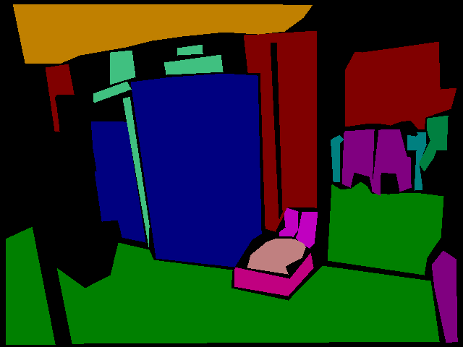

Nouns$⟷$ Objects
Align nouns in language with object class labels
Modelled with standard object-based semantic segmentation using CRFs
  One label per pixel
ceiling
Wall
Cabinet
Chair
Floor

Slide 15
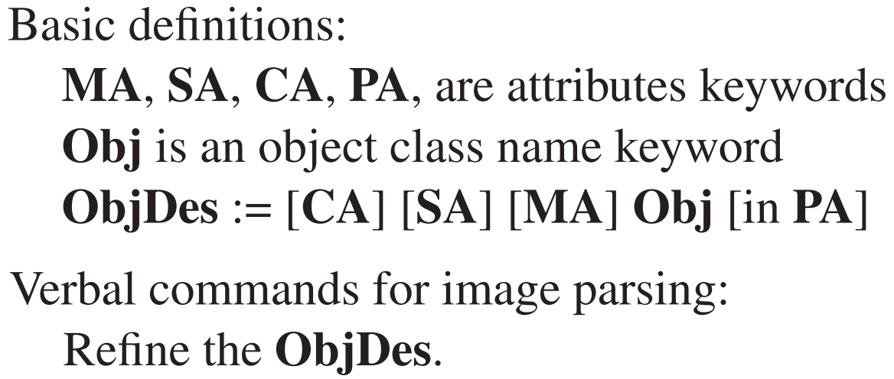

Adjectives$⟷$ Attributes
Multiple attributes per pixel → multi-label CRFs
  The power set of attributes is exponentially large
  Use factorial CRFs to break down the problems
Sample: Refine the glass picture in center-middle.
  Material Attributes (MA)
  Surface Attributes (SA)
  Color Attributes (CA)
  Position Attributes (PA)
Verbal commands ( “[]” represent optional words).

Slide 16

Conditional Random Fields (CRF)
$$E\left(z\right)=\overset{Unary}{\overbrace{\sum_{i∈I}{ψ_{i}\left(z_{i}\right)}}}+\overset{Pairwise}{\overbrace{\sum_{i≠j∈I}{ψ_{ij}(z_{i},z_{j})}}}$$
Unary term
  Cost of assigning an object label to each pixel.
  Get from object classifier
Pairwise term
  Encourages similar and nearby pixels to take similar labels.
Notes:
Conditional random fields are trying to find a best configuration of z which can minimize the energy function E(z). It has two terms, one unary term constrains the cost of assigning an object label to each pixel, the other pairwise term encourage similar and nearby pixels to take similar labels, and penalize the otherwise.

Slide 17
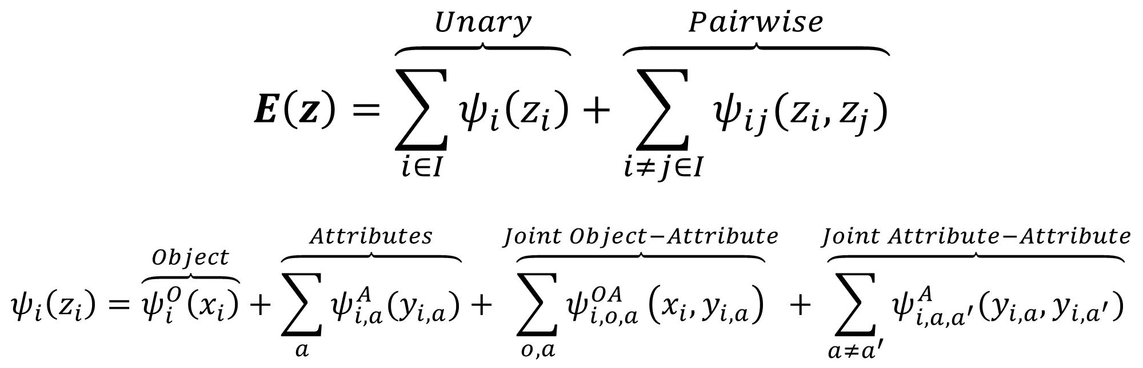
Multi-Label Factorial CRF
$$E\left(z\right)=\overset{Unary}{\overbrace{\sum_{i∈I}{ψ_{i}\left(z_{i}\right)}}}+\overset{Pairwise}{\overbrace{\sum_{i≠j∈I}{ψ_{ij}(z_{i},z_{j})}}}$$
$$ψ_{i}\left(z_{i}\right)=\overset{Object}{\overbrace{ψ_{i}^{O}\left(x_{i}\right)}}+\overset{Attributes}{\overbrace{\sum_{a}{ψ_{i,a}^{A}(y_{i,a})}}}+\overset{Joint Object−Attribute}{\overbrace{\sum_{o,a}{ψ_{i,o,a}^{OA}}\left(x_{i},y_{i,a}\right)}}+\overset{Joint Attribute−Attribute}{\overbrace{\sum_{a≠a^{′}}{ψ_{i,a,a^{′}}^{A}(y_{i,a},y_{i,a^{′}})}}}$$
Object classifiers: table, chair, etc.
Attributes classifiers: wood, plastic, red, etc.
Object and attributes correlation.
Correlation between attributes.
Regarding efficient inference of the CRF, please refer to our papers.
Notes:
We formulate the joint inference problem for objects and attributes by using multi-label factorial CRFs. The energy function is factorized into object term, attribute term, joint-object-attribute term, and joint attribute-attribute term.

Slide 18
Verbal commands
Speech parsing
  Standard SDK
  Fixed grammar
  Limited vocabulary
Interaction
  Update unary and pairwise terms in multi-label CRF.

Slide 19
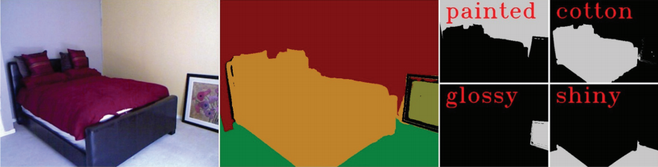
Joint inference results
Results on NYU datasets (724 training & 725 test images)
Methods | H-CRF [1] | DenseCRF [2] | Ours
Average label accuracy | 51.0% | 50.7% | 56.9%
Notes:
We found this significantly help improving the performance.

Slide 20
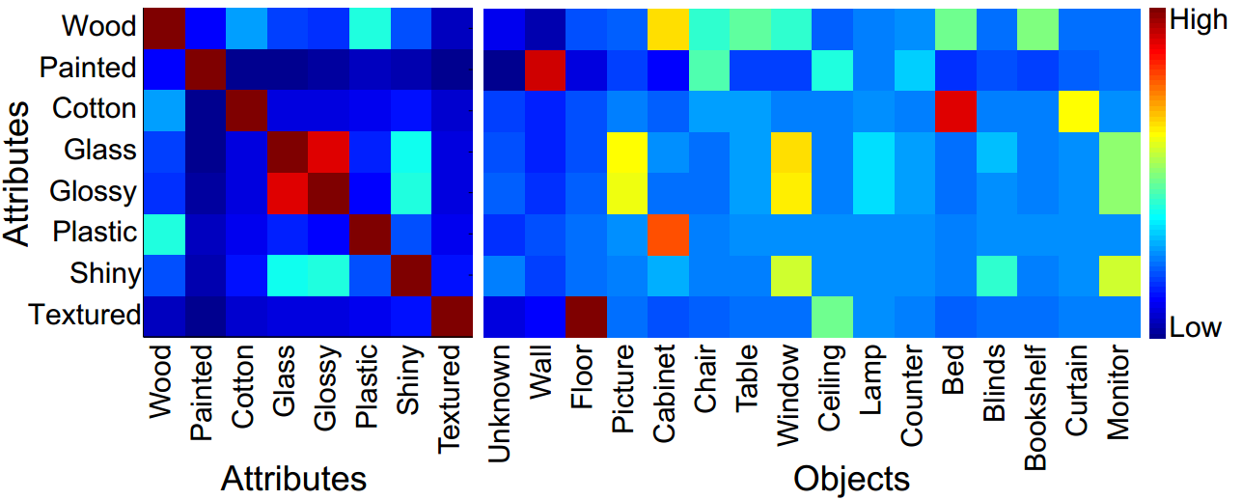
Joint inference results
Object-attributes and attributes-attributes correlations

Slide 21
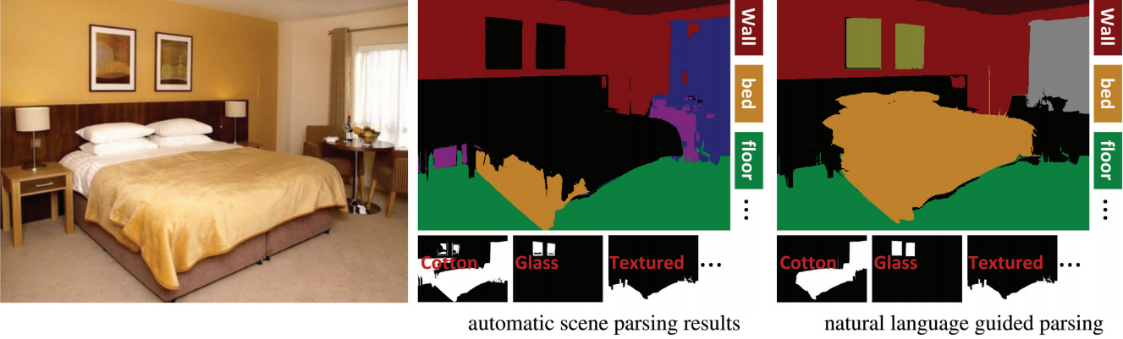
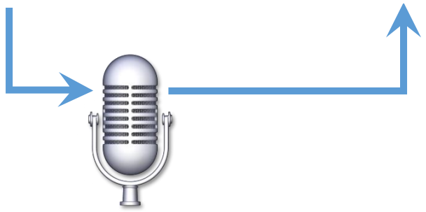
Verbal interaction
Material Attributes (MA)
Surface Attributes (SA)
Color Attributes (CA)
Position Attributes (PA)
Refine the glass picture in center-middle.
Notes:
In our approach, we propose a new verbal interaction, which allows users to refine the image parsing through verbal instructions. We consider four visual attributes, e.g. material attributes like wood, surface properties attributes like shining, color attributes like red or blue, positions attributes like bottom-left, center-middle.
In this demo figure, after automatic image parsing, our system allows user to say “refine the glass picture in center-middle”, which gives the hint to make better image parsing.

Slide 22
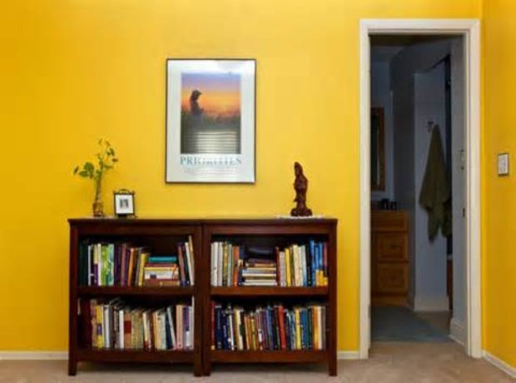
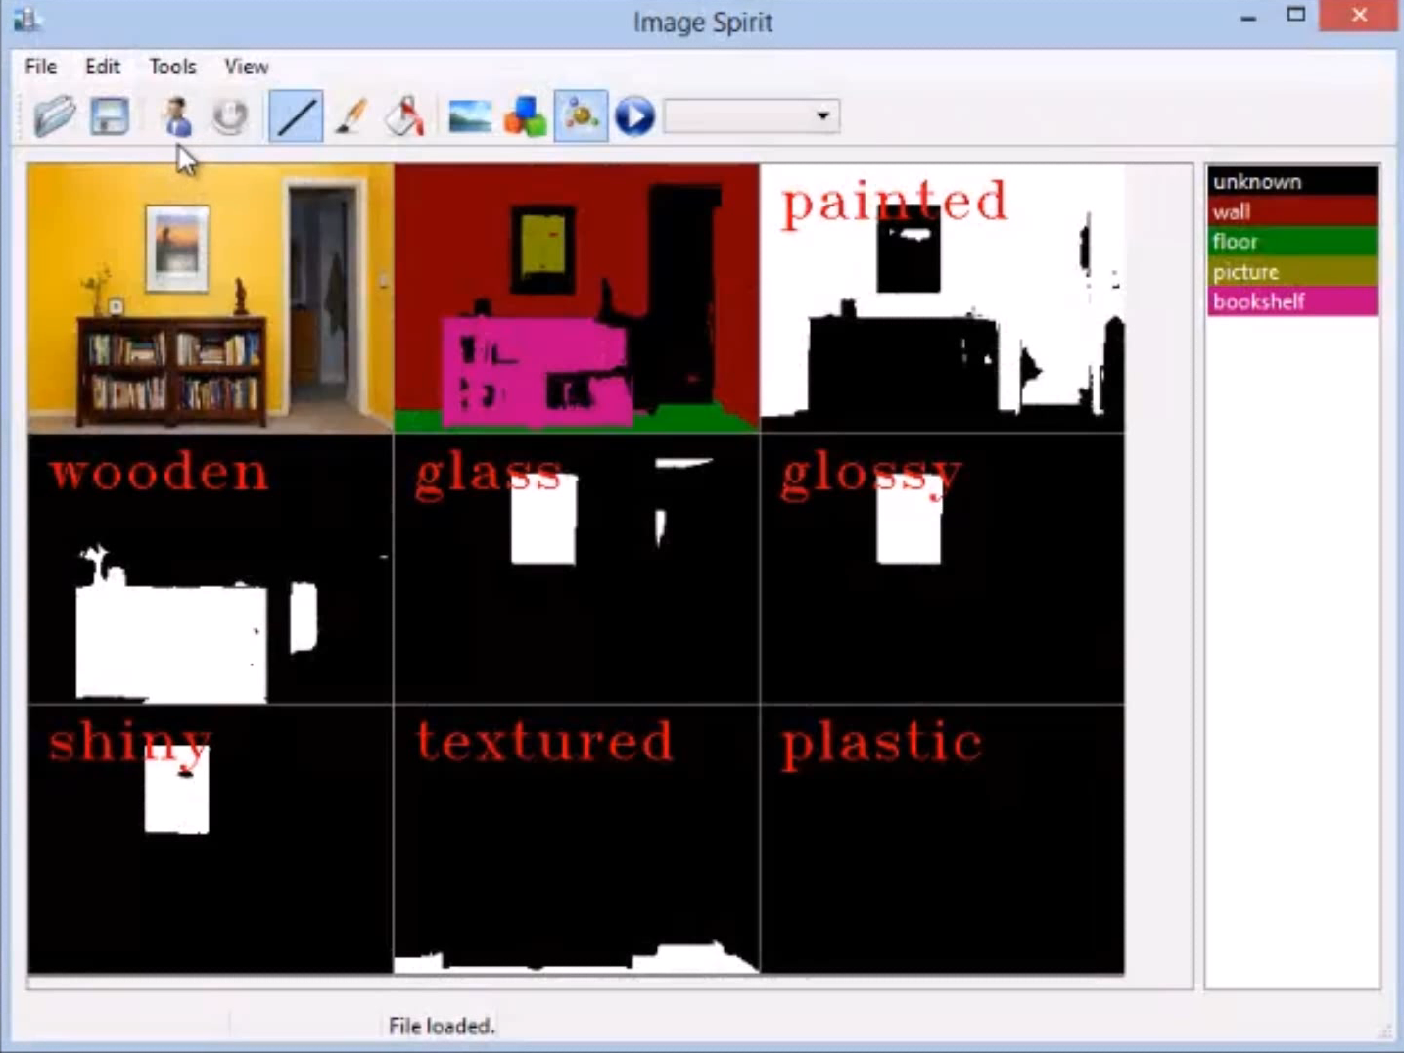



Demo: Verbal Guided Image Parsing
Wooden
Notes:
In this demo, we show that our parsing can be significantly refined through a series of verbal commands.

Slide 23
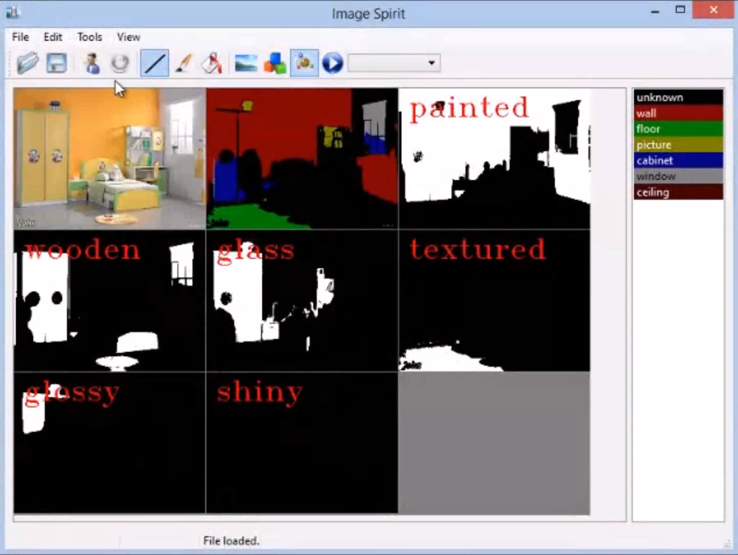
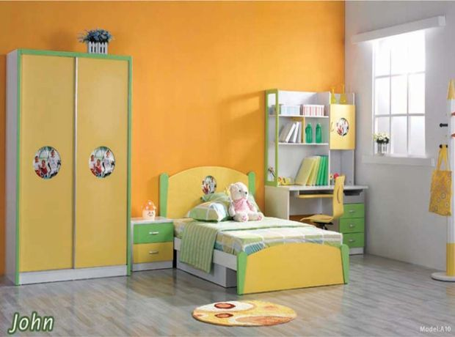
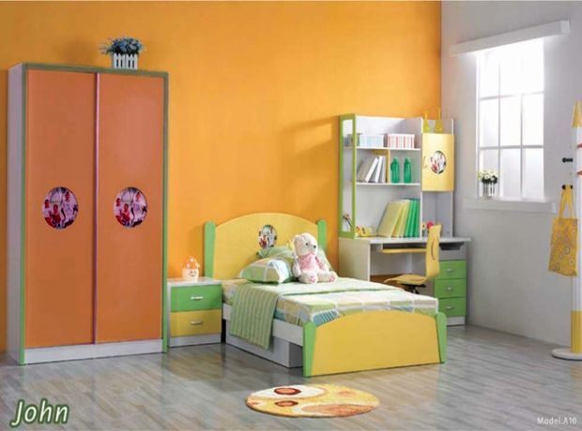
Demo: Verbal Guided Image Manipulation
Avoid the tedious manual selection
  More user friendly
Notes:
This demo shows the results of verbal guided image manipulation, based on our interactive parsing approach.

Slide 24
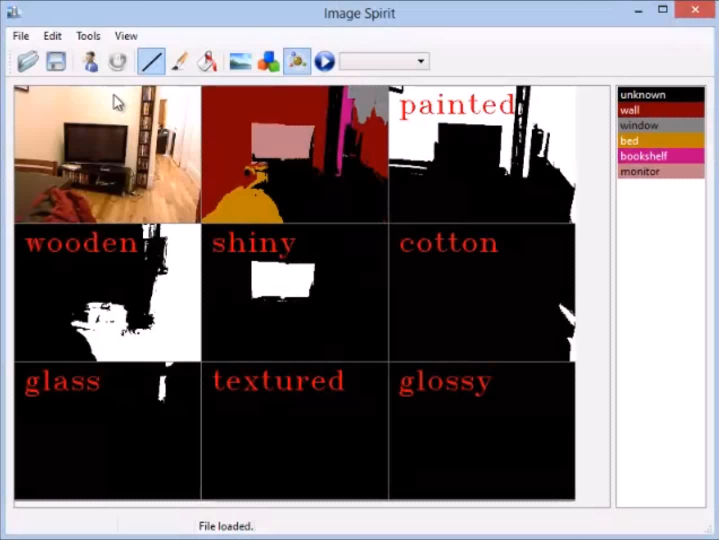
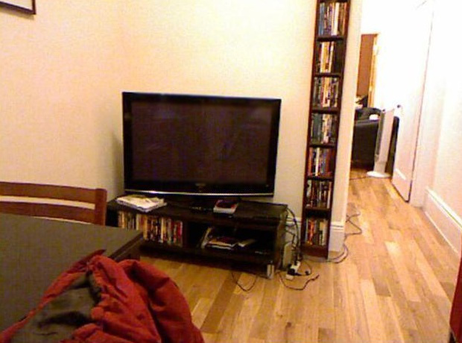
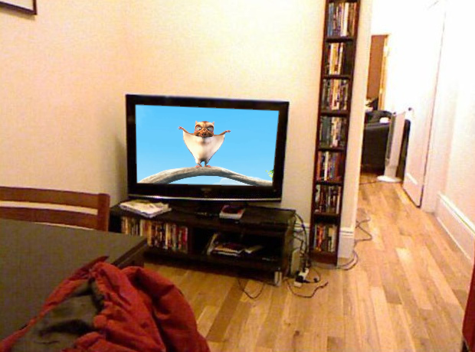
Demo: Semantic Animation
Semantic Animation
  Object semantic →Predefined functions
Notes:
This demo shows the results of verbal guided image manipulation, based on our interactive parsing approach.

Slide 25
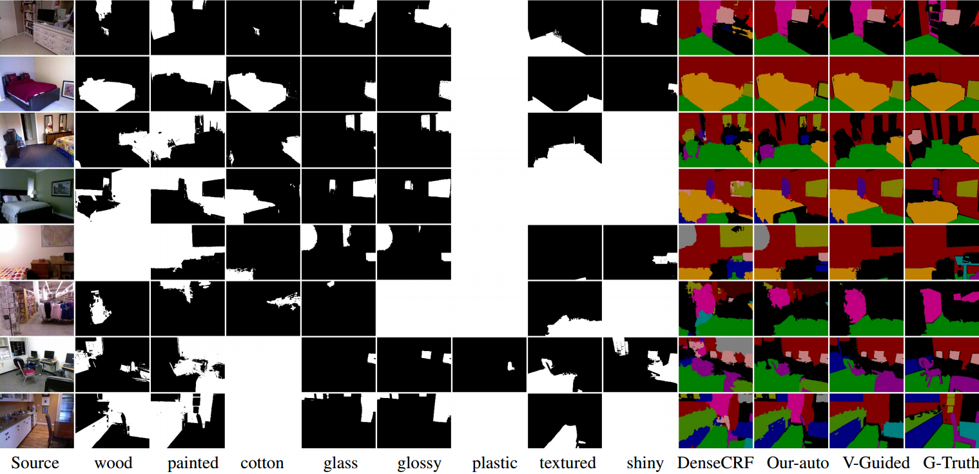
Verbal Guided Image Parsing Results
Notes:
We also found the results are consistently better after verbal guided image parsing.

Slide 26
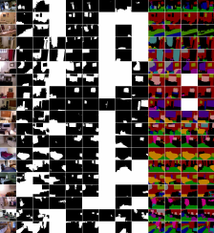
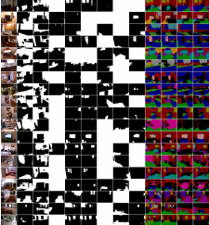
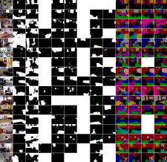
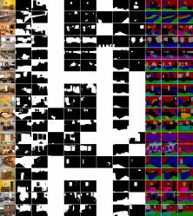
Experimental results
Statistics of verbal guided parsing results
Results for the full datasets (see supplemental)
Methods | DenseCRF | Ours-A | Ours-I
Average Label accuracy | 52.1% | 56.2% | 80.6%
…
Notes:
We also found the results are consistently better after verbal guided image parsing.

Slide 27
Experimental results
Different interaction modalities
Interaction modality | verbal | touch | verbal + touch
Average interaction time (s) | 6.6 | 32.3 | 11.7
Average accuracy (%) | 80.3 | 95.2 | 97.8
Average user preference (%) | 15.8 | 10.5 | 73.7
Notes:
In particularly, we found that the average accuracy (average precision) could achieve close to perfect if we allows both touch and verbal interactions.

Slide 28
Limitations
Supporting limited commands & grammars
  Better speech parsing [Laput13]
Typical failure case of verbal refinement
  No attributes combination for results improving
  Might corresponds to good automatic results
Ambiguity of language description
  Difficult to get 100% accuracy
  Complemental to other interaction modality
PixelTone: a multimodal interface for image editing. ACM SIGCHI, 2013, G.P. Laput, et al.
Notes:
our reliance on attribute handles can fail if there is no combination of attributes that can be used to improve the image parsing
It is also very difficult to evaluate on some objects that have ambiguity.

Slide 29
Discussions
A novel multi-label CRF formulation
  Parsing into per-pixel object and attribute labels.
Attribute labels act as verbal handles
  Users can control the CRF
  Allowing verbal refinement of the image parsing
Hands-free parsing of an image
  Provides verbal methods to select objects of interest

Slide 30
Future work
Scratched the surface of verbal guided image parsing
  Extending video and 3D data [Valentin et al. 2015]
  More sophisticated initial prediction [Zheng et al. 2015]
  Explore efficient multiclass object detection algorithms
    To help working-set selection, and extending the supported object classes
  How to better combine touch and verbal commands?
  Verbal refinement for further improve refinements?
SemanticPaint: Interactive 3d labeling and learning at your fingertips. ACM TOG 2015, Valentin et al.
Conditional Random Fields as Recurrent Neural Networks. arXiv:1502.03240. 2015, S. Zheng et al.

Slide 31
Thanks!
Paper, source code, etc.: http://mmcheng.net/imagespirit/

Slide 32
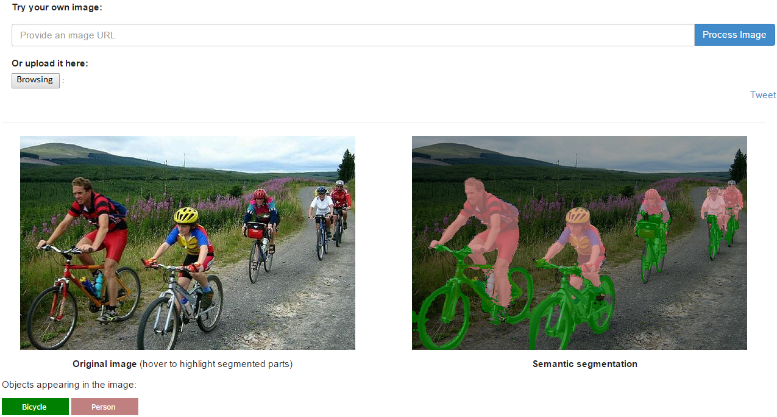
CRF as RNN
http://www.robots.ox.ac.uk/~szheng/crfasrnndemo

Slide 33
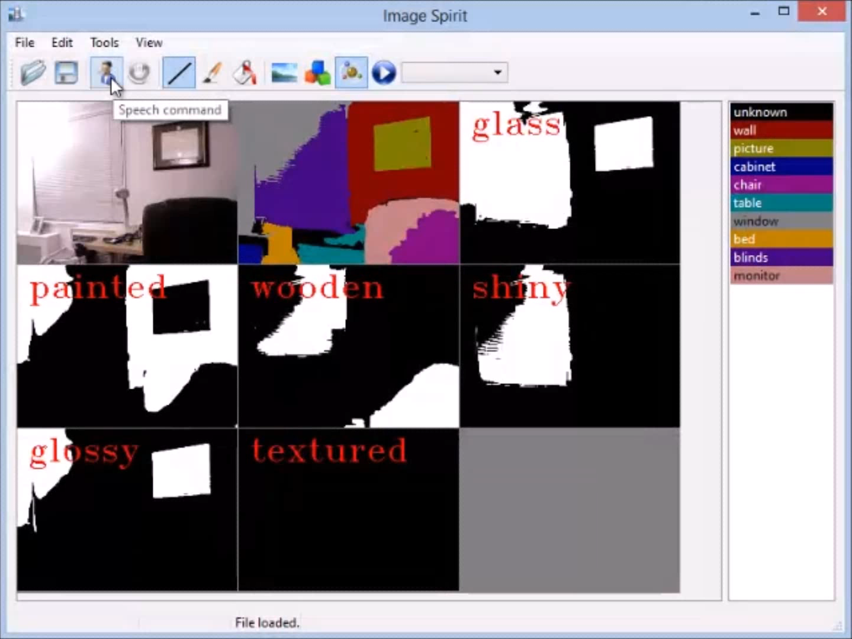
Demo: Semantic Animation

