Slide 1
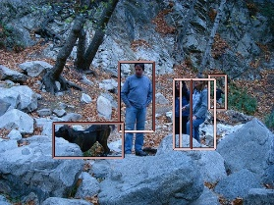
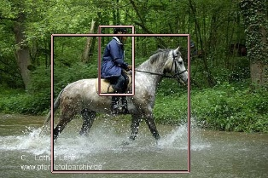
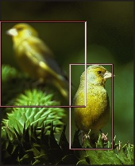
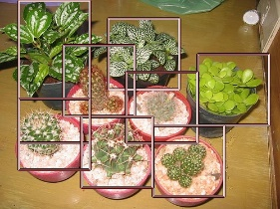
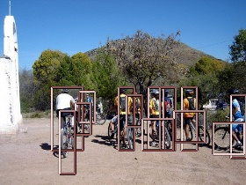
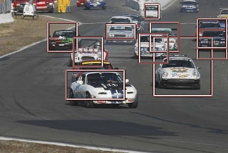
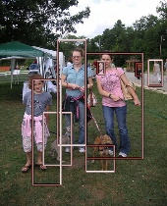
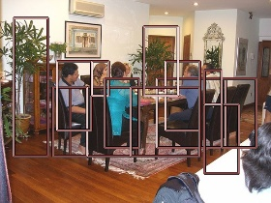



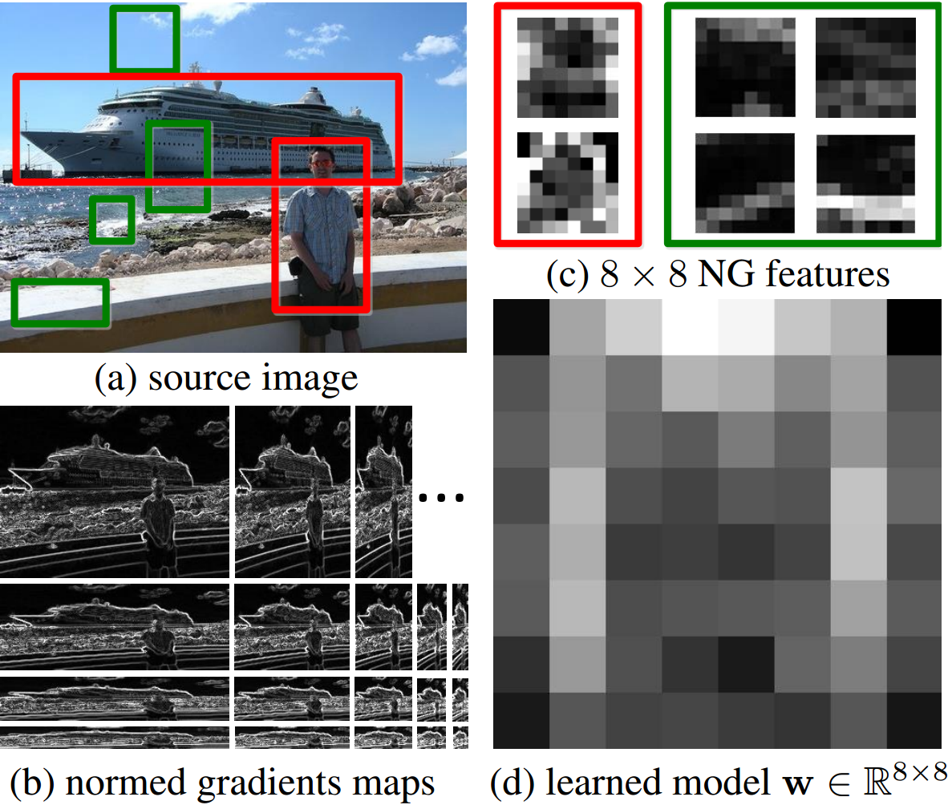
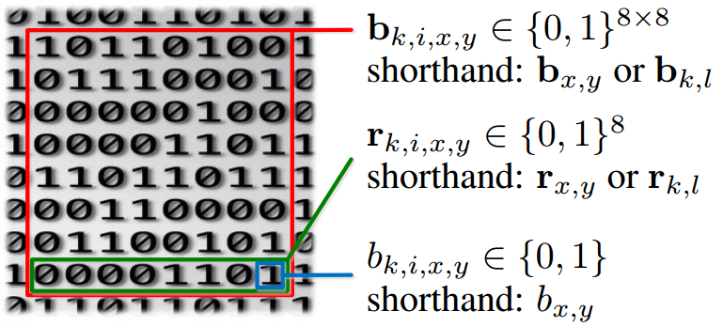
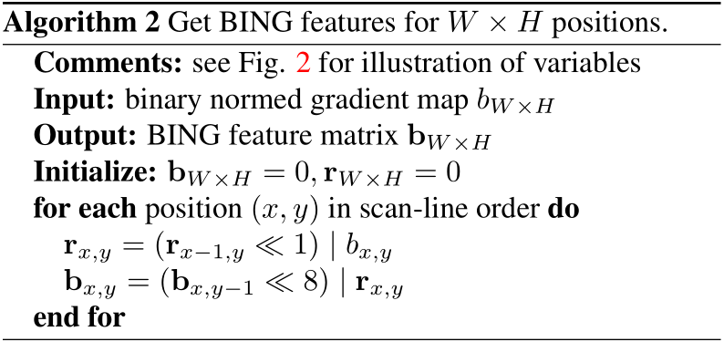
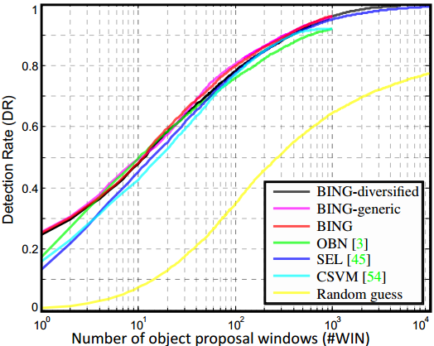
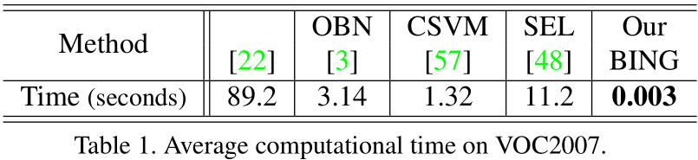
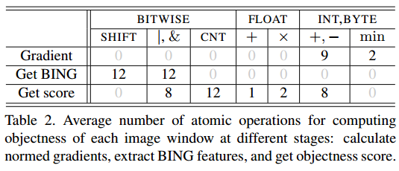
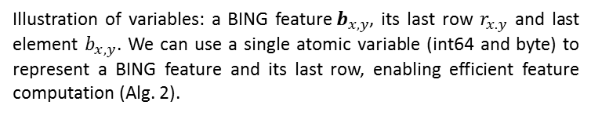
BING: Binarized Normed Gradients for Objectness Estimation at 300fps
Ming-Ming Cheng¹ Ziming Zhang² Wen-Yan Lin³ Philip H. S. Torr¹
¹Oxford University, ²Boston University ³Brookes Vision Group
Abstract
Sample Results (true positives)
  Training a generic objectness measure to produce a small set of candidate object windows, has been shown to speed up the classical sliding window object detection paradigm. We observe that generic objects with well-defined closed boundary can be discriminated by looking at the norm of gradients. Based on this observation, we propose to use a binarized normed gradients (BING) for efficient objectness estimation. Experiments on the PASCAL VOC 2007 dataset show that our method efficiently (300fps on a single laptop CPU) generates a small set of category-independent, high quality object windows, yielding 96.2% detection rate (DR) with 1,000 proposals. Increasing the numbers of proposals and color spaces for computing BING features, our performance can be further improved to 99.5% DR.
free!
  http://mmcheng.net/bing/
Normed gradients (NG) and objectness
Binary normed gradients (BING)
  Illustration of variables: a BING feature$b_{x,y}$, its last row $r_{x.y}$ and last element $b_{x,y}$. We can use a single atomic variable (int64 and byte) to represent a BING feature and its last row, enabling efficient feature computation (Alg. 2).
  Although object (red) and non-object (green) windows present huge variation in the image space (a), in proper scales and aspect ratios where they correspond to a small fixed size (b), their corresponding normed gradients, i.e. a NG feature (c), share strong correlation. We learn a single 64D linear model (d) for selecting object proposals based on their NG features.
Experimental results on Challenging PASCAL VOC benchmark

Slide 2




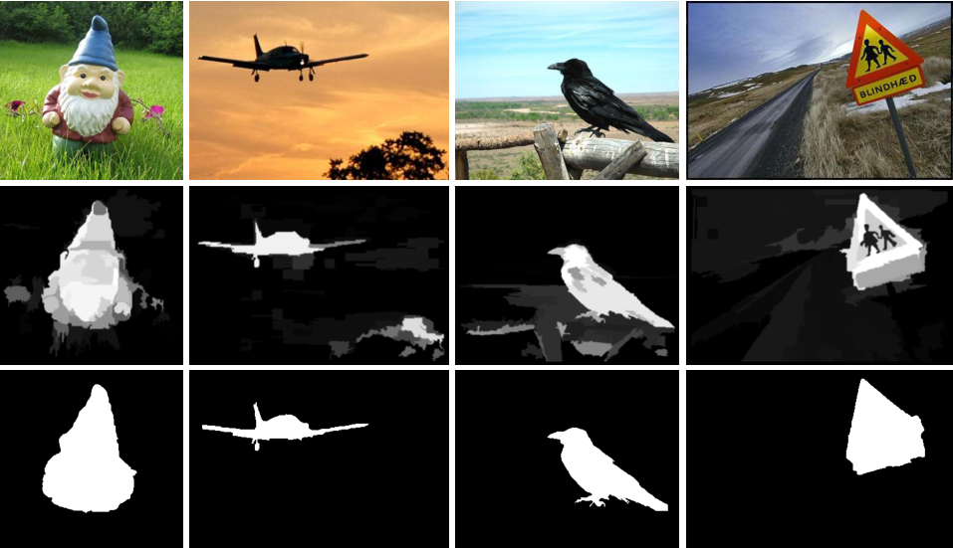
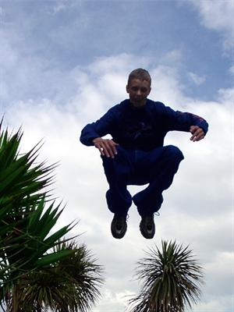
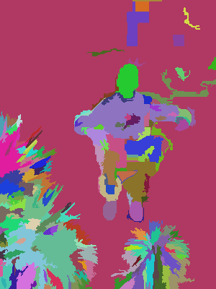
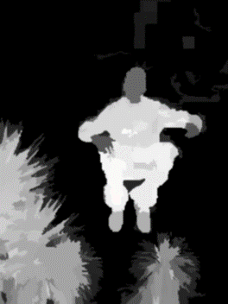
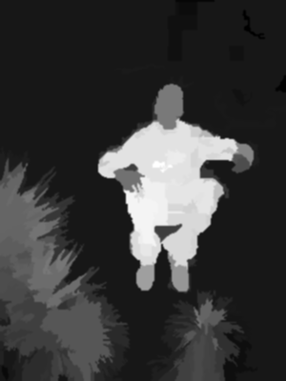
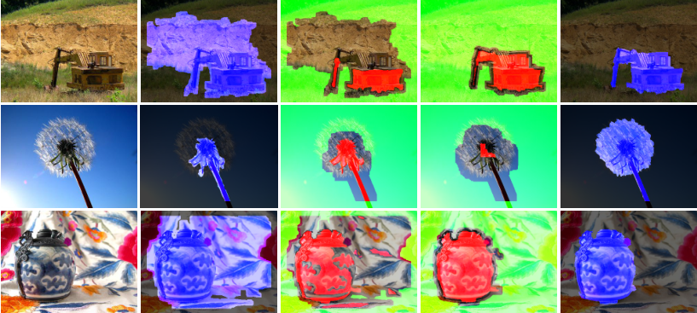
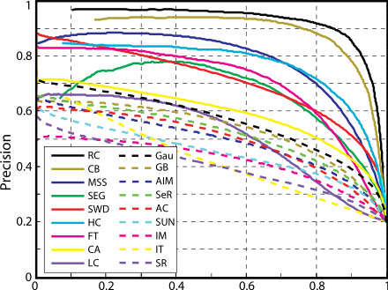
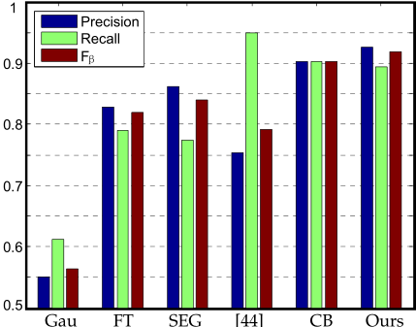
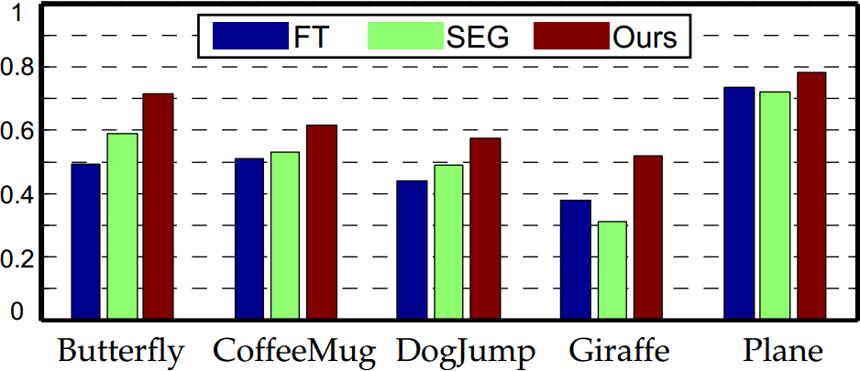
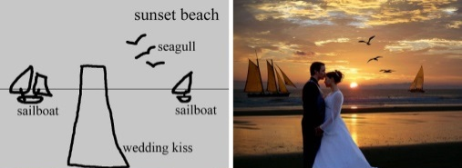
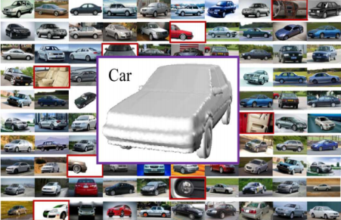
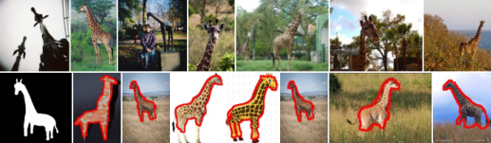
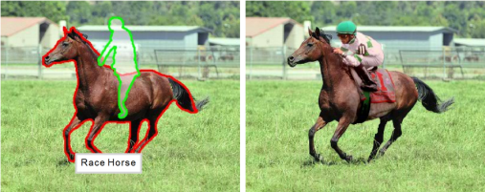
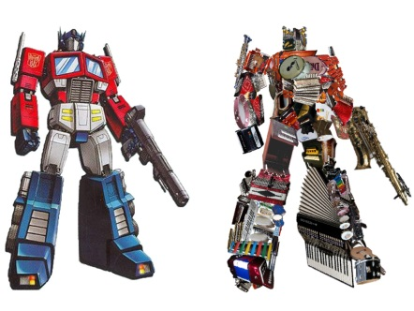
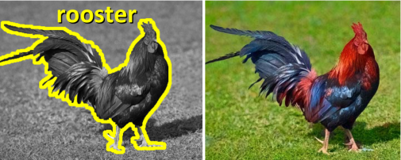
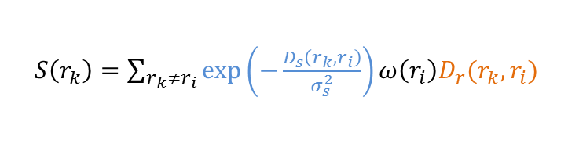
Salient Object Detection and Segmentation
Ming-Ming Cheng^{1,4} Niloy J. Mitra² Xiaolei Huang³ Philip H. S. Torr⁴ Shi-Min Hu¹
¹TNList, Tsinghua University, ²UCL/KAUST ³Lehigh University ⁴Oxford Brookes University
Abstract
Sample Results
  Automatic estimation of salient object regions across images, without any prior assumption or knowledge of the contents of the corresponding scenes, enhances many computer vision and computer graphics applications. We introduce a regional contrast based salient object extraction algorithm, which simultaneously evaluates global contrast differences and spatial weighted coherence scores. The proposed algorithm is simple, efficient, naturally multi-scale, and produces full-resolution, high-quality saliency maps. These saliency maps are further used to initialize a novel iterative version of GrabCut for high quality salient object segmentation. We extensively evaluate our algorithm using popular benchmarks and demonstrate a variety of applications.
Input image
Saliency maps
Saliency cut
free!
  http://cg.cs.tsinghua.edu.cn/people/~cmm/
Core Idea: Region Based Contrast (RC)
SaliencyCut: Automatic salient region extraction
  Image Segmentation $σ_{s}^{2}→∞$ $σ_{s}^{2}→0.4$
  Spatial weighting
  Region size
  $S\left(r_{k}\right)=\sum_{r_{k}≠r_{i}}{\exp\left(−\frac{D_{s}\left(r_{k},r_{i}\right)}{σ_{s}^{2}}\right)}ω\left(r_{i}\right)D_{r}(r_{k},r_{i})$
  Iterative refine: iteratively run GrabCut to refine segmentation
  Adaptive fitting: adaptively fit with newly segmented salient region
  Enables automatic initialization provided by salient object detection.
  Region contrast by sparse histogram comparison.
Evaluation on MSRA 1000 Benchmark Dataset (Simple Images)
Challenging Benchmark: non-selected internet images
Robust Applications Design: automatically process many images + use efficient algorithms to select good results
Sketch
Based Retrieval [2,3, 9]
Image montage [4]
View selection [6]
  [1] Global Contrast based Salient Region Detection. IEEE CVPR, 2011
  [2] Salient Object Detection and Segmentation. TPAMI-2011-10-0753
  [3] SalientShape: Group Saliency in Image Collections. TVC, 2013
  [4] Sketch2Photo: Internet Image Montage. SIGGRAPH Asia, 2009
  [5] Semantic Colorization with Internet Images. SIGGRAPH Asia, 2011.
  [6] Web-Image Driven Best Views of 3D Shapes. TVC, 2011.
  [7] Arcimboldo-like Collage Using Internet Images. SIGGRAPH Asia, 2011.
  [8] Data-Driven Object Manipulation in Images. Eurographics 2012.
  [9] Mobile Product Search with Bag of Hash Bits and Boundary Reranking, CVPR 2012
  [10] More: http://scholar.google.com/scholar?cites=9026003219213417480
Image Manipulation [8]
Semantic Colorization [5]
Image collage [7]

