Slide 1
Res2Net: A New Multi-scale Backbone Architecture
Ming-Ming Cheng
CS, Nankai University
Notes:
从图像中快速鲁棒的获取目标信息是计算机视觉的核心任务。其中，提取强大的图像特征并对输入特征进行高效的整合，对所有常见计算机视觉Aplication都具有重要意义。本报告从特征提取和模型学习两个方面入手。首先，从多尺度特征获取的角度，介绍近年来几个重要的神经网络基础模型的演化过程。通过介绍这些经典模型的优势与不足，引出一种轻量级计算量的新型神经网络基础模型。进而通过大量实验，验证该模型的有效性。其次，本报告将模型集成方法与深度学习相结合，介绍一种新的基于负相关学习的深度集成学习策略，新方法通过学习多组负相关子模型的基础上，提升集成模型的预测能力，同时不增加总体模型的计算复杂度。最后，本报告将介绍这两个核心能力提升在一系列计算机视觉任务中的Aplication，包括：图像分类、物体检测、激活图预测、显著性检测、语义分割、实例分割、关键点估计、人群计数、年龄估计、性格分析、以及图像超分辨率。
It is my great pleasure to present our resent research in this special day.

Slide 2
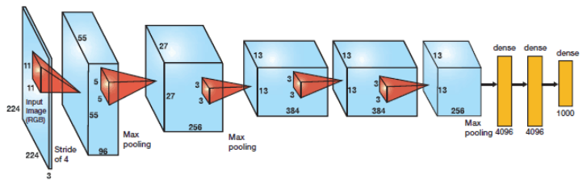

Deep Convolutional Neural Networks
AlexNet
ImageNet classification with deep convolutional neural networks, NIPS 2012.

Slide 3
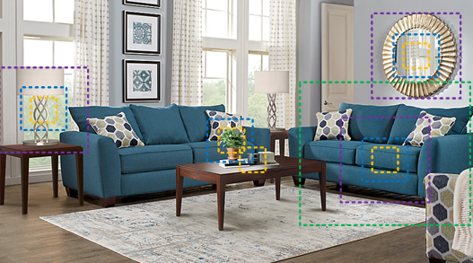
Multi-scale representations
Notes:
由于时间关系，我简要介绍每个研究点里的核心技术。
首先是富多尺度空间的深度神经网络通用架构，许多计算机视觉任务依赖于强大的多层次多尺度特征表达。近年来，每一代深度神经网络基础架构的进步，都展现出了更加强大的多尺度能力，但是这种多尺度能力仅限于层间多尺度。本项目计划在传统神经网络架构设计中，引入分层递进残差网络结构，增强层内多尺度信息表达能力，为众多计算机视觉Aplication提供强大的特征表达。

Slide 4
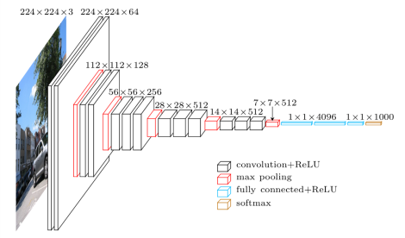
Backbone Models of Deep Learning
VggNet (VGG16)
Very deep convolutional networks for large-scale image recognition, ICLR 2015.

Slide 5
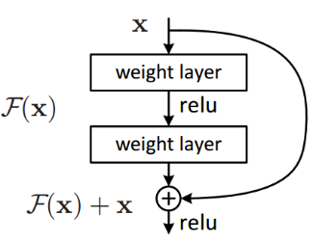
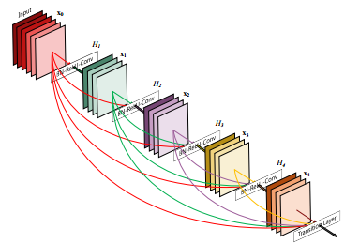
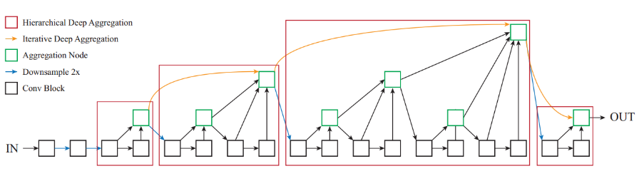
Backbone Models of Deep Learning
DenseNet (CVPR’17)
ResNet (CVPR’16)
DLA
(CVPR’18)

Slide 6
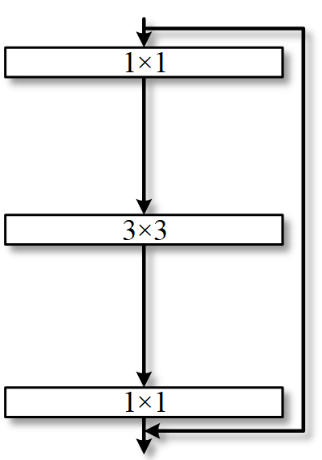
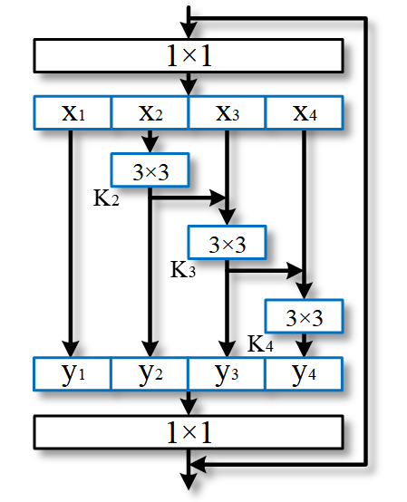
In-layer Multi-scale Representation
Bottleneck block
Res2Net module
Res2Net: A New Multi-scale Backbone Architecture, IEEE TPAMI, 2020.

Slide 7
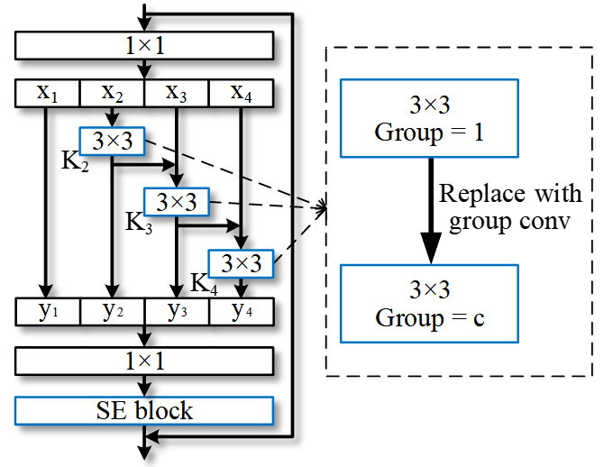
In-layer Multi-scale Representation
Res2Net with dimension cardinality [1] and SE block [2].
Squeeze-and-excitation networks, CVPR 2018.
Aggregated residual transformations for deep neural networks, CVPR 2017.

Slide 8
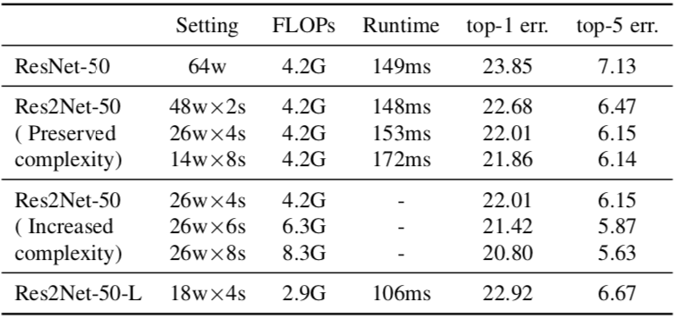
In-layer Multi-scale Representation
Top-1 and Top 5 test error on the ImageNet dataset.

Slide 9
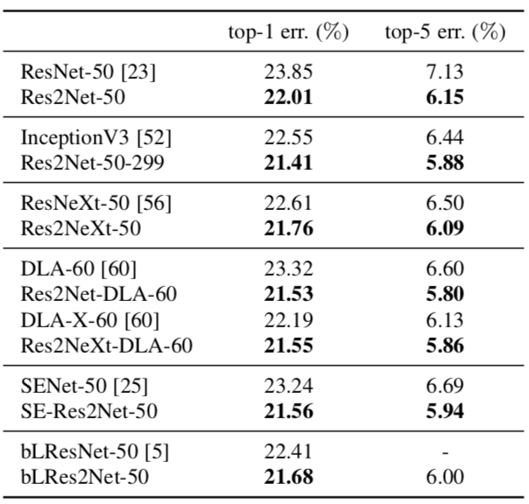
In-layer Multi-scale Representation
Aplication 1: image classification

Slide 10
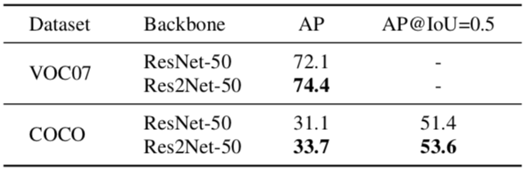
In-layer Multi-scale Representation
Aplication 2: object detection
Using Faster R-CNN as baseline.

Slide 11
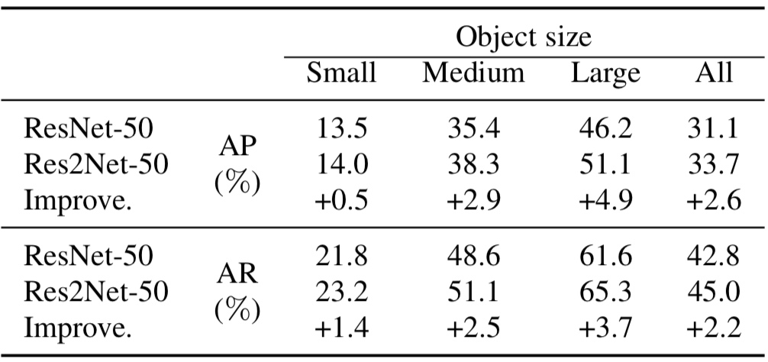
In-layer Multi-scale Representation
Aplication 2: object detection
Using Faster R-CNN as baseline.

Slide 12
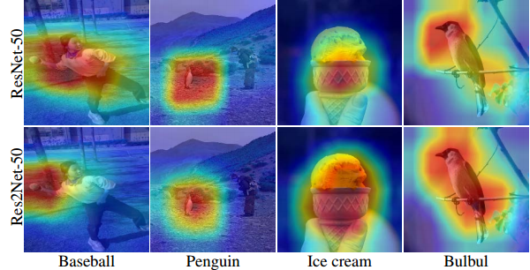
In-layer Multi-scale Representation
Aplication 3: class activation mapping

Slide 13
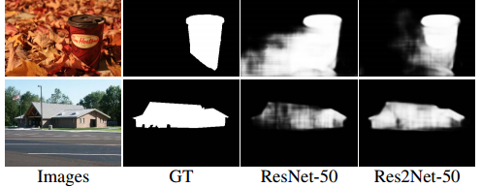
In-layer Multi-scale Representation
Aplication 4: salient object detection

Slide 14
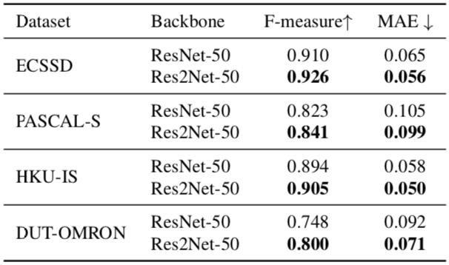
In-layer Multi-scale Representation
Aplication 4: salient object detection

Slide 15
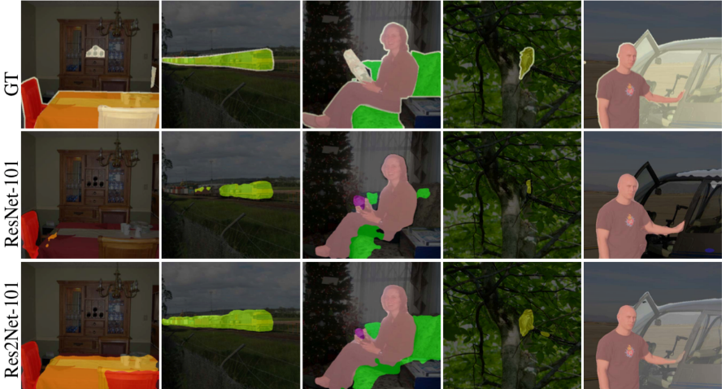
In-layer Multi-scale Representation
Aplication 5: semantic segmentation
Using Deeplab V3+ as baseline.

Slide 16
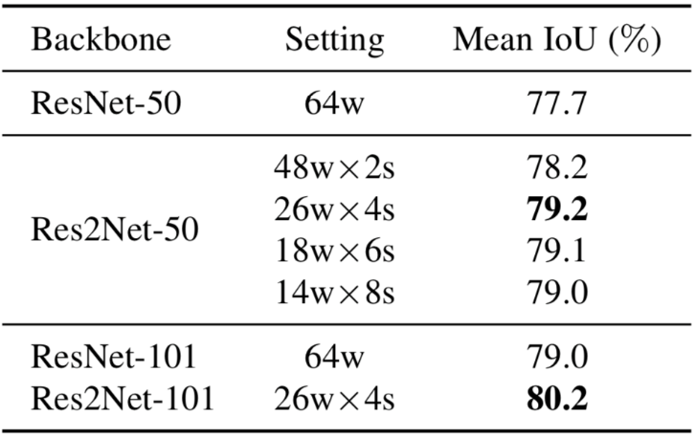
In-layer Multi-scale Representation
Aplication 5: semantic segmentation
Results on PASCAL VOC12 dataset.

Slide 17
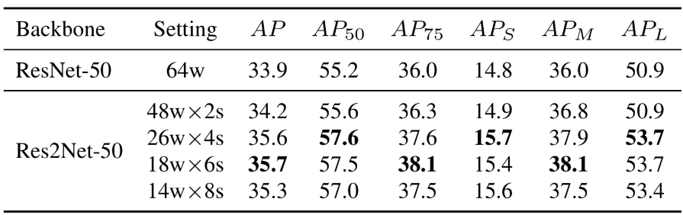
In-layer Multi-scale Representation
Aplication 6: instance segmentation
Using Mask-RCNN as basline (MS COCO)

Slide 18
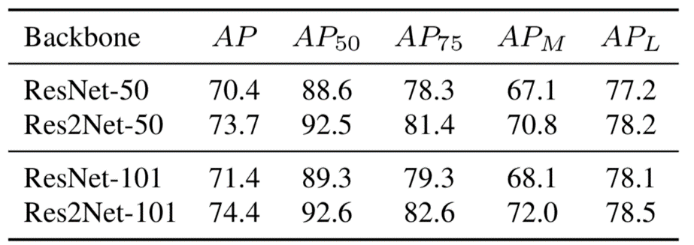
In-layer Multi-scale Representation
Aplication 7: keypoint estimation
Results on COCO val. set using SimpleBaseline [Xiao et. al., ECCV'18].

Slide 19
Conclusion
A new multi-scale backbone model
  with hierarchical in layer residue connections
  STOA results on various applications
Code & discussions
https://mmcheng.net/res2net/

