Slide 1


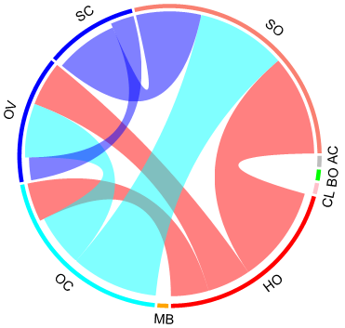
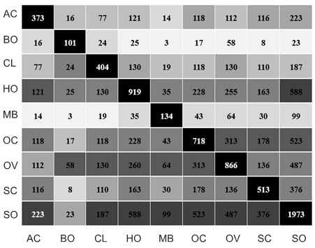
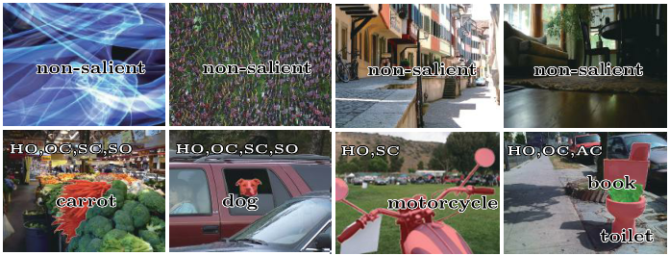
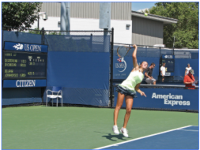






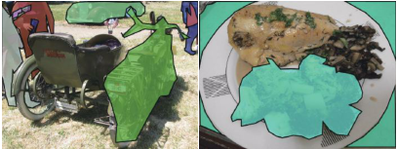
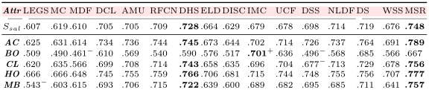
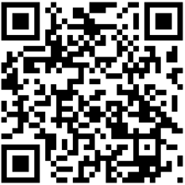
  Salient Objects in Clutter :
  Bringing Salient Object Detection to the Foreground
  ¹ Deng-Ping Fan (范登平), ¹ Ming-Ming Cheng (程明明), ¹Jiang-Jiang Liu, ¹Shang-Hua Gao, ¹Qibin Hou, ²Ali Borji
  ¹ Nankai University ² Central Florida University
  Poster ID：200
ground-truth
  dataset and benchmark specific to the task of salient object detection.
  6,000 images with high-quality ground-truth; 16 state-of-the-art models evaluated.
  Analysis based on attributes that typically faced in the salient object detection task.
  Data and evaluation code available: http://dpfan.net/socbenchmark/
  Problem – datasets biased towards ideal conditions
  Attributes distribution and correlation
  Most existing salient object detection (SOD) datasets
  contain images with at least one salient object, while discard other images.
  contain images with a single object or several objects in low clutter, thus do not adequately reflect the complexity the real world scenes.
  do not contains various attributes that reflect challenges in real-world scenes.
  top performing models have nearly saturated dataset scores but unsatisfactory performance on realistic scenes.
  AC Appearance Change: significant appearance variation.
  BO Big Object that covers > 50% of the image.
  CL Clutter. The foreground and background regions
  around the object have similar color.
  HO Heterogeneous Object regions that have distinct colors.
  MB Motion Blur results in fuzzy boundaries.
  OC Occlusion. Partially or fully occluded.
  OV Out-of-View. Object is clipped by the image boundaries.
  SC Shape Complexity. The object has complex boundaries.
  SO Small Object that cover 10% of the image
  Introduction - SOC Salient Objects in Clutter
ground-truth
  Overall performance
  dataset and benchmark specific to the task of salient object detection.
  6,000 images with high-quality ground-truth; 16 state-of-the-art models evaluated.
  Analysis based on attributes that typically faced in the salient object detection task.
  Data and evaluation code available: http://dpfan.net/socbenchmark/
  Image
  Previous work
  This work
  Segment
  Attribute-based performance
  ILSO
  Our SOC
  MSCOCO
  New dataset (~half year to build) and benchmark specific to the task of SOD
  6,000 images with high-quality instance level ground-truth
  Include scenes with salient or non-salient objects
  Image category annotation for weakly supervised tasks
  Analysis based on common attributes for SOD tasks
  Private online benchmark: http://mmcheng.net/socbenchmark/
  Attribute-based performance that reflect common challenges in real-world scenes
  1) gain a deeper insight into the SOD problem,
  2) investigate the pros and cons of the SOD models,
  3) objectively assess models from different perspectives.
  We believe that our dataset will helps to bring salient object researches to a new stage.

