Slide 1



Structure-measure: A New Way to Evaluate Foreground Maps
Deng-Ping Fan¹ Ming-Ming Cheng¹ Yun Liu¹
Tao Li¹ Ali Borji²
ICCV 2017 (Spotlight)
1
2
Notes:
I’m Deng-Ping Fan

Slide 2
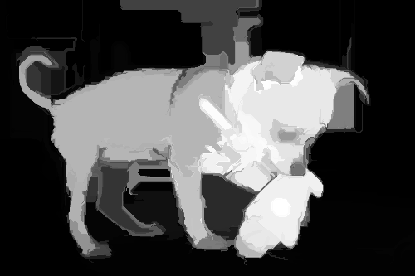
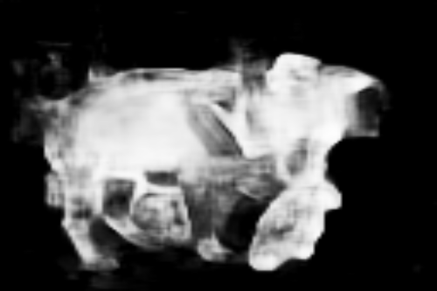



Goal
Similarity?
Ground Truth (GT)
Foreground map (FM)
Notes:
Our goal is to evaluate the similarity between the foreground map and the ground truth.

Slide 3

Pixel-wise based measures (AP, AUC)
(a) GT
(b) FM1
(c) FM2
Notes:
%The problem is that the current popular measures including AP and AUC are pixel-wise based. They ignore the structure similarity,
%So they rank the two different foreground map in the same order. This is contradictory to our common sense.
Existing methods rely on pixel-wise measure and ignore important structure similarity, improperly resulting in same scores for these two foreground maps.

Slide 4






Motivation
Region
structure consistency
of object-parts;
Object
uniformly distributed;
contrast sharply;
Notes:
We propose to evaluate structure similarity in both region level and object level. Our measure prefers structure consistency of object parts and uniformly distributed objects contrast sharply to background.
%Our motivation lies in Region and Object level.
%In Region level: structure consists of object-parts
%In Object level: there are two properties, uniform distributions and contrast sharply.
%So, the left dog is better than the right ones.

Slide 5

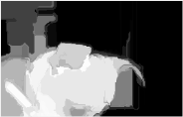
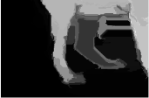


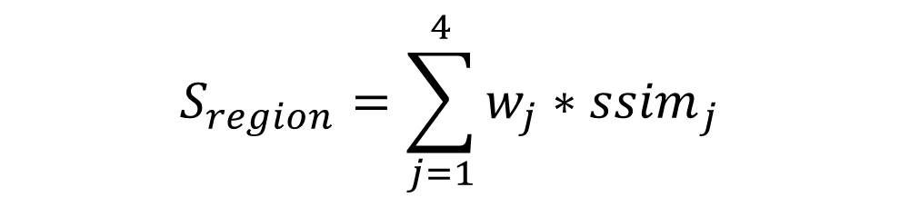
Region-Level
$$S_{region}=\sum_{j=1}^{4}{{w_{j}∗ssim}_{j}}$$
Image quality assessment: from error visibility to structural similarity , IEEE TIP 2004, Z Wang, AC Bovik et. al.
Notes:
We divide the image into parts and use famous ssim metric to evaluate the structure similarity for each region.
%For Region:
%First, we divide the image into object-parts
%Then, we use the famous ssim metric to evaluate each region structure similarity.

Slide 6
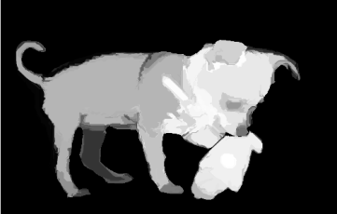
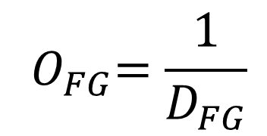
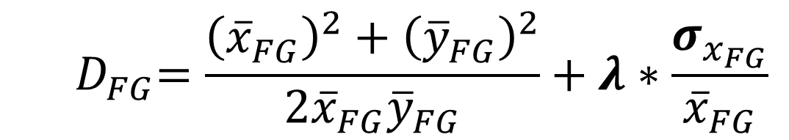
Object-Level: foreground
foreground
GT
foreground
FM
$${ D}_{FG}=\frac{{\left({\overline{x}}_{FG}\right)}^{2}+{\left({\overline{y}}_{FG}\right)}^{2}}{2{\overline{x}}_{FG}{\overline{y}}_{FG}}+λ∗\frac{σ_{x_{FG}}}{{\overline{x}}_{FG}}$$
contrast
uniform
$${ O}_{FG}=\frac{1}{D_{FG}}$$
Notes:
For Object-Level, we evaluate the foreground and background similarity, respectively.
Foreground parts of ground truth and corresponding predicted map are compared in a holistic way, considering both contrast and uniform term.
%First, we separate the foreground.
%Then, we use the contrast and the uniform term to evaluate their similarity.
%Finally, we use the same way to assess the background similarity in object-level.

Slide 7

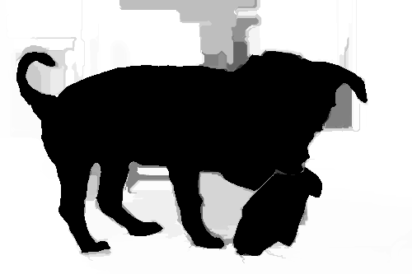



Framework
$$S_{region}$$
+
$$S_{object}=u∗O_{FG}+v∗O_{BG}$$
=
$$S={α∗S}_{region}+(1−α)∗S_{object}$$
Notes:
Here is our proposed framework including region and object similarity.

Slide 8
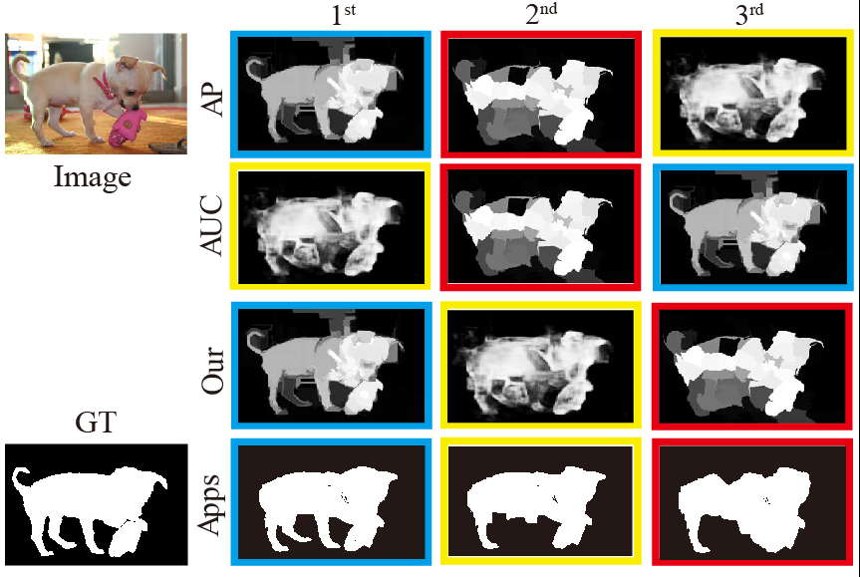
Ranking example
Notes:
Here is a realistic example, each row shows ranking results of AP measure, AUC measure and our results.
Our results consider important structure similarity, resulting in preferable results in real applications.
% the first row is the AP ranking result
% the second row is the AUC ranking result.
% The third row is our results.
By considering the evaluate the structure similarity, our measure’s ranking result is preferable.
%Our result supported by the applications

Slide 9
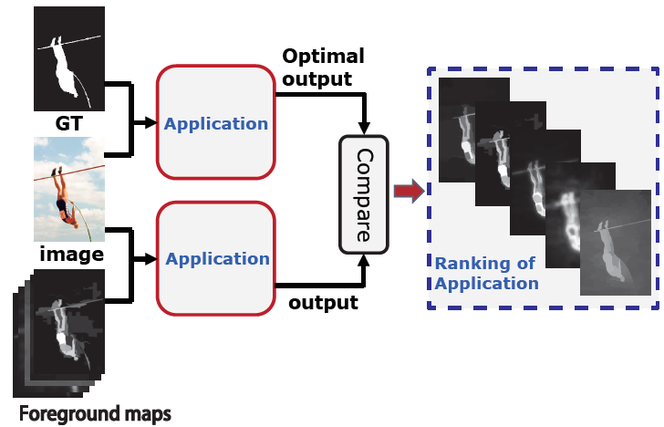
Meta-Measure1
Agree with the application: Saliency Cut
Notes:
To test the quality of our measure, we utilized 4 meta-measures which are used to evaluate the quality of measure.
A good evaluation measure rank result should consist with the application rank result.

Slide 10

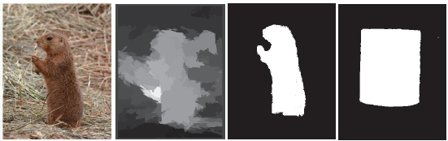
Meta-Measure-2
Prefer a good result over an Generic result
(a)Image
(b)GT
(c)FM1
(d)Generic
Meta-Measure-3
WRONG ground-truth decrease score
(a)Image
(b)FM
(c)GT
(d)WRONG GT
Notes:
The second meta-measure is that the measure should prefer a good result over an generic result.
The third is that the evaluation measure should decrease the score when using the wrong ground-truth.

Slide 11
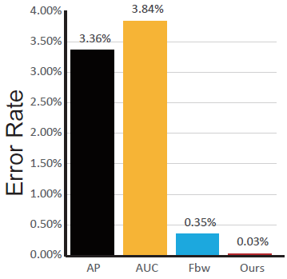
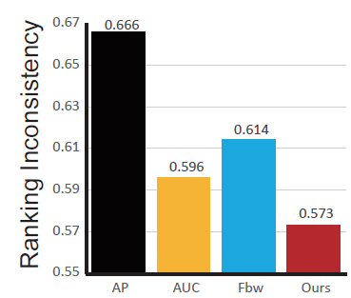
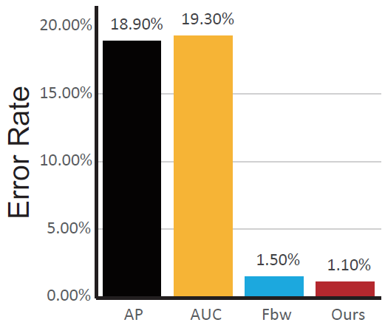
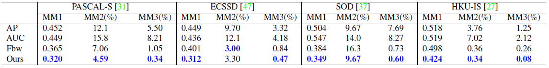
Results
Results in ASD dataset.
Our measure is better than current measures.
(a)Meta-measure1
(b)Meta-measure2
(c)Meta-measure3
Results in other popular datasets.
Notes:
We do the experiment in ASD dataset and other 4 datasets, the results shown that our measure is better than others with a large gap.

Slide 12
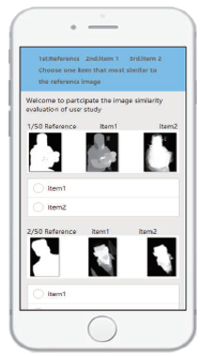
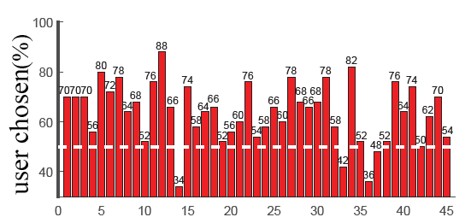
Meta-Measure 4
Agree with the human ranking.
~62% viewer preferred the map chosen
by our measure.
Notes:
The final meta-measure is that the evaluation measure rank result should agree with the human ranking.
The result shown that about 62 percentage viewer preferred the map chosen by our measure.

Slide 13
Thanks!
http://dpfan.net/smeasure/
Notes:
Thank you for your attention.

