Slide 1


BING: Binarized Normed Gradients for Objectness Estimation at 300fps
Ming-Ming Cheng¹ Ziming Zhang² Wen-Yan Li¹ Philip H. S. Torr¹
¹Torr Vision Group, Oxford University ²Boston University
08:30-10:00, Orals 8A – Recognition: Detection, Categorization, and Classification

Slide 2


Motivation: Generic object detection
Category specific detectors to evaluate many image windows (Slow).
Quickly identifying the object regions before recognize them.
Notes:
Most state-of-the-art detectors requires each category specific classifiers to evaluate many image windows.

Slide 3
Motivation: What is an object?
Category specific detectors to evaluate many image windows (Slow).
Quickly identifying the object regions before recognize them.
Notes:
Instead, humans can quickly identify object regions and recognize them.

Slide 4
Motivation: What is an object?
An objectness measure
  A value to reflect how likely an image window covers an object of any category [PAMI 12 Alexe et. al.].
> >
Each category specific detectors to evaluate many image windows (Slow).
Quickly identifying the object regions before recognize them.
Notes:
We propose an objectness measure to efficiently find object regions of any category.

Slide 5
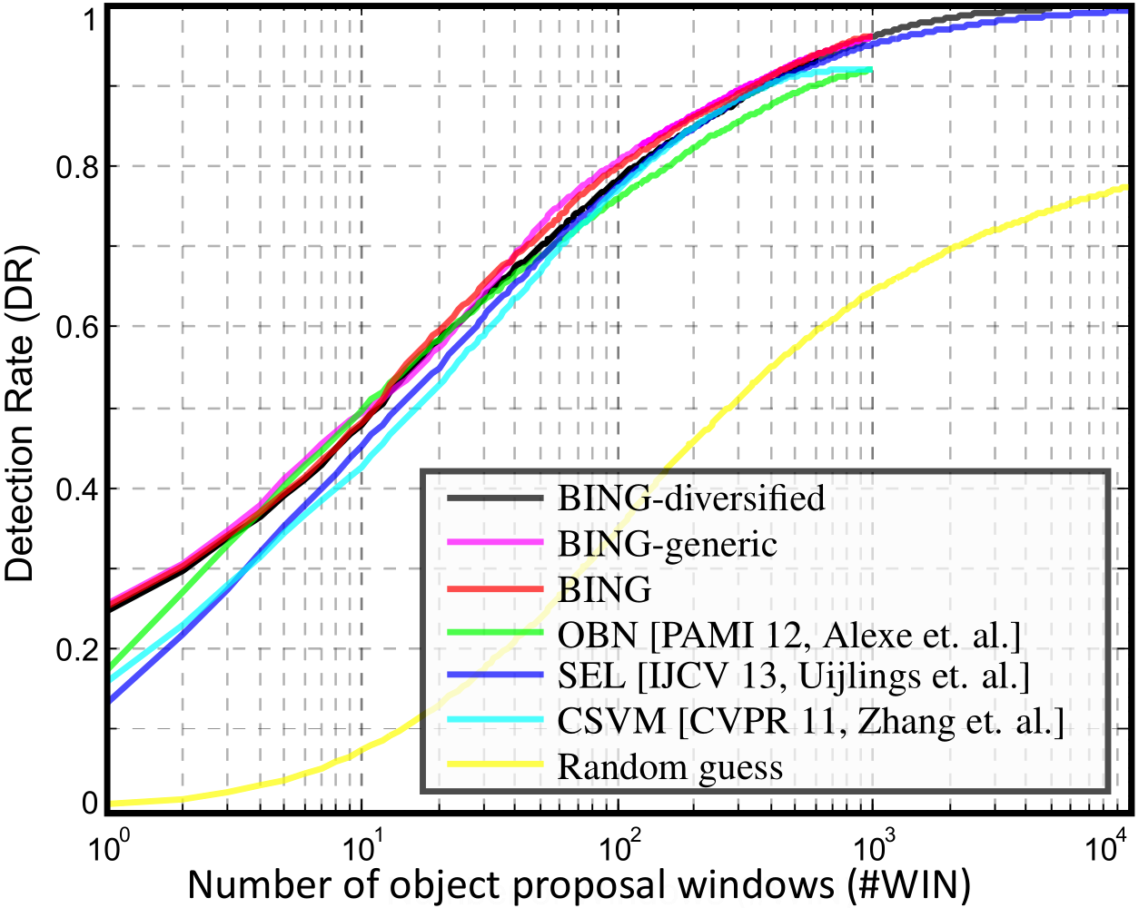
Experimental results
Proposal quality on PASCAL VOC 2007
Better detection rate
& 1000 times faster
Notes:
When compared with popular alternatives, our method achieves better detection rate, while been 1000 times faster.

Slide 6

Conclusion and Future Work
Conclusions
  Surprisingly simple, fast, and high quality objectness measure
    Needs a few atomic operations (i.e. add, bitwise, etc.) per window
      Test time: 300fps!
      Training time on the entire VOC07 dataset takes 20 seconds!
    State of the art results on challenging VOC benchmark
      96.2% Detection rate (DR) @ 1K proposals, 99.5% DR @ 5K proposals
    Generic over classes, training on 6 classes and test on other classes
    100+ lines of C++ to implement the algorithm
Resources: http://mmcheng.net/bing/
  Paper, source code, data, slides, online FAQs, etc.
  1000+ source code downloads in 1 week
  Already got many feedbacks reporting detection speed up
free
Notes:
Our method is surprisingly simple, fast and produce high quality results. Please go to our webpage for more details.

Slide 7
Thanks for watching
Orals 8A, 8:30-10:00, 27th June
Notes:
Thanks for watching.

