Slide 1


How to Write a Good SIGGRAPH paper
Steve Lin
MSRA

Slide 2
What is a Good Paper?
Introduces significant ideas/results to the research community
Clearly communicates your ideas/results
Provides insight and understanding on what you’ve done

Slide 3
Why is Good Writing Important?
Improve chances of paper acceptance
Increase impact of your work
Elevate quality of your research

Slide 4
Overview
Why you should start writing early
How to write a bad research paper
Some general guidelines on writing

Slide 5
Why you should start writing early
Writing well Thinking well
(many thanks to Kurt Akeley)

Slide 6
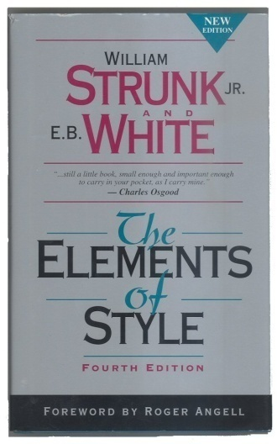
Clear writing comes from clear thinking
“Fortunately the act of composition, or creation, disciplines the mind; writing is one way to go about thinking …”
— E. B. White
In The Elements of Style
Addison Wesley, 1999

Slide 7
Writing improves understanding
“I hear and I forget;
I see and I remember;
I write and I understand.”
— Confucius (translated)

Slide 8
Research and Development Process
No
Research &
Develop
Done?
Write Up
Results
Stop
Yes
Not just wrong, but painfully wrong!

Slide 9
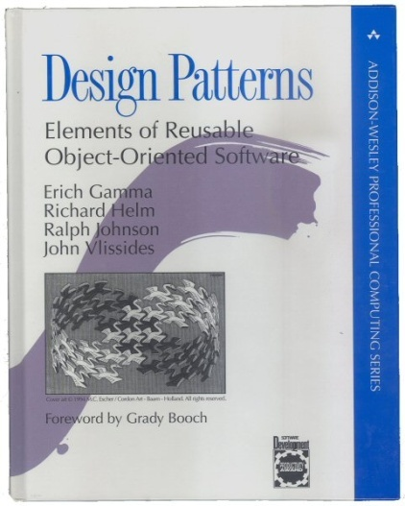
“Don’t worry if you don’t understand this book completely on the first reading. We didn’t understand it all on the first writing!”
— Erich Gamma, Richard Helm, Ralph Johnson, and John Vlissides
In Design Patterns
Addison Wesley, 1995

Slide 10
Research and Development Process
No
Research &
Develop
Write Up
Results
Done?
Stop
Yes
?

Slide 11
“I have always written these motivational abstracts, as I call them… My hit rate on these abstracts, specifically the fraction that become a submitted paper, is about 75 percent.”
— Marc Levoy
EE & CS Professor, Stanford

Slide 12
Overview
Why you should start writing early
How to write a bad research paper
Some general guidelines on writing

Slide 13
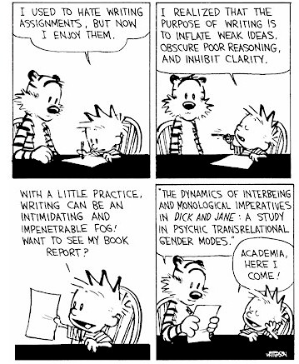
How to write a bad research paper

Slide 14
Write the paper for only yourself
The audience knows everything you do
As long as you understand it, everyone else will
Everything in the paper should be obvious and needs no explanation

Slide 15
The previous work is all garbage
There’s nothing good to say about previous methods
Our work is so good compared to others
Don’t even need to mention some of the other works

Slide 16
Provide no context
Do not explain your problem
Do not mention assumptions or settings
Do not compare to related works
Do not discuss contributions

Slide 17
Just describe what you did
First we did this, then we did that, and then we did another thing…
Do not explain why, or discuss results
Do not mention alternatives

Slide 18
Focus mainly on details
You spent 3 months of the 6-month project on optimizing a certain part of the code, so you should spend half the paper talking about it.
Everyone reads papers for the little details, not the big ideas

Slide 19
Be different just because you can
Create new notation and terminology just to be different from previous works: f = x(y)
Change the notation throughout the paper
Do not give definitions for new or unusual terms

Slide 20
How to write a bad research paper
Write the paper only for yourself
All previous work is garbage
Provide no context
Just describe what you did
Focus mainly on details
Be different just because you can

Slide 21
Overview
Why you should start writing early
How to write a bad research paper
Some general guidelines on writing

Slide 22
Attention from readers
Title
(1000)
Abstract
(100)
Intro & Results
(30)
Body
(10)

Slide 23
Title
Describes your work with accuracy
  “Computing Scattering Properties of Participating Media using Lorentz-Mie Theory”
Stimulates reader interest
  “Symmetrization”
Subtitle
  “Mesh Puppetry: Cascading Optimization of Mesh Deformation with Inverse Kinematics”

Slide 24
Abstract
Many people will read only the abstract
Make it useful and appropriate
Make it as specific and concrete as possible, without getting too technical.

Slide 25
Abstract contents
The problem your work addresses
Why the problem is interesting
What is new about your solution
Results and impact of solution

Slide 26
Abstract example
Problem
We present hybrid images, a technique that produces static images with two interpretations, which change as a function of viewing distance. Hybrid images are based on the multiscale processing of images by the human visual system and are motivated by masking studies in visual perception. These images can be used to create compelling displays in which the image appears to change as the viewing distance changes. We show that by taking into account perceptual grouping mechanisms it is possible to build compelling hybrid images with stable percepts at each distance. We show examples in which hybrid images are used to create textures that become visible only when seen up-close, to generate facial expressions whose interpretation changes with viewing distance, and to visualize changes over time within a single picture.
Interesting
New
Results

Slide 27
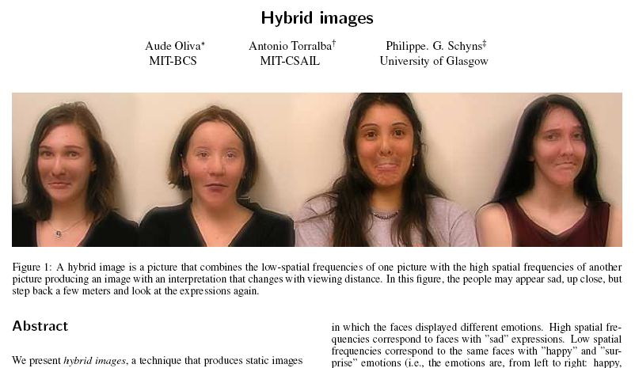
Teaser figure

Slide 28
Introduction
Set up your paper
Perhaps the most difficult part to write
Need to be persuasive

Slide 29
Introduction structure
Introduce problem
Explain why problem is interesting and relevant
Briefly review common approaches to problem
Describe your solution
High-level overview of approach
Highlight contributions, what is new
What results you get
Paper organization

Slide 30
Related works
Describe fairly, be diplomatic
Demonstrate knowledge and understanding
Similar techniques for different problems
Depending on paper length, may be included in introduction

Slide 31
Body
Convey idea before details
Use examples
  explain algorithm using a concrete example for illustration
Equations
  should be able to skip yet still understand paper

Slide 32
Equations
Give simple verbal explanation
  “The BRDF relates the outgoing radiance R to the incoming illumination I as follows:”
Remind readers about previous equations
  “We combine Eq. (2) and Eq. (6) to obtain the following energy function:”
  “We combine the deconvolution constraint of Eq. (2) and the regularization term of Eq. (6) to obtain the following energy function:”

Slide 33
Results
Verify each claim that you made
Comparison to other methods if possible
Point out anything not obvious at a quick glance

Slide 34
Discussion and Conclusion
For experts, discussion may be the most interesting part
  limitations, how they might be addressed
  conditions when assumptions can be relaxed
  insight on contributions, how they can benefit others
Conclusion
  quick reminder of why your work is great
  future directions

Slide 35
Tips for Non-native English Speakers
Learn by examining well-written papers
Spell checker: available in most text editors
Grammar checker: Microsoft Word!
Thank you!

