Slide 1
Efficient Image Scene Analysis and Applications
报告人：程明明
南开大学、计算机与控制工程学院
http://mmcheng.net/

Slide 2

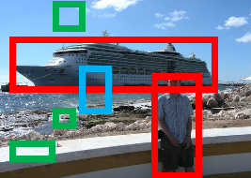
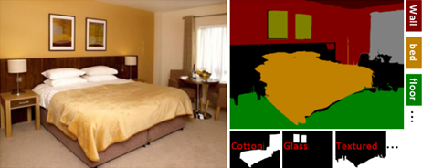
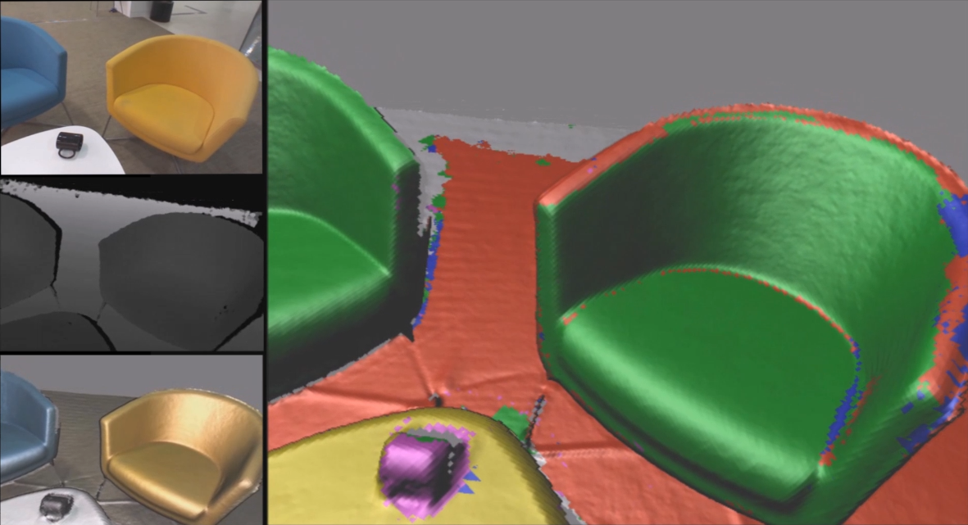
Contents
Global contrast based salient region detection, PAMI 2014
BING: Binarized Normed Gradients for Objectness Estimation at 300fps, CVPR 2014
ImageSpirit: Verbal guided image parsing, ACM TOG 2014
SemanticPaint: Interactive 3d labeling and learning at your fingertips

Slide 3



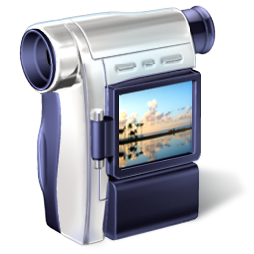
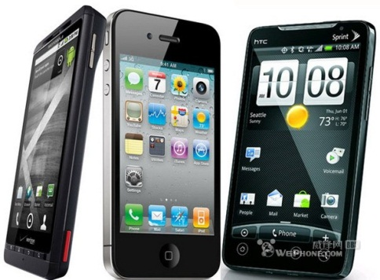
Images change the way we live

Slide 4



Motivation
RGB, RGB, RGB, RGB, RGB, RGB, RGB, RGB, RGB, RGB, RGB, RGB, RGB, RGB, …
Objects, spatial relations, semantic properties, 3d, actions, human pose, …

Slide 5
Motivation: Generic object detection
Notes:
Generic object detection has made great progress in recent years. However, most state-of-the-art method still requires each category specific classifiers to evaluate many image windows in a sliding window fashion.

Slide 6
Contents
Global contrast based salient region detection, PAMI 2014
BING: Binarized Normed Gradients for Objectness Estimation at 300fps, CVPR 2014
ImageSpirit: Verbal guided image parsing, ACM TOG 2014
SemanticPaint: Interactive 3d labeling and learning at your fingertips

Slide 7


Global Contrast based Salient Region Detection, IEEE TPAMI, 2014, MM Cheng, et. al. (2nd most cited paper in CVPR 2011)

Slide 8
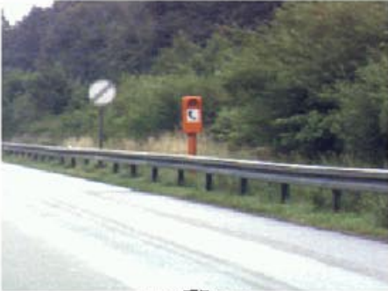
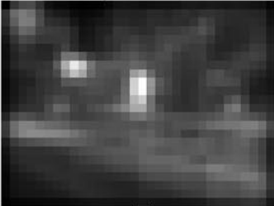
Related works: saliency detection
Fixation prediction
  Predicting saliency points of human eye movement
A model of saliency-based visual attention for rapid scene analysis. PAMI 1998, Itti et al.
Saliency detection: A spectral residual approach. CVPR 2007, Hou et. al.
Graph-based visual saliency. NIPS, Harel et. al.
Quantitative analysis of human-model agreement in visual saliency modeling: A comparative study, IEEE TIP 2012, Borji et. al.
A benchmark of computational models of saliency to predict human fixations, TR 2012.

Slide 9
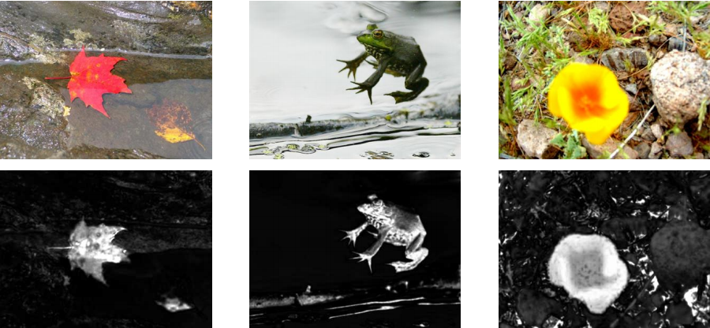
Related works: saliency detection
Salient object detection
  Detect the most attention-grabbing object in the scene
Learning to detect a salient object. CVPR 2007, Liu et. al.
Frequency-tuned salient region detection, CVPR 2009, Achanta et. al.
Global contrast based salient region detection, CVPR 2011, Cheng et. al.
Salient object detection: a benchmark, Ali et. al.

Slide 10
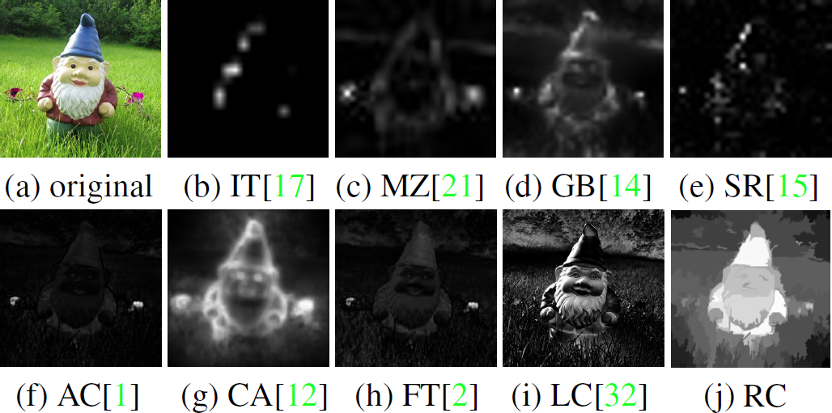
Related works: saliency detection
Observations
  In order to uniformly highlight entire object regions, global contrast based method is preferred over local contrast based methods.
  Contrast to near by regions contributes more than far away regions.

Slide 11
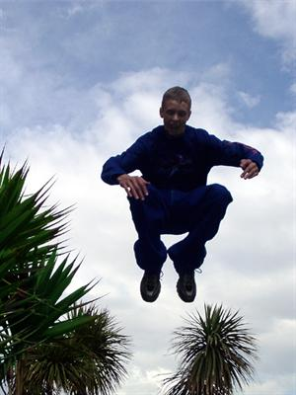
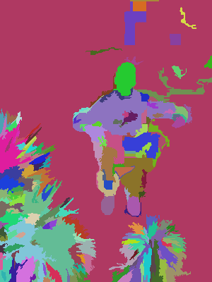
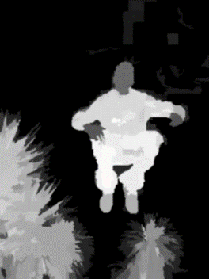
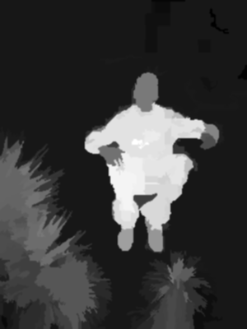
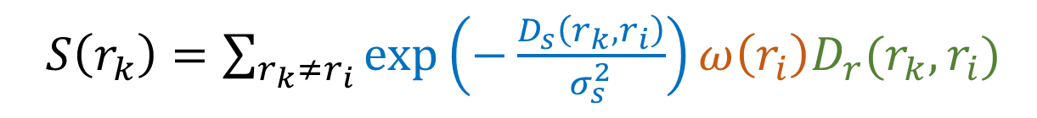
Core idea: region contrast (RC)
  Image Segmentation $σ_{s}^{2}→∞$ $σ_{s}^{2}→0.4$
  Spatial weighting
  Region size
  $S\left(r_{k}\right)=\sum_{r_{k}≠r_{i}}{\exp\left(−\frac{D_{s}\left(r_{k},r_{i}\right)}{σ_{s}^{2}}\right)}ω\left(r_{i}\right)D_{r}(r_{k},r_{i})$
  Region contrast by sparse histogram comparison.

Slide 12
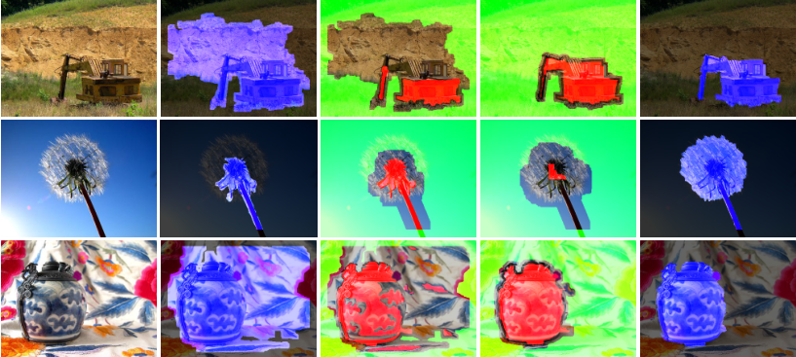
SaliencyCut
  Iterative refine: iteratively run GrabCut to refine segmentation
  Adaptive fitting: adaptively fit with newly segmented salient region
  Enables automatic initialization provided by salient object detection.

Slide 13
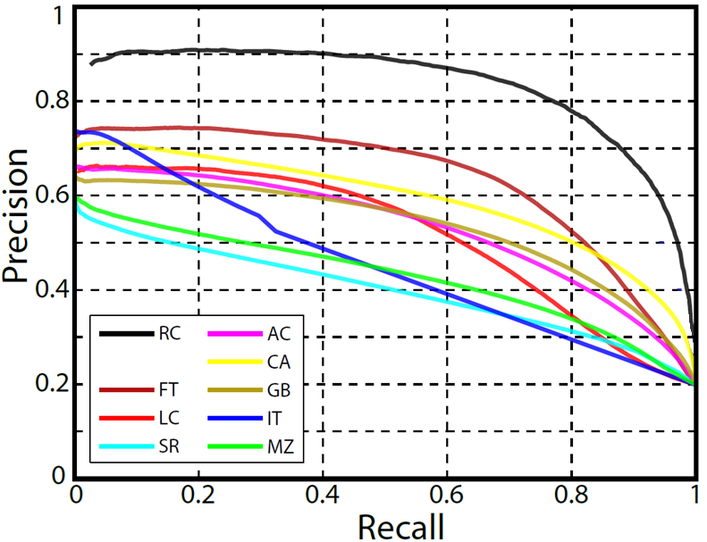
Experimental results
Dataset: MSRA1000 [Achanta09]
  Precision vs. recall

Slide 14
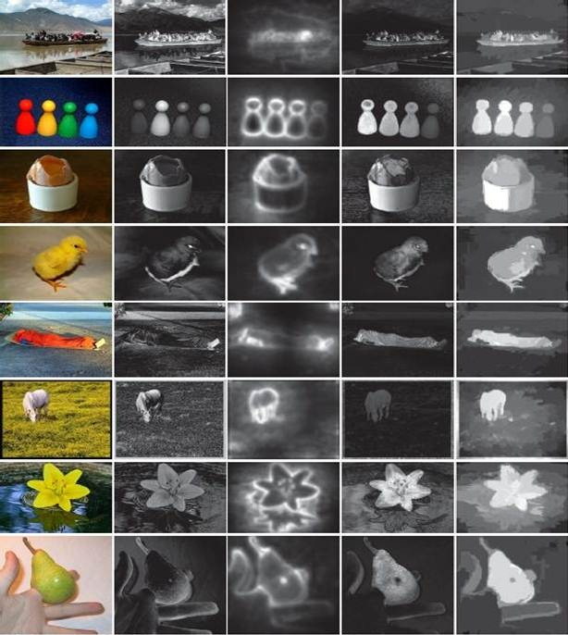

Experimental results
Dataset: MSRA1000 [Achanta09]
  Precision vs. recall
  Visual comparison
Source code (C++) available
  http://mmcheng.net/salobj/
free

Slide 15
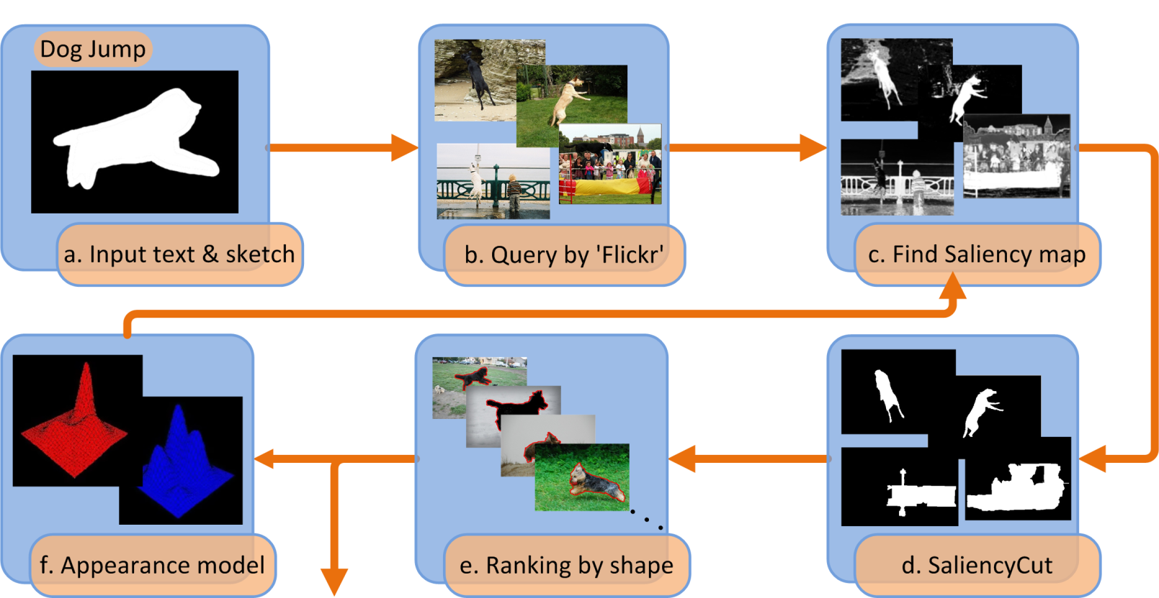
Applications
Is salient object detection for ‘simple’ images useful?
SalientShape: Group Saliency in Image Collections, The Visual Computer 2014. Cheng et. al.

Slide 16
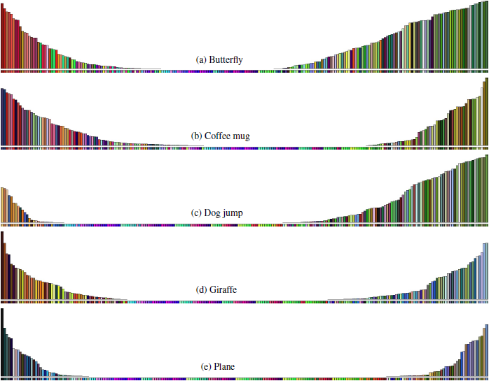
Applications
Illustration of learned appearance models
  Accords with our understanding of these categories

Slide 17
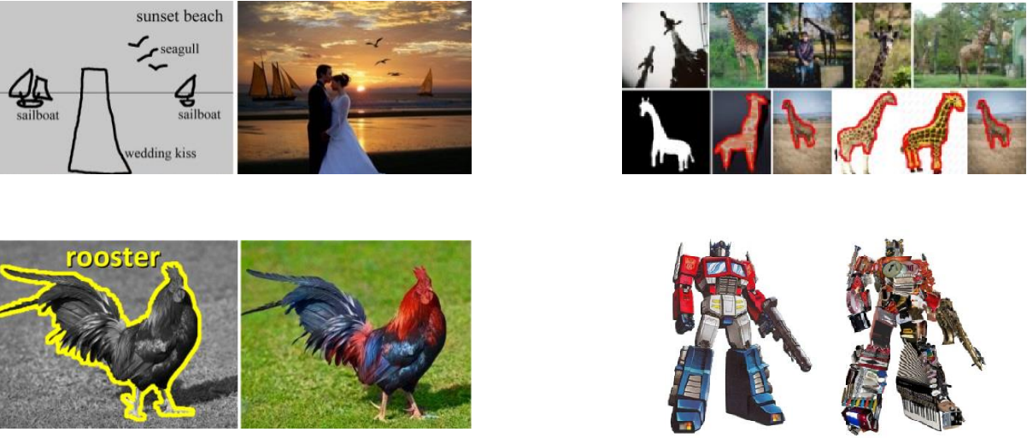
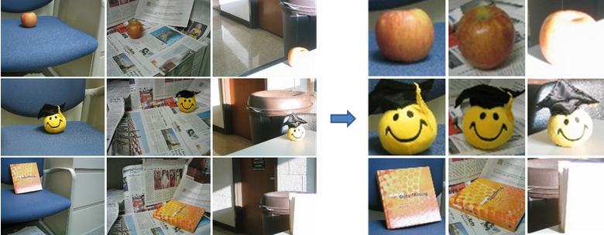
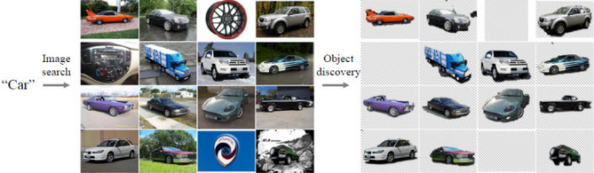
Applications
[ACM TOG 09, Chen et. al.] [Vis. Comp. 14, Cheng et. al.]
[ACM TOG 11, Chia et. al.] [ACM TOG 11, Zhang et. al.]
[CVPR 12, Zhu et. al.] [CVPR 13, Rubinstein et. al.]
  See the 500+ citations of our CVPR 2011 paper for more.

Slide 18
Contents
Global contrast based salient region detection, PAMI 2014
BING: Binarized Normed Gradients for Objectness Estimation at 300fps, CVPR 2014
ImageSpirit: Verbal guided image parsing, ACM TOG 2014
SemanticPaint: Interactive 3d labeling and learning at your fingertips

Slide 19
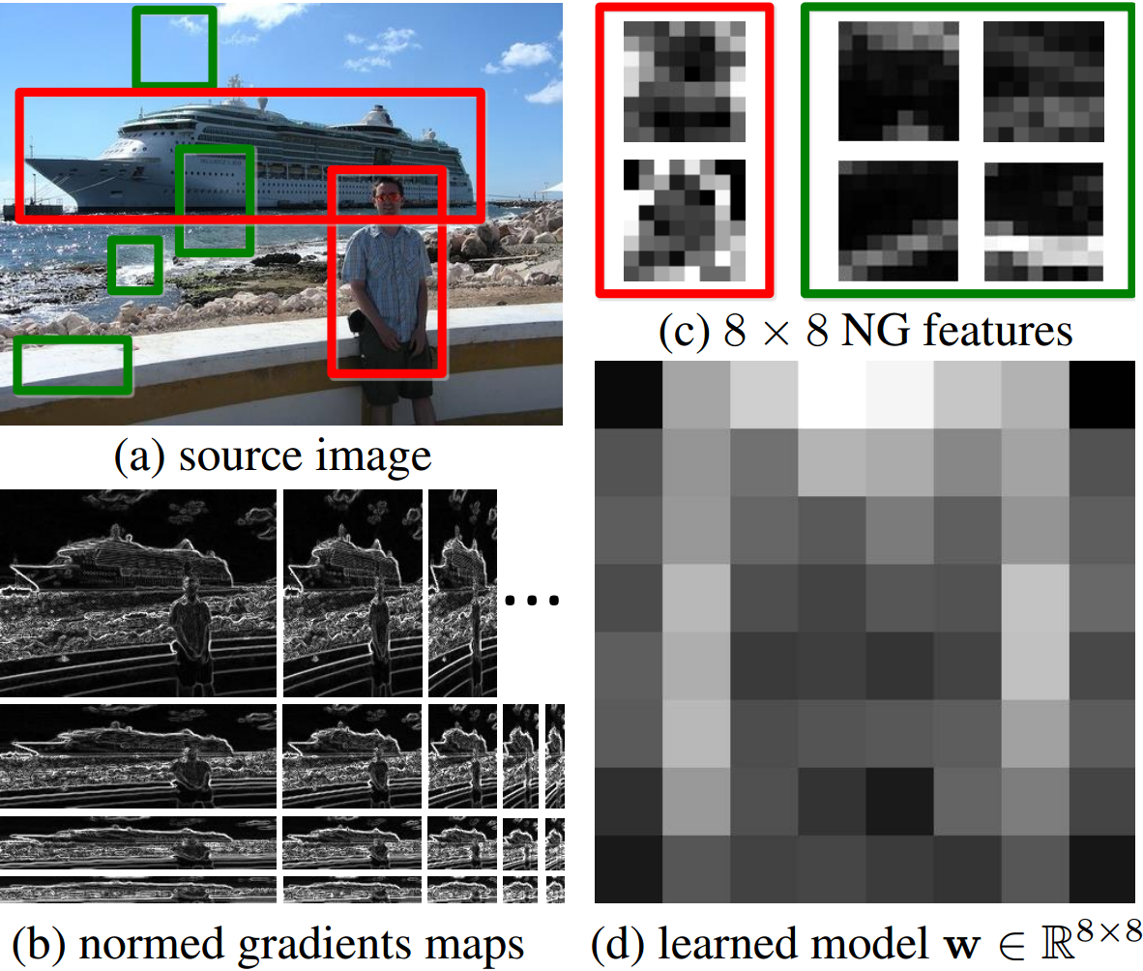
BING: Binarized Normed Gradients for Objectness Estimation at 300fp, IEEE CVPR 2014 (Oral), M.M. Cheng, et. al.

Slide 20
Motivation: What is an object?
> >
Notes:
Objectness is usually represented as a value which reflects how likely an image window covers an object of any category.

Slide 21
Motivation: What is an object?
An objectness measure
  A value to reflects how likely an image window covers an object of any category.
What’s the benefits?
  Improve computational efficiency, reduce the search space
  Allowing the usage of strong classifiers during testing, improve accuracy
Measuring the objectness of image window, IEEE TPAMI 2012, Alexe et. al.

Slide 22
Motivation: What is an object?
What is a good objectness measure?
  Achieve high object detection rate (DR)
    Any undetected objects at this stage cannot be recovered later
  Produce a small number of proposals
    Reducing computational time of subsequent detectors
  Obtain high computational efficiency
    The method can be easily involved in various applications
    Especially for realtime and large-scale applications;
  Have good generalization ability to unseen object categories
    The proposals can be reused by many category specific detectors
    Greatly reduce the computation for each of them.

Slide 23
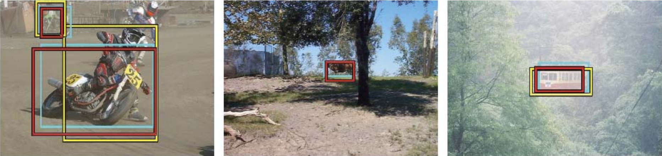
Related works: saliency detection
Objectness proposal generation
  A small number (e.g. 1K) of category-independent proposals
  Expected to cover all objects in an image
Measuring the objectness of image windows. PAMI 2012, Alexe, et. al.
Selective Search for Object Recognition, IJCV 2013, Uijlings et. al.
Category-Independent Object Proposals With Diverse Ranking, PAMI 2014, Endres et. al.
Proposal Generation for Object Detection using Cascaded Ranking SVMs. CVPR 2011, Zhang et al.
Learning a Category Independent Object Detection Cascade. ICCV 2011, Rahtu et. al.
Generating object segmentation proposals using global and local search, CVPR 2014, Rantalankila et al.

Slide 24
Related works: saliency detection
Other efficient search mechanism
  Branch-and-bound
  Approximate kernels
  Efficient classifiers
  …
Beyond sliding windows: Object localization by efficient subwindow search. CVPR 2008, Lampert et. al.
Classification using intersection kernel support vector machines is efficient. CVPR 2008, Maji et. al.
Efficient additive kernels via explicit feature maps. TPAMI 2012, A. Vedaldi and A. Zisserman.
Histograms of oriented gradients for human detection. CVPR 2005, N. Dalal and B. Triggs.

Slide 25

Methodology: observation
Our observation: a small interactive demo
  Take you pen and paper and draw an object which is current in your mind.
  What the object looks like if we resize it to a tiny fixed size?
    E.g. 8x8. Not only changing the scale, but also aspect ratio.

Slide 26
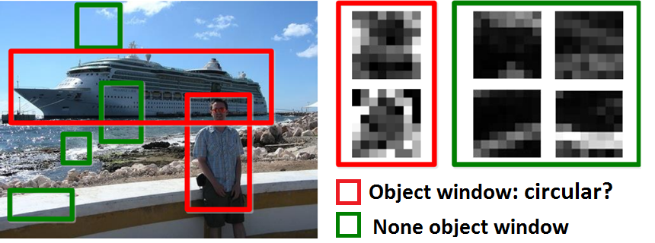
Methodology: observation
Objects are stand-alone things with well defined closed boundaries and centers.
Little variations could present in such abstracted view.
  Finding pictures of objects in large collections of images. Springer Berlin Heidelberg, 1996, Forsyth et. al.
  Using stuff to find things. ECCV 2008, Heitz et. al.
  Measuring the objectness of image window, IEEE TPAMI 2012, Alexe et. al.

Slide 27
Methodology
Normed gradients (NG) + Cascaded linear SVMs
  Normed gradient means Euclidean norm of the gradient

Slide 28
Methodology
Normed gradients (NG) + Cascaded linear SVMs
  Detect at different scale and aspect ratio
  An 8x8 region in the normed gradient maps forms a 64D feature for an window in source image
  Simultaneous Object Detection and Ranking with Weak Supervision, NIPS 2010, Blaschko et. al.
  Proposal Generation for Object Detection using Cascaded Ranking SVMs. CVPR 2011, Zhang et. al.
  LibLinear: A library for large linear classiﬁcation, JMLR 2008, Fan et. al.
  Learning a Category Independent Object Detection Cascade. ICCV 2011, Rahtu et. al.

Slide 29
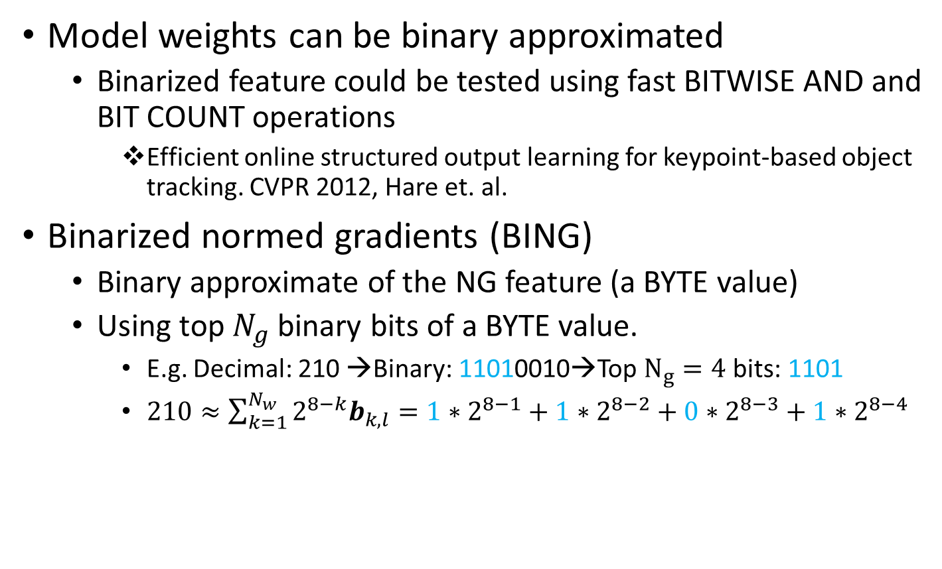
Methodology
Model weights can be binary approximated
  Binarized feature could be tested using fast BITWISE AND and BIT COUNT operations
    Efficient online structured output learning for keypoint-based object tracking. CVPR 2012, Hare et. al.
Binarized normed gradients (BING)
  Binary approximate of the NG feature (a BYTE value)
  Using top $N_{g}$ binary bits of a BYTE value.
    E.g. Decimal: 210 →Binary: 11010010→Top $N_{g}=4$ bits: 1101
    $210≈\sum_{k=1}^{N_{w}}{2^{8−k}b_{k,l}}=1∗2^{8−1}+1∗2^{8−2}+0∗2^{8−3}+1∗2^{8−4}$

Slide 30
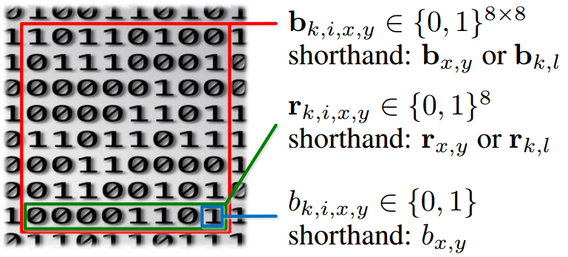
Methodology
Getting BING feature: illustration of the representations
  Use a single atomic variable (int64 & byte) to represents a BING feature and its last row.

Slide 31
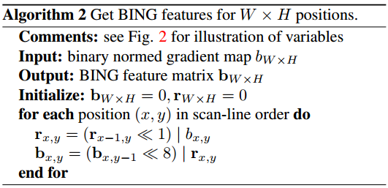
Methodology
Getting BING feature: illustration of the representations
Getting BING feature

Slide 32
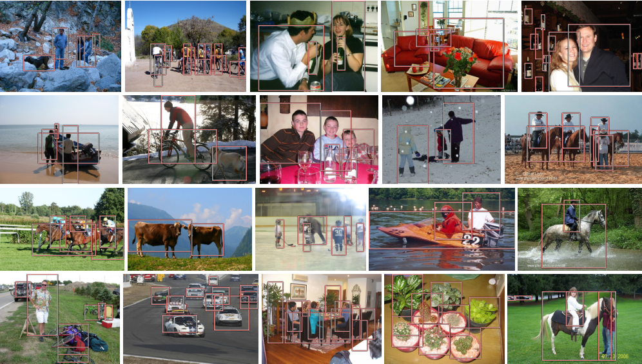
Experimental results
Sample true positives on PASCAL VOC 2007

Slide 33
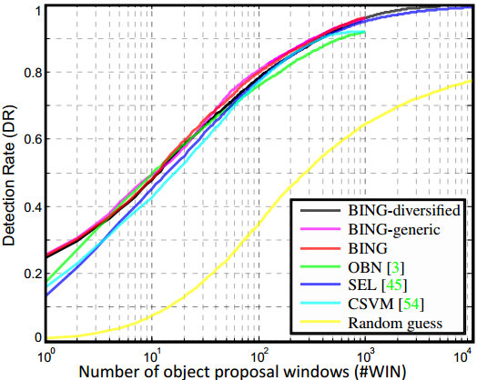
Experimental results
Proposal quality on PASCAL VOC 2007

Slide 34
Experimental results
Computational time
  A laptop with an Intel i7-3940XM CPU
  20 seconds for training on the PASCAL 2007 training set!!
  Testing time 300fps on VOC 2007 images
Method | [1] | OBN [2] | CSVM [3] | SEL [4] | Our BING
Time (seconds) | 89.2 | 3.14 | 1.32 | 11.2 | 0.003
Category-Independent Object Proposals With Diverse Ranking, PAMI 2014, Endres et. al.
Measuring the objectness of image windows. PAMI 2012, Alexe, et. al.
Proposal Generation for Object Detection using Cascaded Ranking SVMs. CVPR 2011, Zhang et. al.
Selective Search for Object Recognition, IJCV 2013, Uijlings et. al.

Slide 35
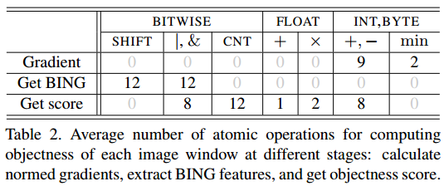
Experimental results
Computational time

Slide 36
Conclusion and Future Work
Conclusions
  Surprisingly simple, fast, and high quality objectness measure
    Needs a few atomic operation (i.e. add, bitwise, etc.) per window
      Test time: 300fps!
      Training time on the entire VOC07 dataset takes 20 seconds!
    State of the art results on challenging VOC benchmark
      96.2% Detection rate (DR) @ 1K proposals, 99.5% DR @ 5K proposals
    Generic over classes, training on 6 classes and test on other classes
    100+ lines of C++ to implement the algorithm
Resources: http://mmcheng.net/bing/
  Source code, data, slides, links, online FAQs, etc.
  1000+ source code downloads in 1 week
  Already got many feedbacks reporting detection speed up
free

Slide 37
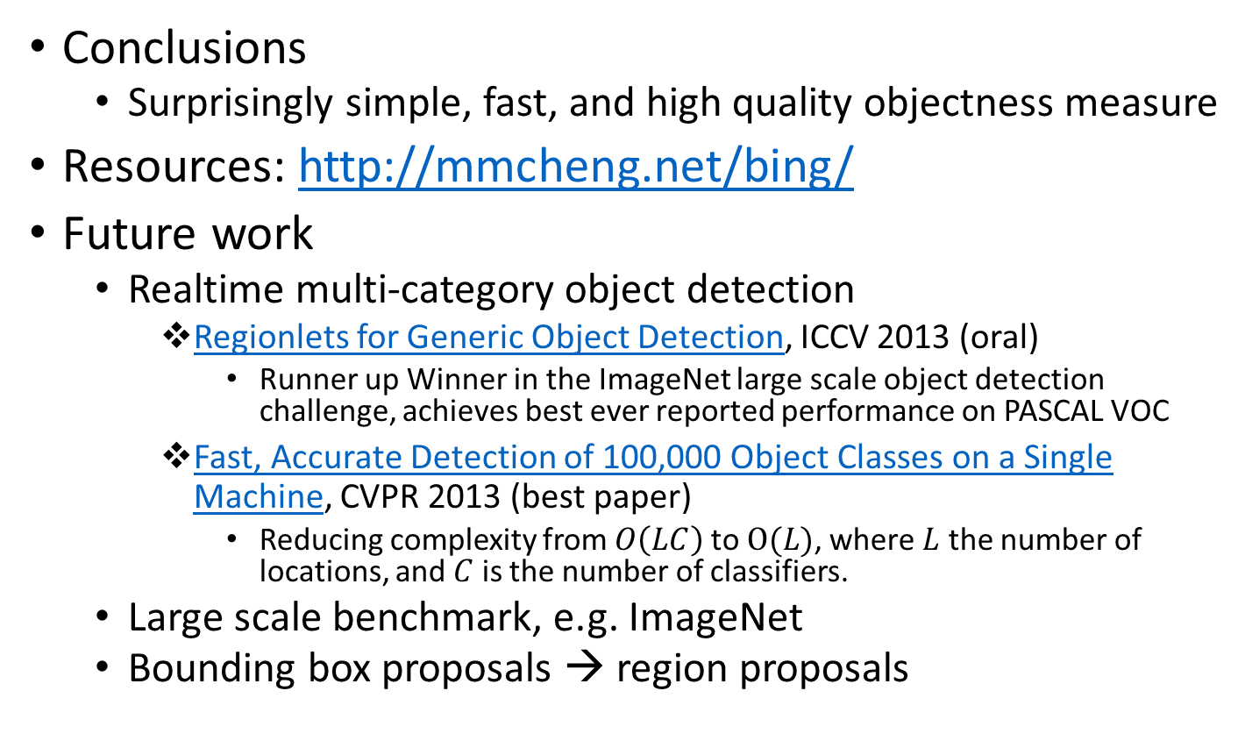
Conclusion and Future Work
Conclusions
  Surprisingly simple, fast, and high quality objectness measure
Resources: http://mmcheng.net/bing/
Future work
  Realtime multi-category object detection
    Regionlets for Generic Object Detection, ICCV 2013 (oral)
      Runner up Winner in the ImageNet large scale object detection challenge, achieves best ever reported performance on PASCAL VOC
    Fast, Accurate Detection of 100,000 Object Classes on a Single Machine, CVPR 2013 (best paper)
      Reducing complexity from $O\left(LC\right)$ to $O(L)$, where $L$ the number of locations, and $C$ is the number of classifiers.
  Large scale benchmark, e.g. ImageNet
  Bounding box proposals → region proposals
free

Slide 38
Contents
Global contrast based salient region detection, PAMI 2014
BING: Binarized Normed Gradients for Objectness Estimation at 300fps, CVPR 2014
ImageSpirit: Verbal guided image parsing, ACM TOG 2014
SemanticPaint: Interactive 3d labeling and learning at your fingertips

Slide 39
ImageSpirit: Verbal Guided Image Parsing, ACM TOG, 2014, M.M. Cheng et. al.

Slide 40
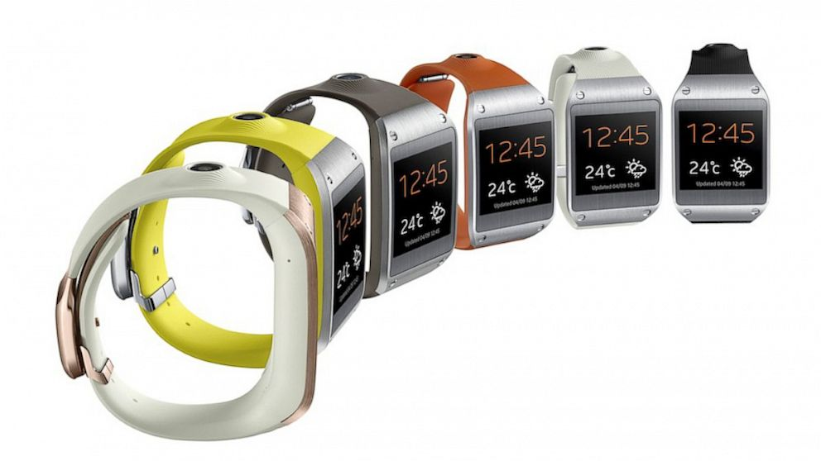


Motivations

Slide 41
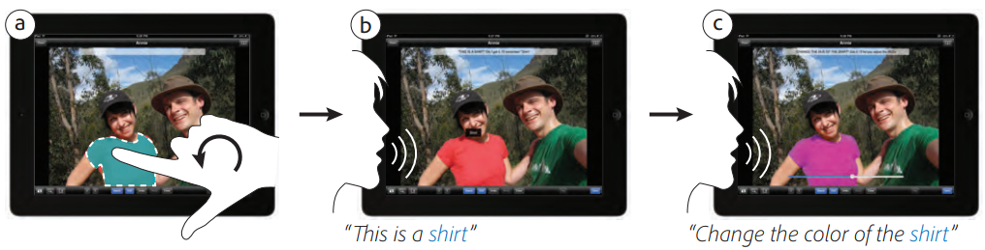
Related works
Concurrent work: PixelTone
  Sketch contour + speech commands, etc.
Foundations of our work
PixelTone: a multimodal interface for image editing. ACM SIGCHI, 2013, G.P. Laput, et al.
Textonboost for image understanding: Multi-class object recognition and segmentation by jointly modeling texture, layout, and context. IJCV 2009, Shotton et al. .
Efficient inference in fully connected crfs with gaussian edge potentials, NIPS 2011, P. Krähenbühl and V. Koltun.
Fast High‐Dimensional Filtering Using the Permutohedral Lattice. Computer Graphics Forum, 2010, A. Adams et al.

Slide 42


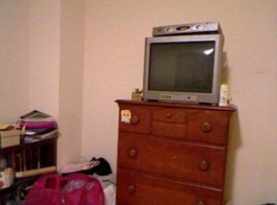
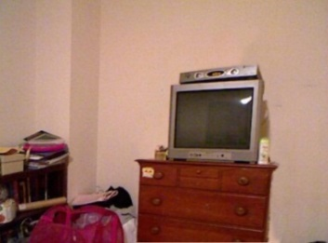


Verbal guided image parsing
Make the wood cabinet in bottom-middle lower
nouns
Adjective
Verb/Adverb
Object Attributes
Commands
Multi label CRF

Slide 43
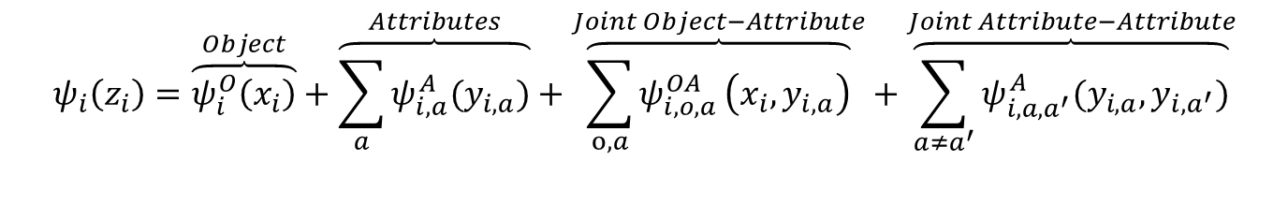
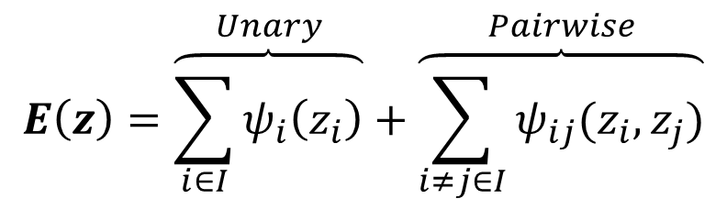
Multi-Label Factorial CRF
$$E\left(z\right)=\overset{Unary}{\overbrace{\sum_{i∈I}{ψ_{i}\left(z_{i}\right)}}}+\overset{Pairwise}{\overbrace{\sum_{i≠j∈I}{ψ_{ij}(z_{i},z_{j})}}}$$
$$ψ_{i}\left(z_{i}\right)=\overset{Object}{\overbrace{ψ_{i}^{O}\left(x_{i}\right)}}+\overset{Attributes}{\overbrace{\sum_{a}{ψ_{i,a}^{A}(y_{i,a})}}}+\overset{Joint Object−Attribute}{\overbrace{\sum_{o,a}{ψ_{i,o,a}^{OA}}\left(x_{i},y_{i,a}\right)}}+\overset{Joint Attribute−Attribute}{\overbrace{\sum_{a≠a^{′}}{ψ_{i,a,a^{′}}^{A}(y_{i,a},y_{i,a^{′}})}}}$$
Object classifiers: table, chair, etc.
Object and attributes correlation.
Correlation between attributes.
Attributes classifiers: wood, plastic, red, etc.

Slide 44
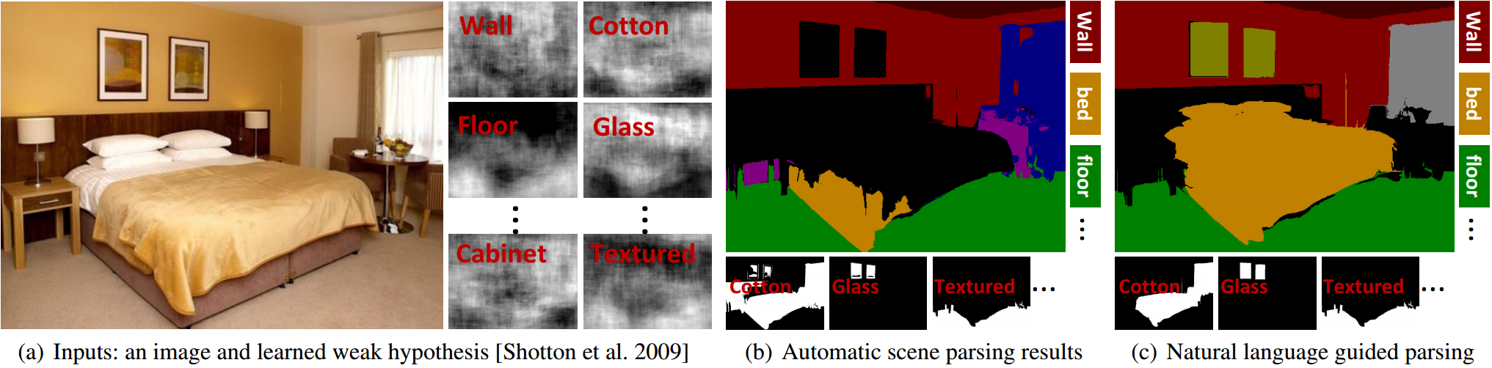
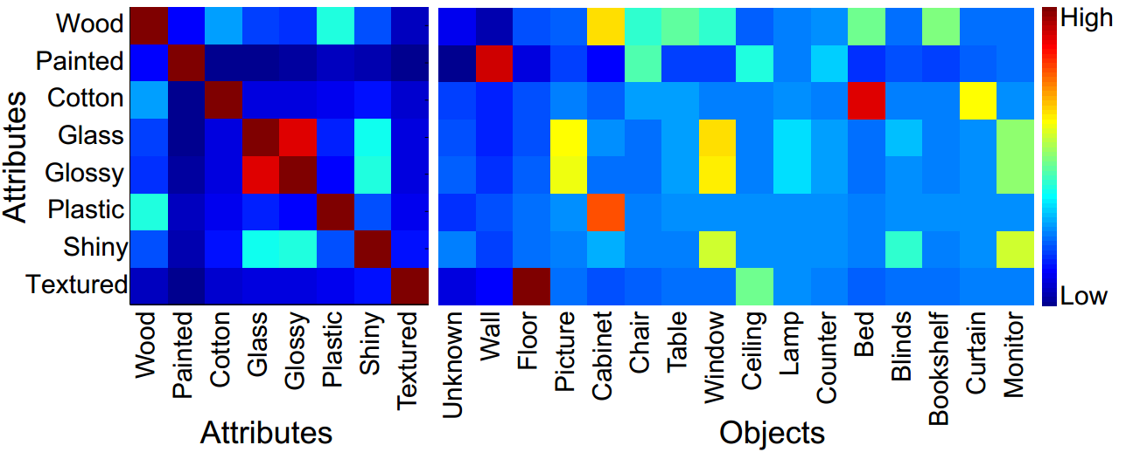
Joint inference

Slide 45
Verbal guided image parsing

Slide 46
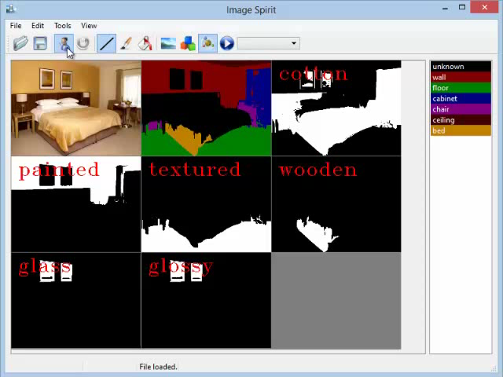
Demo

Slide 47
Contents
Global contrast based salient region detection, PAMI 2014
BING: Binarized Normed Gradients for Objectness Estimation at 300fps, CVPR 2014
ImageSpirit: Verbal guided image parsing, ACM TOG 2014
SemanticPaint: Interactive 3d labeling and learning at your fingertips

Slide 48
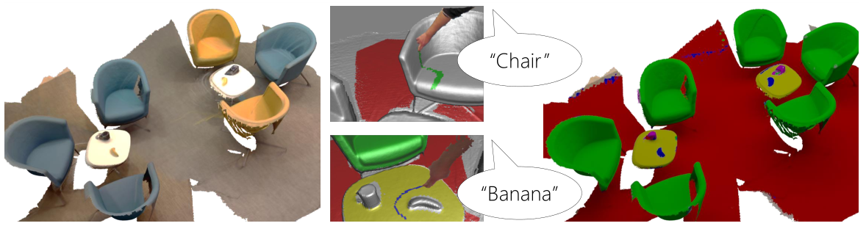
SemanticPaint
SemanticPaint: Interactive 3D Labeling and Learning at your Fingertips, conditional accepted by ACM TOG.
Video demo
  [Online version]
  [Local version]

Slide 49
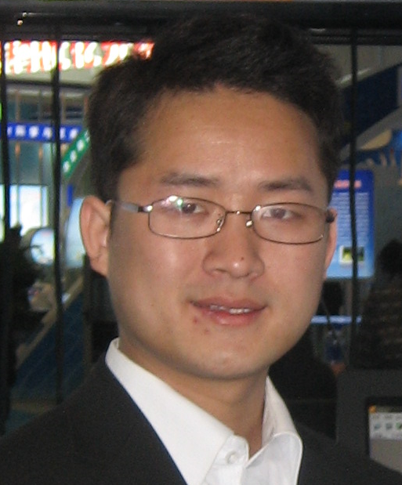



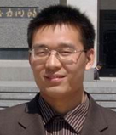

杨巨峰，博士、副教授，研究方向是计算机视觉和图像处理。在研国家自然科学基金1项，目前担任中国计算机学会计算机视觉专业组委员。邮箱yangjufeng AT nankai.edu.cn
南开大学图像处理方向导师信息
程明明，南开大学副教授、清华大学博士、牛津大学研究员。主要研究方向：计算机图形学、计算机视觉、图像处理。2009年至今，已在相关领域顶级(CCF推荐A类) 期刊和会议会议及期刊上发表论文十余篇，他引1000+次。更多信息：http://mmcheng.net
王靖，副教授，美国Rutgers大学博士。研究方向：计算机图形与图像。Email: jingwang@nankai.edu.cn
李岳，副教授，英国华威大学博士。
研究方向：多媒体安全、视频分析、 医学图像分析处理。Email: liyue80@nankai.edu.cn
王玮，副教授，日本富山大学博士。研究方向：智能信息处理、图像处理、算法设计、数据分析处理。Email: kevinwangwei@nankai.edu.cn
王超，副教授，南开大学博士，清华 大学博士后，美国Gatech大学访问学者。研究方向：图像加密、人脸识别、元胞自动机。Email: wangchao@nankai.edu.cn

Slide 50
谢谢大家！
欢迎提出宝贵意见和建议！

